Slide 2
After studying this chapter, you should be able to:
Explain what is meant by ethical behavior at work
Discuss important factors that affect ethical behavior at work
Describe ethical issues (e.g. gift-giving, corruption, guanxi)
Discuss how HRM can influence ethical behavior at work
Give examples of fair disciplinary practices
Explain how to manage dismissals effectively
Discuss dismissal issues in Asian companies

Slide 3
Ethics and Fair Treatment at Work
The Meaning of Ethics
  The principles of conduct governing an individual or a group; specifically, the standards you use to decide what your conduct should be.
  Ethical decisions characterized by two factors:
    They involve normative judgments which imply that something is good or bad, right or wrong
    They involve morality, which is a set of behavior standards accepted by a society

Slide 4
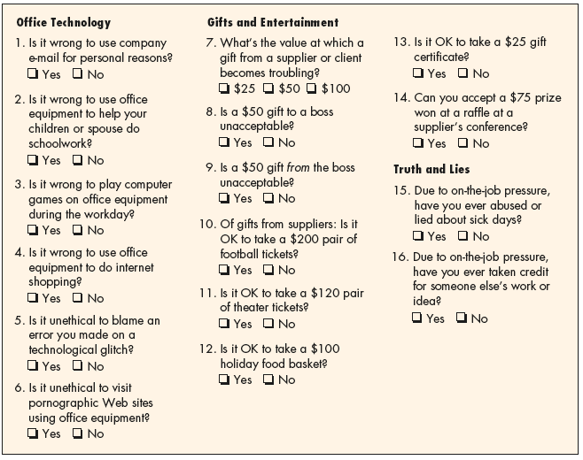
The Wall Street Journal Workplace-Ethics Quiz
Source: Wall Street Journal, October 21, 1999, pp. B1–B4; Ethics Officer Association, Belmont, MA; Ethics Leadership Group, Wilmette, IL; surveys sampled a cross-section of workers at large companies and nationwide.

Slide 5
Ethics and Fair Treatment at Work
Gift-giving and Exchange of Favor
  Gift-giving
    In most societies, it is a social custom among friends and relatives.
  Corporate gifts for customers
    Viewed as favor exchange
    Issue: will it lead to corruption, especially with expensive gifts?

Slide 6
Corruption and Guanxi
Guanxi: Reciprocal relationships extended from family, friends to business
Guanxi | Corruption
Ingredient of social norm | Deviation from social norm
Legal | Illegal
Builds on exchange of favor | Involves monetary exchange
Involves implicit social reciprocity | Pertains to explicit transactional reciprocity
No legal risk if it fails | High legal risk
Long-term orientation | Short-term transaction
No time limit | Requires timeliness
Builds on trust | Based on commodity
Transferable | Not transferable

Slide 7
Corruption and Guanxi
Causes of corruption:
  Low or inadequate salary
  Exposed to opportunities of corruption
  Viewed as low risk, high reward

Slide 8
Ethics and the Law
Ethics and the Law
  Law is not best guide about what is ethical
  An example is dismissing a 58-year-old employee with 30 years’ tenure without notice or cause may be unethical but definitely legal

Slide 9
Protecting Whistleblowers
Protecting Whistleblowers
  Whistleblowers give warning of serious wrongdoings within their organization
  Laws are set up to protect them in states such as Victoria and South Australia

Slide 10
Ethics, Fair Treatment, & Justice
Three components:
  Distributive justice
    The fairness and justice of a decision’s result.
  Procedural justice
    The fairness of the process by which the decision was reached.
  Interactional (interpersonal) justice
    The manner in which managers conduct their interpersonal dealings with employees.

Slide 11
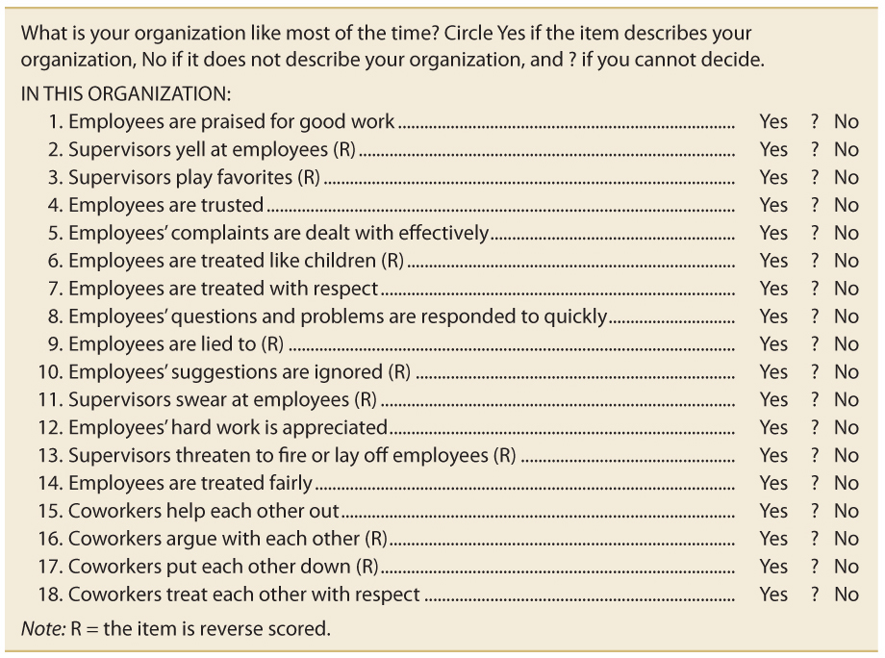
Perceptions of Fair Interpersonal Treatment Scale
Sources: Michelle A. Donovan et al., “The Perceptions of Their Interpersonal Treatment Scale: Development and Validation of a Measure of Interpersonal Treatment in the Workplace,” Journal of Applied Psychology 83, no. 5 (1998), p. 692. Copyright © 1997 by Michelle A. Donovan, Fritz Drasgow, and Liberty J. Munson at the University of Illinois at Urbana-Champaign. All rights reserved.

Slide 12
What Affects Ethical Behavior at Work?
Individual factors
Organizational factors
Societal, cultural and religious factors
Superstition and traditional beliefs

Slide 13
What Affects Ethical Behavior at Work?
Individual factors
  Individuals take the credit/blame for the ethical choices they make
Organizational factors
  Unethical behavior at work is normally not driven by personal interest, such as scheduling pressure, etc.
  An example: In 2004, Worldcom’s CFO covered up the company’s deteriorating financial situation to preserve the company to allow it to withstand as what he believed were temporary financial difficulties.

Slide 14
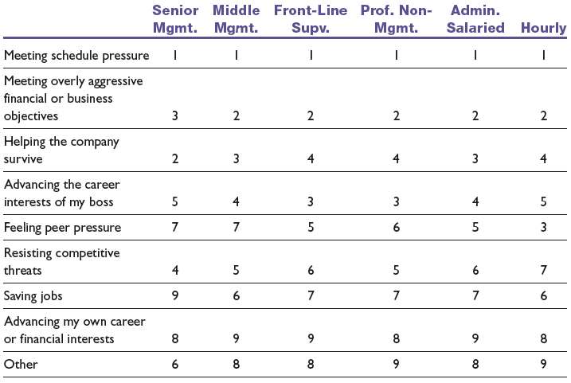
Principal Causes of Ethical Compromises
Note: 1 is high, 9 is low.
Sources: O.C. Ferrell and John Fraedrich, Business Ethics, 3rd ed. (New York: Houghton Mifflin, 1997), p. 28; adapted from Rebecca Goodell, Ethics in American Business: Policies, Programs, and Perceptions (1994), p. 54. Permission provided courtesy of the Ethics Resource Center, 1120 6th Street NW, Washington, DC: 20005.

Slide 15
What Affects Ethical Behavior at Work?
Societal, cultural and religious factors
  Asian societies’ Confucianism, collectivism and paternalism emphasize on relationship and loyalty
    However, too much emphasis may result in cronyism and nepotism
  Confucian values – Chinese
    Harmonious relationship
    Most of these values are collected in The Analects
      Ruling people with power and constraining them with the law, people will behave but have no self-consciousness
      Ruling people with ethics and constraining them with li (etiquette and rites), people will have self-consciousness

Slide 16
What Affects Ethical Behavior at Work?
Societal, cultural and religious factors
  Guanxi – Chinese
  Kone – Japanese
  Karm-oriented – Indian
    Decisions are affected by familial, communal and political factors
  Indonesia (Pancasila – Five Principles)
    Bapakism – benevolent leader
  Malaysia
    Multi-racial, multi-cultural
  Philippines – Pakikisama
    Smooth personal relations

Slide 17
What Affects Ethical Behavior at Work?
Societal, cultural and religious factors
  Singapore
    Kiasuism (fear to lose)
  Thailand
    kreing chai – respectful, humble, considerate, avoid embarrassing others
    jai yen – keep a calm and cool heart
    nam jai – thoughtful, generous kind
Superstition and traditional beliefs
  Feng Shui or geomancy still practiced widely in Asia
  Geomancers are consulted for important events

Slide 18
The Ethics Code
Having one indicates that the company is serious about ethics
May or may not work, e.g. Enron

Slide 19
Organizational Culture
The characteristic values, traditions, and behaviors a company’s employees share.
How is culture revealed?
  Ceremonial events
  Written rules and spoken commands.
  Office layout
  Organizational structure
  Dress codes
  Cultural symbols and behaviors
  Figureheads

Slide 20
The Manager’s Role
The Manager’s Role
  Clarify expectations for values to be followed.
  Use signs and symbols to signal the importance of values.
  Provide physical (the firm’s rewards) support for values.
  Use stories to illustrate values.
  Organize rites and ceremonies reinforcing values

Slide 21
The Role of HR in Ethics and Fair Treatment
Why treat employees fairly?
  “They’re not employees, they’re people”
    Management guru Peter Drucker
  Avoidance of employee litigation
  Enhanced employee commitment
  Enhanced satisfaction with the organization, with jobs, and with leaders
  Increased organizational citizenship behaviors

Slide 22
HR Ethics Activities
Recruitment
  Materials to explicitly mention company’s emphasis on integrity and ethics to screen out undesirable persons even before they apply
  Selection process based on job-related criteria and applied consistently shows company’s values on ethical and fair treatment
  Applicants view job sample test as fair if job-related
  Applicants view interviews as fair if it provides two-way communications

Slide 23
HR Ethics Activities
Training
  How to recognize ethical dilemmas.
  How to use ethical frameworks (such as codes of conduct) to resolve problems.
  How to use HR functions (such as interviews and disciplinary practices) in ethical ways.

Slide 24
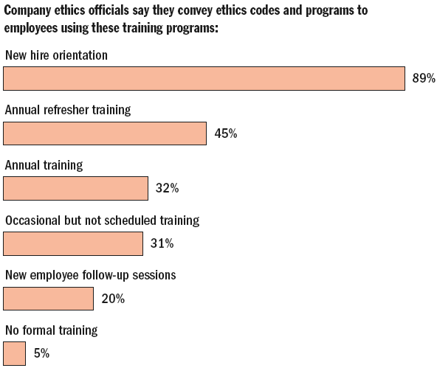
Role of Training in Ethics
Figure 14.5

Slide 25
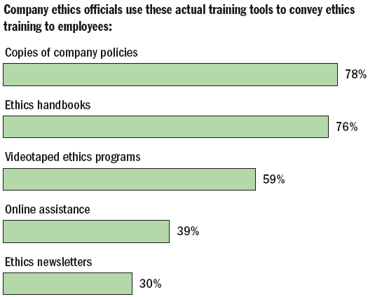
Role of Training in Ethics (cont’d)
Figure 14.5

Slide 26
HR Ethics Activities
Performance appraisal
  Appraisals that make it clear the company adheres to high ethical standards by measuring and rewarding employees who follow those standards.
Reward and disciplinary systems
  Rewards ethical behavior and penalizes unethical behavior
  The organization swiftly and harshly punishes unethical conduct.

Slide 27
Building Two-Way
Communications
Perceptions of fair treatment depend on:
  Engagement: Involving individuals in the decisions that affect them by asking for their input and allowing them to refute the merits of others’ ideas and assumptions
  Explanation: Ensuring that everyone involved and affected understands why final decisions are made and the thinking that underlies the decisions
  Expectation clarity: Making sure everyone knows up front by what standards they will be judged and the penalties for failure.

Slide 28
Employee Discipline
Basis for a fair and just discipline process
  Clear rules and regulations
    Define workplace issues
    Inform employees
  A system of progressive penalties
    The range and severity of the penalty is a function of the offense and number of occurrences.
  An appeals process
    The right of the employee to grieve the decision helps to ensure that supervisors mete out discipline fairly and equitably.

Slide 29
Managing Dismissal
Dismissal
  Involuntary termination of an employee’s employment with the firm.
Reasons for dismissal
  Unsatisfactory performance
  Misconduct
  Lack of ability to do the job
  Changed job requirement

Slide 30
Reasons for Dismissal
Unsatisfactory performance
  Persistent failure to perform assigned duties or to meet prescribed standards on the job.
Misconduct in the workplace
  Deliberate and willful violation of the employer’s rules: stealing, rowdy behavior, and insubordination.
    Insubordination:
      Disregards boss’s authority
      Refuse to obey boss’s orders
      Defiance of clearly stated policies, rules, regulations and procedures

Slide 31
Reasons for Dismissal
Lack of qualifications for the job
  An employee’s inability to do the assigned work although he or she is diligent.
Changed requirements or elimination of the job
  An employee’s inability to do the work assigned, after the nature of the job has changed.
  Elimination of the employee’s job

Slide 32
Managing Dismissal
High Performance Insight
Security measures are important whenever dismissals take place
  Checklist to ensure dismissed employees return all keys and company property as well as (often) accompanying them out of the office and building
  Disable passwords and accounts of former employees to prevent illegal access
  Formal rules for return of company laptops and handhelds

Slide 33
Managing Dismissal
Avoid wrongful discharge suits, when:
  Discharge does not comply with the law.
  Discharge does not comply with the contractual arrangement stated or implied by the firm via its employment application forms, employee manuals, or other promises.
Difficult to dismiss employees in some Asian countries, especially if there are strong trade unions
Companies should obtain legal advice before taking such actions

Slide 34
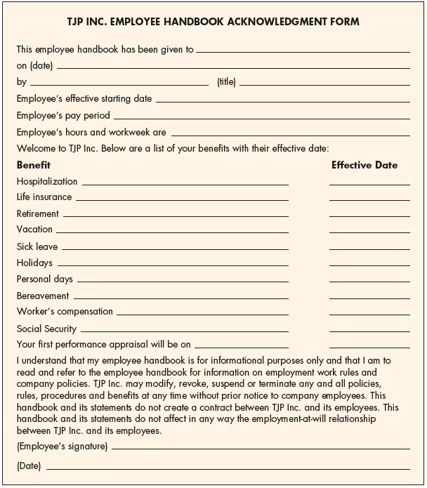
TJP Inc. Employee Handbook Acknowledgment Form

Slide 35
The Termination Interview
Dismissing an employee is a difficult task for most managers.
Dismissed employee may react with disbelief or even violence.
Interviews should be carefully planned and conducted with patience.

Slide 36
The Termination Interview
Outplacement counseling
  A systematic process by which a terminated employee is trained and counseled in the techniques of conducting a self-appraisal and securing a new job appropriate to his or her needs and talents.
    Outplacement does not imply that the employer takes responsibility for placing the person in a new job.
    Outplacement counseling is part of the terminated employee’s support or severance package and is often done by specialized outside firms.

Slide 37
The Termination Interview
Exit interview
  Its aim is to elicit information about the job or related matters that might give the employer a better insight into what is right—or wrong—about the company.
    The assumption is that because the employee is leaving, he or she will be candid.
    The quality of information gained from exit interviews is questionable.

Slide 38
The Termination Interview
Exit interview questions:
  Why are you leaving?
  What circumstances would have prevented your departure?
  What did you like most about your job?
  What did you like least about your job?
  How do you think of your supervisor?
  How do you feel about the employee benefits of this company?

Slide 39
Managing Dismissal
Layoffs:
  Not terminations
  Three conditions are present:
    There is no work available for employees.
    Management expects the no-work situation to be temporary and probably short term.
    Management intends to recall the employees when work is again available.

Slide 40
Managing Dismissal
Alternatives to Layoff
  Voluntarily reducing employees’ pay to keep everyone working.
  Concentrating employees’ vacations during slow periods.
  Taking voluntary time off to reduce the employer’s payroll.
  Taking a “rings of defense approach” by hiring temporary workers that can be let go early.
  Offering buyout packages to find enough volunteers to avoid dismissing people.

Slide 41
Discipline and Dismissal In Malaysia
Under Employment Act, after due inquiry, on the grounds of misconduct, an employer may:
  Dismiss employee without notice
  Downgrade employee
  Impose other lesser punishment

Slide 42
Discipline and Dismissal In Malaysia
Under Industrial Relations Act, employees who feel they have been wrongfully dismissed, can appeal to Director of Industrial Relations for reinstatement
  In view of legal implication, it is necessary to have inquiry in handling cases of misconduct, even though an employee may be caught “red-handed.”
  Kanagalingam explains difference between social justice and natural justice.
  Kanagalingam gives examples of how industrial disciplinary cases were decided by the Malaysian Industrial Court.

Slide 43
Termination of Employment in Cambodia
Stated in the Labor Law
  Termination of contracts, dismissal procedures, compensation
If a contract is broken, either party may be entitled to compensation.
Exceptions:
  Mutual consent
  Serious misconduct
  “Acts of god” (e.g. flood, earthquake)

Slide 44
Termination of Employment in
China
Contract may be revoked by either party with 30 days of written notice.
Employer may dismiss without notice, if:
  After illness, within prescribed period of medical treatment, employee is unable to perform original duties or alternative jobs
  Employee unable to perform job, even after given training, or transferred to other job
  Major changes in the circumstances under which the contract was signed and amendment cannot be reached

Slide 45
Termination of Employment in
China
Employer may not dismiss without notice, if:
  Employees have been suffering from occupational diseases or work-related injuries and have been proven to have completely or partially lost the ability to work
  Employees suffering from illness or injuries but are still in the prescribed period of medical treatment
  Employees who are pregnant, nursing or on maternity leave

Slide 46
Termination of Employment in China
Employer has right to terminate a contract with immediate effect, if:
  Employee fails to satisfy requirements during the probation period
  Employee has seriously violated the disciplinary rules or regulations of the work place
  Employee has committed a serious abuse of duties or engaged in graft, causing damage to the employer
  Employee is charged with a criminal offence

Slide 47
Termination of Employment in Hong Kong
Employment contract may be terminated by either party by giving notice
Circumstances where employer may terminate without notice:
  Employee’s fraud, dishonesty, wilful disobedience
Employment Ordinance (Severance Pay Rate)
  Monthly rated employees – two thirds of a month’s pay for every year of service
  Time or piece-rated employees – 18 days’ wages for every year of service

Slide 48
Termination of Employment in Hong Kong
Long service payment
  After completing at least five years of continuous service
  Payment accrues when employees leave because of ill health, old age or resign voluntarily

Slide 49
Termination of Employment in Indonesia
In disciplinary cases, notice of termination has 3 steps
  Oral warning
  Written and final warning
  Written notice of termination
In practice, employers are reluctant to dismiss employees. There are regulations that forbid termination

Slide 50
Termination of Employment in
Japan
Under Labor Standards Law, employer may terminate employment by:
  Giving 30 days of advanced notice, or
  Paying average wage for above period
Life-time employment is generally practised in Japan.
A dismissal is admissible depends on the judicial decisions (Doctrine of Abuse Dismissal by Case Law).

Slide 51
Termination of Employment in Malaysia
Termination benefits
Situations where employees are not entitled
  Retirement, misconduct dismissal, unreasonable refusal of renewal contract
Length of service | Days of wage
1 year but < 2 | 10
2 but < 5 | 15
5 and more | 20

Slide 52
Termination of Employment in Philippines
Code of Labor states the rate of termination benefit:
  Redundancy of new labor-saving devices:
    1 month’s wage for each year of service
  Retrench to prevent losses or cease operations
    Half month’s wage for each year of service

Slide 53
Termination of Employment in Singapore
Contract may be terminated after giving due notice or pay in lieu of notice
If no notice period is stated in contract, the following will apply:
Retrenchment benefit applicable if employment is at least three years of continuous service
Length of service | Period of notice
Less than 26 weeks | 1 day
26 weeks to < 2 years | 1 week
2 years to < 5 years | 2 weeks
5 years or more | 4 weeks

Slide 54
Termination of Employment in South Korea
Under old labor standards, no dismissal without justifiable reasons
After labor law reform, flexible rules on lay-offs
Dismissal depends on:
  Needs of management
  Efforts were made to avoid lay-off
  Consultation with union or workers

Slide 55
Termination of Employment in Thailand
Under Labor Protection Law:
  Severance pay rate:
Length of service | Pay rate (days of wage)
120 days – less than 1 year | 30
1 year – less than 3 years | 90
3 years – less than 6 years | 180
6 years – less than 10 years | 210
More than 10 years | 300

Slide 56
Termination of Employment in Vietnam
Employee can terminate contract if:
  Company fails to provide work
  Company makes slow or insufficient payment of wage
  Company mistreats employee
  Due to poor health or difficult family situation, employee unable to perform duties

Slide 57
Termination of Employment in Vietnam
Employer can terminate contract if:
  Employee fails to carry out duties
  Employee commits crime or breach of law
  Employee’s illness or injury extends beyond 6 months
  Company has to reduce production or cease operation
  Production is re-organized

Slide 58
Termination of Employment in Vietnam
Compensation for breaching contract
  At least 3 months’ salary (indefinite term contract, or definite term where less than half of term has been performed)
  At least 2 months’ (definite term contract where more than half has been performed)
  At least 1 month’s salary (all other cases)

