Slide 1

Chapter 16
Managing Global Human Resources

Slide 2

HR and The
Internationalization of Business
convergence - divergence debate.
  Levitt and others: markets are converging upon a global market.
  Porter, Douglas & Wind, Prahalad & Doz argue: companies face competing pressures to be both global (and integrate their activities) and local (responding to local requirements).
Keys to success for firms like P&G, IBM, and Citicorp
New challenges
Notes:
Page 465
U.S.-based companies are increasingly doing business abroad. Huge firms like Procter & Gamble, IBM, and Citicorp have long had extensive overseas operations, of course. But with the European market unification, the introduction of the euro currency, the opening of Eastern Europe, and the rapid development of demand in Asia and other parts of the world, even small firms are finding that success depends on their ability to market and manage overseas.

Slide 3
What Firms going International Should Do?
Coordinate plans on a worldwide basis
Create organization structures providing balance
Extend HR challenges, systems abroad
Answer these questions:
Should we staff offices with local or head office managers?
How should we appraise and pay the local employees?
How should we deal with the unions in our offices abroad?
Notes:
Page 465
This confronts firms with some interesting management challenges. Market, product, and production plans must be coordinated on a worldwide basis, for instance, and organization structures capable of balancing centralized home office control with adequate local autonomy must be created. And, of course, the firm must extend its HR policies and systems abroad.

Slide 4
Global Staffing
Pressures
  Candidate selections
  Assignment terms
  Relocation
  Immigration
  Culture and language
  Compensation
  Tax administration
  Handling spouse and dependent matters
Notes:
Page 466
Dealing with global staffing pressures like these is quite complex. For example, it involves addressing, on a global basis, activities including candidate selections, assignment terms and documentation; relocation processing and vendor management; immigration processing; cultural and language orientation and training; compensation administration and payroll processing; tax administration; career planning and development; and handling of spouse and dependent matters.

Slide 5
Inter-country differences that affect HRM
Cultural Factors
Economic Factors
Labor Cost Factors
Industrial Relations Factors
The European Community

Slide 6



Cultural Factors
Cultural factors address the ethos of a country
Management styles vary
Differences Cultural Dimensions (i.e. power distance, individualism, masculinity, uncertainty avoidance, etc)
China
US
Hong Kong
Notes:
Page 466
Instructor’s notes:
US managers hurry to get the job done.
Managers in China have a primary goal to create harmony among the workers. Managers in Hong Kong may lie between these extremes Companies operating only within the borders of the United States generally have the luxury of dealing with a relatively limited set of economic, cultural, and legal variables. The United States is a capitalist, competitive society. A company operating multiple units abroad isn’t blessed with such homogeneity.

Slide 7



A Classic Study of cultural differences
Power distance is the extent to which the less powerful members of institutions accept and expect an unequal distribution of power
  Different expectations
In Mexico,
  Managers keep their distance
  Formal rules
  Individualism and self-sufficiency
German workers never arrive late
Notes:
Page 466
A study by Professor Geert Hofstede identified other international cultural differences affecting US management policies, including power distance. Hofstede says societies differ in power distance— in other words, the extent to which the less powerful members of institutions accept and expect an unequal distribution of power. He concluded that acceptance of such inequality was higher in some countries (such as Mexico) than in others (such as Sweden).
Managers and workers in other countries have different expectations than their US counterparts
Page 466
In Mexico, managers keep their distance and remain formal. Mexican workers adhere to formal rules and regulations but only when boss is present. They don’t place much importance on individualism and self-sufficiency. German workers never arrive late and they address management formally.

Slide 8

Economic Differences
Translate into differences in HR practices:
Espousing ideals of free enterprise
Wage costs vary
Other labor costs vary
US $19.86
Mexico $2.46
Taiwan $5.98
UK $15.88
Germany $29.01
Notes:
Page 467
Shown are hourly wages for production workers (converted into US dollars).
There are other labor costs to consider. For example, there are wide gaps in hours worked. Portuguese workers average about 1,980 hours of work annually, while German workers average 1,648 hours. Several European countries, including the United Kingdom and Germany, require substantial severance pay to departing employees, usually equal to at least two years’ service in the United Kingdom and one year’s in Germany.19 Compared to the usual two or three weeks of U.S. vacation, workers in France can expect two days of paid holiday per full month of service per year, Italians usually get between four and six weeks off per year, and Germans get 18 working days per year after six months of service.

Slide 9

Legal and Industrial Relations Factors
Definition
Industrial relations means the relationships among the worker, the union, and the employer
The US practice of employment at will does not exist in Europe
Work councils
Codetermination
Notes:
Page 467
Work councils are formal , employee-elected groups of worker representatives that meet monthly with managers to discuss a range of topics and are used widely in Europe.
Codetermination means that employees have the legal right to a voice in setting company policies, even HR policies. Used widely in Germany and elsewhere.

Slide 10

European Union
EU formation caused:
Tariffs disappeared
Free movement between jobs
Use of the Euro as single currency
Union consulting
Notes:
Page 468
The European Union In the 1990s, the separate countries of the former European Community (EC) were unified into a common market for goods, services, capital, and even labor called the European Unions (EU). Tariffs for goods moving across borders from one EU country to another generally disappeared, and employees (with some exceptions) now find it easy to move freely between jobs in the EU countries. The introduction of a single currency—the euro—has further blurred many of these differences. The euro replaced the local currencies of most member countries in early 2002.
By 2008, Union law will expand its current consultation practice to create create an ongoing consultation environment.

Slide 11



Intra-EU Differences
Some countries have no minimum wages
Workweeks vary
Minimum number of annual holidays
Termination advance notice length
48 hours
Employment contracts vary
No limit
Notes:
Page 468
Shown are some workweek limits in Greece and United Kingdom
Many countries have minimum wages while others don’t, and workweek hours permitted vary from no maximum in the United Kingdom to 48 per week in Greece and Italy. Other differences exist in minimum number of annual holidays, and minimum advance notice of termination. Employment contracts are another big difference. For most U.S. positions, written correspondence is normally limited to a short letter listing the date, job title, and initial compensation for the new hire.25 In most European countries, employers are usually required to provide a detailed statement of the job. The European Union, for instance, has a directive requiring employers to provide such a statement (including details of terms and conditions of work) within two months of the employee’s starting work.
For example, minimum legally mandated holidays range from none in the United Kingdom to 5 weeks per year in Luxembourg. And while Italy has no formal requirements for employee representatives on boards of directors, they’re required in Denmark for companies with more than 30 employees. The point is that the need to adapt personnel policies and procedures to the differences among countries complicates HR management in multinational companies.

Slide 12
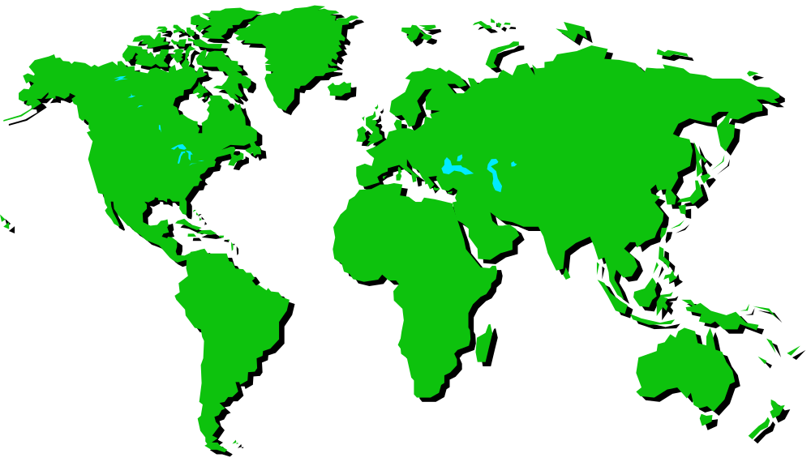
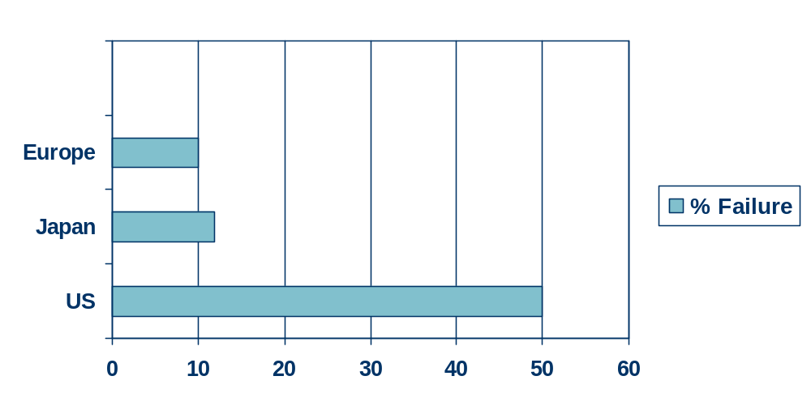

Failure Rates of International Assignments
International assignment failure can cost hundreds of thousands of dollars
Notes:
Page 468
Shown are the maximum failures of a country or region for international assignments
International assignments are the heart of international HR, and it’s therefore disconcerting to see how often such assignments fail. U.S. expatriates’ assignments that end early (the failure rate) range from 16% to 50%, and the direct costs of each such failure can reach hundreds of thousands of dollars or more. European and Japanese multinationals reported lower failure rates, with only about one-sixth of Japanese multinationals and 3% of European multinationals reporting more than a 10% expatriate recall rate.

Slide 13


Why International Assignments Fail
Personality
Person’s intentions
Family pressures
Lack of cultural skills
Other non-work conditions like living and housing conditions, and health care
Notes:
Page 469
Discovering why such assignments fail is therefore an important research task, and experts have made considerable progress. Personality is one factor. For example, in a study of 143 expatriate employees, extroverted, agreeable, and emotionally stable individuals were less likely to want to leave early. And the person’s intentions are important: For example, people who want expatriate careers try harder to adjust to such a life. Non-work factors like family pressures usually loom large in expatriate failures: In one study, U.S. managers listed, in descending order of importance for leaving early: inability of spouse to adjust, managers’ inability to adjust, other family problems, managers’ personal or emotional immaturity, and inability to cope with larger overseas responsibility. Managers of European firms emphasized only the inability of the manager’s spouse to adjust as an explanation for the expatriate’s failed assignment. Other studies similarly emphasize dissatisfied spouses’ effects on the international assignment.
One expert said:
The selection process is fundamentally flawed. . . . Expatriate assignments rarely fail because the person cannot accommodate to the technical demands of the job. The expatriate selections are made by line managers based on technical competence. They fail because of family and personal issues and lack of cultural skills that haven’t been part of the process.

Slide 14

International Staffing
Multinational corporations (MNC’s) use several types of international managers:
  Locals
  Expatriates
  Home-country nationals
  Third-country nationals
Notes:
Page 469
Locals are citizens of the countries in which they work.
Expatriates are non-citizens of the countries in which they’re working.
Home-country nationals are citizens of the country in which the multinational corporation has its headquarters.
Third-country nationals are citizens of a country other than the parent or host country; e.g., a British executive in the Tokyo branch of a US multinational bank.

Slide 15
Reasons to …
Hire Locals
Working in a foreign country
Cost
Being a “better citizen”
Short-term projects
Security
Use Expatriates
Technical competence
Know company culture
Climbing the corporate ladder
Notes:
Page 469
There are several reasons to rely on local managers to fill your foreign subsidiary’s management ranks. Many people don’t want to work in a foreign country, and the cost of using expatriates is usually far greater than the cost of using local workers. Locals may view the multinational as a “better citizen” if it uses local management talent, and some governments even press for the “nativization” of local management. There may also be a fear that expatriates, knowing they’re posted to the foreign subsidiary for only a few years, may overemphasize short-term projects rather than more necessary long-term tasks.
Page 469
The major reason is usually technical competence: In other words, employers often can’t find local candidates with the required technical qualifications. Multinationals also view a successful stint abroad as a required step in developing top managers. (For instance, after a term abroad, the head of General Electric’s Asia-Pacific region was transferred back to a top executive position as vice chairman at GE.) Control is another important reason to use expatriates. The assumption is that home-office managers are readily steeped in the firm’s policies and culture, and thus more likely to implement headquarters’ instructions and ways of doing things.

Slide 16

Orienting and
Training
More form than substance
Little or no systematic selection and training
Only 42% have formal briefings
Notes:
Page 473
When it comes to providing the orientation and training required for success overseas, the practices of most U.S. firms reflect more form than substance. One consultant says that despite many companies’ claims, there is generally little or no systematic selection and training for assignments overseas. In one survey, a sample of company executives agreed that international business required that employees be firmly grounded in the economics and practices of foreign countries. However, few of their companies actually provide such training to their employees. A survey of U.S. companies that assign employees abroad found that only 42% have a “formal program for briefing employees regarding conditions in the host country.”

Slide 17
What Special Training Do Overseas Candidates Need?
Level 1
Impact of cultural differences
Understanding attitude formation
Factual knowledge about target country
Skill building in areas like language and adjustment and adaptation skills
Level 2
Level 3
Level 4
Notes:
Page 474
Level 1 training focuses on the impact of cultural differences, and on raising trainees’ awareness of such differences and their impact on business outcomes. Level 2 aims at getting participants to understand how attitudes (both negative and positive) are formed and how they influence behavior. (For example, unfavorable stereotypes may subconsciously influence how a new manager responds to and treats his or her new foreign subordinates.) Level 3 training provides factual knowledge about the target country, while Level 4 provides skill building in areas like language and adjustment and adaptation skills.

Slide 18


Continued Training and Development
IBM offers rotating assignments
Have worldwide management development centers
INSEAD in France provides educational opportunities
Notes:
Page 474
Beyond these special training needs, managers abroad continue to need traditional training and development. At IBM, for instance, such development includes rotating assignments that permit overseas managers to grow professionally. IBM and other firms also have management development centers around the world where executives can hone their skills. And classroom programs (such as those at the London Business School, or at INSEAD in France) provide overseas executives the sorts of educational opportunities (to acquire MBAs, for instance) that similar stateside programs do for their U.S.-based colleagues.

Slide 19






Training Trends
Trends in expatriate training and development:
Use of cross-cultural training
Use returning managers as resources for new assignees
Software and internet programs like Bridging Cultures for cross-cultural training
Notes:
Page 474
There are several tends in expatriate training and development. First, rather than providing only predeparture
cross-cultural training, more firms are providing continuing, in-country cross-cultural training during the early stages of an overseas assignment. Second, employers are using returning managers as resources to cultivate the “global mind-sets” of their home-office staff. For example, automotive equipment producer Bosch holds regular seminars in which newly arrived returnees pass on their knowledge and experience to relocating managers and their families. There’s also increased use of the software and the Internet for cross-cultural training. For example, Bridging Cultures is a self-training multimedia package for people who will be traveling and/or living overseas. It uses short video clips to introduce case study intercultural problems, and the guides users to selecting the strategy to best handle the situation.

Slide 20



Strategic HR – Seimens Basic HR Strategy
A living company is a learning company
Global teamwork is the key to realizing potential
Redefine management to meet globalization challenges
A climate of mutual respect
Growth
Profit
Notes:
Page 481
When Siemens celebrated its 150th anniversary recently, it was, according to its president, “a perfect occasion to analyze the enduring qualities that helped us survive so long—and identify what we must have to succeed in the future.” As part this review, one of the central questions was: Which human resource strategies will ensure that Siemens’s people—and the company—can succeed in tomorrow’s challenging global environment?
1. A living company is a learning company. The technological and competitive markets in which Siemens does business are evolving, and the firm’s HR processes therefore have to enable employees to learn on a continuing basis. Siemens therefore uses its system of combined classroom and hands-on apprenticeship training around the world.
2. Global teamwork is the key to developing and using all the potential of the firm’s human resources. At Siemens, teamwork “means breaking down all the traditional barriers within the corporate world”—employees must be able to work across divisions, across disciplines, and across regions. This means employees have to understand the whole process, not just bits and pieces. This in turn means Siemens employees have to assume more responsibility, which in turn means the firm must provide extensive training and development so its employees can handle added responsibilities.
3. Redefined management to meet the challenges of globalization. To help it do this, Siemens instituted regular strategic performance assessments that encourage each employee to develop his or her potential.
4. Long-term growth and profitability depend on achieving a balance of interests. Building shareholder value is important, but “we can be profitable only with creative, satisfied, and highly motivated people.”
5. A climate of mutual respect is the basis of all relationships—within the company and with society. At Siemens (and at other firms), it’s not realistic to believe you can build a skilled, motivated, creative, and contented workforce without a culture of mutual respect.

