Slide 1
CHAPTER 4
MANAGING EMPLOYEE DIVERSITY
TOPICS
1. Defining diversity and diversity
management.
2. Reasons for diversity management.
3. Challenges to diversity management.
4. Improving diversity programs.

Slide 2
I. Defining Diversity
1. Simple: Differences among people in terms of their mental and physical characteristics.
2. Traditional: Differences among employees and applicants in relation to their protected class status such as race, sex, religion, color, national origin, age, and disabilities.
3. Broad/Current: Differences among employees and applicants in relation to their demographic characteristics (i.e., protected class status) and their experiences, perspectives, values, and attitudes.

Slide 3
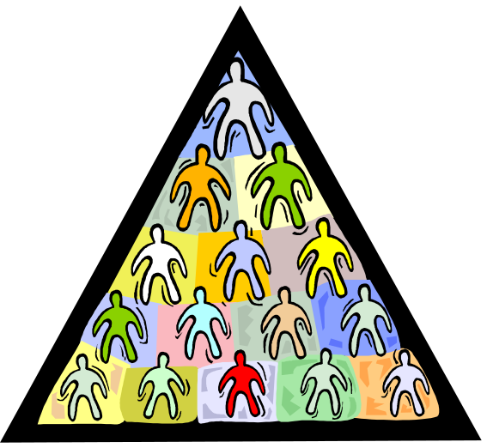
Diversity Management
See Figure 4.2
An attempt to employ and develop non-traditional employees and persons with wide-ranging backgrounds, experiences, and perspectives by (a) increasing diversity awareness, (b) building a culture of respect, fairness, and appreciation of differences, and (c) providing developmental and career opportunities for all employees in order to utilize their unique skills and abilities.

Slide 4
II. Reasons for Diversity Management
Organizational
1. Prevent misunderstandings which could hurt teamwork and productivity.
2. Prevent discrimination and legal complaints.
3. Allow all employees to participate and contribute.
4. Attract persons from an increasingly changing labor force. See Figure 4.3.
Production
1. Gain increased creativity from diverse experiences and perspectives.
2. Gain better problem solving from increased expression of ideas and larger volume of ideas.
3. Gain greater system flexibility due to openness and tolerance for new ideas and approaches.
4. Gain in market awareness, especially in globally competitive industries.

Slide 5
III. Challenges to Diversity Management
1. Valuing Diversity
2. Individual vs. Group
Fairness
3. Resistance to Change
4. Interpersonal Conflict
5. Resentment and Backlash
6. Segmented Networks
7. Retention of Minorities
8. Perceived Competition

Slide 6

1. Valuing Diversity
Seeing diversity as an asset, not something that will threaten organizational conformity and cohesion.

Slide 7
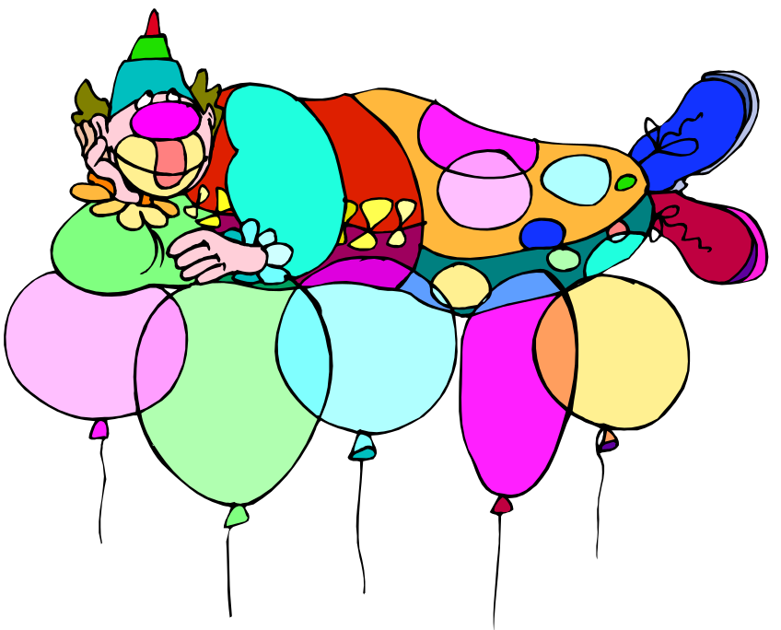
2. Individual versus Group fairness
Don’t offer exclusive programs. (For example, if special training is needed by a certain group, offer it to everyone.)
Communicate HR procedures used in making decisions about employees and applicants.

Slide 8

3. Resistance to Change
Change is always frightening, even when it is positive.
Organizational culture evolves over many years and becomes accepted.
Management must explain the need for change and that employees will be supported.

Slide 9

4. Interpersonal Conflict
Employees are accustomed to people like themselves.
Diversity awareness and training can help reduce stereotypes and misunderstandings.
Time and patience is needed for employees to break-down stereotypes and get to know others as “individuals”.

Slide 10

5. Resentment and Backlash
Majority employees (e.g., Caucasian-American men) may perceive non-traditional employees as a threat to their status and career advancement.
Top management commitment to diversity, communication of the value of diversity, and participation in the process is needed.
The key: Diversity will help the organization compete in the 21st century and create more opportunities for all employees.

Slide 11

6. Segmented Networks
People of similar gender, race, nationality, etc. tend to interact more on a personal basis. In an organization, this may be harmful in that:
Benefits from diversity may be undermined.
Familiarity with other employees is stifled.
Opportunities for networking and advancement may be dampened.
Solution Change culture, use teams, put different people on committees, etc.

Slide 12

7. Retention of Minorities
Retaining minorities is an issue and is related to:
People not feeling welcome.
Being overwhelmed by work demands.
Not being given proper training.

Slide 13

8. Competition for Opportunities
Traditional employees may believe that newly hired minorities are given special treatment and that their jobs and promotional opportunities are threatened. It is important to deal with these perceptions through:
Diversity awareness.
Diversity training.
HR policies that are fair and explained well.
Convincing employees the goal is to build a “bigger pie”.

Slide 14
IV. Improving Diversity Programs
1. Top Management Commitment
2. Diversity Training
3. Support Groups
4. Mentoring
5. Apprenticeships
6. Information Technology
7. Communication Standards
8. Organized Activities
9. Diversity Audits
10. Management Accountability

