Slide 1
Chapter 9
HRM in the Host Country Context
IBUS 618 Dr. Yang

Slide 2

Chapter Objectives
Identify and discuss drivers that shape the interplay between global standardization and localization of HR practices in the MN context:
  Standardization drivers such as MNE strategy and structure, maturity and age, and corporate culture
  Localization drivers such as the host country’s cultural and institutional environment, the mode of operation and subsidiary role
Outline measures which support the development of a balance of globalization and localization of HRM:
  Address the global code of conduct as a device for controlling employee behavior worldwide
  Discuss strategic importance of offshoring and implications for IHRM
  Compare India and China as important offshoring locations
IBUS 618 Dr. Yang

Slide 3
The Global Mindset and Local Responsiveness
The aim of global standardization
  Consistency
  Transparency
  Ease of administration
  Efficiency and effectiveness
  Sense of equity
The aim of localization
  Respect for local culture and traditions
  Adaptation to local institutional requirements such as legislations and government policies
  Educational system and HR practices
  Workplace practices and employee expectations
IBUS 618 Dr. Yang

Slide 4

Three Cultures Interact to Influence Standardization and Adaptation
National culture of the parent company
National culture of the subsidiary unit
Corporate culture as a subtle informal control mechanism and a potential unifier
  Standardization can be achieved through HR practices such as:
    Staffing procedure and criteria
    Appraisal system
    Training and development programs
    Staff rotation
    Corporate code of conduct
  E.g., Unilever
IBUS 618 Dr. Yang

Slide 5
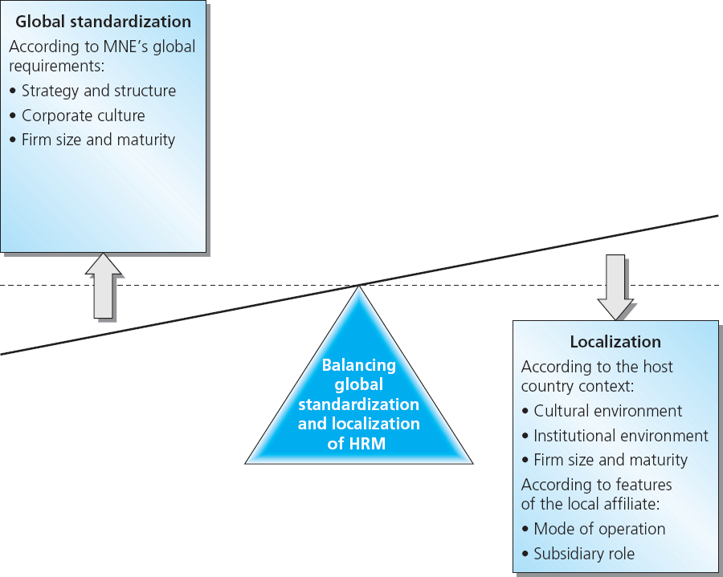
Figure
9-1
Balancing the standardization and localization of HRM in MNEs
IBUS 618 Dr. Yang

Slide 6
Factors Driving Standardization
Organizational context
  Strategy and structure
  Mode of operation involved
  Size and maturity of the firm
  Relative importance of the subsidiary
    E.g., Motorola, Schering AG
Host-country culture and workplace environment
  Germany vs. Britain
  China vs. India
IBUS 618 Dr. Yang

Slide 7
Factors Driving Standardization
The host-country context
  The cultural environment
  The institutional environment
Mode of operation abroad
Subsidiary role
IBUS 618 Dr. Yang

Slide 8
Table
9-1a
Culture construct definitions and sample questionnaire items
Cultural construct definitions | Specific questionnaire item
Power distance: The degree to which members of a collective expect power to be distributed equally. | Followers are (should be) expected to obey their leaders without question.
Uncertainty avoidance: The extent to which a society, organization, or group relies on social norms, rules and procedures to alleviate unpredictability of future events. | Most people lead (should lead) highly structured lives with few unexpected events.
Humane orientation: The degree to which a collective encourages and individuals for being fair, altruistic, generous, caring and kind to others. | People are generally (should be generally) very tolerant of mistakes.
Collectivism I (institutional collectivism): The degree to which organizational and societal institutional practices encourage and reward collective distribution of resources and collective action. | Leaders encourage (should encourage) group loyalty even if individual goals suffer.
IBUS 618 Dr. Yang

Slide 9
Culture construct definitions and sample questionnaire items
Table
9-1b
Cultural construct definitions | Specific questionnaire item
Collectivism II (in-group collectivism): The degree to which individuals express pride, loyalty and cohesiveness in their organizations and families. | Employees feel (should feel) great loyalty toward this organization.
Assertiveness: The degree to which individuals are assertive, confrontational and aggressive in their relationship with others. | People are (should be) generally dominant in their relationships with each other.
Gender egalitarianism: The degree to which a collective minimizes gender inequality. | Boys are encouraged (should be encouraged) more than girls to attain a higher education.
Future orientation: The extent to which individuals engage in future-oriented behaviors such as delaying gratification, planning and investing in the future. | More people live (should live) for the present rather than for the future.
Performance orientation: The degree to which a collective encourages and rewards group members for performance improvement and excellence. | Students are encouraged (should be encouraged) to strive for continuously improved performance.
IBUS 618 Dr. Yang

Slide 10
Host-country Culture
Work behavior is culturally determined, contained in role definition and expectations
Whether corporate culture would supersede or supplant other ‘cultures’ is a subject of much debate
Often, what is meant by corporate culture translates into common practices rather than common values
IBUS 618 Dr. Yang

Slide 11

Go west for a new mindset
Successful Japanese firms expanding abroad suffered from a strong culture of politeness and deference.
In Japan you don’t want to drive an argument aggressively.
In conversation between Japanese, they talk in a roundabout way and hope the others understand.
Yokogawa, an automation company is training its engineers to use English with customers and communicate assertively.
Being assertive is the challenge for Asian firms in general.
IBUS 618 Dr. Yang

Slide 12
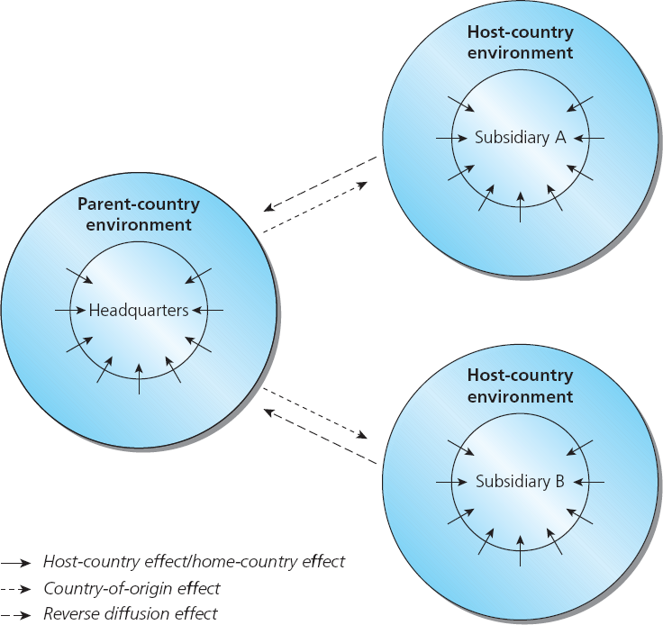
Figure
9-2
Institutional effects on MNEs
Country of origin effects
Home-country effects
Host-country effects
Reversed diffusion
IBUS 618 Dr. Yang

Slide 13
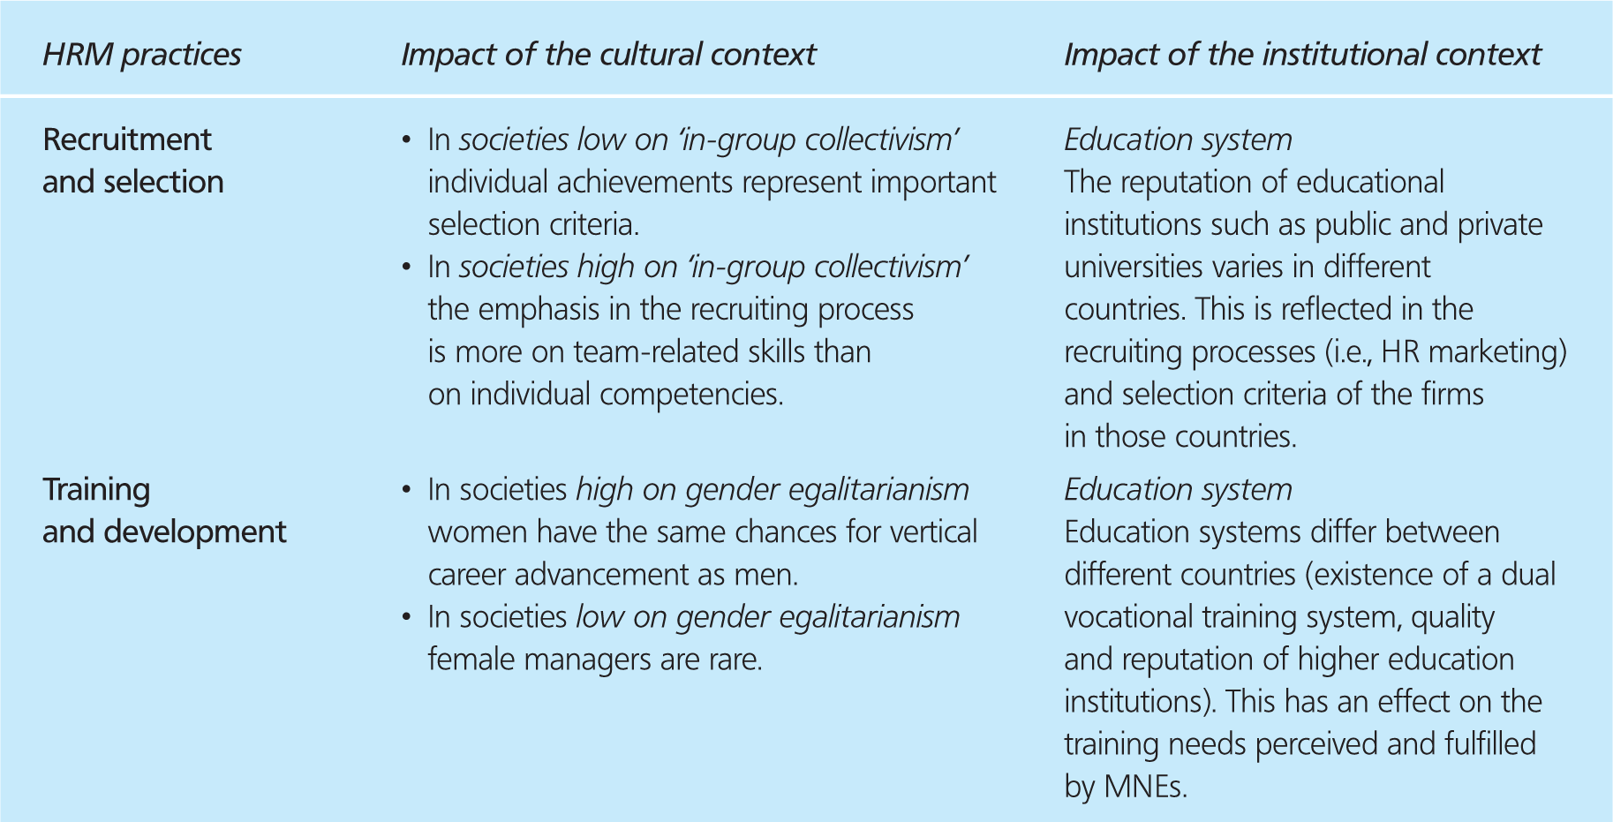
Examples of the impact of the cultural and institutional context on HRM practices
Table
9-2a
IBUS 618 Dr. Yang

Slide 14
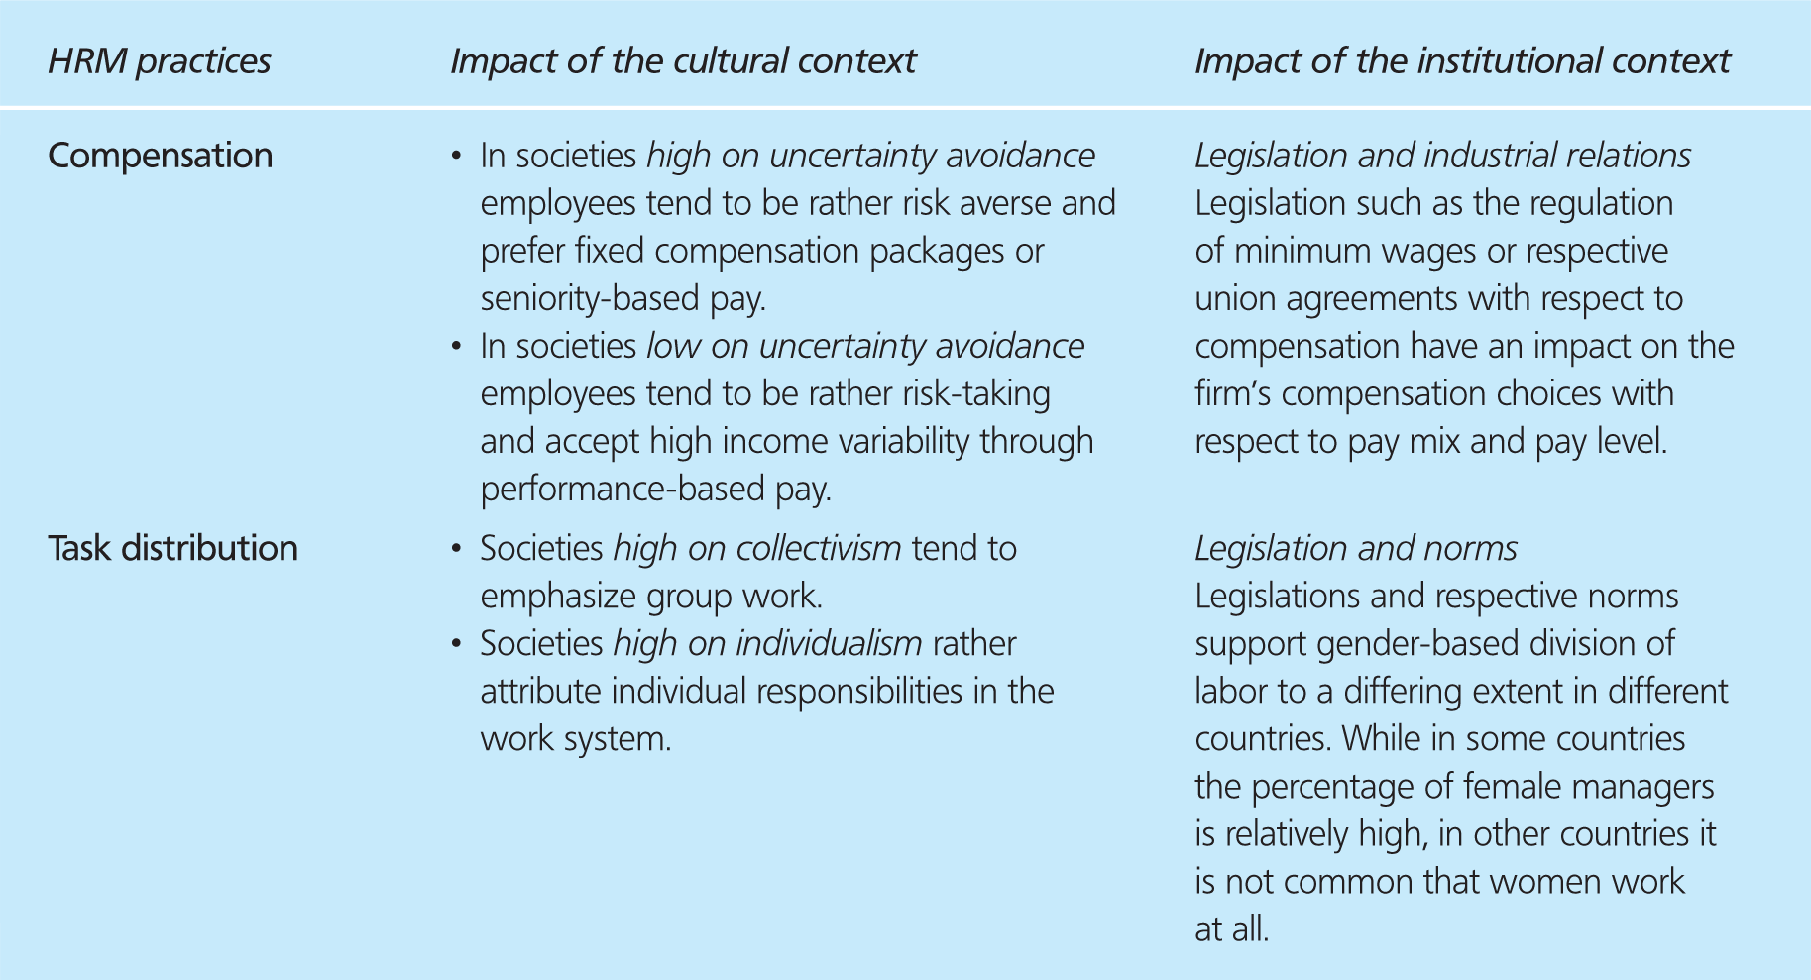
Table
9-2b
Examples of the impact of the cultural and institutional context on HRM practices
IBUS 618 Dr. Yang

Slide 15
Mode of Operation
Choice of mode of operation is important in determining standardization of work practices.
Ownership and control are important factors:
  Acquisition may constrain ability to transfer technical knowledge, management know-how, systems, and HR practices
  Wholly owned subsidiaries provide greater opportunities for transferring work practices than in IJV
  Management contracts provide skills, expertise and training to HCNs, without carrying equity or risks associated with FDI, and may have HC government support.
IBUS 618 Dr. Yang

Slide 16

Work Standardization
The size of the firm, maturity, and international experience are important firm level factors.
Motorola in China is a case in point:
  Large size
  Wealth of international experience
  A wholly owned operation in Tianjin, China, 1992
  Centralized IHR programs
  Management could draw on these aspects when entering China
        中国
IBUS 618 Dr. Yang

Slide 17
Motorola’s China Challenge
The world largest mobile phone market, with 240 million cell-phone users, fashion-conscious
Loss of top talent
  Lost its China ECO Timothy Chen to Microsoft in 2003
  Aims to recruit 3,000 engineers in various R&D centers
  To recruit up to 1,000 in China as the country becomes an important R&D base for the firm
More competition, e.g., Nokia, Ericsson, local Chinese brands, such as LCT
Slower growth, around 10%
中国
IBUS 618 Dr. Yang

Slide 18
Subsidiary Role
Specifies the position of a particular unit in relation to the rest of the organization and expected performance contributions
Varies in Function, power and resource relationships, initiative-taking
Host-country environment
Predisposition of top management
Active champing of subsidiary management
IBUS 618 Dr. Yang

Slide 19
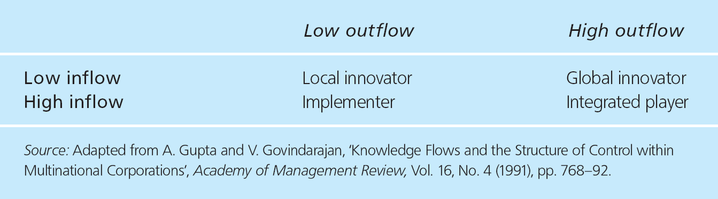
Gupta and Govindarajan’s four generic subsidiary roles
Table
9-3
IBUS 618 Dr. Yang

Slide 20
Subsidiary Issues
Approach to subsidiary management is a function of:
  The nature of the relationship between the units and the ‘parent’, e.g.
    Long-term or short-term
    The role of the subsidiary in the broader context
  The level of equity involved, e.g.
    Mode of operation
  Factors within host-country environments that facilitate or constrain the transfer of global management practices and business processes, e.g.
    Government regulations
    Social norms
IBUS 618 Dr. Yang

Slide 21
Standardization of HR Practices
Depends on
  Receptivity of local workforce to adhere to corporate norms of behavior
  Effectiveness of expatriates as agents of socialization
  Whether localization is timely (not just prompted by cost considerations)
  Appropriateness to the local environment
IBUS 618 Dr. Yang

Slide 22
Subsidiary Initiative and Knowledge Sharing
The position a subsidiary holds within the global ‘family’ is an important aspect when discussing the transfer of work practices.
  GE’s Center of Excellence in Hungary
  Hitachi’s R&D Center in China
  Wal-Mart Supercenters in China
Transferring knowledge and competence is difficult as subsidiary initiatives are often not seen as relevant due to “corporate immune system”.
Subsidiaries’ roles and positions alter over time.
  Staff movements can assist information sharing
  Face-to-face communication helps build trust and networks
  Project teams as a control and socializing mechanism
IBUS 618 Dr. Yang

Slide 23
Monitoring Host-country Subcontractors
Outsourcing activities to host-country subcontractors requires some monitoring of HR practices
Further contracting is likely to occur.
Vocal groups such as NGOs have accused MNEs of condoning work practices that would not be permitted in their home countries, regarding:
  Child labor
  Minimum pay
  Work hours
  Work conditions and safety
  Environmental issues
E.g., Nike, Levi Strauss, Benetton, Reebok, Adidas
IBUS 618 Dr. Yang

Slide 24
Measures to Create the HR Balance between Standardization and Localization
Formal and informal control mechanisms
The global code of conduct
IBUS 618 Dr. Yang

Slide 25
HRM role with the Global Code of Conduct
Drawing up and reviewing codes of conduct
Conducting a cost–benefit analysis to oversee compliance of employees and relevant alliance partners
Championing the need to train employees and alliance partners in elements of the code of conduct
Checking that performance and rewards systems take into consideration compliance to codes of conduct
IBUS 618 Dr. Yang

Slide 26
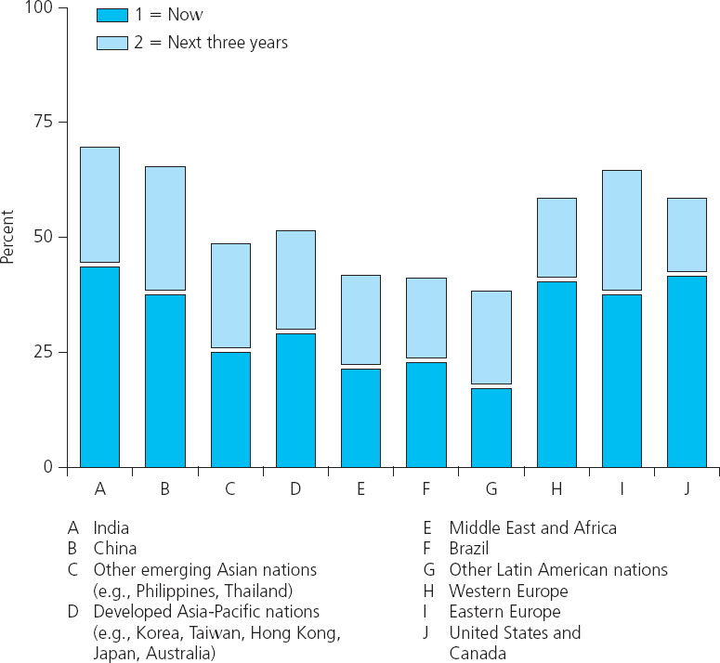
Figure
9-3
Target countries for future foreign business operations
IBUS 618 Dr. Yang

Slide 27
Offshoring and HRM in India
Benefits
  3.1m graduates each year
  20% population speak English
  Salaries used to be 80% lower than Western employees
  Technological infrastructure, particularly for information system
  Motivation
Challenges
  Low job satisfaction
  High turnover rates at 20-80%
  Driving salary increase at 10-20%/yr
  HR policies and practices influenced by castes, social relationships and politics, rather than performance
  Low emphasis on training and career development
IBUS 618 Dr. Yang

Slide 28
Offshoring and HRM in China
Benefits
  Inexpensive manufacturing
  High emphasis on education and career advancement
  Size of the market
  Sociopolitical stability
  Fast growing economy
  Infrastructure, such as transportation
Challenges
  Language
  High turnover rates
  Lack of systematic link of HRM with business strategy
  Lack of systematic link between performance, reward, and long-term motivation
  Lack of coherence and continuity of enterprise training
  Difficulty in assessing right Guanxi
IBUS 618 Dr. Yang

Slide 29
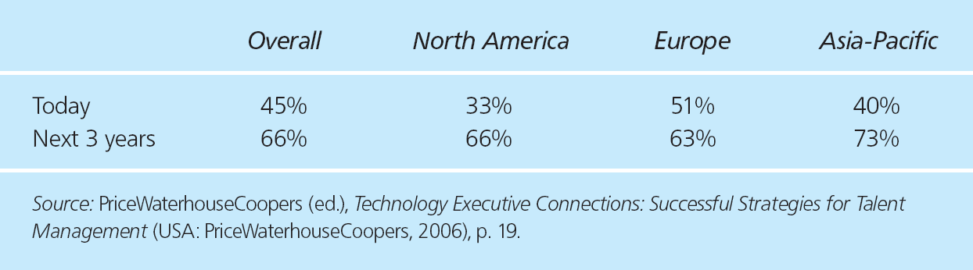
Table
9-4
Where Talent Is Scare
IBUS 618 Dr. Yang

Slide 30
HRM Role with Issues of Offshoring
Consultation with unions/employee representatives
Manpower planning, considering the scope for employee redeployment
Contributing to the internal communication strategy
Identifying training needs
Designing new jobs which stem from offshoring operations
Highlighting potential risks, such as the implications of employment regulation both in the home country and in foreign locations.
IBUS 618 Dr. Yang

Slide 31
Chapter Summary
In this chapter we have focused on issues relating to HRM and work practices in the host-country context. We have examined three main areas:
The standardization versus localization debate as it relates to subsidiary operations. We identified inter-related factors:
  Factors driving standardization
  Factors driving localization
HR measures and the concept of global codes of conduct
Managing human resources in offshoring countries
  India and china
  General trends and challenges
In the next chapter we will revisit some of these issues relating to managing international industrial relations
IBUS 618 Dr. Yang

Slide 32
Discussion Questions
What are the determinants of the balance of standardization and localization in human resource management in MNEs?
How does a subsidiary’s role affect its ability to transfer ideas and work practices to other parts of the global network? What is the impact of the resources controlled by the respective affiliate?
What contributes to the poaching of subsidiary employees? What steps can be taken to recruit and retain key employees?
What are typical HRM problems in offshoring organizations? How can companies, for example in India and in China, design their human resource management systems to avoid these problems?
IBUS 618 Dr. Yang

