Slide 2
Objectives
After studying this chapter, you should be able to:
Explain the purposes of performance appraisals and the reasons they can sometimes fail.
Identify the characteristics of an effective appraisal program.
Describe the different sources of appraisal information.
Explain the various methods used for performance evaluation.
Outline the characteristics of an effective performance appraisal interview.

Slide 3
Performance Appraisal and Other HRM Functions
Performance appraisal judges effectiveness of recruitment efforts
Recruitment
Quality of applicants determines feasible performance standards
Performance appraisal validates selection function
Selection
Selection should produce workers best able to meet job requirements
Performance appraisal determines training needs
Training and Development
Training and development aids achievement of performance standards
Performance appraisal is a factor in determining pay
Compensation
Management
Compensation can affect appraisal of performance
Performance appraisal justifies personnel actions
Labor Relations
Appraisal standards and methods may be subject to negotiation
Presentation Slide 8–1

Slide 4

Performance Appraisal
Appraisal Programs
Administrative
Developmental
Compensation
Ind. Evaluation
Job Evaluation
Training
EEO/AA Support
Career Planning
Notes:
6
Sexual Harassment is defined as unwelcome advances, requests for sexual favors, and other verbal or physical conduct of a sexual nature in the working environment. In 1995, 15,549 complaints were filed with the EEOC and state agencies alleging sexual harassment. The EEOC under Title VII recognizes two forms of sexual harassment: quid pro quo and hostile environment.
Quid Pro Quo Harassment.
This occurs when submission to or rejection of sexual conduct is used as a basis for employment decisions. For example, if a person is denied a promotion for refusing to date a superior or is promoting because of agreeing to date a superior, sexual harassment has occurred.
Hostile Environment.
This occurs when unwelcome sexual conduct has the purpose or effect of unreasonably interfering with the job performance or creating an intimidating, hostile, or offensive working environment. A work environment in which sexually explicit material and/or jokes makes a person feel uncomfortable about her or his position in the company can be said to constitute sexual harassment.
The somewhat subjective nature of what constitutes a “hostile environment” makes this section of the law more controversial. To some extent, this objective is justified -- what one person considers unacceptable conduct in this regard may not bother another person. But courts and companies also recognize that a standard need not be totally objective to be enforceable. The concept of intersubjectivity (eye of the beholder) can be applied here and certainly companies should take into consideration the personal feelings of their actual employees in relation to what they may find objectionable.
The EEOC considers an employer guilty of sexual harassment when the employer knew, or should have known, about the unlawful conduct and failed to remedy it or take corrective action.

Slide 5
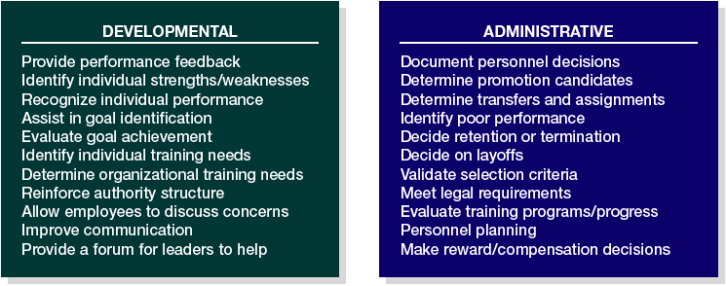
Purposes for Performance Appraisal
Figure 8.1

Slide 6

Reasons Appraisal Programs Fail
Lack of top-management information and support
Unclear performance standards
Rater bias
Too many forms to complete
Use of the appraisal program for conflicting purposes.

Slide 7
Managerial Issues Concerning Appraisals
Managers feel that little or no benefit will be derived from the time and energy spent in the process.
Managers dislike the face-to-face confrontation of appraisal interviews.
Managers are not sufficiently adept in providing appraisal feedback.
The judgmental role of appraisal conflicts with the helping role of developing employees.

Slide 8
Common Appraisal Problems
Inadequate preparation on the part of the manager.
Employee is not given clear objectives at the beginning of performance period.
Manager may not be able to observe performance or have all the information.
Inconsistency in ratings among supervisors or other raters.
Performance standards may not be clear.
Rating personality rather than performance.
The halo effect, contrast effect, or some other perceptual bias.

Slide 9
Common Appraisal Problems (cont’d)
Inappropriate time span (either too short or too long).
Overemphasis on uncharacteristic performance.
Inflated ratings because managers do not want to deal with “bad news.”
Subjective or vague language in written appraisals.
Organizational politics or personal relationships cloud judgments.
No thorough discussion of causes of performance problems.
Manager may not be trained at evaluation or giving feedback.
No follow-up and coaching after the evaluation.

Slide 10
Let me count the ways…
Manager lacks information
Lack of appraisal skills
Insufficient reward for performance
Manager not taking appraisal seriously
Unclear language
Performance appraisals fail because…
Manager not prepared
Ineffective discussion of employee development
Employee not receiving ongoing feedback
Manager not being honest or sincere
Presentation Slide 8–2

Slide 11
Why Appraisal Systems Are Ineffective
Inadequate preparation on the part of the manager.
Employee is not given clear objectives at the beginning of performance period.
Manager may not be able to observe performance or have all the information.
Performance standards may not be clear.
Inconsistency in ratings among supervisors or other raters.
Sources: Patricia Evres, “Problems to Avoid during Performance Evaluations,” Air Conditioning, Heating & Refrigeration News 216, no. 16 (August 19, 2002): 24–26; Clinton Longnecker and Dennis Gioia, “The Politics of Executive Appraisals,” Journal of Compensation and Benefits 10, no. 2 (1994): 5–11; “Seven Deadly Sins of Performance Appraisals,” Supervisory Management 39, no. 1 (1994): 7–8.
Figure 8.2a

Slide 12
Why Appraisal Systems Are Ineffective (cont’d)
Rating personality rather than performance.
The halo effect, contrast effect, or some other perceptual bias.
Inappropriate time span (too short or too long).
Overemphasis on uncharacteristic performance.
Inflated ratings because managers do not want to deal with “bad news.”
Subjective or vague language in written appraisals.
Sources: Patricia Evres, “Problems to Avoid during Performance Evaluations,” Air Conditioning, Heating & Refrigeration News 216, no. 16 (August 19, 2002): 24–26; Clinton Longnecker and Dennis Gioia, “The Politics of Executive Appraisals,” Journal of Compensation and Benefits 10, no. 2 (1994): 5–11; “Seven Deadly Sins of Performance Appraisals,” Supervisory Management 39, no. 1 (1994): 7–8.
Figure 8.2b

Slide 13
Why Appraisal Systems Are Ineffective (cont’d)
Organizational politics or personal relationships cloud judgments.
No thorough discussion of causes of performance problems.
Manager may not be trained at evaluation or giving feedback.
No follow-up and coaching after the evaluation.
Sources: Patricia Evres, “Problems to Avoid during Performance Evaluations,” Air Conditioning, Heating & Refrigeration News 216, no. 16 (August 19, 2002): 24–26; Clinton Longnecker and Dennis Gioia, “The Politics of Executive Appraisals,” Journal of Compensation and Benefits 10, no. 2 (1994): 5–11; “Seven Deadly Sins of Performance Appraisals,” Supervisory Management 39, no. 1 (1994): 7–8.
Figure 8.2c

Slide 14

Establishing Performance Standards
Criterion contamination: Elements that affect the appraisal measures that are not part of the actual performance
Performance measures
Reliability:
Measures that are consistent across raters and over time
Actual
performance
Strategic relevance: Performance standards linked to organizational goals and competencies
Zone of valid assessment
Criterion deficiency:
Aspects of actual performance that are not measured
Figure 8.3
Presentation Slide 8–3

Slide 15
Performance Standards Characteristics
Strategic
Relevance
Individual standards directly relate to strategic goals.
Criterion
Deficiency
Standards capture all of an individual’s contributions.
Criterion Contamination
Performance capability is not reduced by external factors.
Reliability
(Consistency)
Standards are quantifiable, measurable, and stable.
Notes:
4
Pregnancy Discrimination Act of 1978.
This act broadens the definition of sex discrimination in the Equal Pay Act and other following acts to include pregnancy, childbirth, or related medical conditions. It prohibits employers from discriminating against pregnant women in employment benefits if they are capable of performing their duties. The act treats pregnancy as a temporary disability from which employee will recover. This act requires benefit coverage of pregnancy if other similar temporary disabilities are covered.
Americans with Disabilities Act of 1990.
This act, which grew out of the Vocational Rehabilitation Act 1973, prohibits discrimination against persons with physical or mental disabilities or chronic illnesses that limit major life activities. Employers are required to make reasonable accommodation. What is a reasonable accommodation? Accommodations is decided on case-by-case basis. The accommodation cost and the capability of the employer to bear the cost are considered. Persons must be able carry out the essential functions of the job with an accommodation. The law does not require hiring blind truck drivers. Firms must establish the business necessity and the job-relatedness of any job requirements. The term disability is constantly being redefined to cover more people.
Civil Rights Act of 1991.
This provides compensatory and punitive monetary damages and jury trials in cases involving intentional discrimination. It requires employers to show job practices are job-related business necessities.
Uniformed Services Act of 1994. This protects the employment rights of persons who enter the military for short periods of service.

Slide 16
Compliance with the Law
Brito v Zia
  The Supreme Court ruled that performance appraisals were subject to the same validity criteria as selection procedures.
Albemarle Paper Company v Moody
  The U.S. Supreme Court found that employees had been ranked, against a vague standard, open to each supervisor’s own interpretation.

Slide 17
Legal Guidelines for Appraisals
Performance ratings must be job-related.
Employees must be given a written copy of their job standards in advance of appraisals.
Managers who conduct the appraisal must be able to observe the behavior they are rating.
Supervisors must be trained to use the appraisal form correctly.
Appraisals should be discussed openly with employees and counseling or corrective guidance offered.
An appeals procedure should be established to enable employees to express disagreement with the appraisal.

Slide 18
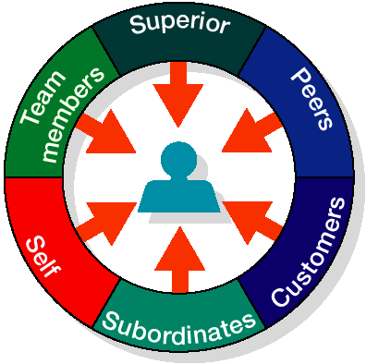

Alternative Sources of Appraisal
Figure 8.4

Slide 19
Sources of Performance Appraisal
Manager and/or Supervisor
  Appraisal done by an employee’s manager and reviewed by a manager one level higher.
Self-Appraisal Performance
  By the employee being evaluated, generally on an appraisal form completed by the employee prior to the performance interview.
Subordinate Appraisal
  Appraisal of a superior by an employee, which is more appropriate for developmental than for administrative purposes.

Slide 20
Sources of Performance Appraisal
Peer Appraisal
  Appraisal by fellow employees, compiled into a single profile for use in an interview conducted by the employee’s manager.
Team Appraisal
  Appraisal, based on TQM concepts, recognizing team accomplishment rather than individual performance.
Customer Appraisal
  Appraisal that seeks evaluation from both external and internal customers.

Slide 21


Alternative Sources of Performance Appraisal
Supervisor
Team
Peers
Self
Customers
Subordinates
Presentation Slide 8–4

Slide 22
Pros and Cons of 360-Degree Appraisal
PROS
  The system is more comprehensive in that responses are gathered from multiple perspectives.
  Quality of information is better. (Quality of respondents is more important than quantity.)
  It complements TQM initiatives by emphasizing internal/external customers and teams.
  It may lessen bias/prejudice since feedback comes from more people, not one individual.
  Feedback from peers and others may increase employee self-development.
Sources: Compiled from David A. Waldman, Leanne E. Atwater, and David Antonioni, “Has 360-Degree Feedback Gone Amok?” Academy of Management Executive 12, no. 2 (May 1998): 86–94; Bruce Pfau, Ira Kay, Kenneth Nowak, and Jai Ghorpade, “Does 360-Degree Feedback Negatively Affect Company Performance?” HRMagazine 47, no. 6 (June 2002): 54–59; Maury Peiperl, “Getting 360-Degree Feedback Right,” Harvard Business Review 79, no. 1 (January 2001): 142–47; Jack Kondrasuk, Mary Riley, and Wang Hua, “If We Want to Pay for Performance, How Do We Judge Performance?” Journal of Compensation and Benefits 15, no. 2 (September/October 1999): 35–40; Mary Graybill, “From Paper to Computer,” The Human Resource Professional 13, no. 6 (November/ December 2000): 18–19; David W. Bracken, Lynn Summers, and John Fleenor, “High-Tech 360,” Training and Development 52, no. 8 (August 1988): 42–45; Gary Meyer, “Performance Reviews Made Easy, Paperless,” HRMagazine 45, no. 10 (October 2000): 181–84.
Figure 8.5a

Slide 23
Pros and Cons of 360-Degree Appraisal
CONS
  The system is complex in combining all the responses.
  Feedback can be intimidating and cause resentment if employee feels the respondents have “ganged up.”
  There may be conflicting opinions, though they may all be accurate from the respective standpoints.
  The system requires training to work effectively.
  Employees may collude or “game” the system by giving invalid evaluations to one another.
  Appraisers may not be accountable if their evaluations are anonymous.
Sources: Compiled from David A. Waldman, Leanne E. Atwater, and David Antonioni, “Has 360-Degree Feedback Gone Amok?” Academy of Management Executive 12, no. 2 (May 1998): 86–94; Bruce Pfau, Ira Kay, Kenneth Nowak, and Jai Ghorpade, “Does 360-Degree Feedback Negatively Affect Company Performance?” HRMagazine 47, no. 6 (June 2002): 54–59; Maury Peiperl, “Getting 360-Degree Feedback Right,” Harvard Business Review 79, no. 1 (January 2001): 142–47; Jack Kondrasuk, Mary Riley, and Wang Hua, “If We Want to Pay for Performance, How Do We Judge Performance?” Journal of Compensation and Benefits 15, no. 2 (September/October 1999): 35–40; Mary Graybill, “From Paper to Computer,” The Human Resource Professional 13, no. 6 (November/ December 2000): 18–19; David W. Bracken, Lynn Summers, and John Fleenor, “High-Tech 360,” Training and Development 52, no. 8 (August 1988): 42–45; Gary Meyer, “Performance Reviews Made Easy, Paperless,” HRMagazine 45, no. 10 (October 2000): 181–84.
Figure 8.5b

Slide 24
360-Degree Performance Appraisal System Integrity Safeguards
Assure anonymity.
Make respondents accountable.
Prevent “gaming” of the system.
Use statistical procedures.
Identify and quantify biases.

Slide 25
Training Performance Appraisers
Common rater-related errors
Error of central tendency
Leniency or strictness errors
Similar-to-me errors
Recency errors
Contrast and halo errors
Notes:
5
Adverse impact is a concept that refers to the rejection of a significantly higher percentage of a protected class for employment, placement, or promotion than the successful, nonprotected class.
Adverse Rejection Rate (Four-Fifths Rule).
In the Uniform Guidelines on Employee Selection Procedures, a selection program has adverse impact if the selection rate for any protected racial, ethnic, or sex class is less than four-fifths (or 80%) of the rate of the class with the highest selection rate.
Standard Deviation Analysis.
Handed down from the U.S. Supreme court in Hazelwood School District v United States (1977), this uses the statistical concept of standard deviation to measure whether the difference between the expected selection rates for protected groups and the actual selection rates could be attributed to chance. If chance is eliminated, then it is assumed that the selection technique has an adverse impact.
The concept of standard deviation. It is a measure of how far and how many individual occurrences in a population will be from the mean (average case). In a bell-shaped distribution, 95% of all occurrences fall within two standard deviations. In social science, the number of standard deviations used to rule out occurrences due to chance is subjective. Most social science disciplines use 2 standard deviations (.05); some use 3 standard deviations (.01).
McDonnell-Douglas Test. McDonnell-Douglas Corp. v Green (1973)
This test provides four guidelines for individuals who believe they have been unjustly rejected for employment: Guidelines are:
The person is a member of a protected class.
The person applied for a job for which he or she was qualified.
The person was rejected despite being qualified.
The employer continued to seek other applicants with similar qualifications.

Slide 26
Rater Errors
Error of Central Tendency
  A rating error in which all employees are rated about average.
Leniency or Strictness Error
  A rating error in which the appraiser tends to give all employees either unusually high or unusually low ratings.
Recency Error
  A rating error in which appraisal is based largely on an employee’s most recent behavior rather than on behavior throughout the appraisal period.

Slide 27
Rater Errors
Contrast Error
  A rating error in which an employee’s evaluation is biased either upward or downward because of comparison with another employee just previously evaluated.
Similar-to-Me Error
  An error in which an appraiser inflates the evaluation of an employee because of a mutual personal connection.

Slide 28

Trait Methods
Graphic Rating Scale
Mixed Standard Scale
Trait
Methods
Forced-Choice
Essay

Slide 29
Trait Methods
Graphic Rating-Scale Method
  A trait approach to performance appraisal whereby each employee is rated according to a scale of individual characteristics.
Mixed-Standard Scale Method
  An approach to performance appraisal similar to other scale methods but based on comparison with (better than, equal to, or worse than) a standard.

Slide 30
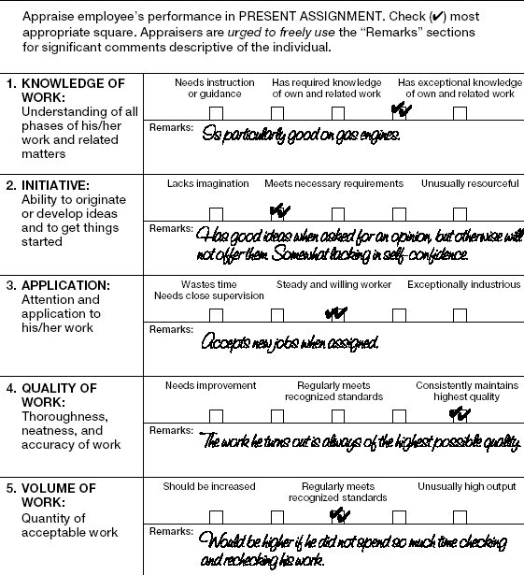
Graphic Rating Scale With Provision For Comments
HRM 2

Slide 31
Trait Methods
Forced-Choice Method
  Requires the rater to choose from statements designed to distinguish between successful and unsuccessful performance.
Essay Method
  Requires the rater to compose a statement describing employee behavior.

Slide 32
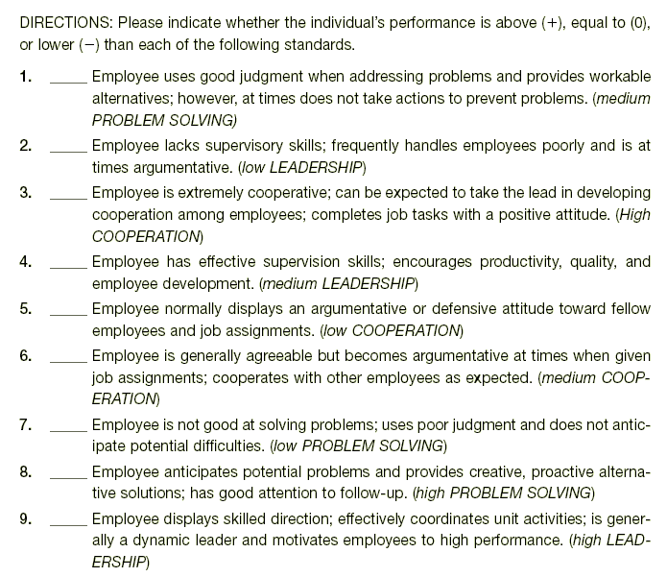
Example Of A Mixed-standard Scale
HRM 3

Slide 33
Behavioral Methods
Critical Incident
Behavioral Checklist
Behavioral Methods
Behaviorally Anchored Rating Scale (BARS)
Behavior Observation Scale (BOS)

Slide 34
Behavioral Methods
Critical Incident
  An unusual event denoting superior or inferior employee performance in some part of the job.
Behaviorally Anchored Rating Scale (BARS)
  A performance appraisal that consists of a series of vertical scales, one for each dimension of job performance.
Behavior Observation Scale (BOS)
  A performance appraisal that measures the frequency of observed behavior.

Slide 35
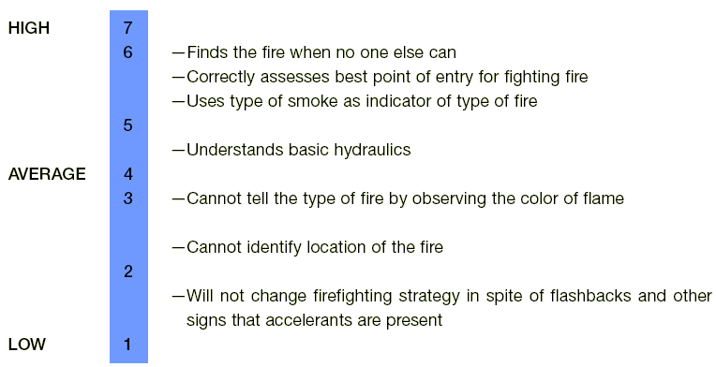
Examples Of A Bars For Municipal Fire Companies
FIREFIGHTING STRATEGY: Knowledge of Fire Characteristics.
Source: Adapted from Landy, Jacobs, and Associates. Reprinted with permission.
HRM 4

Slide 36
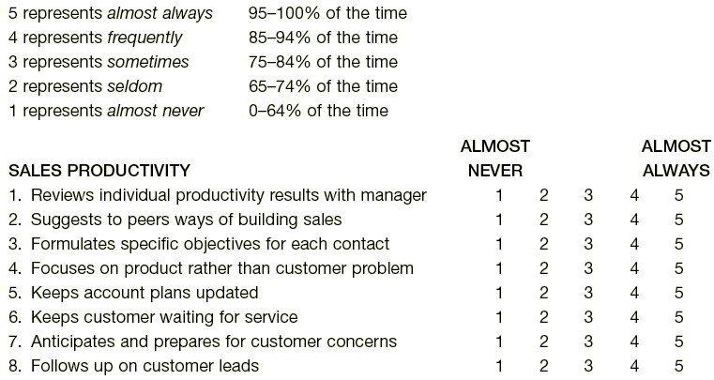
Sample Items From Behavior Observation Scales
HRM 0

Slide 37

Results Methods
Management by Objectives (MBO)
  A philosophy of management that rates performance on the basis of employee achievement of goals set by mutual agreement of employee and manager.

Slide 38
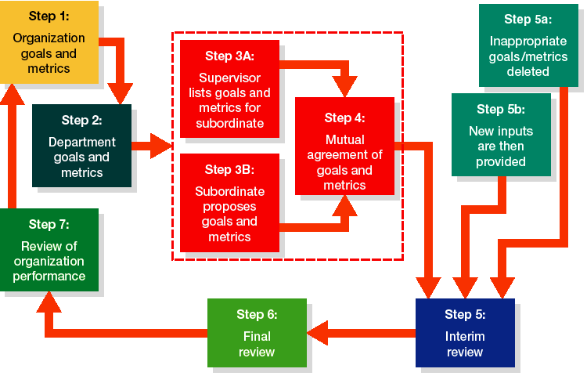
Performance Appraisal under an MBO Program
Management by Objectives
Figure 8.6

Slide 39
Summary of Appraisal Methods
ADVANTAGES
DISADVANTAGES
Inexpensive
Potential for error
TRAITS
Meaningful
Poor for counseling
Easy to use
Poor for allocating rewards
Poor for promotional decisions
Specific dimensions
Time consuming
BEHAVIOR
Accepted by employees
Costly
Useful for feedback
Some rating error
OK for reward/promotion
Less subjectivity bias
Time consuming
RESULTS
Accepted by employees
Focus on short term
Performance-reward link
Criterion contamination
Encourages goal setting
Criterion deficiency
Good for promotion
decisions
Presentation Slide 8–5

Slide 40
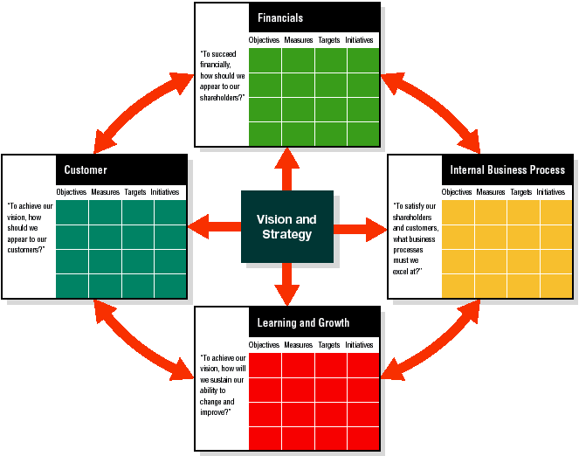
The Balanced Scorecard
Source: Robert Kaplan and David Norton, “Strategic Learning and the Balanced Scorecard,” Strategy & Leadership 24, no. 5 September/ October 1996): 18–24.
HRM 6

Slide 41
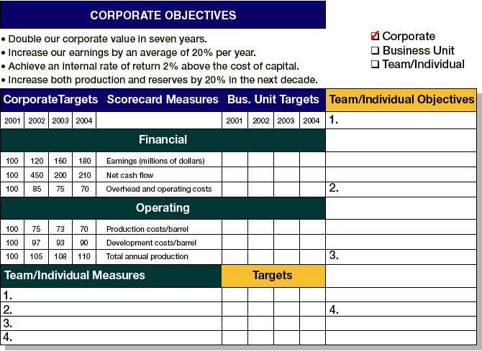
Personal Scorecard
Source: Robert Kaplan and David Norton, “Using the Balanced Scorecard as a Strategic Management System,” Harvard Business Review (January–February 1996): 75–85.
HRM 7

Slide 42
Summary of Appraisal Methods
Trait Methods
  Advantages
    Are inexpensive to develop
    Use meaningful dimensions
    Are easy to use
  Disadvantages
    Have high potential for rating errors
    Are not useful for employee counseling
    Are not useful for allocating rewards
    Are not useful for promotion decisions
Figure 8.7a

Slide 43
Summary of Appraisal Methods (cont’d)
Behavioral Methods
  Advantages
    Use specific performance dimensions
    Are acceptable to employees and superiors
    Are useful for providing feedback
    Are fair for reward and promotion decisions
  Disadvantages
    Can be time-consuming to develop/use
    Can be costly to develop
    Have some potential for rating error
Figure 8.7b

Slide 44
Summary of Appraisal Methods (cont’d)
Results Methods
  Advantages
    Have less subjectivity bias
    Are acceptable to employees and superiors
    Link individual to organizational performance
    Encourage mutual goal setting
    Are good for reward and promotion decisions
  Disadvantages
    Are time-consuming to develop/use
    May encourage short-term perspective
    May use contaminated criteria
    May use deficient criteria
Figure 8.7c

Slide 45
Types of Appraisal Interviews
Appraisal Interview Formats
Tell and Sell - persuasion
Tell and Listen - nondirective
Problem solving- focusing the interview on problem resolution and employee development
Notes:
5
Adverse impact is a concept that refers to the rejection of a significantly higher percentage of a protected class for employment, placement, or promotion than the successful, nonprotected class.
Adverse Rejection Rate (Four-Fifths Rule).
In the Uniform Guidelines on Employee Selection Procedures, a selection program has adverse impact if the selection rate for any protected racial, ethnic, or sex class is less than four-fifths (or 80%) of the rate of the class with the highest selection rate.
Standard Deviation Analysis.
Handed down from the U.S. Supreme court in Hazelwood School District v United States (1977), this uses the statistical concept of standard deviation to measure whether the difference between the expected selection rates for protected groups and the actual selection rates could be attributed to chance. If chance is eliminated, then it is assumed that the selection technique has an adverse impact.
The concept of standard deviation. It is a measure of how far and how many individual occurrences in a population will be from the mean (average case). In a bell-shaped distribution, 95% of all occurrences fall within two standard deviations. In social science, the number of standard deviations used to rule out occurrences due to chance is subjective. Most social science disciplines use 2 standard deviations (.05); some use 3 standard deviations (.01).
McDonnell-Douglas Test. McDonnell-Douglas Corp. v Green (1973)
This test provides four guidelines for individuals who believe they have been unjustly rejected for employment: Guidelines are:
The person is a member of a protected class.
The person applied for a job for which he or she was qualified.
The person was rejected despite being qualified.
The employer continued to seek other applicants with similar qualifications.

Slide 46

Appraisal Interview Guidelines
Invite Participation
Ask for Self-Assessment
Change Behavior
Problem Solving Focus
Minimize Criticism
Express Appreciation
Establish Goals
Be Supportive
Follow Up Day by Day
Presentation Slide 8–6
Notes:
8
According to Maier, three types of appraisal interviews are common:
Tell-and-Sell Interview.
Tell-and-Listen Interview.
Problem-Solving Interview.
Guidelines for conducting appraisal interviews include:
Ask for a Self-Assessment. It is useful for employees to evaluate their own performance prior to the appraisal interview. This helps them to start thinking about performance and identifies impressions and expectations the employee brings to the appraisal.
Invite Participation. Active participation by the employee makes it more likely that causes of and obstacles to performance concerns can be uncovered.
Express Appreciation. It is important that good performance be acknowledged.
Minimize Criticism. It is better to focus on key objectives that are the most important for improvement than to cover every single detail to work on.
Change the Behavior, Not the Person. Focusing on actions helps to minimize ego-defensiveness.
Focus on Problem Solving. Problems, not personalities, are at issue. Why something is happening can lead to rationalization. Focus on what needs to be done and how to do it.
Be Supportive. Demonstrate a willingness to help.
Establish Goals. Be sure that the interview sets new plans for improvement.
Follow Up Day by Day. Feedback is most useful when it is immediate. If the manager sees the employee daily, reference to goals and how the employee is or can do things to meet them will be well received.

Slide 47
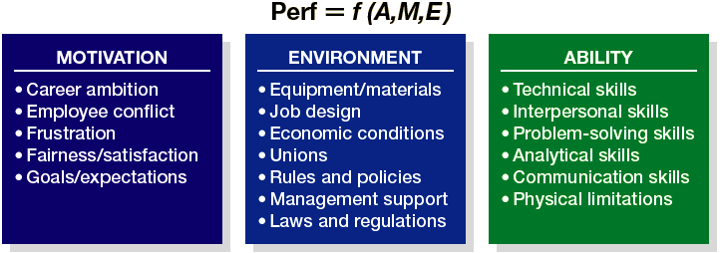
Factors That Influence Performance
Figure 8.8

Slide 48
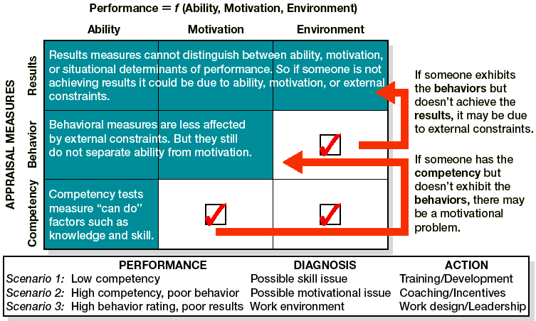
Performance Diagnosis
Source: Scott Snell, Cornell University.
HRM 8

