Slide 1
Performance Management and Appraisal

Slide 2

After studying this chapter, you should be able to:
Describe the appraisal process.
Develop, evaluate, and administer at least four performance appraisal tools.
Explain and illustrate the problems to avoid in appraising performance.
List and discuss the pros and cons of six appraisal methods.
Perform an effective appraisal interview.
Discuss the pros and cons of using different raters to appraise a person’s performance.
9–<number>
<footer>© 2005 Prentice Hall Inc. All rights reserved.

Slide 3
Comparing Performance Appraisal and Performance Management
Performance appraisal
  Evaluating an employee’s current and/or past performance relative to his or her performance standards.
Performance management
  The process employers use to make sure employees are working toward organizational goals.
    Employees’ individual goals point towards overall strategic direction

Slide 4
Why Performance Management?
Increasing use by employers of performance management reflects:
  The popularity of the total quality management (TQM) concepts.
  The belief that traditional performance appraisals are often not just useless but counterproductive.
  The necessity in today’s globally competitive industrial environment for every employee’s efforts to focus on helping the company to achieve its strategic goals.

Slide 5
Continuous improvement
A management philosophy that requires employers to continuously set and relentlessly meet ever-higher quality, cost, delivery, and availability goals by:
  Eradicating the seven wastes:
    overproduction, defective products, and unnecessary downtime, transportation, processing costs, motion, and inventory.
  Requiring each employee to continuously improve his or her own personal performance, from one appraisal period to the next.

Slide 6
An Introduction to Appraising
Performance
Why appraise performance?
  Appraisals play an integral role in the employer’s performance management process.
  Appraisals help in planning for correcting deficiencies and reinforce things done correctly.
  Appraisals, in identifying employee strengths and weaknesses, are useful for career planning
  Appraisals affect the employer’s salary raise decisions.

Slide 7
Realistic Appraisals
The tool will NOT matter if the appraisal isn’t accurate
Motivations for soft (less-than-candid) appraisals
  The fear of having to hire and train someone new
  The unpleasant reaction of the appraisee
  A company appraisal process that’s not conducive to candor
Hazards of giving soft appraisals
  Employee loses the chance to improve before being forced to change jobs.
  Lawsuits arising from dismissals involving inaccurate performance appraisals.

Slide 8
Defining Goals and Work Efforts
Guidelines for effective goals
  Assign specific goals
  Assign measurable goals
  Assign challenging but doable goals
  Encourage participation
SMART goals are:
  Specific, and clearly state the desired results.
  Measurable in answering “how much.”
  Attainable, and not too tough or too easy.
  Relevant to what’s to be achieved.
  Timely in reflecting deadlines and milestones.

Slide 9
Performance Appraisal Roles
Supervisors
  Usually do the actual appraising.
  Must be familiar with basic appraisal techniques.
  Must understand and avoid problems that can cripple appraisals.
  Must know how to conduct appraisals fairly.
    Give the employee advance notice
    Give the employee an advance copy of the appraisal
  Must BE PREPARED.
    Review prior performance appraisals
    Review any notes taken regarding employee’s performance
    BE FAMILIAR with the employee’s job
      What projects they are working on, etc.

Slide 10
Performance Appraisal Roles (cont’d)
HR department
  Serves a policy-making and advisory role.
  Provides advice and assistance regarding the appraisal tool to use.
  Prepares forms and procedures and insists that all departments use them.
  Responsible for training supervisors to improve their appraisal skills.
  Responsible for monitoring the system to ensure that appraisal formats and criteria comply with EEO laws and are up to date.

Slide 11
Steps in Appraising Performance
Defining the job
  Making sure that you and your subordinate agree on his or her duties and job standards.
    Here’s where that job description comes in handy..
Appraising performance
  Comparing your subordinate’s actual performance to the standards that have been set; this usually involves some type of rating form.
Providing feedback
  Discussing the subordinate’s performance and progress, and making plans for any development required.

Slide 12
Designing the Appraisal Tool
What to measure?
  Work output (quality and quantity)
  Personal competencies
  Goal (objective) achievement
How to measure?
  Graphic rating scales
  Alternation ranking method
  MBO

Slide 13
Performance Appraisal Methods
Graphic rating scale
  A scale that lists a number of traits and a range of performance for each that is used to identify the score that best describes an employee’s level of performance for each trait.

Slide 14
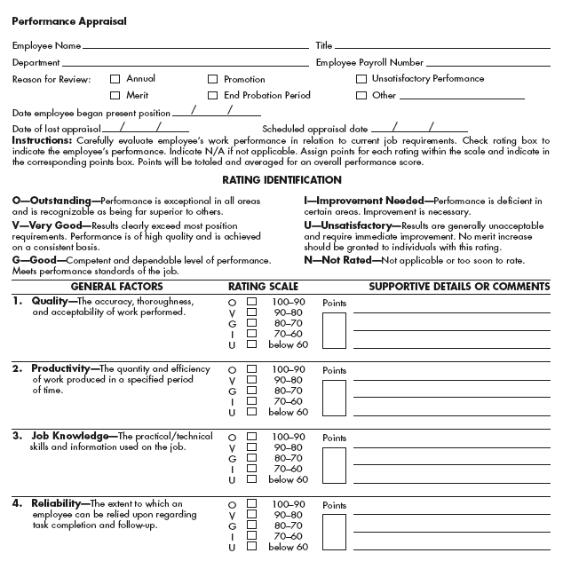
Graphic Rating Scale with Space for Comments
Figure 9–3

Slide 15
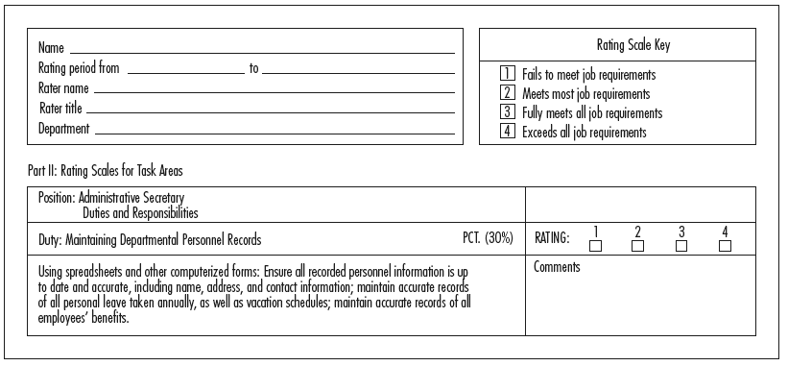
Portion of an Administrative Secretary’s Sample Performance Appraisal Form
Source: James Buford Jr., Bettye Burkhalter, and Grover Jacobs, “Link Job Description to Performance Appraisals,” Personnel Journal, June 1988, pp. 135–136.
Figure 9–4

Slide 16
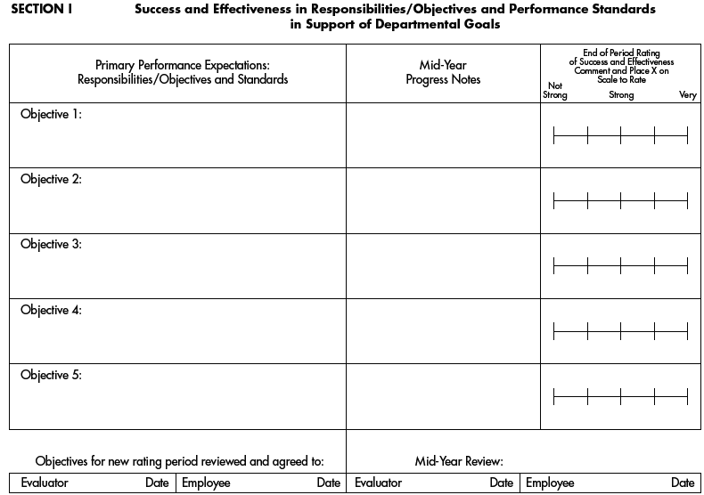
Performance Management Outline
Source: www.cwru.edu.
Figure 9–5a

Slide 17
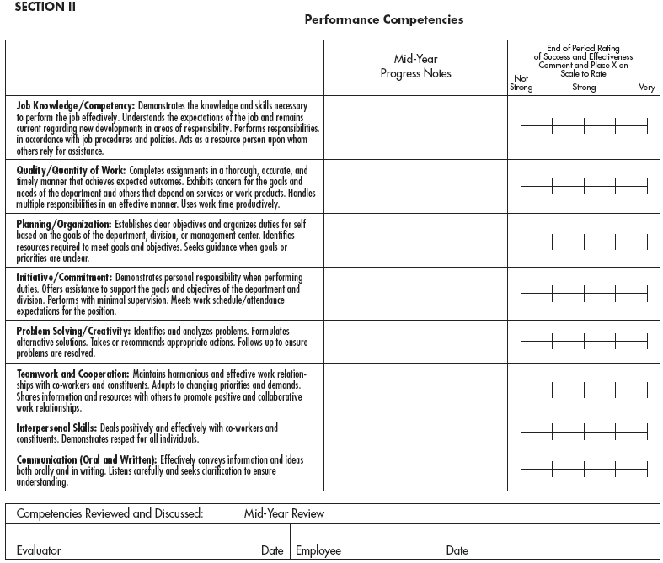
Performance Management Outline
(cont’d)
Source: www.cwru.edu.
Figure 9–5b

Slide 18
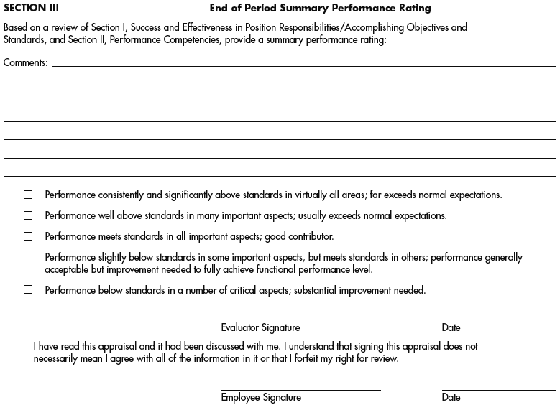
Performance Management Outline (cont’d)
Source: www.cwru.edu.
Figure 9–5c

Slide 19
Performance Appraisal Methods (cont’d)
Alternation ranking method
  Ranking employees from best to worst on a particular trait, choosing highest, then lowest, until all are ranked.
Paired comparison method
  Ranking employees by making a chart of all possible pairs of the employees for each trait and indicating which is the better employee of the pair.

Slide 20
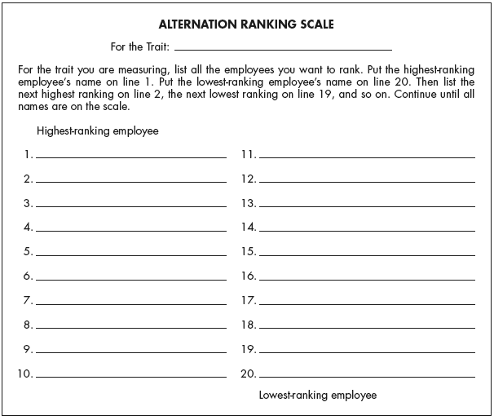
Alternation Ranking Scale
Figure 9–6

Slide 21
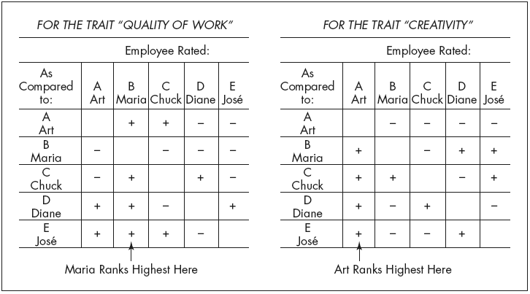
Ranking Employees by the
Paired Comparison Method
Note: + means “better than.” − means “worse than.” For each chart, add up the number of 1’s in each column to get the highest-ranked employee.
Figure 9–7

Slide 22
Performance Appraisal Methods (cont’d)
Forced distribution method
  Similar to grading on a curve; predetermined percentages of ratees are placed in various performance categories.
  Example:
    15% high performers
    20% high-average performers
    30% average performers
    20% low-average performers
    15% low performers
Narrative Forms

Slide 23
Performance Appraisal Methods (cont’d)
Behaviorally anchored rating scale (BARS)
  An appraisal method that uses quantified scale with specific narrative examples of good and poor performance.
Developing a BARS:
  Generate critical incidents
  Develop performance dimensions
  Reallocate incidents
  Scale the incidents
  Develop a final instrument

Slide 24
Performance Appraisal Methods (cont’d)
Advantages of using a BARS
  A more accurate gauge
  Clearer standards
  Feedback
  Independent dimensions
  Consistency

Slide 25
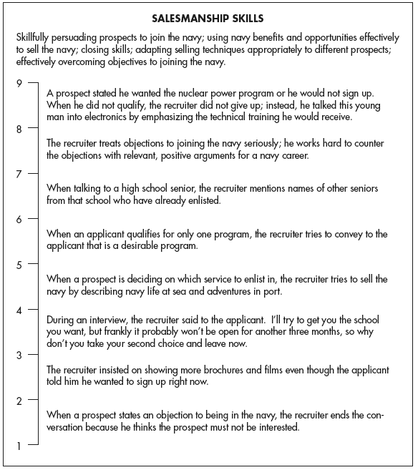
Example of a Behaviorally Anchored Rating Scale for the Dimension Salesmanship Skill
Source:Walter C. Borman, “Behavior Based Rating,” in Ronald A. Berk (ed.), Performance Assessment: Methods and Applications (Baltimore, MD: Johns
Hopkins University Press, 1986), p. 103.
Figure 9–9

Slide 26
Management by Objectives (MBO)
Involves setting specific measurable goals with each employee and then periodically reviewing the progress made.
  Set the organization’s goals.
  Set departmental goals.
  Discuss departmental goals.
  Define expected results (set individual goals).
  Performance reviews.
  Provide feedback.
Biggest problem with MBO’s is when they are vague or unclear

Slide 27
Potential Rating Scale Appraisal Problems
Unclear standards
  An appraisal that is too open to interpretation.
Halo effect
  Occurs when a supervisor’s rating of a subordinate on one trait biases the rating of that person on other traits.
Central tendency
  A tendency to rate all employees the same way, such as rating them all average.

Slide 28
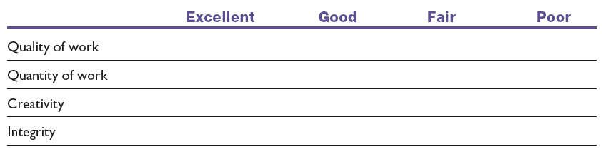
A Graphic Rating Scale with Unclear Standards
Note: For example, what exactly is meant by “good,” “quantity of work,” and so forth?
Table 9–2

Slide 29
Potential Rating Scale Appraisal Problems (cont’d)
Strictness/leniency
  The problem that occurs when a supervisor has a tendency to rate all subordinates either high or low.
Bias
  The tendency to allow individual differences such as age, race, and sex to affect the appraisal ratings employees receive.

Slide 30
How to Avoid Appraisal Problems
Learn and understand the potential problems, and the solutions for each.
Use the right appraisal tool. Each tool has its own pros and cons.
Train supervisors to reduce rating errors such as halo, leniency, and central tendency.
Have raters compile positive and negative critical incidents as they occur.
PAY ATTENTION

Slide 31
Who Should Do the Appraising?
The immediate supervisor
Peers
Rating committees
  Employee’s supervisor and 2-3 other supervisors
Self-ratings
Subordinates
360-Degree feedback

Slide 32
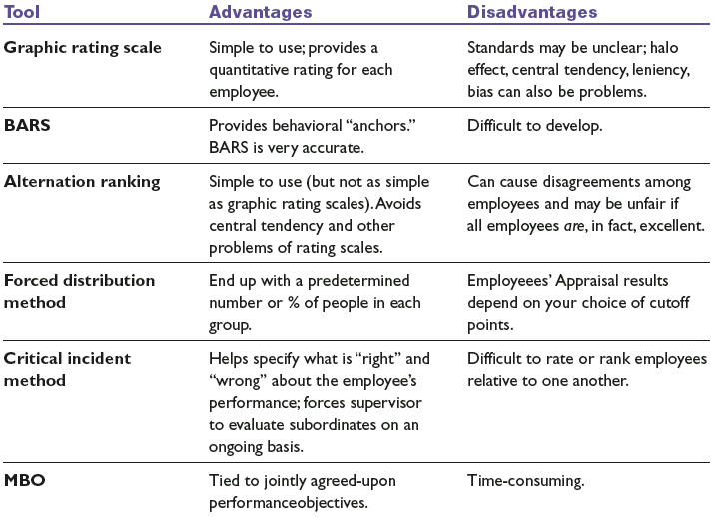
Advantages and Disadvantages of Appraisal Tools
Table 9–3

Slide 33
The Appraisal Interview
Types of appraisal interviews
  Satisfactory—Promotable
  Satisfactory—Not promotable
  Unsatisfactory—Correctable
    Immediately followed by some form of a CAP
  Unsatisfactory—Uncorrectable
How to conduct the appraisal interview
  Talk in terms of objective work data.
  Don’t get personal.
  Encourage the person to talk.
  Don’t tiptoe around.

Slide 34
The Appraisal Interview (cont’d)
How to handle a defensive subordinate
  Recognize that defensive behavior is normal.
  Never attack a person’s defenses.
  Postpone action.
  Recognize your own limitations.
    You are their boss – not their shrink

Slide 35
The Appraisal Interview (cont’d)
How to criticize a subordinate
  Do it in a manner that lets the person maintain his or her dignity and sense of worth.
  Criticize in private, and do it constructively.
  Avoid once-a-year “critical broadsides” by giving feedback on a daily basis, so that the formal review contains no surprises.
  Never say the person is “always” wrong
  Criticism should be objective and free of any personal biases on your part.

Slide 36
The Appraisal Interview (cont’d)
How to ensure the interview leads to improved performance
  Don’t make the subordinate feel threatened during the interview.
  Give the subordinate the opportunity to present his or her ideas and feelings and to influence the course of the interview.
  Have a helpful and constructive supervisor conduct the interview.
  Offer the subordinate the necessary support for development and change.

Slide 37
The Appraisal Interview (cont’d)
How to handle a formal written warning
  Purposes of the written warning
    Purpose is to CHANGE BEHAVIOR
    To shake your employee out of bad habits.
    Help you defend your rating, both to your own boss and (if needed) to the courts.
  Written warnings should:
    Identify standards by which employee is judged.
    Make clear that employee was aware of the standard.
    Specify deficiencies relative to the standard.
    Indicates employee’s prior opportunity for correction.

Slide 38
Creating the Total Performance
Management Process
“What is our strategy and what are our goals?”
“What does this mean for the goals we set for our employees, and for how we train, appraise, promote, and reward them?”
What will be the technological support requirements?

Slide 39
Key Terms
performance appraisal
performance management
graphic rating scale
alternation ranking method
paired comparison method
forced distribution method
critical incident method
behaviorally anchored rating
scale (BARS)
management by objectives
(MBO)
electronic performance
monitoring (EPM)
unclear standards
halo effect
central tendency
strictness/leniency
bias
appraisal interview

