Slide 1
Chapter 11
Performance Appraisal
Cynthia D. Fisher
Lyle F. Schoenfeldt
James B. Shaw
- - - - - - - - - - -
Multimedia Slides by:
Milton M. Pressley
University of New Orleans

Slide 2
LEARNING OBJECTIVES
The Performance Appraisal Process
Strategic Importance of Performance Appraisal
Functions of Performance Appraisal
Criteria for a Good Appraisal System
Deciding What Types of Performance to Measure
Methods of Appraising Performance
Raters of Employee Performance
Enhancing the Measurement of Employee Performance
Feedback of Results: The Performance Appraisal Interview
Contemporary Appraisal Practices

Slide 3

The Performance Appraisal Process
Performance Appraisal

Slide 4

Strategic Importance of
Performance Appraisal
Consistency Between Organizational Strategy and Job Behavior
Consistency Between Organizational Values and Job Behavior
Performance Management
  Defining Performance
  Empowering Employees
  Measuring Performance
  Feedback and Coaching

Slide 5
Table 11.1 Multiple Organizational Uses for Performance Appraisal Information
Functions of Performance Appraisal
General Applications Specific Uses
Developmental uses Identification of individual training needs
Performance feedback
Determining transfers and job
assignments
Identification of individual strengths and
developmental needs
Administrative uses/decisions Salary
Promotion
Retention or termination
Recognition of individual performers
Organizational maintenance/objectives Human resource planning
Determining organization training needs
Evaluation of organizational goal
achievement
Information for goal identification
Evaluation of human resources systems
Reinforcement of organizational development needs
Source: (See next slide)

Slide 6
Table 11.1 Multiple Organizational Uses for Performance Appraisal Information (Continued)
Functions of Performance
Appraisal (Continued)
General Applications Specific Uses
Documentation Criteria for validation research
Documentation of human resource decisions
Helping to meet legal requirements
Source: J. N. Cleveland, K. R. Murphy, and R. E. Williams, “Multiple Uses of Performance Appraisal: Prevalence and
Correlates,“ Journal of Applied Psychology, Vol. 74, 1989, pp. 130-135. Copyright 1989 by the American Psychological
Association. Adapted by permission

Slide 7
Functions of Performance Appraisal
Performance Appraisal as an Employee
Development Tool
  Reinforcing and Sustaining Performance
  Improving Performance
  Determining Career Progression Goals
  Determining Training Needs

Slide 8
Functions of Performance
Appraisal (Continued)
Performance Appraisal as an
Administrative Tool
  Linking Rewards to Performance
  Evaluation of HRM Policies
  and Programs

Slide 9
Functions of Performance
Appraisal (Continued)
Performance Appraisal as an
Administrative Tool
  Linking Rewards to Performance
  Evaluation of HRM Policies
  and Programs
Summary

Slide 10
Criteria for a Good
Appraisal System
Validity

Slide 11
Fig. 11.1 The Relationship Between Relevance, Deficiency, and Contamination
Perfect Measure
of Performance
Actual Measure
of Performance
Deficiency
Relevance
Contamination
Important aspects of a
perfect measure of per-
formance that are not
included in the actual
measure the organization
is using
Aspects unrelated to
performance that are
somehow included
within the actual
measure
The overlap between
the perfect measure
of performance and
an actual measure

Slide 12
Criteria for a Good
Appraisal System
Validity
Reliability

Slide 13
Criteria for a Good Appraisal System (Continued)
Freedom from Bias
  Legal Issues of Fairness
    Race Differences
    Age Differences
  Freedom from Rating Errors
    Leniency Errors
    Severity Errors
    Central Tendency Errors
    Halo Errors
  Why Do Rating Errors Occur?
    Unintentional Errors
      Cognitive Information Processing (CIP)
      Schemas

Slide 14

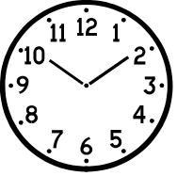
Fig. 11.3 How Information Processing Causes Rating Errors
Never
Absent
Writes
well
Always finishes
projects on time
Gets along well with coworkers
Prototype of a
“Good Worker”

Slide 15
Fig. 11.3 How Information Processing Causes Rating Errors
Never
Absent
Writes
well
Always finishes
projects on time
Gets along well with coworkers
Prototype of a
“Good Worker”
Employee’s Actual Behavior Observed by Supervisor
Never
Absent

Slide 16
Fig. 11.3 How Information Processing Causes Rating Errors
Never
Absent
Writes
well
Always finishes
projects on time
Gets along well with coworkers
Prototype of a
“Good Worker”
Employee’s Actual Behavior Observed by Supervisor
Never
Absent
Supervisor’s Later
Appraisal of Employee (applies prototype)
Never
Absent
Writes
well
Always finishes
projects on time
Gets along well with coworkers

Slide 17
Criteria for a Good Appraisal System (Continued)
Freedom from Bias
  Legal Issues of Fairness
    Race Differences
    Age Differences
  Freedom from Rating Errors
    Leniency Errors
    Severity Errors
    Central Tendency Errors
    Halo Errors
  Why Do Rating Errors Occur?
    Unintentional Errors
      Cognitive Information Processing (CIP)
      Schemas
    Intentional Errors
Practicality

Slide 18
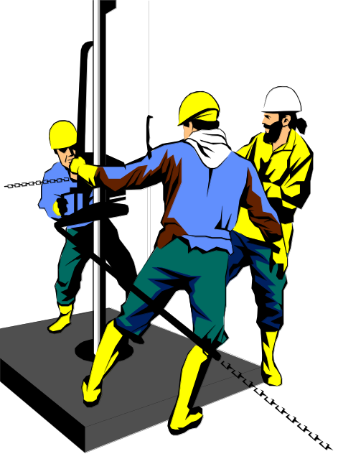
Deciding What Types of Performance to Measure
Trait-Based Appraisals
Behavior-Based Appraisals
Results-Based Appraisals

Slide 19
Methods of Appraising Performance
Objective Measures
  Production Measures
  Dollar Sales
    Opportunity Bias
  Personnel Data
    Personnel Measures
    Contamination
  Performance Tests
  Business Unit Performance Measures
  Summary

Slide 20
Methods of Appraising
Performance (Continued)
Subjective Measures
  Comparative Procedures
    Ranking
      Straight Ranking
      Alternate Ranking
      Paired-Comparison Ranking
    Forced Distribution
    Advantages and Disadvantages of Comparative Procedures
  Absolute Standards
    Graphic Rating Scales
    Mixed Standard Scales

Slide 21
Methods of Appraising
Performance (Continued)
Subjective Measures (Continued)
  Absolute Standards
    Graphic Rating Scales
    Mixed Standard Scales
  Weighted Checklists
    Critical-Incident Technique
    Behaviorally Anchored Rating Scales (BARS)
  Behavioral Observation Scales (BOS)

Slide 22
Methods of Appraising
Performance (Continued)
Subjective Measures (Continued)
  Absolute Standards
    Graphic Rating Scales
    Mixed Standard Scales
  Weighted Checklists
    Critical-Incident Technique
    Behaviorally Anchored Rating Scales (BARS)
  Behavioral Observation Scales (BOS)
Management by Objectives

Slide 23
Table 11.5 Factors Contributing to MBO Program Failure
Lack of management support
Inadequate training of managers in how to use MBO
Easy goals
Setting unrealistically difficult goals
Lack of flexibility in setting goals for different units
Not altering goals to meet changes in circumstances
Pseudoparticipation
Overemphasizing goal attainment
Excessive paperwork
Source: From Steven J. Carroll and Craig E. Schneier, Performance Appraisal and Review, 1982. p. 150.
Copyright 1982 by Scott, Foresman and Company. Reprinted by permission of the author.

Slide 24
Raters of Employee Performance
Self-Evaluation
Peer Evaluation
Subordinate Evaluation
Customer Evaluation
360-Degree Appraisals
Computers in Performance Evaluation

Slide 25
Enhancing the Measurement of Employee Performance
Training Evaluators
  Rater Error Training (RET)
  Frame-of-Reference (FOR) Training
  Information-Processing Approaches
    Observation Training
    Decision-Making Training
  Which Training Method is Best?
Feedback to Evaluators

Slide 26
Feedback of Results: The Performance Appraisal Interview
Types of Feedback Interviews
  Tell and Sell
  Tell and Listen
  Problem Solving
Problems with the Appraisal Interview
  Disagreement and Defensiveness
  Multiple Purposes
  Impression Management in the Feedback Process

Slide 27

Feedback of Results: The Performance Appraisal Interview (Continued)
Improving the Performance
Appraisal Interview
  Feedback Specificity
  Subordinate Acceptance
  Setting Clear Goals

Slide 28
Contemporary Appraisal Practices
Self-Managed Teams as a Performance Appraisal Challenge
360-Degree Appraisals as an Innovation in Performance Appraisal

Slide 29
Review
The Performance Appraisal Process
Strategic Importance of Performance Appraisal
Functions of Performance Appraisal
Criteria for a Good Appraisal System
Deciding What Types of Performance to Measure
Methods of Appraising Performance
Raters of Employee Performance
Enhancing the Measurement of Employee Performance
Feedback of Results: The Performance Appraisal Interview
Contemporary Appraisal Practices

