Slide 1
Chapter 11
Rewarding Performance
1. Psychological Theories Related to Rewards.
2. Challenges to Pay-for-Performance.
3. Meeting the Challenges to Pay-for-Performance.
4. Difference in Merit Pay and Incentive Pay.
5. Four Types of Incentive Systems and the Conditions Favoring Each Type.

Slide 2
Overview
In the fields of organizational behavior and human resource management, Pay-for-Performance remains an unsettled and controversial topic. Based upon the many articles and books written on the subject, there appears to be an equal number of proponents and critics.
Essentially, pay-for-performance is based on the assumption that people will work harder and better for more money. Research indicates that sometimes this is true and sometimes it is not. The goal here is to identify factors that may help or harm the success of performance based pay and to identify the basic types of plans.

Slide 3
1. Psychological Theories Related to Rewards
I. Maslow’s Hierarchy of Needs
II. Reinforcement Theory
III. Deci’s Intrinsic Motivation Theory
IV. Vroom’s Expectancy Theory

Slide 4

I. Maslow’s Hierarchy of Needs
Physical Needs
Wages and salaries
Security Needs
Job Security/Benefits
Social Needs
Peer Relations/Equity/Group Rewards
Self-Esteem Needs
Extrinsic: Promotions/Title/Bonuses
Intrinsic:
Challenge/Autonomy/Achieve

Slide 5
II. Reinforcement Theory
1. Fixed Interval After a specific time period, gives moderate and inconsistent response. (Monthly paycheck).

Slide 6
II. Reinforcement Theory
1. Fixed Interval After a specific time period, gives moderate and inconsistent response. Example: Monthly paycheck.
2. Fixed Ratio After specific goals are met, gives moderate but more consistent response. (Piece Rate, Commission, Bonus – i.e. traditional short term performance pay).

Slide 7
II. Reinforcement Theory
1. Fixed Interval After a specific time period, gives moderate and inconsistent response. (Monthly paycheck).
2. Fixed Ratio After specific goals are met, gives moderate but more consistent response. (Piece Rate, Commission, Bonus – i.e. short term performance pay).
3. Variable Interval After varied time period, gives strong and consistent response. Extrinsic: (Praise, Promotion, and Title) and Intrinsic: (Achievement, Challenge, and Autonomy).

Slide 8
II. Reinforcement Theory
1. Fixed Interval After a specific time period, gives moderate and inconsistent response. Example: Monthly paycheck.
2. Fixed Ratio After specific goals are met, gives moderate but more consistent response. Example: Piece Rate, Commission, Bonus (Short term performance pay).
3. Variable Interval After varied time period, gives strong and consistent response. Extrinsic: (Praise, Promotion, and Title) and Intrinsic: (Achievement, Challenge, and Autonomy).
4. Variable Ratio After varied performance success, gives strong and consistent response. Extrinsic: (Praise/Promotion/Title and Company-Wide Performance Pay, i.e. Gainsharing and Profit Sharing) and Intrinsic: (Achievement, Challenge, and Autonomy).

Slide 9
III. Deci’s Intrinsic Motivation Theory
DESIGNED EXPERIEMENTS INVOLVING PROBLEM SOLVING TASKS THAT WERE EITHER HIGH OR LOW IN INTRINSIC SATISFACTION
FOUR EXPERIMENTAL GROUPS
High Intrinsic Task – No Reward
High Intrinsic Task – Monetary Reward
Low Intrinsic Task – No Reward
Low Intrinsic Task – Monetary Reward

Slide 10
Deci’s Findings
HIGHEST EFFORT AND PERFORMANCE, AND HIGHEST TASK SATISFACTION WAS FOUND FOR:
High Intrinsic Task and No Monetary Reward
Low Intrinsic Task and Monetary Reward
Interpretation: When tasks are intrinsically rewarding, external rewards (at least in the short-run) may lower the sense of autonomy and achievement. For tasks low in intrinsic satisfaction, external rewards are needed to in order to obtain cooperation in performing the tasks.

Slide 11
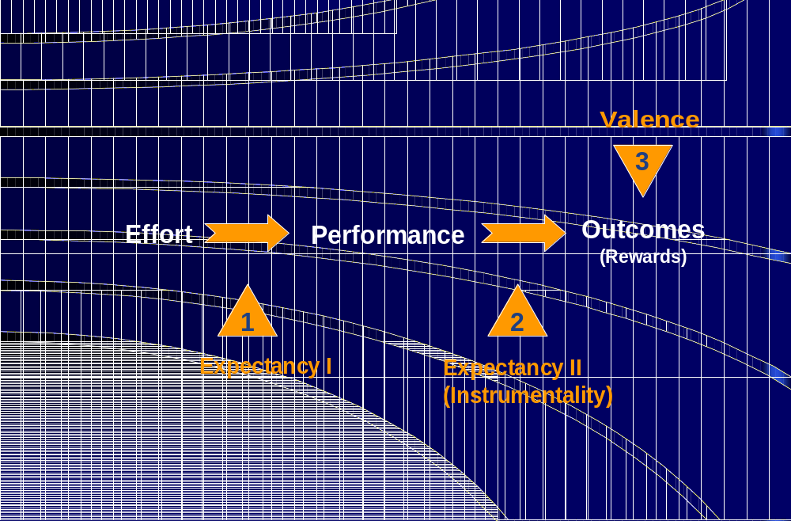
IV. Vroom’s Expectancy Theory

Slide 12

2. Challenges to Performance Based Pay
Focus only on behaviors leading to rewards.
Negative effects on cooperation.
Lack of control over factors necessary for success.
Difficulty in measuring performance.
Psychological contract.
Credibility gap.
Job dissatisfaction and stress.
Reduction in intrinsic motivation.

Slide 13
Understanding the Challenges to Performance Based Pay in the Context of Expectancy Theory
Direct effects upon:
Expectancy
Instrumentality
Valence
How performance pay is designed will enhance or distract from employee motivation.
Performance based pay arrangements may have unintended negative consequences on employee behaviors and work relationships.

Slide 14
Categorizing the “Challenges”
Challenges | Effects on Expectancy | Unintended Consequences
1. Narrow job focus. |  | Instrumentality focus.
2. Harm to cooperation. |  | Instrumentality focus.
3. Lack of control. | Expectancy I
4. Measurement difficulty. | Expectancy I & II
5. Psychological contract. |  | Fixed Ratio Schedule
6. Credibility gap. | Expectancy I & II
7. Job dissatisfaction/stress. |  | Valence focus.
8. Harm to intrinsic rewards. |  | Valence focus.

Slide 15
Challenge 1: Focus only on behaviors leading to rewards.
See example of Lantech Company in Issues and Applications, p. 367 in textbook. Many other such experiences have been documented in the HR literature describing the “gamesmanship” behavior of employees, particularly managers, who take shortcuts, emphasize short-term performance, “juggle” the numbers, and argue over allocations of operating costs and resources.

Slide 16
Challenge 2: Negative effects on cooperation.
Again, see example of Lantech Company, p. 367, in which the CEO, Jim Lancaster states: “I was spending 95% of my time in conflict resolution [between the company’s divisions] instead of on how to serve our customers.” Also, see Case 11.2 on p. 393, “Conflict at Lakeside Utility Company.”
For most jobs and operations, cooperation is needed for success. Any reward program that attempts to single-out and focus rewards on individuals or subgroups within the work flow often leads to conflict and hard feelings.

Slide 17
Challenge 3: Lack of control over factors necessary for success.
See example p. 365 in textbook of ‘physicians in managed care programs who's bonuses depend on the often conflicting goals of “revenue” (affected by patient satisfaction and patronage) and “cost containment” (affected by medical suppliers, pharmaceutical companies, and staff costs)’.
This lack of control over important work related factors lowers Expectancy I perceptions.

Slide 18
Challenge 4: Difficulty in measuring performance.
Accuracy and validity of performance measurement effects Expectancy I (belief that effort leads to performance) and Expectancy II (belief that good performance leads to rewards).
Organizations must ensure that performance measures are relevant and devoid of bias and favoritism.

Slide 19
Challenge 5: Perceived Psychological Contract.
Extrinsic Rewards using the Fixed Ratio schedule may lead to expectations that rewards will always be forthcoming. Consistency in performance and rewards may lead to dissatisfaction in situations where performance declines.
Some experts recommend using short term individual and group pay incentives only in environments where performance trends indicate predictable and consistent growth.

Slide 20
Challenge 6: The credibility gap.
See p. 366 in textbook - the results of a review of several studies by J. T. Rich, “The Solution to Employee Performance Mismanagement.” Workspan, Vol. 45(2), 2002. - which indicated up to 75% of employees question the integrity of performance pay plans.
For performance based pay to motivate, employees must trust management to set realistic targets and to provide equitable rewards when those targets are met.

Slide 21
Challenge 7: Job dissatisfaction and stress.
Job dissatisfaction and stress associated with performance based pay arises from a number of sources, including:
Perceived lack of control over work related factors.
Poor training for the job.
Break-downs in communication and coordination among individuals and departments.
Pressure to attain inflexible performance goals.
Dissatisfaction with the size of the rewards.

Slide 22
Challenge 8: Reduction in Intrinsic Motivation.
Research in the fields of psychology and management science have documented the importance of Intrinsic motivation.
Employees seek (a) variety, (b) challenge, (c) interest, (d) autonomy, and (e) a sense of personal achievement from their work.
Short term pay-for-performance programs, which emphasize Extrinsic motivation, may dilute the sense of employee “ownership” and empowerment, and undermine intrinsic motivational effects.

Slide 23

3. Meeting the Challenges
1. Linking pay to performance.
2. Use as part of broader HR system.
3. Build employee trust.
4. Allow employee involvement.
5. Communicate company goals.
6. Use multiple layers of rewards.
7. Build on intrinsic motivation.

Slide 24
1. Link pay to performance
Consider using performance based pay plans only where:
1. There is a range of behavior possible in the job.
2. Employees have reasonable control over factors that affect their performance.
3. Performance goals can be clearly identified.
4. Performance standards and rewards can be clearly specified.

Slide 25
2. Use as part of a broader HR system.
Performance based pay plans are more likely to succeed when complimentary HR programs are effective. Employees are more likely to perform well and receive rewards when:
Selection assures
needed skills.
Employees are
trained effectively.
Career planning
puts people in
right jobs.

Slide 26
3. Build employee trust.
Communicate performance standards and how rewards are determined. Adjust standards as conditions change.
4. Provide employee involvement.
Appoint an oversight committee, use worker councils, productivity committees (quality circles), and allow appeals.
5. Communicate company goals and how employee performance makes a difference.
Share industry data, company performance, and relevant financial information.

Slide 27

6. Use multiple layers of rewards.
Multiple layers of rewards – i.e. individual, group, and company-wide - helps ensure cooperation and reduces anxiety about the risk of having “all the eggs are in one basket”. Employees are not dependent on only one type of performance for their rewards.

Slide 28
7. Provide an opportunity for intrinsic rewards.
Intrinsic motivation emanates from a sense of personal achievement and growth. It is experienced through the variable reinforcement schedule, which gives strong and consistent performance.
Organizations can capitalize on this kind of human motivation through:
Empowerment
Job enrichment
Participative management

Slide 29
4. Difference Between Merit Pay and Incentive Pay
Merit Pay
Annual salary increase.
Incentive Pay
One time bonus.

Slide 30
4. Difference Between Merit Pay and Incentive Pay
Merit Pay
Annual salary increase.
Based on supervisor ratings.
Incentive Pay
One time bonus.
Based on objective outcomes.

Slide 31
4. Difference Between Merit Pay and Incentive Pay
Merit Pay
Annual salary increase.
Based on supervisor ratings.
Merit fund is indirectly linked to company success.
Incentive Pay
One time bonus.
Based on objective outcomes.
Bonuses are directly tied to outcome targets (set formula).

Slide 32
4. Difference Between Merit Pay and Incentive Pay
Merit Pay
Annual salary increase.
Based on supervisor ratings.
Merit fund is indirectly linked to company success.
Employees compete for a share of a fixed amount.
Incentive Pay
One time bonus.
Based on objective outcomes.
Bonuses are directly tied to outcome targets.
Employees receive an equal percentage bonus.

Slide 33
5. Types of Incentive Plans
I. Individual
II. Group/Team
III. Facility/Division
IV. Corporate

Slide 34

I. Individual Plans
Rewards are based on individual performance (e.g. piece rate, commissions, or bonuses). Also, stock awards are used in many companies.

Slide 35
Conditions Favoring Individual Plans
Jobs call for autonomy and independence.
Individual performance and contributions can be isolated (i.e. measured).
Coordination is not critical for success.

Slide 36

II. Group/Team Plans
Rewards are based upon group or team performance and/or outcomes. May include peer appraisals to assess member contributions.

Slide 37
Conditions Favoring Group/Team Plans
Technology calls for interaction and assistance.
Less supervision is needed (e.g. self-directed teams).
Emphasis is on common goals.
Employees tend to have high job commitment.

Slide 38

III. Facility/Division Plans
Facility or division plans are often referred to as “Gainsharing” plans. The focus is on monthly, quarterly, or annual productivity, cost, and/or quality targets.
Emphasis is on inter-group cooperation. Pulling together toward shared goals.

Slide 39
Conditions Favoring Facility/Division Plans
Small to medium sized firms.
Technology allows improvements in performance.
Stable product market.
Historical data available to set meaningful targets.
Corporate culture of trust and participation.

Slide 40
Typical Gainsharing Formula
Step 1: Determine average Labor Cost as a percentage of Sales or Production Value over the past 5 to 7 years.
Example: Labor Costs = $4,000,000. Sales = $10,000,000.
Labor Cost Target = 40% of Sales.
Step 2: Compare Targeted Labor Cost to Actual Labor Cost in the designated performance period.
Example: Month of June. Sales = $1,500,000 and Labor Cost = $525,000. Targeted Labor Cost = $600,000 (40% * $1,500,000). The cost saving is $75,000, which is the “gainsharing” amount.
Step 3: Compute the gainsharing bonus as 60% of the gainsharing amount. Thus, 60% * $75,000 = $45,000 bonus fund. Dividing $45,000 by the monthly payroll cost of $525,000 = 8.6% bonus for each employee.

Slide 41

IV. Corporate-Wide Plans
Corporate-wide plans are typically designed as Profit Sharing arrangements. These plans attempt to reduce the complexity of other incentive plans, but hope to secure long term employee commitment.

Slide 42
Conditions Favoring Corporate-Wide Plans
Medium to large firms.
Interdependence of many divisions.
Competitive markets may be complex and/or volatile.
Other short term rewards are available.

