Slide 2
Objectives
After studying this chapter, you should be able to:
Discuss the systems approach to training and development.
Describe the components of training-needs assessment.
Identify the principles of learning and describe how they facilitate training.
Identify the types of training methods used for managers and nonmanagers.
Discuss the advantages and disadvantages of various evaluation criteria.

Slide 3
Objectives (cont’d)
After studying this chapter, you should be able to:
Describe the special training programs that are currently popular.

Slide 4
Training and Development and Other HRM Functions
Availability of training can aid in recruitment
Recruitment
Provide an additional source of trainees
Training may permit hiring less-qualified applicants
Selection
Effective selection may reduce training needs
Training aids in the achievement of performance
Performance
Appraisal
A basis for assessing training needs and results
Training and development may lead to higher pay
Compensation
Management
A basis for determining employee’s rate of pay
Training may include a role for the union
Labor Relations
Union cooperation can facilitate training efforts
Presentation Slide 6–1

Slide 5
Training and Development
Training
  Effort initiated by an organization to foster learning among its members.
  Tends to be narrowly focused and oriented toward short-term performance concerns.
Development
  Effort that is oriented more toward broadening an individual’s skills for the future responsibilities.

Slide 6
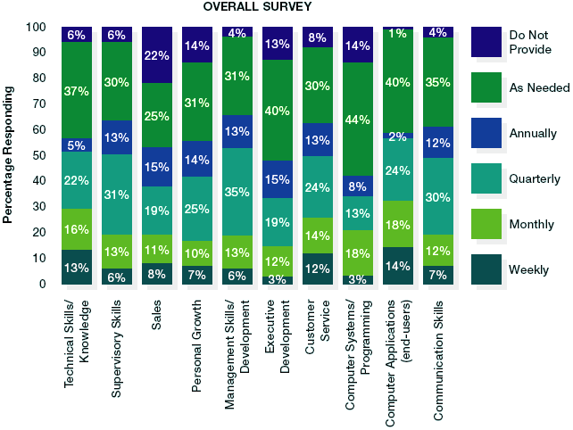
Use of the Types of Training
How Often the Types of Training Are Offered
Source: Tammy Galvin, “The Methods,” Training 38, no. 10 (October 2001): 48–56.
Figure 6.1

Slide 7
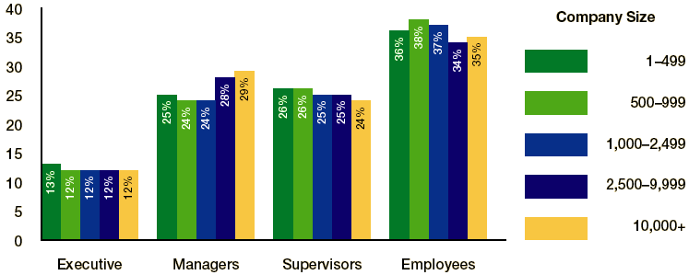
Training Dollars Spent On…
Source: Tammy Galvin, “The People,” Training 38, no. 10 (October 2001): 58–64.
Figure 6.2

Slide 8


The Systems Approach to Training and Development
Four Phases
  Needs assessment
  Program design
  Implementation
  Evaluation

Slide 9
Systems Model of Training
Phase 4:
Evaluation
________________
Reactions
Learning
Behavior transfer
Results
Phase 3:
Implementation
________________
On-the-job
methods
Off-the-job
methods
Management
development
Phase 2:
Design
________________
Instructional objectives
Trainee
readiness
Learning
principles
Phase 1:
Needs Assessment
________________
Organization analysis
Task analysis
Person analysis
Presentation Slide 6–2
Figure 6.3

Slide 10
Needs Assessment for Training
Competency assessment
  Analysis of the sets of skills and knowledge needed for decision-oriented and knowledge-intensive jobs.
ORGANIZATIONAL
ANALYSIS
TASK ANALYSIS
PERSON ANALYSIS
…of environment, strategies, and resources to determine where to emphasize training
…of the activities to be performed in order to determine the KSAs needed.
…of performance, knowledge, and skills in order to determine who needs training.
Presentation Slide 6–3
Figure 6.4

Slide 11

Phase 1: Conducting the Needs Assessment
Organization Analysis
  An examination of the environment, strategies, and resources of the organization to determine where training emphasis should be placed.
Task Analysis
  The process of determining what the content of a training program should be on the basis of a study of the tasks and duties involved in the job.
Person Analysis
  A determination of the specific individuals who need training.

Slide 12
Phase 2: Designing Training Programs
Issues in training design
Instructional objectives
Trainee readiness and motivation
Principles of learning
Characteristics of successful trainers
Notes:
5

Slide 13

Designing the Training Program
Instructional Objectives
  Represent the desired outcomes of a training program
    Performance-centered objectives
  Provide a basis for choosing methods
  and materials and for selecting
  the means for assessing
  whether the instruction
  will be successful.

Slide 14
Trainee Readiness and Motivation
Strategies for Creating a Motivated Training Environment:
  Use positive reinforcement.
  Eliminate threats and punishment.
  Be flexible.
  Have participants set personal goals.
  Design interesting instruction.
  Break down physical and psychological obstacles to learning.

Slide 15
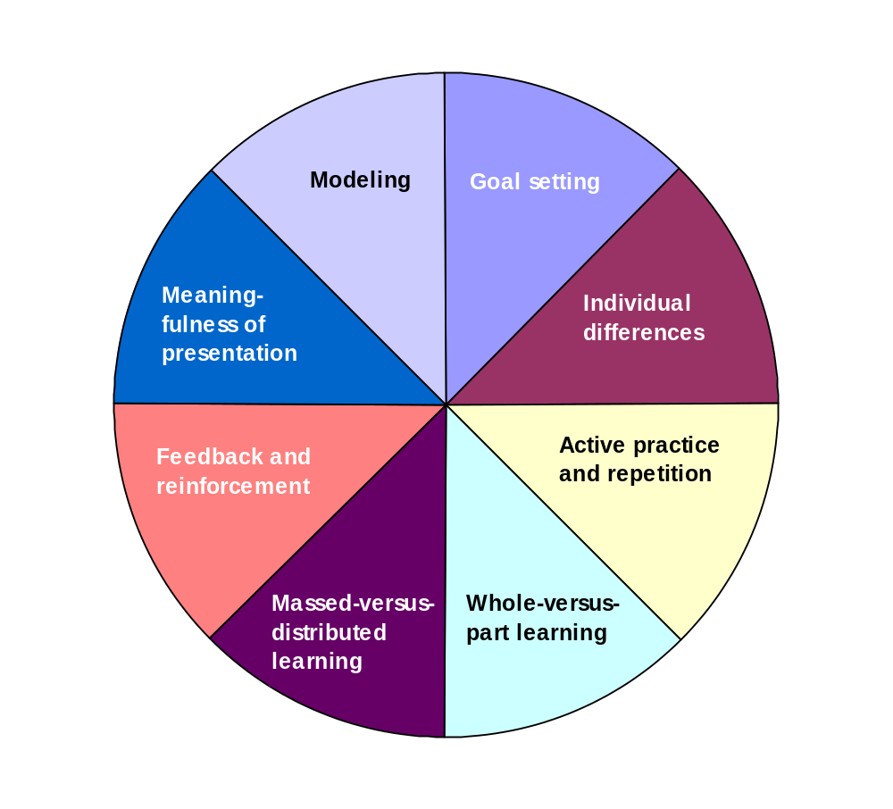

Principles of
Learning
PRINCIPLES OF LEARNING
Presentation Slide 6–4
Figure 6.5

Slide 16
Principles of Learning
Focus on learning and transfer
Goal setting - What’s the value?
Meaningfulness of presentation
Behavioral modeling
Recognition of individual learning differences
Notes:
5

Slide 17
Principles of Learning (cont’d)
Focus on method and process
Active practice and repetition
Whole versus-part learning
Massed-vs-distributed learning
Feedback and knowledge of progress (learning curve)
Notes:
5

Slide 18
A Typical Learning Curve
High
Performance
Plateau
Low
Time (weeks)
Figure 6.6
Presentation Slide 6–5

Slide 19

Feedback and Reinforcement
Behavior Modification
  The technique based on the principle that behavior that is rewarded, or positively reinforced, is repeated more frequently, whereas behavior that is penalized or unrewarded will decrease in frequency.

Slide 20

Characteristics of Successful Instructors
Knowledge of the subject
Adaptability
Sincerity
Sense of humor
Interest
Clear instructions
Individual assistance
Enthusiasm

Slide 21

Phase 3: Implementing the Training Program
Choosing the instructional method
Nature of training
Type of trainees
Organizational extent of training
Importance of training outcomes
Notes:
5

Slide 22

Training Methods for Nonmanagerial Employees
On-the-Job Training (OJT)
Apprenticeship Training
Cooperative Training, Internships, and Governmental Training
Classroom Instruction
Programmed Instruction
Audiovisual Methods
Computer-based Training and E-Learning
Simulation

Slide 23
Training Methods for Nonmanagerial Employees (cont’d)
On-the-job training (OJT)
  Method by which employees are given hands-on experience with instructions from their supervisor or other trainer.
Apprenticeship training
  System of training in which a worker entering the skilled trades is given thorough instruction and experience, both on and off the job, in the practical and theoretical aspects of the work.

Slide 24
Training Methods for Nonmanagerial Employees (cont’d)
Cooperative Training
  Training program that combines practical on-the-job experience with formal educational classes.
Internship Programs
  Programs jointly sponsored by colleges, universities, and other organizations that offer students the opportunity to gain real-life experience while allowing them to find out how they will perform in work organizations.

Slide 25
Training Methods for Nonmanagerial Employees (cont’d)
Vestibule Training
  A special type of classroom facility is used to give instruction in the operation of equipment like that found in operating departments
  The emphasis is on instruction rather than production.

Slide 26

Training Methods for Nonmanagerial Employees (cont’d)
Computer-assisted Instruction (CAI)
  A system that delivers instructional materials directly through a computer terminal in an interactive format.
Computer-managed Instruction (CMI)
  A system normally employed in
  conjunction with CAI that uses
  a computer to generate and
  score tests and to determine
  the level of training proficiency.

Slide 27
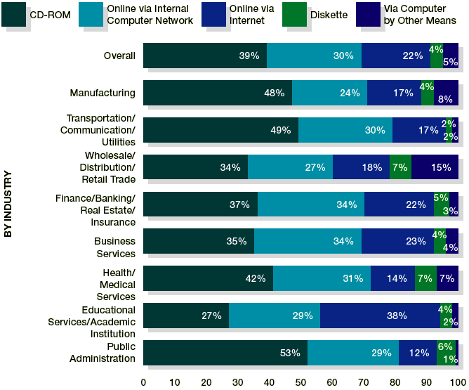
How Different Industries Use Technology For Training
HRM 7

Slide 28
Advantages of Web-based Training
Learning is self-paced.
Training comes to the employee.
Training is interactive.
New employees do not have to wait for a scheduled training session.
Training can focus on specific needs as revealed by built-in tests.
Trainees can be referred to online help or written material.

Slide 29
Advantages of Web-based Training (cont’d)
It is easier to revise a computer program than to change classroom-training materials.
Record keeping is facilitated.
The computer program can be linked to video presentations.
The training can be cost-effective if used for a large number of employees.

Slide 30
Training Methods for Management Development
On-the-Job Experiences
Seminars and Conferences
Case Studies
Management Games
Role Playing
Behavior Modeling

Slide 31
On-the-Job Experiences
Coaching
Understudy Assignment
Job Rotation
Lateral Transfer
Special Projects
Action Learning
Staff Meetings
Planned Career Progressions

Slide 32
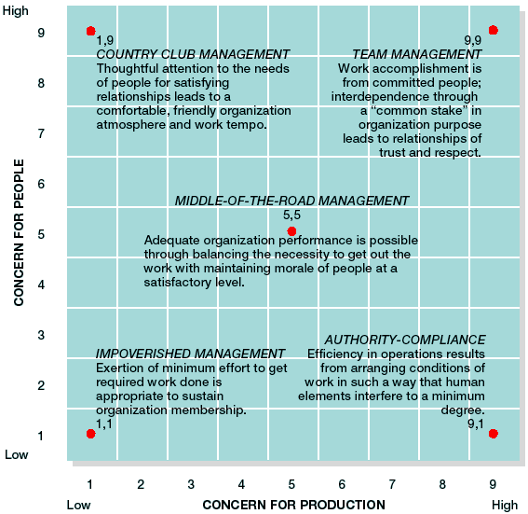
The
Leadership
Grid®
Figure 6.7
Source: Robert R. Blake and Anne Adams McCanse, Leadership Dilemmas—Grid Solutions (Houston: Gulf Publishing, 1991), 29. (First
published as The Managerial Grid Figure by Robert R. Blake and Jane S. Mouton.) Courtesy of Gulf Publishing Company, Houston, Texas, 800-231-6275. All rights reserved.

Slide 33
Case Studies
The use of case studies is most appropriate when:
  Analytic, problem-solving, and critical thinking skills are most important.
  The KSAs are complex and participants need time to master them.
  Active participation is desired.
  The process of learning (questioning, interpreting, and so on) is as important as the content.
  Team problem solving and interaction are possible.

Slide 34
Case Studies
When Using Case Studies…
  Be clear about learning objectives, and list possible ways to achieve the objectives.
  Decide which objectives would be best served by the case method.
  Identify available cases that might work, or consider writing your own.
  Set up the activity—including the case material, the room, and the schedule.
  Follow the principles of effective group dynamics.
Source: Adapted from Albert A. Einsiedel, Jr., “Case Studies: Indispensable Tools for Trainers,” Training and Development, August 1995, 50–53.
Figure 6.8a

Slide 35
Case Studies (cont’d)
When Using Case Studies…
  Provide a chance for all learners to take part and try to keep the groups small.
  Stop for process checks and be ready to intervene if group dynamics get out of hand.
  Allow for different learning styles.
  Clarify the trainer’s role.
  Bridge the gap between theory and practice.
Source: Adapted from Albert A. Einsiedel, Jr., “Case Studies: Indispensable Tools for Trainers,” Training and Development, August 1995, 50–53.
Figure 6.8b

Slide 36
Role Playing
Successful role play requires that instructors:
  Ensure that group members are comfortable with each other.
  Select and prepare the role players by introducing a specific situation.
  To help participants prepare, ask them to describe potential characters.
  Realize that volunteers make better role players.

Slide 37
Role Playing (cont’d)
Successful role play requires that instructors:
  Prepare the observers by giving them specific tasks (such as evaluation or feedback).
  Guide the role-play enactment through its bumps (since it is not scripted).
  Keep it short.
  Discuss the enactment and prepare bulleted points of what was learned.

Slide 38
Behavior Modeling
Behavior Modeling
  An approach that demonstrates desired behavior and gives trainees the chance to practice and role-play those behaviors and receive feedback.
  Involves four basic components:
    Learning points
    Model
    Practice and role play
    Feedback and reinforcement

Slide 39
Phase 4: Evaluating the Training Program
Results
Learning
Behavior
Criteria for
Evaluating
Training
Reactions
Figure 6.9

Slide 40

Training Program Evaluation
Measuring program effectiveness
Criterion 1: Trainee reactions
Criterion 2: Extent of learning
Criterion 3: Learning transfer to job
Criterion 4: Results assessment
Notes:
5

Slide 41
Criterion 1: Reactions
Participant Reactions.
  The simplest and most common approach to training evaluation is assessing trainees.
  Potential questions might include the following:
    What were your learning goals for this program? Did you achieve them?
    Did you like this program?
    Would you recommend it to others who have similar learning goals? What suggestions do you have for improving the program?
    Should the organization continue to offer it?

Slide 42
Criterion 2: Learning
Checking to see whether they actually learned anything.
  Testing knowledge and skills before beginning a training program gives a baseline standard on trainees that can be measured again after training to determine improvement.
  However, in addition to testing trainees, test employees who did not attend the training to estimate the differential effect of the training.

Slide 43
Criterion 3: Behavior
Transfer of Training
  Effective application of principles learned to what is required on the job.
Maximizing the Transfer of Training
  Feature identical elements
  Focus on general principles
  Establish a climate for transfer.
  Give employees transfer strategies

Slide 44
Criterion 4: Results
Utility of Training Programs.
  The benefits derived from training.
Return on Investment
  Viewing training in terms of the extent to which it provides knowledge and skills that create a competitive advantage and a culture that is ready for continuous change.

Slide 45
Criterion 4: Results (cont’d)
Benchmarking
  The process of measuring one’s own services and practices against the recognized leaders in order to identify areas for improvement.
  Plan: conduct a self-audit to identify areas for benchmarking.
  Do: collect data about activities.
  Check: Analyze data.
  Act: Establish goals, implement changes, monitor progress, and redefine benchmarks.

Slide 46
Special Training and Development Topics
Organization-wide training programs
New and old employee orientation
Basic skills education training
Teamwork training
Notes:
5

Slide 47
Special Topics in Training and Development
Orientation
  A formal process of familiarizing new employees with the organization, their jobs, and their work units.
Basic Skills Training
  Typical basic skills: Reading, writing, computing, speaking, listening, problem solving, managing oneself, knowing how to learn, working as part of a team, leading others.

Slide 48
Items for an Orientation Packet
Company history
Copy of specific job goals and descriptions
List of unique terms in the industry, company, and job
Organizational publications
Telephone numbers and locations of key personnel
Performance appraisal forms and procedures
List of on-the-job training opportunities
Safety and emergency procedures
Policy handbook
Current organization chart
Map of facility
Union contract
List of holidays
List of employee benefits
Sources of information
Insurance plans
Figure 6.10

Slide 49
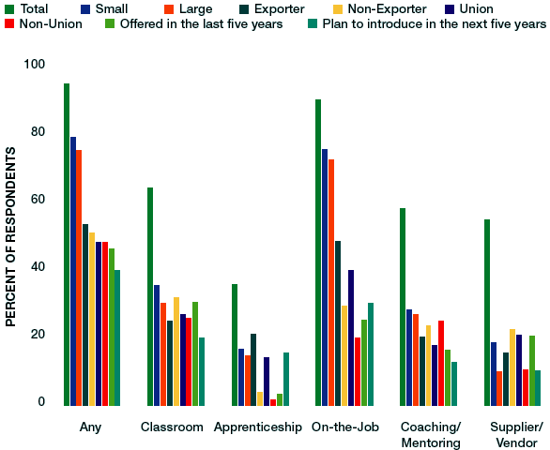
Remedial Programs in the Workplace
Source: Scott Hayes, “The ABCs of Workplace Literacy,” Workforce 78, no. 4 (April 1999): 70–74. Used with permission of the Manufacturing Institute’s Center for Workforce Success.
Figure 6.11

Slide 50
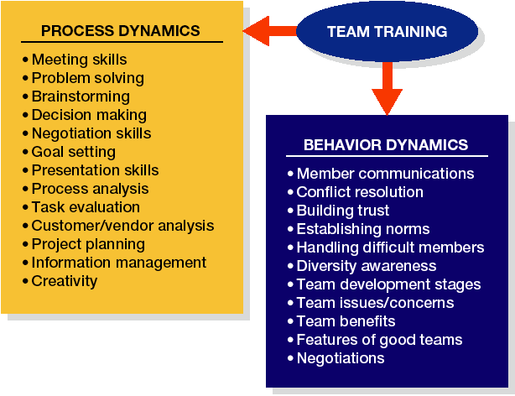
Team Training Skills
Source: George Bohlander and Kathy McCarthy, “How to Get the Most from Team Training,” National Productivity Review, Autumn 1996, 25–35.
Figure 6.12

Slide 51
Special Training and Development Topics
Organization-wide training programs
Diversity training
Crisis prevention training
Global training
Notes:
5

