Slide 1
Training and Developing Employees

Slide 2

After studying this chapter, you should be able to:
Describe the basic training process.
Describe and illustrate how you would go about identifying training requirements.
Explain how to distinguish between problems you can fix with training and those you can’t.
Explain how to use five training techniques.
8–<number>
<footer>© 2005 Prentice Hall Inc. All rights reserved.

Slide 3
Orienting Employees
Employee orientation
  A procedure for providing new employees with basic background information about the firm.
Orientation content
  Information on employee benefits
  Personnel policies
  The daily routine
  Company organization and operations
  Safety measures and regulations
  Facilities tour

Slide 4
Orienting Employees (cont’d)
A successful orientation should accomplish four things for new employees:
  Make them feel welcome and at ease.
  Help them understand the organization in a broad sense.
  Make clear to them what is expected in terms of work and behavior.
  Help them begin the process of becoming socialized into the firm’s ways of acting and doing things.

Slide 5
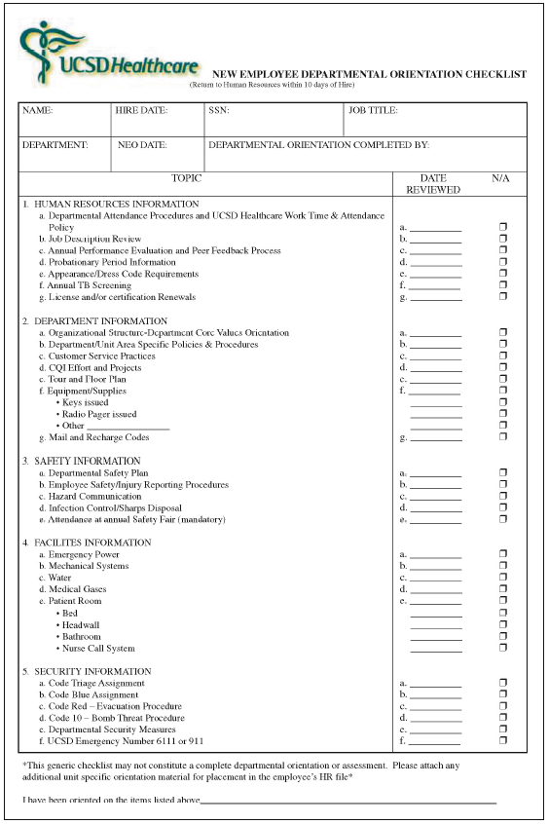
New Employee Departmental Orientation Checklist
Source: UCSD Healthcare. Used with permission.
Figure 8–1

Slide 6
The Training Process
Training
  The process of teaching new employees the basic skills they need to perform their jobs.
The strategic context of training
  Performance management: the process employers use to make sure employees are working toward organizational goals.
    Web-based training
    Distance learning-based training
    Cross-cultural diversity training

Slide 7
The Training and Development Process
Needs analysis
  Identify job performance skills needed, assess prospective trainees skills, and develop objectives.
Instructional design
  Produce the training program content, including workbooks, exercises, and activities.
Validation
  Presenting (trying out) the training to a small representative audience.
Implement the program
  Actually training the targeted employee group.
Evaluation
  Assesses the program’s successes or failures.

Slide 8
Make the Learning Meaningful
At the start of training, provide a bird’s-eye view of the material to be presented to facilitates learning.
Use a variety of familiar examples.
Organize the information so you can present it logically, and in meaningful units.
Use terms and concepts that are already familiar to trainees.
Use as many visual aids as possible.

Slide 9
Make Skills Transfer Easy
Maximize the similarity between the training situation and the work situation.
Provide adequate practice.
Label or identify each feature of the machine and/or step in the process.
Direct the trainees’ attention to important aspects of the job.
Provide “heads-up” preparatory information that lets trainees know they might happen back on the job.

Slide 10
Motivate the Learner
People learn best by doing so provide as much realistic practice as possible.
Trainees learn best when the trainers immediately reinforce correct responses
Trainees learn best at their own pace.
Create a perceived training need in the trainees’ minds.
The schedule is important too: The learning curve goes down late in the day, less than full day training is most effective.

Slide 11
Analyzing Training Needs
Task analysis
  A detailed study of a job to identify the specific skills required, especially for new employees.
Performance analysis
  Verifying that there is a performance deficiency and determining whether that deficiency should be corrected through training or through some other means (such as transferring the employee).

Slide 12
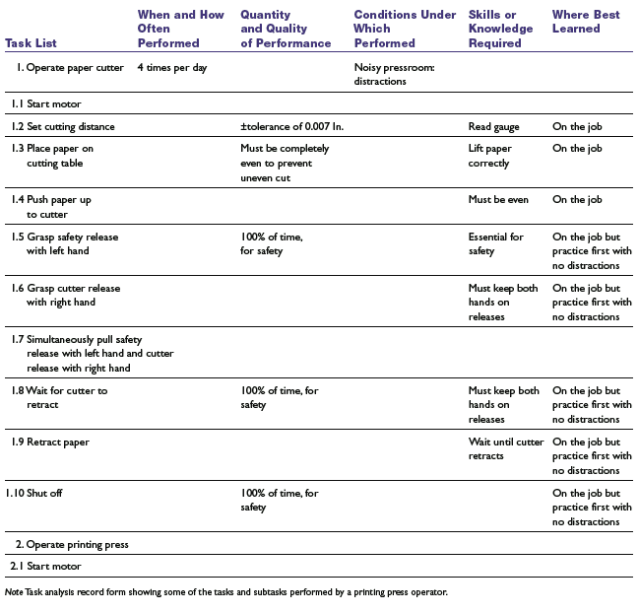
Task Analysis Record Form
Table 8–1

Slide 13
Training Methods
On-the-job training (OJT)
  Having a person learn a job by actually doing the job.
OJT methods
  Coaching or understudy
  Job rotation
  Special assignments
Advantages
  Inexpensive
  Immediate feedback

Slide 14
Steps in OJT
Step 1: Prepare the learner
  Put the learner at ease—relieve the tension.
  Explain why he or she is being taught.
  Create interest, encourage questions, find out what the learner already knows about this or other jobs.
  Explain the whole job and relate it to some job the worker already knows.
  Place the learner as close to the normal working position as possible.
  Familiarize the worker with equipment, materials, tools, and trade terms.

Slide 15
Steps in OJT (cont’d)
Step 2: Present the operation
  Explain quantity and quality requirements.
  Go through the job at the normal work pace.
  Go through the job at a slow pace several times, explaining each step. Between operations, explain the difficult parts, or those in which errors are likely to be made.
  Again go through the job at a slow pace several times; explain the key points.
  Have the learner explain the steps as you go through the job at a slow pace.

Slide 16
Steps in OJT (cont’d)
Step 3: Do a tryout
  Have the learner go through the job several times, slowly, explaining each step to you.
  Correct mistakes and, if necessary, do some of the complicated steps the first few times.
  Run the job at the normal pace.
  Have the learner do the job, gradually building up skill and speed.
  As soon as the learner demonstrates ability to do the job, let the work begin, but don’t abandon him or her.

Slide 17
Steps in OJT (cont’d)
Step 4: Follow up
  Designate to whom the learner should go for help.
  Gradually decrease supervision, checking work from time to time against quality and quantity standards.
  Correct faulty work patterns before they become a habit. Show why the learned method is superior.
  Compliment good work; encourage the worker until he or she is able to meet the quality and quantity standards.

Slide 18
Training Methods (cont’d)
Apprenticeship training
  A structured process by which people become skilled workers through a combination of classroom instruction and on-the-job training.
Informal learning
  The majority of what employees learn on the job they learn through informal means of performing their jobs on a daily basis.
Job instruction training (JIT)
  Listing each job’s basic tasks, along with key points, in order to provide step-by-step training for employees.

Slide 19
The 25 Most Popular Apprenticeships
According to the U.S. Department of Labor apprenticeship database, the occupations listed below had the highest numbers of apprentices in 2001. These findings are approximate because the database includes only about 70% of registered apprenticeship programs—and none of the unregistered ones.
• Boilermaker
• Bricklayer (construction)
• Carpenter
• Construction craft laborer
• Cook (any industry)
• Cook (hotel and restaurant)
• Correction officer
• Electrician
• Electrician (aircraft)
• Electrician (maintenance)
• Electronics mechanic
• Firefighter
• Machinist
• Maintenance mechanic (any industry)
• Millwright
• Operating engineer
• Painter (construction)
• Pipefitter (construction)
• Plumber
• Power plant operator
• Roofer
• Sheet-metal worker
• Structural-steel worker
• Telecommunications technician
• Tool and die maker
Source: Olivia Crosby, “Apprenticeships,” Occupational Outlook Quarterly, 46, no. 2 (Summer 2002), p. 5.
Figure 8–2

Slide 20
Training Methods (cont’d)
Effective lectures
  Use signals to help listeners follow your ideas.
  Don’t start out on the wrong foot.
  Keep your conclusions short.
  Be alert to your audience.
  Maintain eye contact with the trainees.
  Make sure everyone in the room can hear.
  Control your hands.
  Talk from notes rather than from a script.
  Break a long talk into a series of five-minute talks.

Slide 21
Programmed Learning
Programmed instruction (PI)
  A systematic method for teaching job skills involving:
    Presenting questions or facts
    Allowing the person to respond
    Giving the learner immediate feedback on the accuracy of his or her answers
Advantages
  Reduced training time
  Self-paced learning
  Immediate feedback
  Reduced risk of error for learner

Slide 22
Training Methods (cont’d)
Literacy training techniques
  Responses to functional illiteracy
    Testing job candidates’ basic skills.
    Setting up basic skills and literacy programs.
Audiovisual-based training
  To illustrate following a sequence over time.
  To expose trainees to events not easily demonstrable in live lectures.
  To meet the need for organizationwide training and it is too costly to move the trainers from place to place.

Slide 23
Training Methods (cont’d)
Simulated training (occasionally called vestibule training)
  Training employees on special off-the-job equipment so training costs and hazards can be reduced.
  Computer-based training (CBT)
  Electronic performance support systems (EPSS)
  Learning portals

Slide 24
Computer-based Training (CBT)
Advantages
  Reduced learning time
  Cost-effectiveness
  Instructional consistency
Types of CBT
  Intelligent Tutoring systems
  Interactive multimedia training
  Virtual reality training

Slide 25
Distance and Internet-Based Training
Teletraining
  A trainer in a central location teaches groups of employees at remote locations via TV hookups.
Videoconferencing
  Interactively training employees who are geographically separated from each other—or from the trainer—via a combination of audio and visual equipment.
Training via the Internet
  Using the Internet or proprietary internal intranets to facilitate computer-based training.

Slide 26
What Is Management Development?
Management development
  Any attempt to improve current or future management performance by imparting knowledge, changing attitudes, or increasing skills.
Succession planning
  A process through which senior-level openings are planned for and eventually filled.
    Anticipate management needs
    Review firm’s management skills inventory
    Create replacement charts
    Begin management development

Slide 27
Managerial on-the-Job Training
Job rotation
  Moving a trainee from department to department to broaden his or her experience and identify strong and weak points.
Coaching/Understudy approach
  The trainee works directly with a senior manager or with the person he or she is to replace; the latter is responsible for the trainee’s coaching.
Action learning
  Management trainees are allowed to work full-time analyzing and solving problems in other departments.

Slide 28
Off-the-Job Management Training and Development Techniques
Case study method
  Managers are presented with a description of an organizational problem to diagnose and solve.
Management game
  Teams of managers compete by making computerized decisions regarding realistic but simulated situations.
Outside seminars
  Many companies and universities offer Web-based and traditional management development seminars and conferences.

Slide 29
Off-the-Job Management Training and Development Techniques (cont’d)
Role playing
  Creating a realistic situation in which trainees assume the roles of persons in that situation.
Behavior modeling
  Modeling: showing trainees the right (or “model”) way of doing something.
  Role playing: having trainees practice that way
  Social reinforcement: giving feedback on the trainees’ performance.
  Transfer of learning: Encouraging trainees apply their skills on the job.

Slide 30
Off-the-Job Management Training and Development Techniques (cont’d)
Corporate universities
  Provides a means for conveniently coordinating all the company’s training efforts and delivering Web-based modules that cover topics from strategic management to mentoring.
In-house development centers
  A company-based method for exposing prospective managers to realistic exercises to develop improved management skills.

Slide 31
Off-the-Job Management Training and Development Techniques (cont’d)
Executive coaches
  An outside consultant who questions the executive’s boss, peers, subordinates, and (sometimes) family in order to identify the executive’s strengths and weaknesses.
  Counsels the executive so he or she can capitalize on those strengths and overcome the weaknesses.

Slide 32
Managing Organizational Change and Development
What to change?
  Strategy: mission and vision
  Culture: new corporate values
  Structure: departmental structure, coordination, span of control, reporting relationships, tasks, decision-making procedures
  Technologies: new systems and methods
  Employees: changes in employee attitudes and skills

Slide 33
Overcoming Resistance to Change
What causes resistance?
  All behavior in organizations is a product of two kinds of forces—those striving to maintain the status quo and those pushing for change.
Lewin’s Change Process
  Unfreezing: reducing the forces striving to maintain the status quo.
  Moving: developing new behaviors, values, and attitudes, sometimes through structural changes.
  Refreezing: reinforcing the changes.

Slide 34
Overcoming Resistance to Change
Change initiatives
  Political campaign: creating a coalition strong enough to support and guide the initiative.
  Marketing campaign: tapping into employees’ thoughts and feelings and also effectively communicating messages about the prospective program’s theme and benefits.
  Military campaign: Deploying executives’ scarce resources of attention and time to actually carry out the change.

Slide 35
How to Lead the Change (in 10 Steps)
Establish a sense of urgency.
Mobilize commitment through joint diagnosis of problems.
Create a guiding coalition.
Develop a shared vision.
Communicate the vision.
Help employees to make the change.
Generate short-term wins.
Consolidate gains and produce more change.
Anchor the new ways of doing things in the company’s culture.
Monitor progress and adjust the vision as required.

Slide 36
Using Organizational Development
Organizational development (OD)
  A special approach to organizational change in which employees themselves formulate and implement the change that’s required.
    Usually involves action research.
    Applies behavioral science knowledge.
    Changes the attitudes, values, and beliefs of employees.
    Changes the organization in a particular direction.

Slide 37
Examples of OD Interventions
Human Process
  T-groups
  Process consultation
  Third-party intervention
  Team building
  Organizational confrontation meeting
  Intergroup relations
Technostructural
  Formal structural change
  Differentiation and integration
  Cooperative union–management projects
  Quality circles
  Total quality management
  Work design
Human Resource Management
  Goal setting
  Performance appraisal
  Reward systems
  Career planning and development
  Managing workforce diversity
  Employee wellness
Strategic
  Integrated strategic management
  Culture change
  Strategic change
  Self-designing organizations
Table 8–3

Slide 38
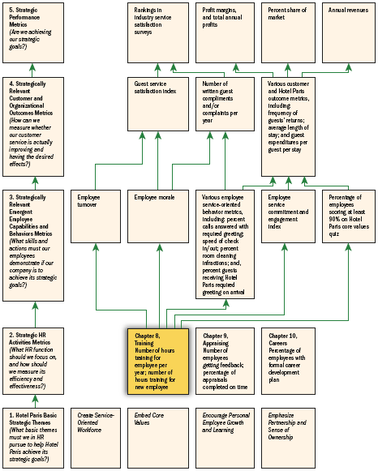
HR Scorecard for Hotel Paris International Corporation*
Note: *(An abbreviated example showing selected HR practices and outcomes aimed at implementing the competitive strategy, “To use superior guest services to differentiate the Hotel Paris properties and thus increase the length of stays and the return rate of guests and thus boost revenues and profitability”)
Figure 8–4

Slide 39
Evaluating the Training Effort
Designing the study
  Time series design
  Controlled experimentation
Training effects to measure
  Reaction of trainees to the program
  Learning that actually took place
  Behavior that changed on the job
  Results that were achieved as a result of the training

Slide 40
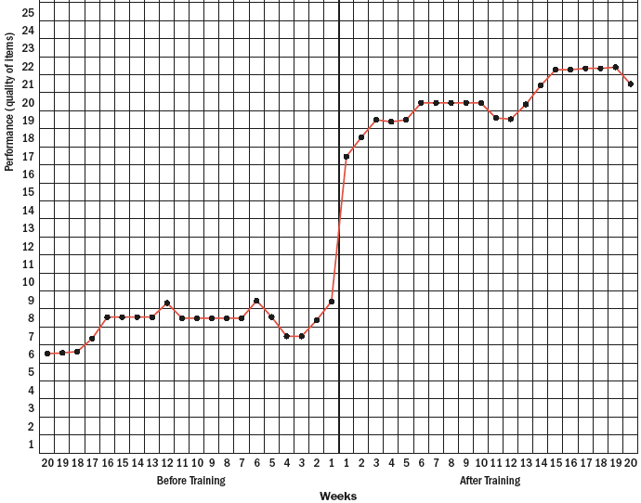
Time Series Training Evaluation Design
Figure 8–5

Slide 41
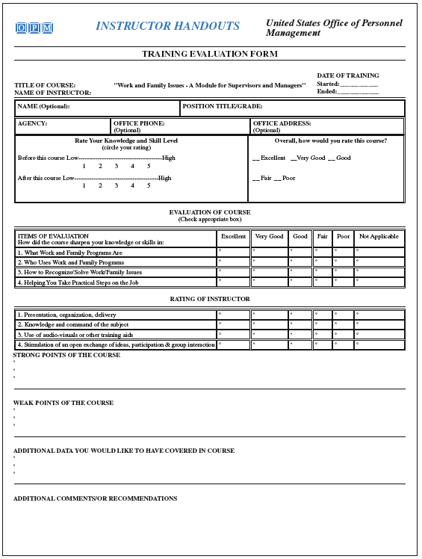
A Sample Training Evaluation Form
Source: www.opm.gov/wrkfam/.
Figure 8–6

Slide 42
Key Terms
employee orientation
training
performance management
negligent training
task analysis
performance analysis
on-the-job training
apprenticeship training
job instruction training (JIT)
programmed learning
simulated training
job aid
electronic performance support systems (EPSS)
management development
succession planning
job rotation
action learning
case study method
management game
role playing
behavior modeling
in-house development center
outsourced learning
organizational development
controlled experimentation

