Slide 2
Objectives
After studying this chapter, you should be able to:
Explain how a career development program integrates individual and organizational needs.
Describe the conditions that help make a career development program successful.
Discuss how job opportunities can be inventoried and employee potential assessed.
Compare the methods used for identifying and developing managerial talent.
Cite the ways in which employers can facilitate the career development of women.

Slide 3
Objectives (cont’d)
After studying this chapter, you should be able to:
Discuss the ways in which employers can facilitate the career development of members of minority groups and of dual-career couples.
Describe the various aspects of personal career development that one should consider.

Slide 4
Career Development: Creating Favorable Conditions
Management Participation
  Provide top management support
  Provide collaboration between line managers and HR managers
  Train management personnel
Setting Goals
  Plan human resources strategy
Changing HR Policies
  Provide for job rotation
  Provide outplacement service
Announcing the Program
  Explain its philosophy
Presentation Slide 7–1

Slide 5
Career Development: Determining Employee Potential
Career Planning Workbooks
  Stimulate thinking about careers, strengths/limitations, development needs
Career Planning Workshops
  Discuss and compare attitudes, concerns, plans
Career Counseling
  Discuss job, career interests, goals
Presentation Slide 7–2

Slide 6

HR’s Role in Career Development
THE GOAL: MATCH INDIVIDUAL AND ORGANIZATION NEEDS
---------------------------------
The Goal: Matching
Encourage employee ownership of career.
Create a supportive context.
Communicate direction of company.
Establish mutual goal setting and planning
IDENTIFY CAREER OPPORTUNITIES AND REQUIREMENTS
---------------------------------
Opportunities & Requirements
Identify future competency needs.
Establish job progressions/career paths.
Balance promotions, transfers, exits, etc.
Establish dual career paths.
1
2
INSTITUTE CAREER DEVELOPMENT INITIATIVES
------------------------------------
Career Development Initiatives
Provide workbooks and workshops.
Provide career counseling.
Provide career self-management training.
Give developmental feedback.
Provide mentoring.
GAUGE
EMPLOYEE
POTENTIAL
---------------------------------
Gauge Employee Potential
Measure competencies (appraisals).
Establish talent inventories.
Establish succession plans.
Use assessment centers.
4
3
Figure 7.1
Presentation Slide 7–3

Slide 7

The Goal: Matching Individual and Organizational Needs
The Employee’s Role
The Organization’s Role: Establishing a Favorable Context
Blending Individual and Organizational Goals

Slide 8
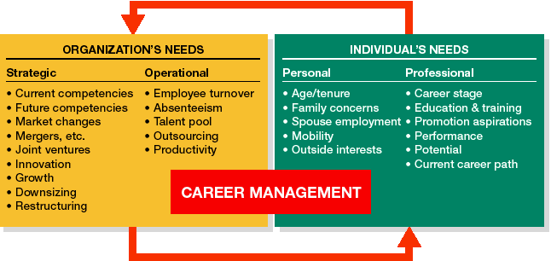
Balancing Individual and Organizational Needs
Figure 7.2

Slide 9

Identifying Career Opportunities and Requirements
Competency Analysis
  Measures three basic competencies for each job: know-how, problem solving, and accountability.
Job Progressions
  The hierarchy of jobs a new employee might experience, ranging from a starting job to jobs that require more knowledge and/or skill.
Career Paths
  Lines of advancement in an occupational field within an organization.

Slide 10
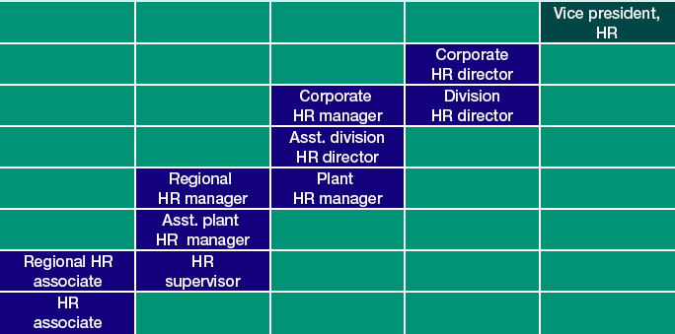
Typical Line of Advancement in HR Management
Figure 7.3

Slide 11
Career Path Of Colin Powell
1954 Joins ROTC program
1957 Enrolls in City College of New York 1963 Tour of duty in Vietnam
1968 Graduates from U.S. Army Command and General Staff College (CGSC)
1971 Graduate School at the George Washington University
1972 White House Fellow under President Richard Nixon
1974 Commander of 1st Battalion, 32nd Infantry in Korea
1977 Colonel, Commander of 2nd Brigade, 101st Infantry
1978 Works in Office of Secretary of Defense under President Jimmy Carter
1982 Brigadier General, Commander of 4th Infantry Division
1982 Deputy Commanding General of Combined Arms Combat Developments Activity
1987 National Security Advisor under President Ronald Reagan
1989 Chairman, Joint Chiefs of Staff under President George Bush
1992 Approached to be Bill Clinton’s vice presidential running mate (declined)
1993 Chairman, Joint Chiefs of Staff under President Bill Clinton
1993 Retired from military service
2000 Secretary of State under President George W. Bush
HRM 1

Slide 12
Career Changes
Promotion
  A change of assignment to a job at a higher level in the organization.
  Principal criteria for determining promotions are merit, seniority, and potential.
Transfer
  The placement of an individual in another job for which the duties, responsibilities, status, and remuneration are approximately equal to those of the previous job.

Slide 13
Career Change Organizational Assistance
Relocation services
  Services provided to an employee who is transferred to a new location:
    Help in moving, in selling a home, in orienting to a new culture, and/or in learning a new language.
Outplacement services
  Services provided by organizations to help terminated employees find a new job.

Slide 14
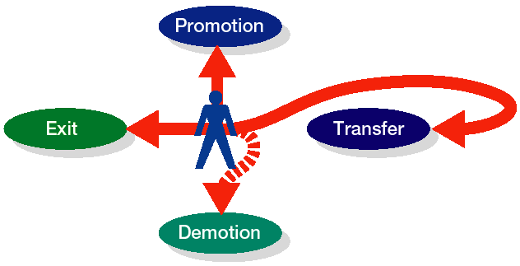
Alternative Career Moves
Figure 7.4

Slide 15
Dual Career Tracks: Xenova System
Scientist
Senior Scientist
Section Leader
Research Associate
Department Head
Principal Scientist
Source: Adapted from Alan Garmonsway of Xenova and Michael Wellin of Behavioral Transformation, “Creating the Right Natural Chemistry,” People Management 1, no. 19 (September 21, 1995): 36–39.
HRM 2

Slide 16
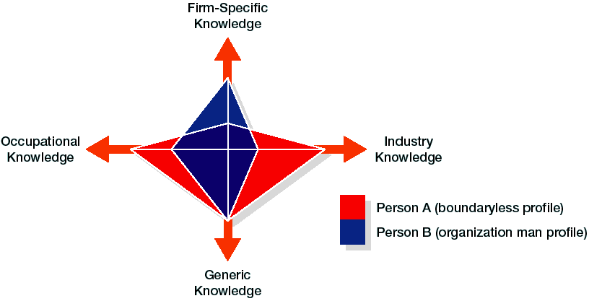
Human Capital Profiles for Two Different Careers
Source: Scott Snell, Cornell University.
Figure 7.5

Slide 17

Using Assessment Centers
Assessment Center
  A process by which individuals are evaluated as they participate in a series of situations that resemble what they might be called upon to handle on the job.
  In-basket training
    A process for evaluating trainees by simulating a real-life work situation
  Leaderless group discussions
    A process that places trainees in a conference setting to discuss an assigned topic, either with or without designated group roles

Slide 18
Successful Career-Management Practices
Placing clear expectations on employees.
Giving employees the opportunity for transfer.
Providing a clear and thorough succession plan
Encouraging performance through rewards and recognition.
Giving employees the time and resources they need to consider short- and long-term career goals.
Encouraging employees to continually assess their skills and career direction.

Slide 19
Internal Barriers to Career Advancement
Lack of time, budgets, and resources for employees to plan their careers and to undertake training and development.
Rigid job specifications, lack of leadership support for career management, and a short-term focus.
Lack of career opportunities and pathways within the organization for employees.

Slide 20
Career Development Initiatives
Career Planning Workbooks
Career Planning Workshops
Career Counseling
  The process of discussing with employees their current job activities and performance, their personal and career interests and goals, their personal skills, and suitable career development objectives.

Slide 21
Individualized Career Development
Fast-track Program
  A program that encourages young managers with high potential to remain with an organization by enabling them to advance more rapidly than those with less potential.
Career Self-Management Training
  Helping employees learn to continuously gather feedback and information about their careers.
  Encouraging them to prepare for mobility.

Slide 22
Mentoring
Mentors
  Executives who coach, advise, and encourage individuals of lesser rank.
Mentoring functions
  Functions concerned with the career advancement and psychological aspects of the person being mentored.

Slide 23
Top Ten Myths about Mentors
Mentors exist only for career development.
You need only one mentor.
Mentoring is a one-way process.
A mentor has to be older than the protégé.
A mentor has to be the same gender and race as the protégé.
Mentor relationships just happen.
Highly profiled people make the best mentors.
Once a mentor, always a mentor.
Mentoring is a complicated process.
Mentor-protégé expectations are the same for everyone.
Figure 7.6

Slide 24
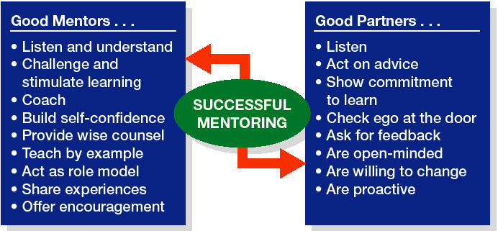
Mentoring Functions
Source: Matt Starcevich, Ph.D. and Fred Friend, “Effective Mentoring Relationships from the Mentee’s Perspective,” Workforce, supplement (July 1999): 2–3. Used with permission of the Center for Coaching and Mentoring, Inc., http://coachingandmentoring.com/.
Figure 7.7

Slide 25

Forming a Mentoring Relationship
Research the mentor’s background.
Make contact with the mentor.
Request help on a particular matter.
Consider what you can offer in exchange.
Arrange a meeting.
Follow up.
Ask to meet on an
ongoing basis.

Slide 26
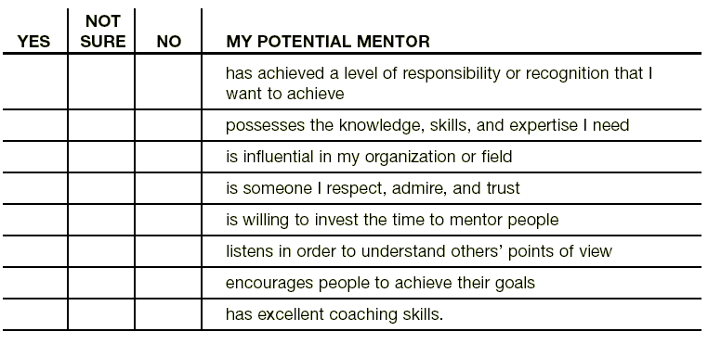
Mentor Checklist
Source: Excerpted with permission of the publisher from Connecting with Success: How to Build Your Mentoring Network to Fast-Forward Your Career, by Kathleen Barton; Davis-Black Publishing, 800.624.1765.
HRM 5

Slide 27
Career Networking Contacts
Your college alumni association or career office networking lists
Your own extended family
Your friends’ parents and other family members
Your professors, advisors, coaches, tutors, clergy
Your former bosses and your friends’ and family members’ bosses
Members of clubs, religious groups, and other organizations to which you belong
All of the organizations near where you live or go to school

Slide 28

Career Development for Women
The “Glass Ceiling”
  Artificial barriers based on attitudinal or organizational bias that prevent qualified women from advancing upward in their organizations into management level positions.
Eliminating Barriers to Advancement
  Development of women’s networks
  Online e-mentoring for women
  Diminishing stereotyping of women
  Presence of women in significant managerial positions

Slide 29
Glass-Ceiling Audits
Glass ceiling audit factors:
  Upper-level management and executive training
  Rotational assignments International assignments
  Opportunities for promotion
  Opportunities for executive development programs at universities
  Desirable compensation packages
  Opportunities to participate on high-profile project teams
  Upper-level special assignments

Slide 30
The Top Ten Highest-Paid Women in America
ANNUAL LONG-TERM 2000
RANK EXECUTIVE NAME/TITLE/COMPANY NAME COMP. COMP. COMP.
MILLIONS
1. HEATHER KILLEN, Senior VP, Yahoo! $0.3 $32.5 $32.7
2. DAWN G. LEPORE, Vice-Chmn., Exec. VP & CIO, Charles Schwab 2.1 20.2 22.3
3. M. ZITA COBB, Executive VP, JDS Uniphase 0.4 18.3 18.7
4. SUSAN D. DESMOND-HELLMANN, Executive VP, Genentech 0.9 15.2 16.1
5. TERRI A. DIAL, Group Executive VP, Wells Fargo 2.0 10.7 12.8
6. JANICE M. ROBERTS, Senior VP, 3Com 0.5 11.7 12.2
7. LOIS D. JULIBER, COO, Colgate-Palmolive 1.6 10.6 12.2
8. DONNA S. BINKS, Executive VP & CFO, Adaptive Broadband 0.5 10.0 10.4
9. DEBORAH C. HOPKINS, Executive VP & CFO, Lucent Technologies 5.2 4.3 9.5
10. LESLIE C. TORTORA, CIO, Goldman Sachs Group 7.5 1.9 9.4
Data: Execucomp, provided by Standard & Poor’s Institutional Market Services, a division of the McGraw-Hill Companies
Source: Louis Lavelle, “For Female CEOs, It’s Stingy at the Top,” Business Week (April 23, 2001).
Figure 7.8

Slide 31

Career Development for Minorities
Career development for minorities is advanced by:
  Organizational support for the advancement of minorities to significant management positions
  Provision of internships to attract minorities to management careers
  Organization of training courses to foster the development of minority’s managerial skills and knowledge.

Slide 32
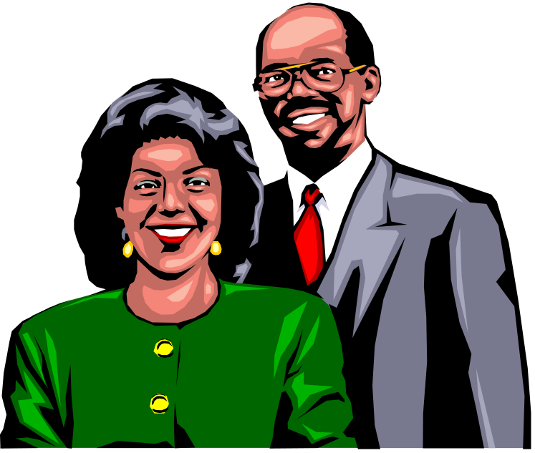
Dual-Career Couples
Dual-Career Partnerships
  Couples in which both members follow their own careers and actively support each other’s career development.
    Flexible work schedules
    Adaptive leave policies
    Work-at-home
    On-premises day care
    Job sharing

Slide 33

Stages of Career Development
Stage 5: Late Career (ages 55–retirement):
Remain productive in work, maintain self-esteem, prepare for effective retirement.
Stage 4: Midcareer (ages 40–55):
Reappraise early career and early adulthood goals, reaffirm or modify goals, make choices appropriate to middle adult years, remain productive.
Stage 3: Early Career (ages 25–40):
Learn job, learn organizational rules and norms, fit into chosen occupation and organization, increase competence, pursue goals.
Stage 2: Organizational Entry (ages 18–25):
Obtain job offer(s) from desired organization(s), select appropriate job based on complete and accurate information.
Stage 1: Preparation for Work (ages 0–25):
Develop occupational self-image, assess alternative occupations, develop initial occupational choice, pursue necessary education.
Figure 7.9
Presentation Slide 7–4

Slide 34
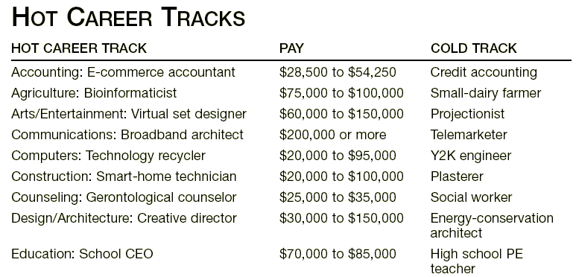
Source: Mindy Charski, “Have We Got a Job for You: Move Over, Nostradamus. Here’s the Help-Wanted Dope,” U.S. News & World Report 127, no. 17 (1999): 93–102. See also Justin Ewers, “The New Hot Jobs on Campus,” U.S. News & World Report 133, no. 12 (2002): 96.
HRM 8

Slide 35
CISS Orientation and Basic Scales
Influencing
  Leadership, law/politics, public speaking, sales, advertising
Organizing
  Supervision, financial services, office practices
Analyzing
  Mathematics, science
Helping
  Adult development, counseling, child development, religious activities, medical practice
Creating
  Art/design, performing arts, writing, international activities, fashion, culinary arts
Producing
  Mechanical crafts, wood-working, farming/forestry, Plants/gardens, animal care
Adventuring
  Athletics/physical fitness, military/law enforcement, risks/adventure
Source: ©1992 David Campbell, Ph.D. All rights reserved. Published and distributed by NCS Assessments, P.O. Box 1416 Minneapolis, MN 55440. Reproduced with permission. “Campbell Interest and Skill Survey” and “CISS” are both registered trademarks of David Campbell, Ph.D.
Presentation Slide 7–5

Slide 36
Combinations of Career Interests and Skills
High
Explore
Pursue
SKILLS
Avoid
Develop
Low
Low
High
INTERESTS
Figure 7.10
Presentation Slide 7–6

Slide 37
The Plateauing Trap
Career Plateau
  Situation in which for either organizational or personal reasons the probability of moving up the career ladder is low.
Types of Plateaus
  Structural plateau: end of advancement
  Content plateau: lack of challenge
  Life plateau: crisis of personal identity

Slide 38
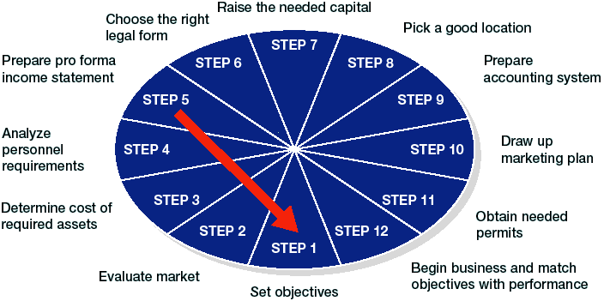
Twelve Steps for Starting a New Business
Source: From Business in a Changing World, 3rd edition, by W. Cunningham, R. Aldag, and S. Block: 139 © 1993. Reprinted with permission of South-Western College Publishing, a division of Thomson Learning. Fax 800-730-2215.
Figure 7.12

Slide 39

Keeping a Career in Perspective
Maintaining Off-the-Job Interests
Having a Healthy Marital and/or Family Life
Planning for Retirement
Maintaining a Healthy Balance

