Slide 1
Managing Careers

Slide 2

After studying this chapter, you should be able to:
Compare employers’ traditional and career planning-oriented HR focuses
Explain the employee’s manager’s and employer’s career development roles
Describe the issues to consider when making promotion decisions
Describe the methods for enhancing diversity through career management
Answer the question: How can career development foster employee commitment?
10–<number>
<footer>© 2005 Prentice Hall Inc. All rights reserved.

Slide 3
The Basics of Career Management
Career
  The occupational positions a person has had over many years.
Career management
  The process for enabling employees to better understand and develop their career skills and interests, and to use these skills and interests more effectively.
Career development
  The lifelong series of activities that contribute to a person’s career exploration, establishment, success, and fulfillment.

Slide 4
The Basics of Career Management
Career planning
  The deliberate process through which someone becomes aware of personal skills, interests, knowledge, motivations, and other characteristics; and establishes action plans to attain specific goals.
Careers today
  Careers are no simple progressions of employment in one or two firms with a single profession.
  Employees now want to exchange performance for training, learning, and development that keep them marketable.

Slide 5
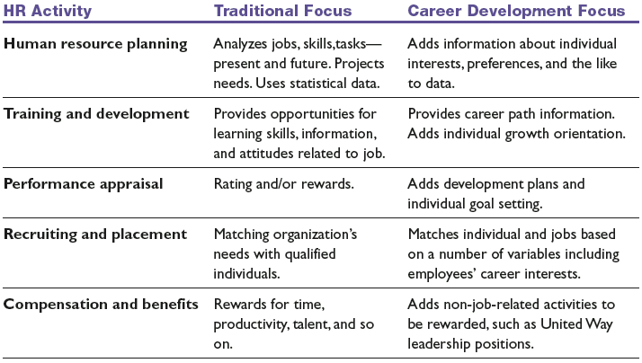
Traditional Versus Career Development Focus
Source: Adapted from Fred L. Otte and Peggy G. Hutcheson, Helping Employees Manage Careers (Upper Saddle River, NJ: Prentice Hall, 1992), p. 10.
Table 10–1

Slide 6
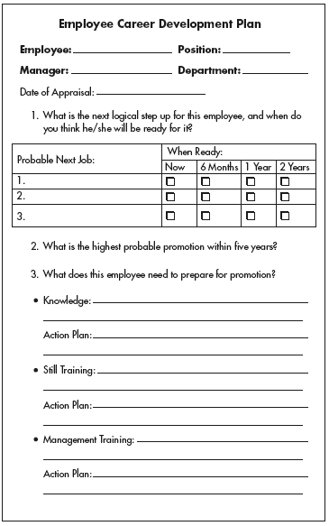
Employee Career Development Plan
Source: Reprinted with permission of the publisher, HRnext.com Copyright HRnext.com, 2003.
Figure 10–1

Slide 7
Roles in Career Development
The Individual
  • Accept responsibility for your own career.
  • Assess your interests, skills, and values.
  • Seek out career information and resources.
  • Establish goals and career plans.
  • Utilize development opportunities.
  • Talk with your manager about your career.
  • Follow through on realistic career plans.
The Manager
  • Provide timely performance feedback.
  • Provide developmental assignments and support.
  • Participate in career development discussions.
  • Support employee development plans.
The Organization
  • Communicate mission, policies, and procedures.
  • Provide training and development opportunities.
  • Provide career information and career programs.
  • Offer a variety of career options.
Source: Fred L. Otte and Peggy G. Hutcheson, Helping Employees Manage Careers (Upper Saddle River, NJ: Prentice Hall, 1992), p. 56.
Table 10–2

Slide 8
Choosing a Mentor
Choose an appropriate potential mentor.
Don’t be surprised if you’re turned down.
Be sure that the mentor understands what you expect in terms of time and advice.
Have an agenda.
Respect the mentor’s time.

Slide 9
The Employer’s Role in Career Development
Realistic job previews
Challenging first jobs
Career-oriented appraisals
Job rotation
Mentoring
Networking and interactions

Slide 10
Innovative Corporate Career Development Initiatives
Provide each employee with an individual budget.
Offer on-site or online career centers.
Encourage role reversal.
Establish a “corporate campus.”
Help organize “career success teams.”
Provide career coaches.
Provide career planning workshops
Utilize computerized on- and offline career development programs
Establish a dedicated facility for career development

Slide 11
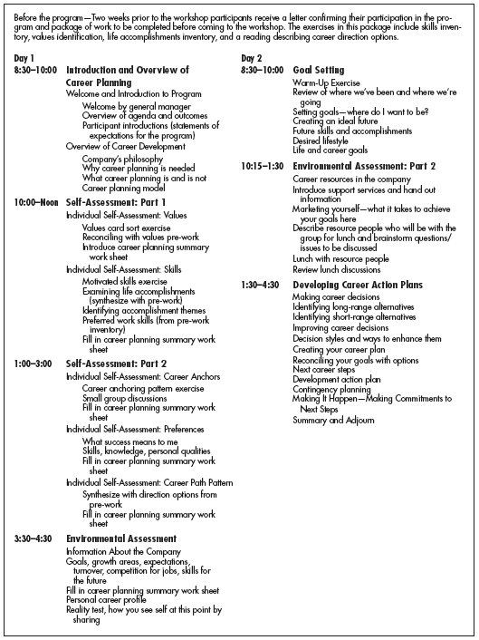
Sample Agenda—Two-Day Career Planning Workshop
Source: Fred L. Otte and Peggy Hutcheson, Helping Employees Manage Careers (Upper Saddle River, NJ: Prentice Hall, 1992), pp. 22–23. In addition to career development training and follow-up support, First USA Bank has also outfitted special career development facilities at its work sites that employees can use on company time. These contain materials such as career assessment and planning tools.
Figure 10–2

Slide 12
Managing Promotions
Making promotion decisions
  Decision 1: Is Seniority or Competence the Rule?
  Decision 2: How Should We Measure Competence?
  Decision 3: Is the Process Formal or Informal?
  Decision 4: Vertical, Horizontal, or Other?

Slide 13
Managing Transfers
Employees’ reasons for desiring transfers
  Personal enrichment and growth
  More interesting jobs
  Greater convenience (better hours, location)
  Greater advancement possibilities
Employers’ reasons for transferring employees
  To vacate a position where an employee is no longer needed.
  To fill a position where an employee is needed.
  To find a better fit for an employee within the firm.
  To boost productivity by consolidating positions.

Slide 14
Enhancing Diversity through Career Management
Sources of bias and discrimination in promotion decisions
  Having few people of color employed in the hiring department
  The “old-boy network” of informal friendships
  A lack of women mentors
  A lack of high-visibility assignments and developmental experiences (glass ceiling)
  A lack of company role models for members of the same racial or ethnic group
  Inflexible organizations and career tracks

Slide 15
Enhancing Women’s and Minorities’
Prospects
Eliminate institutional barriers
Improve networking and mentoring
Eliminate the glass ceiling
Institute flexible schedules and career tracks

Slide 16
Career Management and Employee Commitment
The “New Psychological Contract”
  Old contract: “Do your best and be loyal to us, and we’ll take care of your career.”
  New contract: “Do your best for us and be loyal to us for as long as you’re here, and we’ll provide you with the developmental opportunities you’ll need to move on and have a successful career.”

Slide 17
Career Management and Employee Commitment
Commitment-oriented career development efforts
  Career development programs
    Career workshops that use vocational guidance tools (including a computerized skills assessment program and other career gap analysis tools) to help employees identify career-related skills and the development needs they possess.
  Career-oriented appraisals
    Provide the ideal occasion to link the employee’s performance, career interests, and developmental needs into a coherent career plan.

Slide 18
Retirement
Retirement
  The point at which one gives up one’s work, usually between the ages of 60 and 65.
Preretirement practices
  Explanation of Social Security benefits
  Leisure time counseling
  Financial and investment counseling
  Health counseling
  Psychological counseling
  Counseling for second careers
  Counseling for second careers inside the company

Slide 19
Key Terms
career
career management
career development
career planning
career planning and
development
reality shock
job rotation
mentoring
promotions
transfers
retirement
preretirement counseling
career cycle
growth stage
exploration stage
establishment stage
trial substage
stabilization substage
midcareer crisis substage
maintenance stage
decline stage
career anchors

Slide 20
Managing Your Career

Slide 21
Identify Your Career Stage
Growth stage
Exploration stage
Establishment stage
  Trial substage
  Stabilization substage
  Midcareer crisis substage
Maintenance Stage
Decline Stage

Slide 22
Identify Your Occupational Orientation
Realistic orientation
  Physical activities (forestry, farming)
Investigative orientation
  Thinking, organizing, understanding (biologist)
Social orientation
  Interpersonal rather than intellectual skills (social work, psychologist)
Conventional orientation
  Structured, rule-regulated activities (banker, accountant)
Enterprising orientation
  Influencing others (lawyers, PR executives)
Artistic orientation
  Self-expression (artists, musicians)

Slide 23
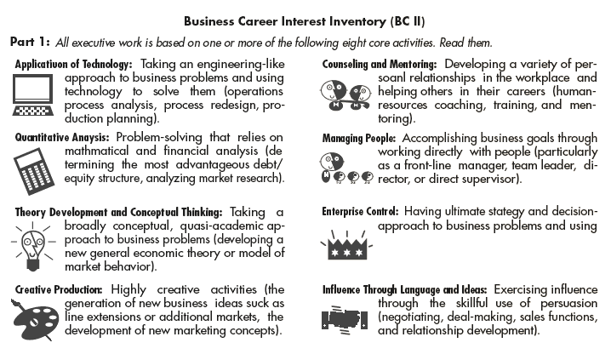
Example of Some Occupations that May Typify Each Occupational Theme
Source: James Waldroop and Timothy Butler, " Finding the Job You Should Want,” Fortune, March 2, 1998, p. 211.
Figure 10–A3

Slide 24
Identify Your Career Anchors
Career anchor
  A concern or value that a person you will not give up if a [career] choice has to be made.
Typical career anchors
  Technical/functional competence
  Managerial competence
    (analytical competence, interpersonal competence & emotional competence)
  Creativity
  Autonomy and independence
  Security

Slide 25
Finding the Right Job
Do Your Own Local Research
Personal Contacts
Answering Advertisements
Employment Agencies
Executive Recruiters
Career Counselors
Executive Marketing Consultants
Employers’ Web Sites

Slide 26
Writing Your Résumé
Introductory Information
Job Objective
Job Scope
Your Accomplishments
Length
Personal Data
Make Your Résumé Scannable

Slide 27
Handling the Interview
Prepare, Prepare, Prepare
Uncover the Interviewer’s Needs
Relate Yourself to the Person’s Needs
Think Before Answering
Make a Good Appearance and Show Enthusiasm

Slide 28
Class Exercise
Determine the following:
  Identify your occupational orientation (page 373)
  Identify your career anchor or anchors (page 375)
  1-2 career goals
  2-3 development steps to get from where you are now to where you want to be

Slide 29
Marcia Norgard – Career Plan
My occupational orientation is enterprising
  Using my skills to influence others
My career anchors are
  Managerial competence
  Security
Career goals
  To be a VP of HR
Development Steps
  More global responsibility
  More analytical business experience

