Slide 1
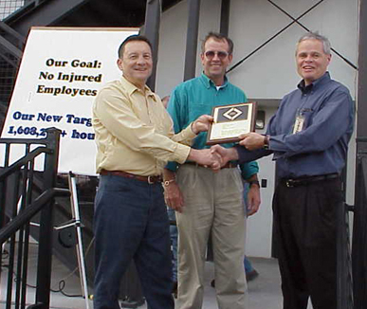
Chapter 15
Employee Safety and Health

Slide 2
The importance of dealing with Health and Safety in the workplace
Economic Reasons: reduces accidents, insurance, improves employee relations, and facilitates employee commitment to quality goals
Legal Reasons: Employees have a legal right to work in a safe and healthy environment.
Workplace Behaviour and Performance:A healthy and safe workplace can have a strong positive affect on the psychological contract.
Ethical Reasons:Those whom contributing to the causation of work-related diseases are morally responsible for their action AND ……

Slide 3
The importance of dealing with Health and Safety in the workplace (cont.)
The numbers are staggering
Toll can be greater than the numbers suggest considering lives are at stake
13.2 million accidents
860,000+ illnesses
6000+ deaths
$23000/accident
$171 B
Notes:
Page 428
One study, published in the Journal of the American Medical Association, said workers actually suffer an estimated 13.2 million nonfatal injuries, and 862,200 illnesses annually, for a total cost of $171 billion each year.3 Many injuries and accidents, the study goes, just go unreported.

Slide 4

Responsibilities of Employers and Employees
Employers
  Provide hazard-free workplace
  Can seek consulting help and identification
  Can’t punish employee
Employees
  Comply with standards
  Report problems to supervisors
  Can demand safety

Slide 5
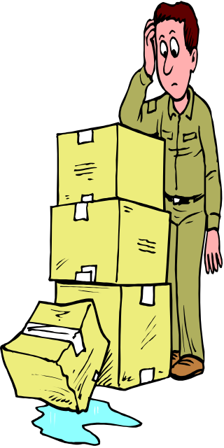


What Causes Accidents
Chance occurrences
Unsafe conditions
Unsafe employee acts
Notes:
Unsafe conditions include:
Improperly guarded equipment
Defective equipment
Hazardous procedures
Unsafe storage
Improper illumination
Improper ventilation
What causes unsafe acts:
People cause accidents
Studies do not show “proneness” is the cause
Remedy may be to change work assignment

Slide 6
A strategic approach to managing health and safety
A proactive response includes:
Reduce unsafe conditions and design safer systems of work
Exhibit commitment to health and safety- supervisors must take an active role
Inspect the workplace regularly
Establish procedures and controls
Reduce unsafe acts through selection & placement
Develop training programmes that emphasize health and safety
Establish health and safety committees
Monitor health and safety policy
Draw up an action plan.
Motivation to reduce unsafe acts
Notes:
Reducing unsafe conditions is always an employer’s first line of defense. Safety engineers should design jobs to remove or reduce physical hazards. In addition, supervisors and managers play a role in reducing unsafe conditions. A checklist can help identify and remove potential hazards.
Employers use computerized tools to design safer equipment. For example, Designsafe (from Designsafe Engineering, Ann Arbor, Michigan) facilitates hazard analysis, risk assessment, and the identification of safety control options. Sometimes the solution for eliminating an unsafe condition is obvious, and sometimes it’s more subtle. For example, slips and falls at work are often the result of debris or a slippery floor.50 Relatively obvious remedies for problems like these include slip-reducing floor coatings, floor mats, better lighting, and a system to quickly block off spills. But perhaps less obviously, special safety gear can also reduce the problems associated with otherwise unsafe conditions.
Supervisors should:
Praise employees when they choose safe behaviors;
Listen when employees offer suggestions, concerns, or complaints;
Be a good example, for instance, by following every safety rule and procedure;
Visit plant areas regularly;
Maintain open safety communications—for instance, by telling employees as
much as possible about safety activities such as testing alarms and changing safety
equipment or procedures;
Link managers’ bonuses to safety improvements.
Routinely inspect all premises for possible safety and health problems, using checklists as aids. Investigate all accidents and “near misses.” Have a
system in place for letting employees notify managers about hazards. Use employee safety committees to do the inspecting.
Screening is another way to reduce unsafe acts. Here, the aim is to isolate the trait (such as visual skill) that might predict accidents on the job in question, then screen candidates for this trait. Studies suggest that a test like the Employee Reliability Inventory (ERI) can help employers reduce unsafe acts at work. The ERI purportedly measures reliability dimensions such as emotional maturity, conscientiousness, safe job performance, and courteous job performance. Also, ask at least a few related questions during the selection interview—for instance, “What would you do if you saw another employee working in an unsafe way?” and “What would you do if your supervisor gave you a task, but didn’t provide any training on how to perform it safely?”
Motivation:
Safety posters also help reduce unsafe acts. In one study, their use apparently increased safe behavior by more than 20%. However, posters are no substitute for a comprehensive safety program; instead, employers should combine them with other techniques (like screening and training) to reduce unsafe conditions and acts, and also change them often. Others use positive reinforcement programs to improve safety at work. Researchers introduced one program in a wholesale bakery that bakes, wraps, and transports pastry products to retail outlets nationwide. An analysis of the safety related conditions existing in the plant before the study suggested a number of areas that needed improvement. The firm placed commercial safety posters at the entrance to the work area and on a bulletin board in the dining room but often neglected to update them. No single person was responsible for safety. Managers said little or nothing to employees who took the time to act safely. Although the accident rate had been climbing, many employees had yet to experience an injury from unsafe performance, so this “punishment” was also missing.
The new safety program included positive reinforcement and training. The firm set and communicated a reasonable goal (in terms of observed incidents performed safely), and ensured workers knew what the firm expected of them in terms of this goal. A training phase was next. At the conclusion of the training phase, supervisors showed employees a graph with their pre-training safety record (in terms of observed incidents performed safely) plotted. Then the researchers posted the graph and a list of safety rules in a conspicuous place in the work area. The graph helped provide positive reinforcement. Whenever observers walked through the plant collecting safety data, they posted on the graph the percentage of incidents they had seen performed safely by the group as a whole, thus providing the workers with feedback. Workers could compare their current safety performance with both their previous performance and their assigned goal. In addition, supervisors praised workers when they performed selected incidents safely. Safety in the plant subsequently improved markedly.
Behavior-based safety - Identifying the worker behaviors that contribute to accidents and then training workers to avoid these behaviors.

Slide 7
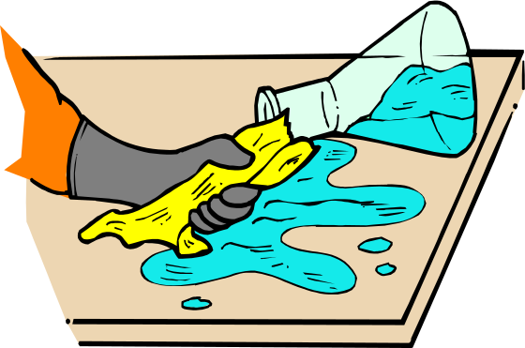
Managing health and safety (cont.)
Management commitment is key to safety:
  Institutionalize commitment
  Analyze accidents, incidents
  Set specific achievable safety goals
Notes:
Page 435
Institutionalize management’s commitment with a safety policy, and publicize it. This should emphasize that the firm will do everything practical to eliminate or reduce accidents and injuries. Emphasize that accident and injury prevention are not just important but of the utmost importance.
Analyze the number of accidents and safety incidents and then set specific achievable safety goals. Georgia-Pacific reduced its workers’ compensation costs with a policy that forces managers to halve accidents or forfeit 30% of their bonuses.

Slide 8
UK Health & Safety Law http://www.worksmart.org.uk
Health and Safety law is very extensive:
Health and Safety at Work Act 1974. (general principles of health and safety compliance)
Various Regulations (general or specific)
Approved Codes of Practice (ACOPs) guidance, examples of good practice and explanations of the law.
European Union
Notes:
Deals with
rights and responsibilities
workplace safety
hazards at work
accidents, incidents and injuries
Health and Safety law is very extensive. The basis of UK health and safety law is the Health and Safety at Work Act 1974. This sets out the general principles of health and safety compliance and is supplemented by various Regulations, some of which apply to all industries and some of which apply to specific industries, types of premises or specific health and safety issues.
Approved Codes of Practice (ACOPs) are published from time to time containing guidance, examples of good practice and explanations of the law.
The Health and Safety Commission (HSC) is the body responsible for health and safety policy and its executive arm, the Health and Safety Executive (HSE) is responsible for enforcement of health and safety law.In recent years the European Union has been influential in adopting health and safety measures which are implemented by member states, including, of course, the UK.
Health and safety law creates rights and obligations on employers and workers and protection extends beyond an employer's own employees to other workers and visitors the employer's premises.
The employer's duties are to ensure, "so far as is reasonably practicable" the health, safety and welfare of workers, including stress at work. This has to be done by carrying out a risk assessment, consulting safety representatives and safety committees, providing information, instruction and training to workers and others who are in a contractual relationship. Compliance with some Regulations is absolute and not constrained by the "practicability" provision.
Failure by an employer to comply with health and safety law is an offence and may lead to prosecution by the HSE.
Workers who exercise their health and safety statutory rights are protected from detrimental action by their employer.
The following, non exhaustive list gives some examples of areas of work and matters which come within the scope of health and safety law:
ventilation
temperature
lighting
cleanliness and waste materials
floor space
seating
sanitation
washing facilities
smoking
visual Display Units (VDUs)
Workers have responsibilities and duties too and may be liable to prosecution as well if they interfere with anything provided in the interests of health and safety.

Slide 9

Job Stress and Burnout
Substance abuse can result from job stress
Can you think of some factors that lead to job stress?
Personality affects reaction to stress
What are the consequences of stress? Stressors affect:
  organisational performance
  levels of absenteeism and,
  long terms illness and disability.
Notes:
Page 448
Instructor’s notes:
There are no right or wrong answer but should include items like:
work schedule, pace of work, job security, route to and from work, the number and nature of customers or clients,
work environment noise level like people talking or telephones ringing.
Stress consequences include: anxiety, depression, anger, and various physical consequences, such as cardiovascular disease, headaches, and accidents. For the employer, the consequences include high turnover due to burnout.

Slide 10
Stress and Corporate Liability
Increasing numbers of cases to European court, alleging organisations’ negligence in taking appropriate action to reduce levels of known stressors.
Can you identify any?

Slide 11
Sources of stress in the workplace
change in duties
lack of opportunity for personal autonomy
lack of training
working hours – shifts
work load
role ambiguity/overlap
physical working conditions
access to work - travel times
harassment, bullying, exclusion

Slide 12

Actions to reduce the stressors in the workplace
Relationships (improved work environment)
Biting
Your relationship with your boss
Realistic deadlines
Lead time
Detachment and relaxation
job design, enlargement, enrichment
training and development policy and practice
protection of individuals rights to privacy and dignity in the workplace
actions to reduce the possibility of harassment.
Notes:
Page 449
In his book Stress and the Manager, Dr. Karl Albrecht suggests the following ways to reduce job stress:
Build rewarding, pleasant, cooperative relationships with colleagues and employees.
Don’t bite off more than you can chew.
Build an especially effective and supportive relationship with your boss.
Negotiate with your boss for realistic deadlines on important projects.
Learn as much as you can about coming events and get as much lead time as you can to prepare for them.
Find time every day for detachment and relaxation.

Slide 13

Actions to reduce the stressors in the workplace (cont.)
Take a walk
Reduce unnecessary noise
Reduce trivia in your job - delegate
Limit interruptions
Distasteful problems
Make a “worry list” – include solutions
Notes:
Page 449
Take a walk around the office to keep your body refreshed and alert.
Find ways to reduce unnecessary noise.
Reduce the amount of trivia in your job; delegate routine work whenever possible.
Limit interruptions.
Don’t put off dealing with distasteful problems.
Make a constructive “worry list.” That includes solutions for each problem.

Slide 14

Reducing Job Stress
Good supervisor skills are important:
  Reduce personal conflicts
  Open communication
  Support employees’ efforts
  Ensure job–person fit
  More job control
  Provide EAP’s, counseling
Notes:
Page 449
The employer and its HR specialists and supervisors can also play a role in identifying and reducing job stress. Supportive supervisors and fair treatment are two obvious steps. Based on a survey of 1,299 employers by one insurance company, other steps include:
Reduce personal conflicts on the job.
Have open communication between management and employees.
Support employees’ efforts, for instance, by regularly asking how they are doing.
Ensure effective job–person fit, since a mistake can trigger stress.
Give employees more control over their jobs.
Provide employee assistance programs including professional counseling.

Slide 15
Actions to address the stress responses by organisations
- sports and leisure facilities/clubs
- individual counselling programmes
- health screening programmes
- healthy eating programmes

Slide 16
Burnout
Definition
Burnout – the total depletion of physical and mental resources caused by excessive striving to reach an unrealistic work-related goal
Notes:
Page 449

Slide 17

Burnout – Read the Signs
Inability to relax
Identification with your activities
Meaningless advancement goals
Workaholic
Notes:
Page 449
excessive striving to reach an unrealistic work-related goal. Signs of impending burnout include:
_x0002_ You are unable to relax.
_x0002_ You identify so closely with your activities that when they fall apart, you do, too.
_x0002_ The positions you worked so hard to attain often seem meaningless now.
_x0002_ You would describe yourself as a workaholic and constantly strive to obtain your
work-related goals to the exclusion of almost all outside interest.112

Slide 18
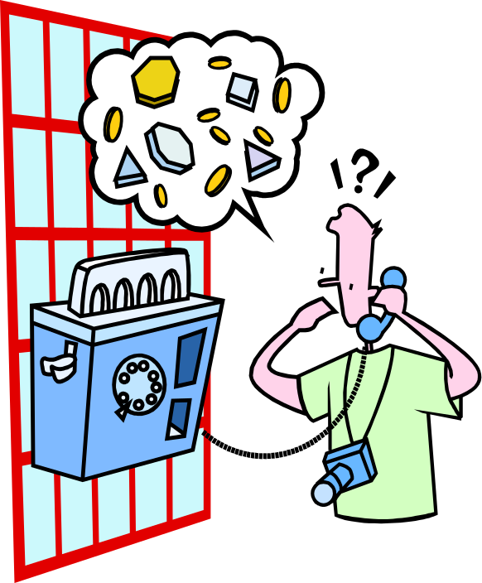
Research Insight
Do vacations fix burnout?
  Research says “No”
Burnout returns partly within 3 days of returning to work
Must remove stress causes
Mid-week mini-vacations show promise
Notes:
Page 450
Seventy-six clerks in an administrative department in the headquarters of an electronics firm in central Israel completed questionnaires measuring job stress and burnout twice before a vacation, once during the vacation, and twice after the vacation. The clerks’ burnout certainly did decline during the vacation. The problem was the burnout quickly returned to pre-vacation levels by the time of the second post-vacation survey. At least for these 76 clerks, burnout moved partway back toward its pre-vacation level by three days after the vacation, and all the way by three weeks after they returned to work.

