Slide 1

Blogging 101

Slide 2
Learning outcomes
Is Blog a Website?
How is blog different from a website?
Dangers of Blogging
How to start a Blog
Tools of the trade
Tools Statistics
Activity

Slide 3
How is Blog different from a website?
A blog is a website
This a website that has primarily blog posts (written content)
A blog is focused on the regular creation and distribution of content.
Content posted on blogs is usually based on a specific topic or industry the blogger is passionate about.
A blog is regularly updated with new content, it’s less formal than a traditional website.
Readers can typically interact with the content by leaving comments.
Examples:
The Huffington Post, Perez Hilton, The Pioneer Woman

Slide 4
How is Blog different from a website?
A website, on the other hand, is static.
It’s focused on communicating a product or service and it’s more formal.
Visitors cannot interact with the content.
Most businesses today have a website.
Plumbers, lawyers, dentists, landscapers, and business coaches all have a website.

Slide 5
How is Blog different from a website?
A website has a blog
This website has a blog in addition to other services, products etc. to post regular content related to their product or service
Examples:
Adventure Associates
https://www.adventureassoc.com/
River Pools & Spas is a website with a blog
https://www.riverpoolsandspas.com/
Problogger.com

Slide 6
Dangers of Personal blogging
Cyberstalking, which is a new phenomenon that allows online stalkers to prowl for victims.
Especially females, should be cautious when creating their own personal blogs.
The following measures could be taken to avoid Cyber stalking:
Do not have an online profile
Post anonymously
Avoid personal or identifying details
No photos
Avoid inappropriate dialog
Lurkers
Timeless
Learn more about internet safety at iSafeVentures.com
(Housley, n.d.)

Slide 7
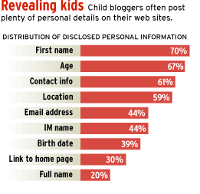
Dangers of Personal blogging
Too Much Information
Each piece of information seems harmless.
It’s when the predators put multiple pieces together that you have put yourself in danger.

Slide 8
How to start a Blog?
Choose a platform
Choose a web host for your blog
Setting up a blog on your own domain
Designing your new blog
Useful resources for blogging

Slide 9
1. Choose blogging platform
This is one of the tools of the trade that is needed to provide blogging.
There are many free tools available, such as WordPress, Blogger, Tumblr, TypePad and many more
WordPress has got biggest market share of approximately of 60%(w3techs.com, 2019)

Slide 10
2. Choosing a webhost
A webhost is a company that puts your website on the Internet.
This can be free or paid (self hosting) monthly
Free providers are helpful for beginners, but they have limitations.
Paid (self hosting) ones are good for professional bloggers.
For example, JustHost.com

Slide 11
3. Setting up the blog
You must decide about the domain for your blog. A domain is simply your website address like facebook.com, google.co.uk etc
Free host or selfhosting?
Once hosting is completed, a tool like, WordPress must be installed. It would be much easier; you don’t have to be a techie.

Slide 12
4. Designing your blog
This starts with selecting a theme or a template usually provided by the tool provider like WordPress.
Your blog should reflect you and and your personality
It must be clutter free and user friendly
You may need a professional training if you are a professional blogger with the intension of making money

Slide 13
5. Useful resources for Beginner blogs
Look at some professional blogs to get an idea
You might make mistakes initially and you must learn from it.
However, there is always a room for more learning and improvement.

Slide 14



The tools of the trade
Name | Advantages | Disadvantages | Target users
 | Free & Open source Massive user & developer base Plug-ins and themes Hosted centrally or self-install | Complexity Most flexibility requires self-install | Professional bloggers
 | Free One of the earliest blogging platforms Ease of start-up Excellent Google integration (AdSense) | No back-end code access Limited customizations (themes and plugins) Difficult to set up own domain | Casual bloggers
 | Free Ease of use (post online, SMS, audio) Multiple blog support Mobile-friendly | Visual-centric, doesn’t encourage text-heavy blogging Emphasis on sharing devalues original | Casual bloggers who want something between Twitter and WP Photobloggers

Slide 15


The tools of the trade
Name | Advantages | Disadvantages | Target users
 | Oldest premium blogging platform Very good analytics & publishing tools Promotes blogs within internal blogosphere | Expensive, especially with free, powerful alternatives Lack of features and flexibility Dated | Casual bloggers who want something easier and more robust than WP/Blogger
 | Highly customizable (drag-n-drop) Dedicated mobile apps Easy to import blogs created on other platforms Built-in ecommerce solution | Expensive No back-end code access Limited customizations (themes and plugins) | Creative professionals and businesses that want a cloud-based, no-nonsense blogging solution with extensive customization options
There are also tons of others, but either in limited market share or limited availability (beta).

Slide 16
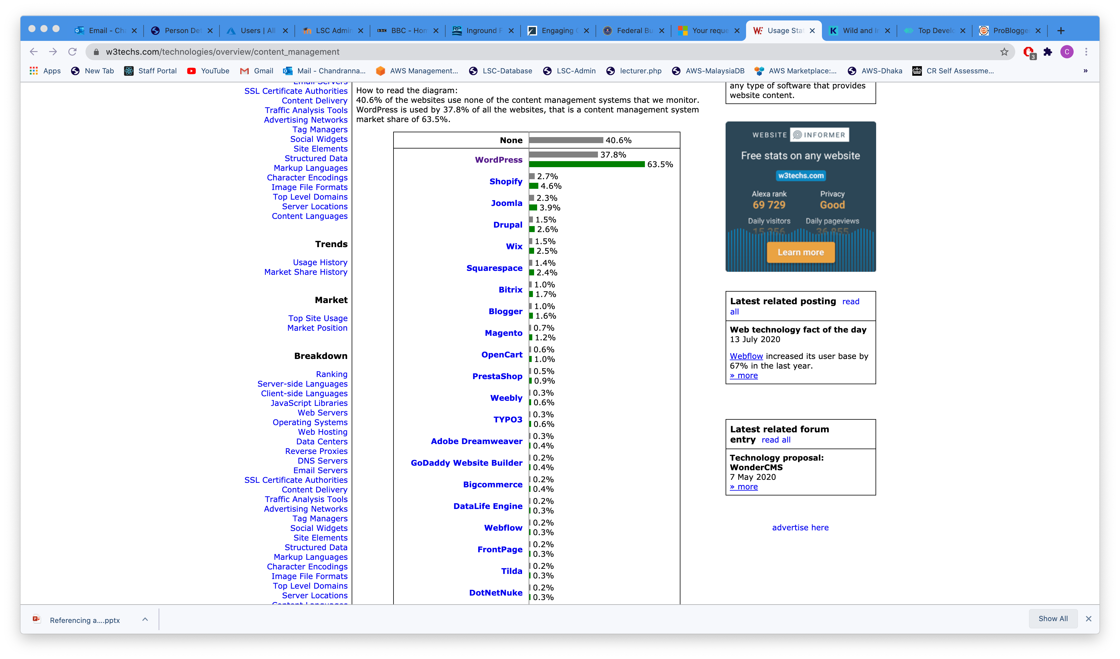
Tools statistics
How to read the diagram: 40.6% of the websites use none of the content management systems that we monitor. WordPress is used by 37.8% of all the websites, that is a content management system market share of 63.5%.
(W3tech.com, 2020)

Slide 17
Activity
Tasks
Conduct an online search, find out and list the most popular Content Management Systems(CMS).
Go to google and type the following:
top content management systems
What can be achieved with CMS? Can a website, blog or both be created?
Go to google and type the following:
What is content management system
Can you create a Blog of your own choice of any topic that you are interested in? Just play around, you do not have to be a techie for this.
Open your browser and type of the following:
wordpress.com
blogger.com
You can use any tool that you are familiar or comfortable with.
How easy or difficult it was to create a website or a blog? Give your own opinion.

Slide 18
References
Housley, S., n.d. The Dangers in Blogging. [Online] Available at: https://www.feedforall.com/dangers-blogging.htm [Accessed 10 08 2020].
W3techs.com. (2019). Usage Statistics and Market Share of WordPress for Websites, April 2019. [online] Available at: https://w3techs.com/technologies/details/cm-wordpress/all/all [Accessed 7 Apr. 2019].
W3tech.com, 2020. Usage statistics of content management systems. [Online] Available at: https://w3techs.com/technologies/overview/content_management [Accessed 11 08 2020].

