Slide 1
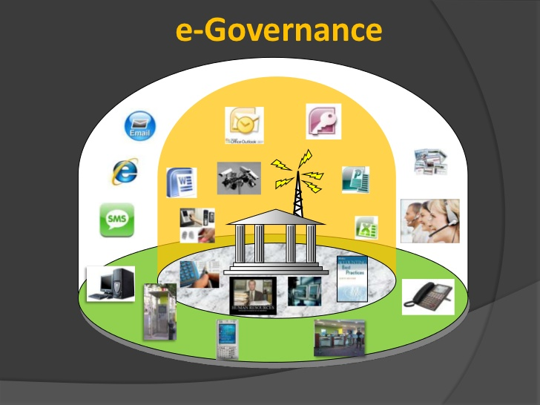
e-Governance Integrating Services to Citizens

Slide 2
Learning Outcomes
What is e-Governance and e-Government?
Pillars of e-Governance
Benefits and barriers of e-Government
Types of e-Government (G2C, G2G,G2B)
G2C - Interactions of citizens with e-Government
G2G
G2B
e-Government – conclusions
e-Government - principles

Slide 3
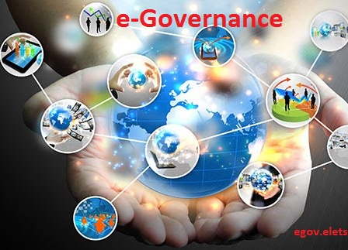
What is e-Governance?
Is the application of information technology to the processes of government functioning to bring about
Smart
Moral
Accountable
Responsive
Transparent governance
E-Governance is the development, deployment and enforcement of the policies, laws and regulations necessary to support the functioning of a knowledge society as well as of e-Government

Slide 4
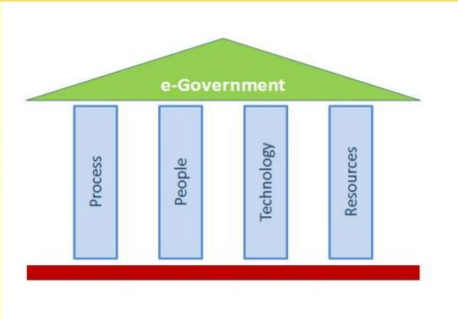
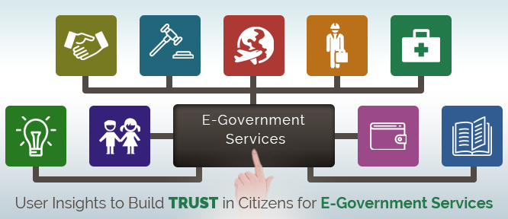
Pillars of e-Governance

Slide 5
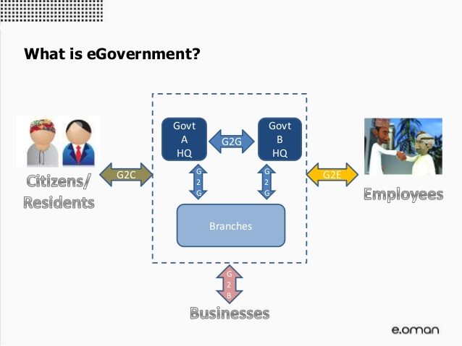
What is e-Government?
Is the transformation of internal and external public sector relationships, through Information and Communications Technology (ICT) in order to optimize government service delivery and citizen participation.
Is the digital interaction between a government and citizens, government and businesses/commerce, government and employees, and also between government and governments /agencies.
Essentially, the eGovernment delivery models can be briefly summed up as:
G2C (Government-to-Citizens)
G2B (Government-to-Businesses)
G2E (Government-to-Employees)
G2G (Government-to-Governments)

Slide 6
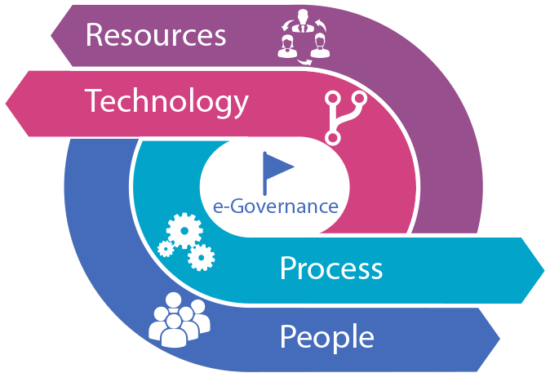
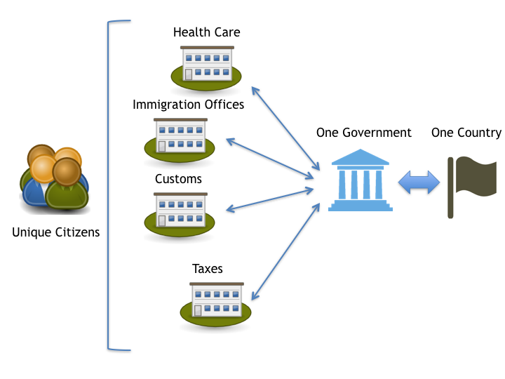
e-Governance vs e-Government
e-Government is part of e-Governance as it is a broader notion than government
e-Governance refers to processes which use ICT for enabling transaction between stakeholders and the government
e-Governance reflects efficient delivery of services by using emerging technologies
e-Governance encompasses the state’s institutional arrangements, decision making processes, relationships between government and public
e-Government reflects largely on improving administrative efficiency

Slide 7
Purpose of e-Governance?
E-Governance is the integration of Information and Communication Technology (ICT) in all the processes, with the aim of enhancing government ability to address the needs of the general public.
Basic purpose is to simplify processes for all, such as government, citizens, businesses etc at local, national and international levels.
Promoting good governance to cause simple, moral, accountable and transparent and corruption free
Providing access to government services in disseminating information, communicating in a quick and efficient manner.

Slide 8
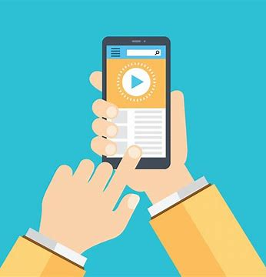
Benefits of e-Governance
Improved delivery of services to citizens
Improved interface with businesses and industries
Empower citizens with access to knowledge and information
Working of a government is more efficient and effective
Greater convenience
Increased transparency
Smoother flow of information
Improved collaboration with other agencies
Less corruption
Revenue growth
Cost reductions
Attract overseas investors
New kinds of service
Improved availability of Government 24/7

Slide 9

Barriers of e-Governance
Lack of integrated services
Lack of public awareness
Resistant to change
Public fear and skepticism
ICT facilities
Lack of privacy and security
Digital Divide

Slide 10
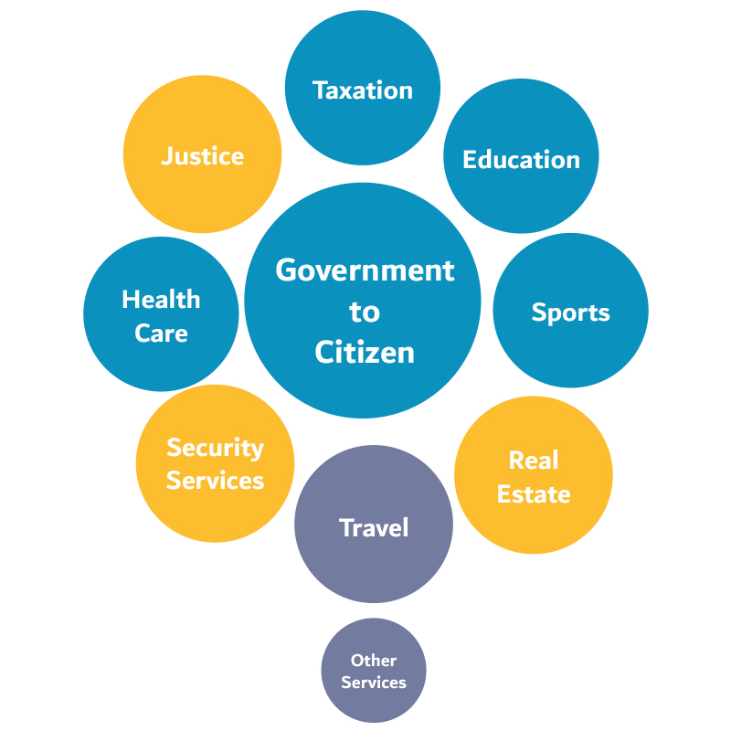
G2C – Government to Citizen
Government to citizen information should be available online
Public department interaction forms
On-line submission forms
Transactions (Payments)
Revenue collection, payment of utility bills
Online complaints
Track and Trace Systems
Citizens can trace all their complaints and unlimited cases and can get online updates such as status, objection, rejection etc.
Citizen registration
Birth and death registration and certificates, driving licence etc.

Slide 11
G2C - Citizens interactions with Public Service
Varies by country, but general EU pattern
Government need to identify and authenticate citizen
need to establish identity of person
need to authenticate “facts” about person
e.g., citizenship, residency
Dominated by large service delivery agencies
Health
Social Security
Tax
Local Authorities
Agriculture
Passport Office
Others
Activity: visit gov.uk and data.gov.uk and list out the services provided by UK government

Slide 12

G2C - Citizen to Government Interactions - Typical Features
Government need to establish “entitlement” of citizen to services
based on qualifying criteria
income level,
presence of qualifying condition,
employment status, etc.
Family situation
For example, social benefits like housing.

Slide 13

G2C - Citizen to Government Interactions - Typical Features
Government need to collect additional information from citizen at point of contact
citizen must repeat their “story” for each organisation at each point of contact
supplementary information often needs to be corroborated(supported with evidence) by third parties

Slide 14

G2C- Access Channels to Public Service
Online application forms, certificates, etc.
Walk-in Offices - face to face contact
Telephone
Remote over network
web
kiosk
TV
mobile

Slide 15
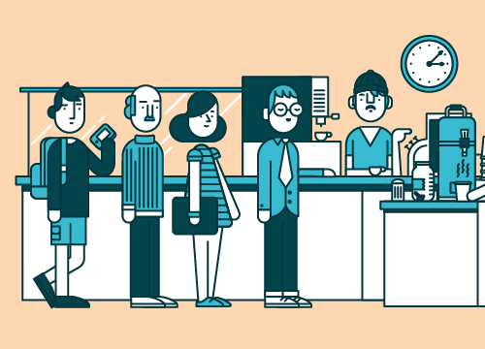
G2C- Mediated vs Self Service
Overwhelming majority of transactions are Mediated or Assisted
Tiny proportion are Self Service

Slide 16

G2C- Choice
Citizens must continue to have a choice of access channel
difficult to discontinue old channels
e-channels to run in parallel as additional option
e-channels must offer added value to attract “customers”

Slide 17
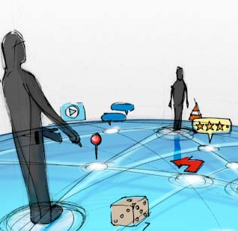
G2C - Citizen to Government Interactions -Issues
Access to internet/networked devices
most frequent users of public services are the often most disadvantaged in terms of :
income
education
self confidence
computer literacy
Result: major access issue

Slide 18

G2C - Citizen to Government Interactions -Issues
Fears of Public Service Staff
“turf wars” - loss of work /status
range of knowledge required
demands of 24x7 operations
Ability of Public Service to realise savings
ability to achieve radical transformation in business practices

Slide 19

G2C - Citizen to Government Interactions -Issues
Privacy vs. Efficiency
Government as “Big Brother”
Data Protection Legislation
Public Trust a major issue
Citizen control over personal data can build trust

Slide 20
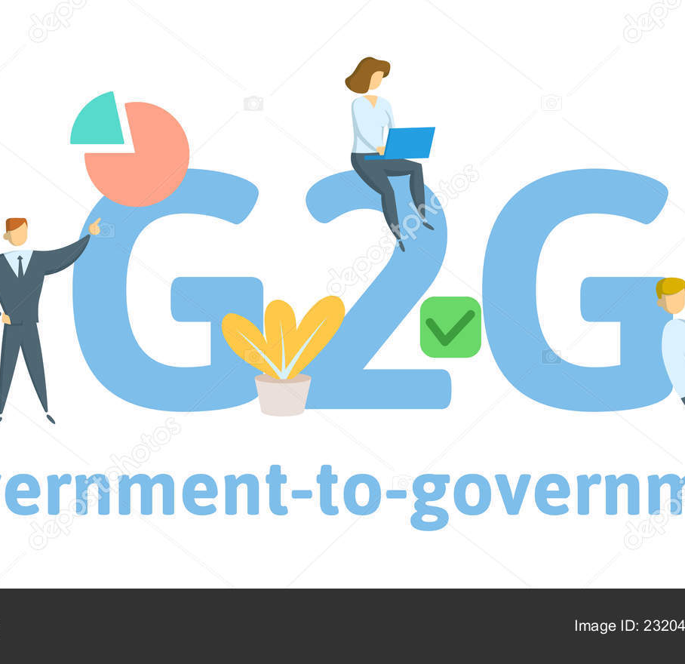
G2G – Government to Government
Inter-departmental interaction
Planning, reporting, budgeting, administrative and financial
Interaction among multilevel governments
Local councils, banks, hospitals etc
Notices, summaries and policies for different departments
Inspections, observations and inquiries
Interactions between control offices and field offices
Activity:
Visit local.gov.uk, londoncouncils.gov.uk
Find your council website and see what services are provided

Slide 21
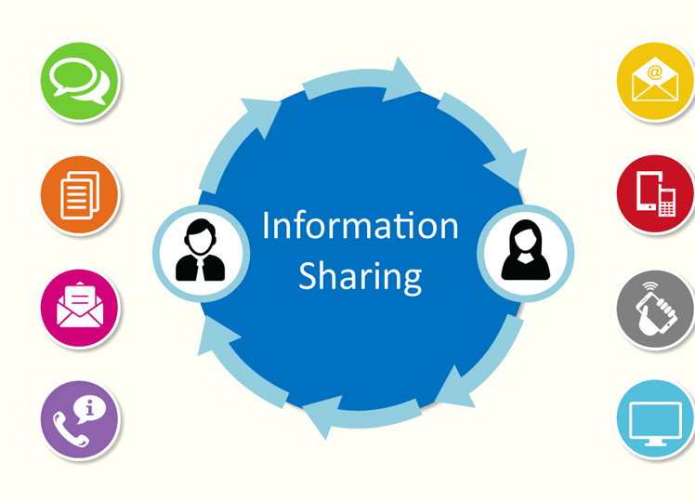
G2G – Share Information to avoid repetition
Public agencies should share information on citizens to eliminate need for repetition
share only what is needed and essential for each transaction.
Capture data once only
agency at point of contact must act on behalf of the whole

Slide 22
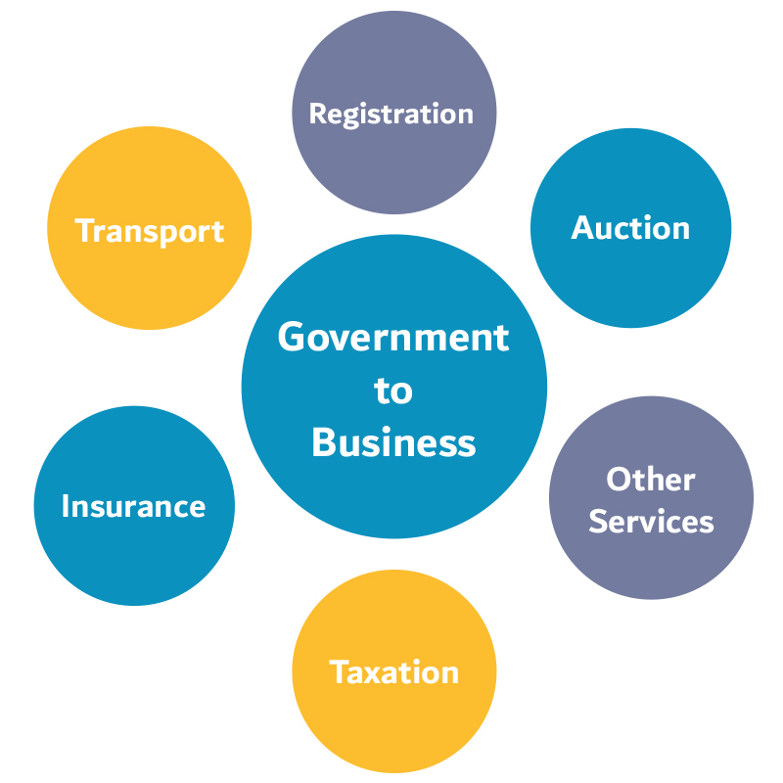
G2B - Government to Business
Transaction between government and businesses. Includes:
e-Procurements
Trade, business and industrial policies
Guidelines for different businesses
Tax e-Filing
Loaning etc.
Furlough during Pandemic
Eat Out to Help Out scheme

Slide 23

E-Business vs. E-Government
Commercial
inform about products
identify product and price
agreement to purchase
secure collection of money
deliver product
learn about customers
encourage loyalty
Government
establish identity
identify appropriate “product” or service
establish entitlement
collect supporting data
authenticate data
decide entitlement
deliver service.

Slide 24
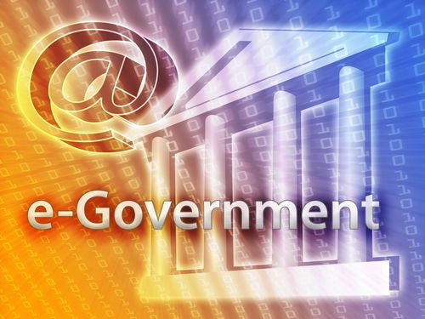
E-Government - some conclusions
may be more difficult than we might think
complexity of Government and knowledge imbalance major problems for citizens
citizens’ access to e-services is a problem
public trust is a major issue
current/traditional channels likely to predominate for many years

Slide 25
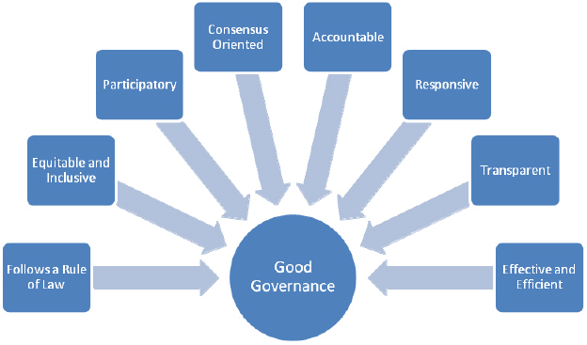
E-government - some principles
Simplify services
help citizens to navigate complexity
build virtual “one stop shops”
group services around events/life episodes
cater for traditional/current channels as well as e-channels
help citizens to access e-services
build public trust
focus on realising benefits
choice of channels
e-channels must add value for citizens, Government and public service staff

