Slide 1
Course: BABSFY Subject: Integrated Professional Skills in Digital Age Level:3
Lecture Topic: Digital Footprint

Slide 2
Learning Outcomes
After completing this topic, you should be able to:
Understand what a digital footprint is?
Controlling Digital Footprint
Managing Footprint
What are the benefits of being digital?
Notes:
Digital v/s Analog. Some background introduction to computers.

Slide 3
Digital footprint
What is a digital footprint?
It is the data trail left by your interactions in the digital world
It is a public record of
what you said
what was said about you
what you liked, retweeted or shared
where you are, or have been
Although it’s less public, there’s also a record of
what you’ve clicked on
what you’ve searched for
your IP address
Notes:
Digital v/s Analog. Some background introduction to computers.

Slide 4
Controlling Digital Footprint
Why is it important to be in control of your digital footprint?
Employers can, and do, Google people who apply for jobs with them. They could check social media sites that appear in the search to see whether you’re the kind of person they want working for them.
Criminals gather information about you to fraudulently impersonate you – things like applying for credit cards or gaining access to sites or systems in your name.
Websites you visit place cookies on your computer to allow advertisers to target you with products based on your browsing history.

Slide 5
Controlling Digital Footprint
And it’s surprisingly easy to publish information about you online. Even if you aren’t in the public eye, at some point someone might want to gather information about you with the intention of discrediting you.
To find out more about why it’s important, and about how information about you is used and shared, search for the Internet Society’s resources on managing your identity.
Visit www.internetsociety.org

Slide 6
Managing Digital Footprint
Be kind, helpful and understanding
Use privacy settings
Keep a list of accounts
Do not overshare
Use a password keeper, Ex: Dashlane
Google yourself, know what’s out there.
Monitor linking accounts
Consider using an anonymous secondary email
At least skim the terms and conditions
Know that sending is publishing-forever
Understand that searches are social. DuckDuckGo.com
Use digital tools to manage your digital footprint
(Boyle, 2019)

Slide 7

Why should we care to ‘being digital’?
It saves time:
Being digitally literate can save hours per month for tasks that could only be done offline in the past
Examples?

Slide 8
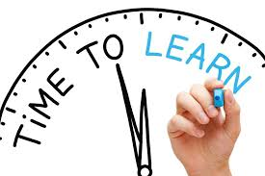
Why should we care to ‘being digital’?
You learn faster:
Study at your own pace, lookup words, data, facts, figures. Try new things without fear.
Examples?

Slide 9

Why should we care to ‘being digital’?
You save money:
Coupon codes, daily deal sites, comparison shopping sites and mobile apps, make it easier than ever to get the best product at the best price.
Examples?

Slide 10

Why should we care to ‘being digital’?
It makes you safer:
From checking medications, travelling abroad, to fixing your home – do more things safely.
Examples?

Slide 11

Why should we care to ‘being digital’?
It keeps you informed:
From minor traffic annoyances to life threatening natural disasters.
Examples?

Slide 12
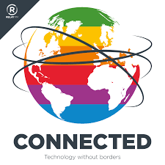
Why should we care to ‘being digital’?
It keeps you connected:
Technology allows you to talk to anyone, anytime on your own terms.
Examples?

Slide 13
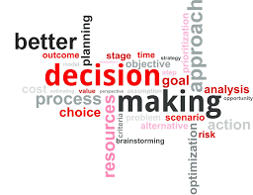
Why should we care to ‘being digital’?
You will make better decisions:
Digital literacy allows you to search, study, analyse and compare at any time.
Examples?

Slide 14

Why should we care to ‘being digital’?
It can keep you employed:
Most jobs today require some form of computer skills including jobs outside the traditional office.
Examples?

Slide 15

Why should we care to ‘being digital’?
It makes you happier:
No matter how technically advanced the world gets, we will always love creativity and innovation.
Examples?

Slide 16
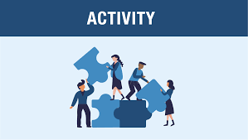
Activity
Activity:
Which of the digital technologies being used at your institution, workplace or any place you come across?
How have they influenced your position/experience?
Share the digital technologies you have been using

Slide 17
In Summary, we looked at the following
What a digital footprint is?
Controlling Digital Footprint
Managing Footprint
What are the benefits of being digital?

Slide 18
References
Boyle, J. (2019). 12 Tips For Students To Manage Their Digital Footprints. [online] TeachThought. Available at: https://www.teachthought.com/the-future-of-learning/11-tips-for-students-tomanage-their-digital-footprints/ [Accessed 19 May 2019].

Slide 19


