Slide 1
IT INFRASTRUCTURE AND EMERGING TECHNOLOGIES

Slide 2
LEARNING OBJECTIVES
Define IT infrastructure and describe its components.
Assess contemporary computer hardware platform trends.
Assess contemporary software platform trends.
Notes:
Are students familiar with any of the trends in hardware or software platforms? Do they see the iPhone/iPad for instance as a device, a computing platform, or a just a telephone? They might be familiar with developments such as Facebook’s Application platform, where developers can design games and activities for use within Facebook itself. Also recall that cloud computing has been mentioned in earlier chapters, so students should be able to point to that as a contemporary hardware platform trend.

Slide 3
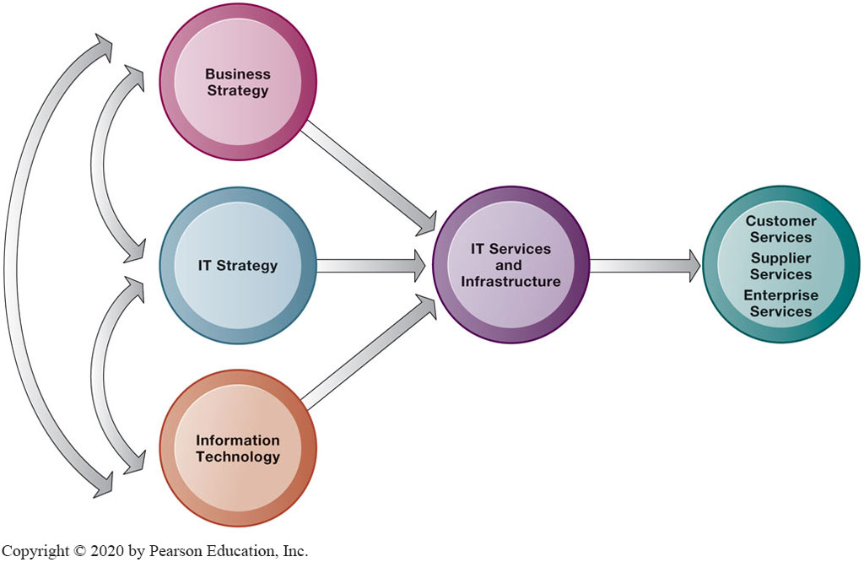
IT Infrastructure
Connection Between the Firm, I T Infrastructure, and Business Capabilities
Notes:
Are students familiar with any of the trends in hardware or software platforms? Do they see the iPhone/iPad for instance as a device, a computing platform, or a just a telephone? They might be familiar with developments such as Facebook’s Application platform, where developers can design games and activities for use within Facebook itself. Also recall that cloud computing has been mentioned in earlier chapters, so students should be able to point to that as a contemporary hardware platform trend.

Slide 4
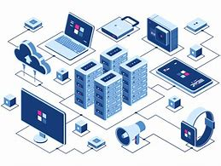
IT Infrastructure
IT infrastructure:
Set of physical devices and software required to operate enterprise
Set of firmwide services including:
Computing platforms providing computing services
Telecommunications services
Data management services
Application software services
Physical facilities management services
IT management, education, and other services
“Service platform” perspective
More accurate view of value of investments
Notes:
The “service platform” perspective refers to analyzing the actual services enabled by new technology tools. For example, a new PC might save an employee one hour per day in wait time for information, dramatically increasing his or her value to the firm.

Slide 5
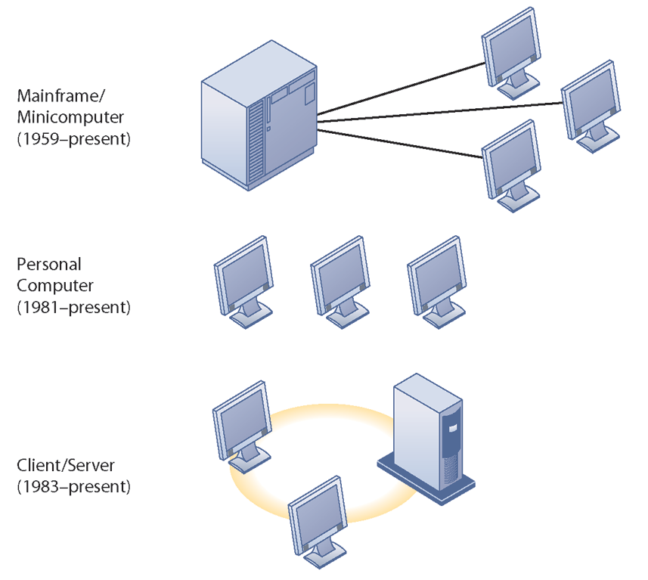
IT Infrastructure
Evolution of IT infrastructure
General-purpose mainframe and minicomputer era: 1959 to present
1958: IBM first mainframes introduced
1965: less expensive DEC minicomputers introduced
Personal computer era: 1981 to present
1981: Introduction of IBM PC
Proliferation in 80s, 90s resulted in growth of personal software
Client/server era: 1983 to present
Desktop clients networked to servers, with processing work split between clients and servers
Network may be two-tiered or multitiered (N-tiered)
Various types of servers (network, application, Web)
Notes:
Students may be unfamiliar with the concept of mainframe computers. Explain the difference in size (much larger) and computing capacity (much smaller) from today’s computers to give them a sense of perspective regarding how far the computing industry has gone in 60 years. However, modern-day mainframes (IBM z-Series), are extremely powerful servers used for large Fortune 1000 enterprise networks and corporate Web sites. The mainframe is not dead in other words and still represents a large revenue stream for IBM.

Slide 6
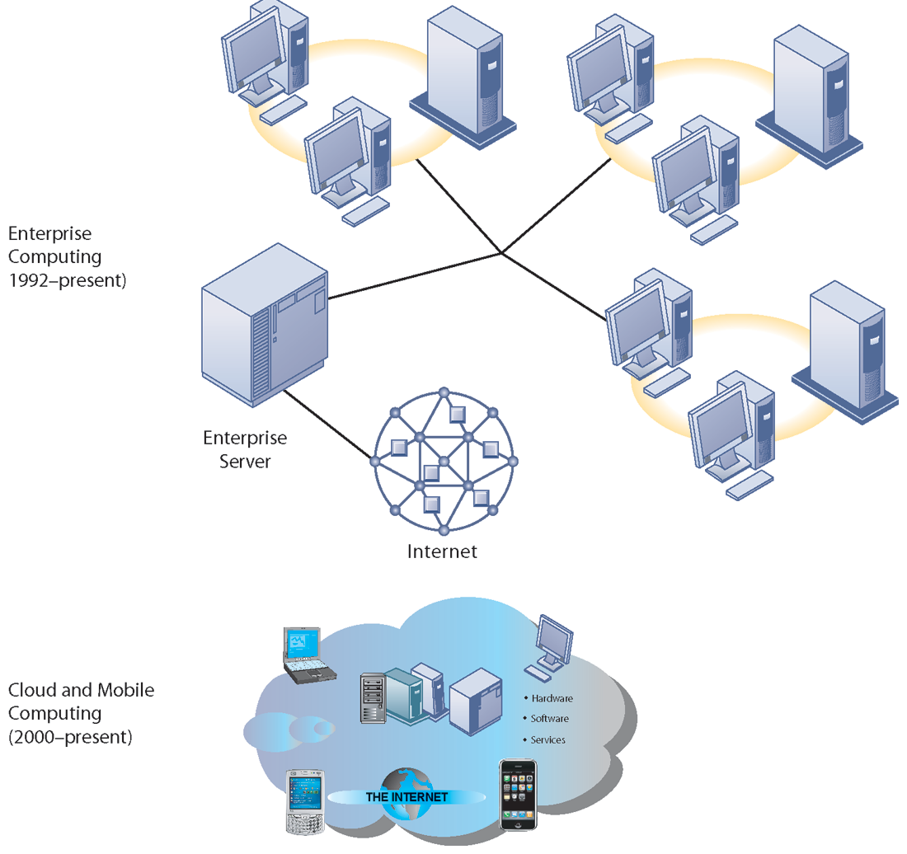
IT Infrastructure
Evolution of IT infrastructure (cont.)
Enterprise computing era: 1992 to present
Move toward integrating disparate networks, applications using Internet standards and enterprise applications
Cloud and mobile computing: 2000 to present
Cloud computing: computing power and software applications supplied over the Internet or other network
Fastest growing form of computing
Notes:
Examples of the use of cloud computing are Google Apps, Google’s suite of software applications that rivals Microsoft’s Office applications at a fraction of the cost, and Salesforce.com’s CRM management software, delivered over the Internet. Most large Fortune 500 firms have some applications that run in the cloud. Most of these same corporations do not put their strategic or critical systems on the cloud just yet because of lingering concerns about reliability and security.

Slide 7
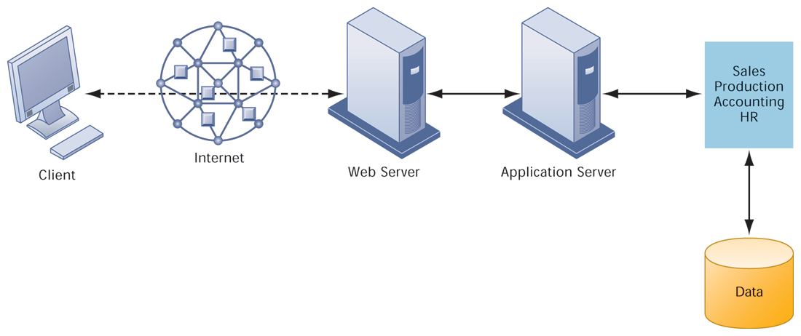
A MULTITIERED CLIENT/SERVER NETWORK (N-TIER)
FIGURE 5-3
In a multitiered client/server network, client requests for service are handled by different levels of servers.
Notes:
Explain that the distribution of computing power across smaller, less expensive machines enabled by client/server computing is in part responsible for the drastic increase in computing power and applications throughout the firm. Prior to small, less expensive server computers, computing power had to purchased in large blocks at great expense. With client/server computing, you can grow your firm’s inventory of computers gradually, over time, to meet current demand.

Slide 8
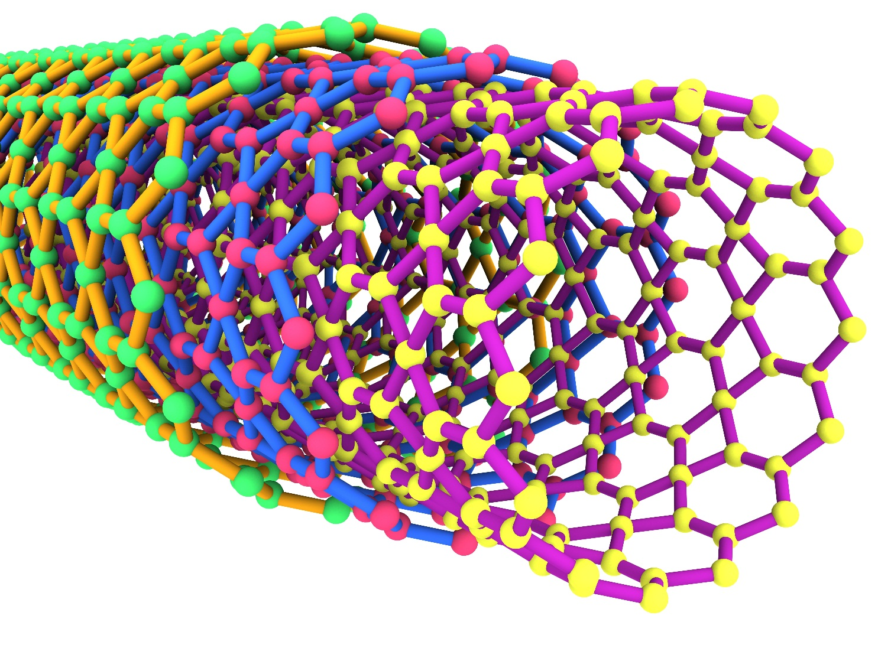
EXAMPLES OF NANOTUBES
Nanotubes are tiny tubes about 10,000 times thinner than a human hair. They consist of rolled up sheets of carbon hexagons and have the potential uses as minuscule wires or in ultrasmall electronic devices and are very powerful conductors of electrical current.
FIGURE 5-6
Notes:
Nanotechnology is used to create transistors of the tiny size previously mentioned. Can students describe any other applications of this type of technology (for example, medical)?

Slide 9
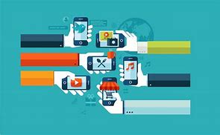
Contemporary Hardware Platform Trends
The mobile digital platform
Cell phones, smartphones (iPhone, Android, and Blackberry)
Data transmission, Web surfing, e-mail, and IM duties
Netbooks:
Small lightweight notebooks optimized for wireless communication and core tasks
Tablets (iPad)
Networked e-readers (Kindle and Nook)
Notes:
Business computing is increasingly moving from PCs and desktops to mobile devices, and managers are increasingly using these to coordinate work and communicate with employees. Students may think the smartphone they own is just a phone, or music player, but for businesses it is becoming an important management tool. Ask students for examples of how they are using smartphones in their business or work.

Slide 10
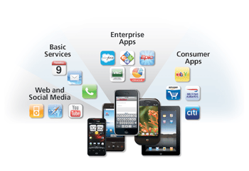
Contemporary Hardware Platform Trends
BYOD (Bring your own device)
Allowing employees to use personal mobile devices in workplace
Consumerization of IT
New information technology emerges in consumer markets first and spreads to business organizations
Forces businesses and IT departments to rethink how IT equipment and services are acquired and managed
Notes:
In the past, IT departments in large firms dictated to their employees what kinds of devices they could use, both on site and off site while traveling. Increasingly, employees are telling the IT department what tools they want to use, and demanding that IT support these tools.

Slide 11
SHOULD YOU USE YOUR IPHONE FOR WORK?
What are the advantages and disadvantages of allowing employees to use their personal smartphones for work?
Allowing employees to use their own smartphones for work will save the company money. Do you agree?

Slide 12
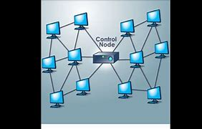
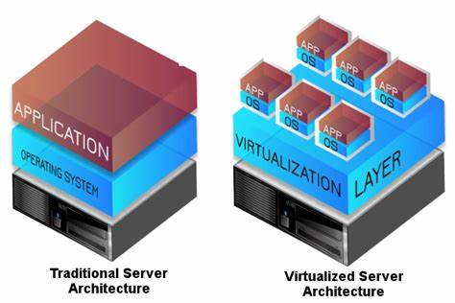
Contemporary Hardware Platform Trends
Grid computing
Connects geographically remote computers into a single network to combine processing power and create virtual supercomputer
Provides cost savings, speed, agility
Virtualization
Allows single physical resource to act as multiple resources (i.e., run multiple instances of OS)
Reduces hardware and power expenditures
Facilitates hardware centralization
Notes:
Both grid computing and virtualization allow organizations to optimize their use of resources in new ways. Grid computing allows corporations to take advantage of spare computing power in the form of networked virtual supercomputers. Virtualization allows companies also to take advantage of spare computing power by allowing a single resource to act as multiple resources.

Slide 13
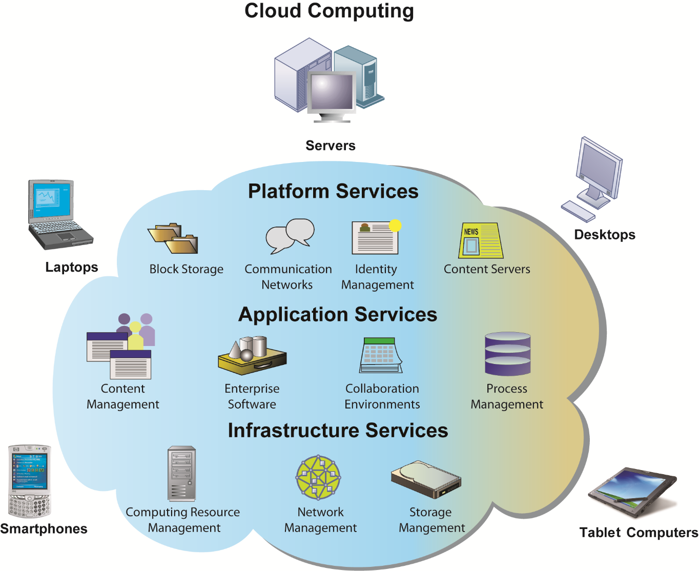
Contemporary Hardware Platform Trends
Cloud computing
On-demand (utility) computing services obtained over network
Infrastructure as a service
Platform as a service
Software as a service
Cloud can be public or private
Allows companies to minimize IT investments
Drawbacks: Concerns of security, reliability
Hybrid cloud computing model
Notes:
Explain that on-demand or utility computing describes a payment structure in which use is dependent upon actual time or power used. Cloud computing refers to a platform—networked access to remote services. Cloud computing allows organizations to avoid the expenses of maintaining their own hardware and software, relying on the cloud instead. Ask students if they have used Google Apps or other forms of cloud computing. Are there any other concerns they might have over transferring computing resources to a shared “cloud”? Have they read about Amazon Web Services going down and offline for short periods of time?

Slide 14
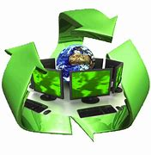
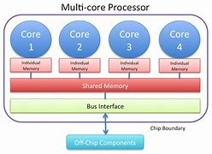
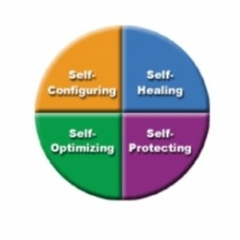
Contemporary Hardware Platform Trends
Green computing
Practices and technologies for manufacturing, using, disposing of computing and networking hardware
High performance, power-saving processors
Multi-core processors
Autonomic computing
Industry-wide effort to develop systems that can configure, heal themselves when broken, and protect themselves from outside intruders
Similar to self-updating antivirus software; Apple and Microsoft both use automatic updates
Notes:
Data centers will use approximately 2% of all U.S. electrical power. Cutting power consumption in data centers has become both a serious business and environmental challenge. Ask students what forms of green computing they have noticed. Answers may range from more publicized local management of electronic equipment disposal and recycling to the use of solar chargers, and so on. Another driver in minimizing the power consumption of computer processors is the proliferation of handheld devices; to reduce heat in the devices as well as lengthen time between battery charges.

Slide 15
GREEN DATA CENTERS: GOOD FOR BUSINESS?
What business and social problems does data center power consumption cause?
What solutions are available for these problems?
What are the business benefits and costs of these solutions?
Should all firms move toward green computing?
Notes:
Emphasize that not only is there an environmental concern, but there is also the incentive to reduce costs by developing more efficient and environmentally friendly methods of powering systems. It is within the ability of almost any firm to take measures to “go green” with their computing. Virtualization is mentioned in the case as an effective way to reduce the total computing resources required to run applications.

Slide 16
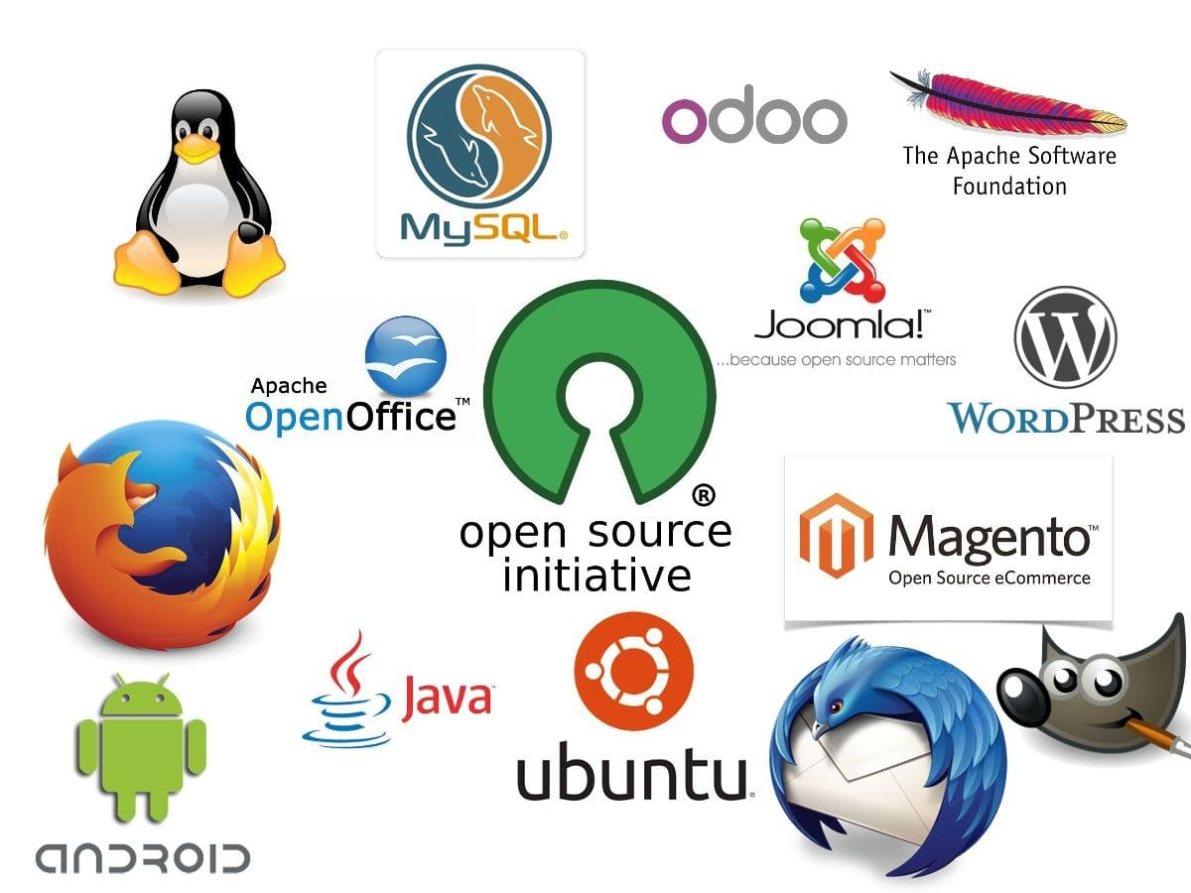
Contemporary Software Platform Trends
Open-source software:
Produced by community of programmers
Free and modifiable by user
Examples: Apache web server, Mozilla Firefox browser, OpenOffice
Linux
Open-source OS
Used in mobile devices, local area networks, Web servers, high-performance computing
Notes:
Linux plays a major role in the administration of local area networks. Around 20% of the server operating system market is owned by Linux. Ask students to give reasons why an open-source operating system might be a better choice for network administrators than alternatives that are not open-source (such as Microsoft’s Windows server).

Slide 17
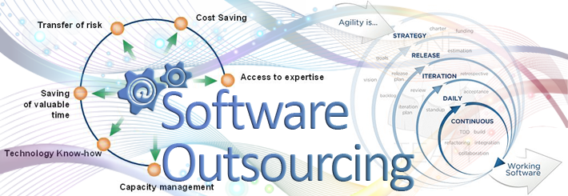
Contemporary Software Platform Trends
Software outsourcing and cloud services
Three external sources for software:
Software packages and enterprise software
Software outsourcing
Contracting outside firms to develop software
Cloud-based software services
Software as a service (SaaS)
Accessed with Web browser over Internet
Service Level Agreements (SLAs): formal agreement with service providers
Notes:
This slide discusses the trend in software outsourcing and in cloud software services. Remind students that internal sources for software refers to developing software fully in house. Most companies today purchase or lease software or outsource development. Why do students think that software outsourcing is growing quickly in popularity? How about offshore outsourcing (mostly to India and other English-speaking, developing countries)? Ask students what types of software they have used online. Note that service level agreements are formal contracts between customers and their service providers that define the specific responsibilities of the service provider and the service expected by the customer. These are important to establish communication between the two firms and to manage the project efficiently.

Slide 18

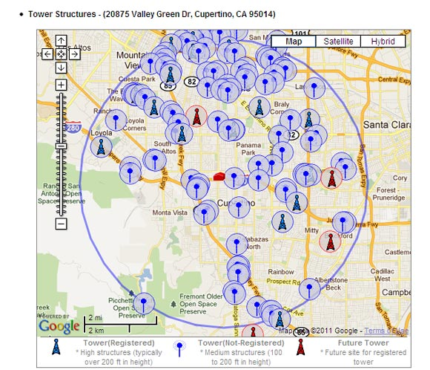
Contemporary Software Platform Trends
Software outsourcing and cloud services (cont.)
Mashups
Combinations of two or more online applications, such as combining mapping software (Google Maps) with local content
Apps
Small pieces of software that run on the Internet, on your computer, or on your cell phone
iPhone, Android
Generally delivered over the Internet
Notes:
In addition to the large enterprise software packages and services, some business tasks can be enabled through smaller programs or components that are combined to create a new function. The open-source movement, and the universal standards of Internet technologies, have created an environment in which software components can be created, used, and shared easily. Ask students which mashups and apps they have used. Have any students created any mashups or apps?

Slide 19
Thank You

