Slide 1
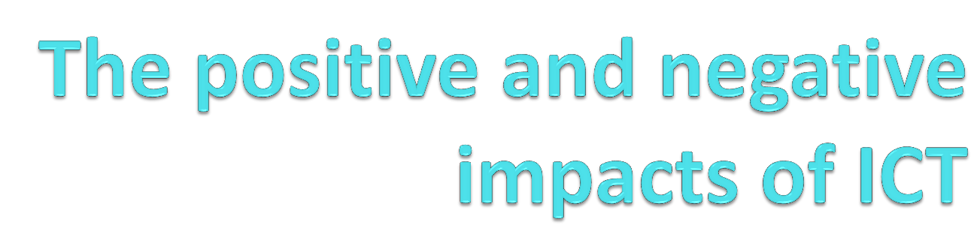
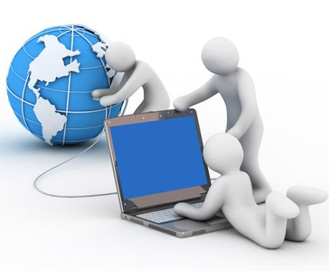

Slide 2
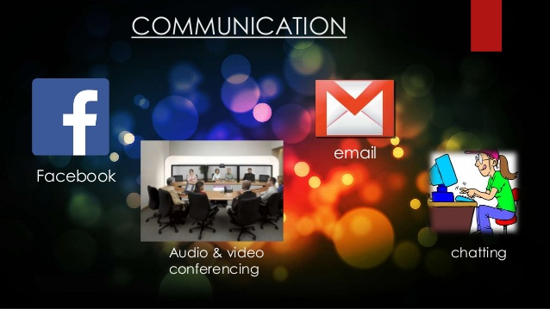
Learning Outcomes
Social Networking: Positives/Negatives
Personal Security: Positives/Negatives
Generation barriers: Positives/Negatives
Health: Benefits/Negatives
Business: Positive/Negatives
School: Positives/Negatives
Positive Overall
Negative Overall

Slide 3


Social Networking: Positive
On the Internet you can use social networking sites such as Facebook and twitter etc.
On these websites, you can talk to your friends and people you haven't seen in a long time. This has a positive impact on society because you can communicate to a wider range of people over the internet.

Slide 4
Social Networking: Negative
The Negative impact of social networking sites is that it would improve the likely hood of paedophiles, stalkers and cyber bullying because using the internet would be an easy way to do it.
Also it may increase the rate of crime due to websites because of cyber bullying, paedophiles and stalkers. Also people could pretend to be you on these websites.

Slide 5
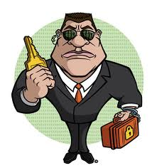
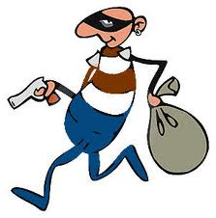
Personal Security: Positive/Negative
When you are searching online you have some form of internet security which should protect you from hackers, thieves, identity theft and viruses.
The negativity on the security is that there are some hackers able to break through and steal things such as your credit card details.
They could also commit fraud and pretend to be you which could ultimately destroy your business and your reputation.

Slide 6
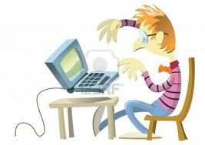
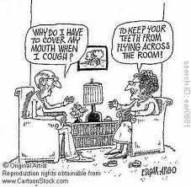
Generation Barriers
The impact from internet on the society has created some generation barriers; for example an elderly person would generally not understand anywhere near the amount about a computer than a child and this is a generation barrier.
The positive side is that the children can teach the older generation and help them.
The negative side is it may prevent one generation communicating with another.
That also mean they may not be communicating with other people in their families which is a negative impact on society.

Slide 7
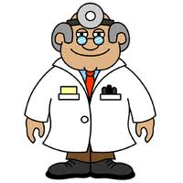
Health: Benefits
Using the internet you can find out what you have wrong with you if you are ill either by forums or have a conversation to a doctor using a webcam where you can get diagnosed by someone who live many miles away from you without the hassle of travelling to far.
Also if the symptoms are correct it allows you to know quicker so you would be able to act against the illness quicker.

Slide 8
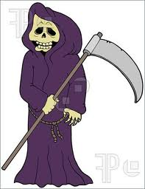
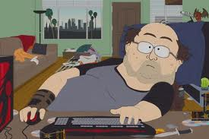
Health: Negatives
Using computers can have negative impacts on your health; for example if you are looking at a computer screen for long, it could damage your eyes.
Also if you are on a computer all day it would affect your health because you would not be getting any exercise.
Also the doctors online may diagnose you wrong because they are not seeing you in person.

Slide 9
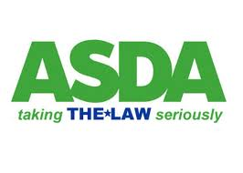

Business: Positive
Using the internet some world wide companies can produce large amounts of profit for example Tesco, Amazon and Asda. This is good way to make their company more known
It can produce and increase profit as some companies advertise their products on other websites to increase the interest in their products.
This is good because it lets people know which shop is selling what before they travel there or can purchase the product online.

Slide 10
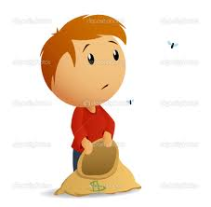
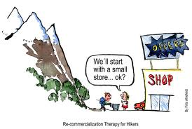
Business: Negative
The Negative side of ICT in business is that it makes it harder for new companies to succeed due to big companies such as Tesco, ASDA and Amazon being well known online websites
People would more likely visit their websites over new companies websites or stores. As a result of this newer companies could go into bankruptcy before they have barely even started to sell their products to the general public.

Slide 11
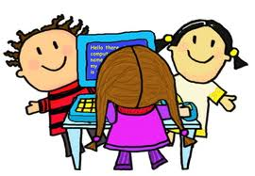
School : Positives
The positives for ICT in schools is that it gives students another option to study and get qualifications in it
It makes easier for students to research what needs to be searched also students can save their work onto the system and do their school work on the computers.
It can help students email their work to themselves so they can improve it at home.

Slide 12
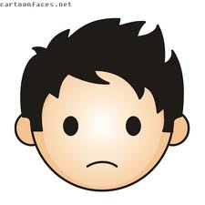
School: Negative
The negative impact from ICT on schools is that the work that students save on it could be deleted by a system error
They could have received the wrong information from the research they did because they used the wrong websites to get the information from.

Slide 13
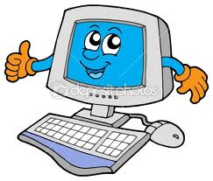
Positive Overall
Overall, the positives are that you can communicate to your friends fast over the internet, also you can research nearly anything online and you can purchase products online this makes it easier to purchase products and services.
Also it is easier people delivering the product to your house than going to the store and purchasing it in store.

Slide 14
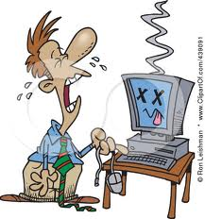
Negative Overall
The Negative impacts on society is that it creates a generation barrier where different generations are rarely communicating and it can make people vulnerable to hackers viruses and identity thieves
They could get the wrong information for things such as coursework if they are using the wrong websites for information.
It could cause some bad health because of damage to the eyes and also it could cause small businesses to go bankrupt.

Slide 15
Thank You

