Slide 1
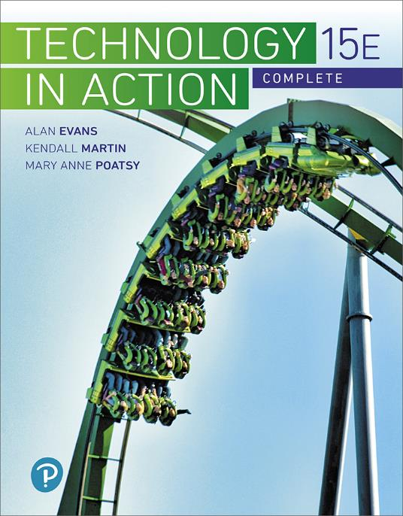
Technology in Action
15th Edition
Chapter 8
Managing a Digital Lifestyle: Media and Ethics
Notes:
If this PowerPoint presentation contains mathematical equations, you may need to check that your computer has the following installed:
1) MathType Plugin
2) Math Player (free versions available)
3) NVDA Reader (free versions available)

Slide 2
Learning Objectives (1 of 3)
8.1 Describe how digital convergence has evolved.
8.2 Explain the differences between digital and analog signals.
8.3 Describe the different types of e-readers.
8.4 Explain how to purchase, borrow, and publish e-texts.
8.5 Describe how digital music is created and stored.
8.6 Summarize how to listen to and publish digital music.
8.7 Explain how best to create, print, and share digital photos.
Notes:
Slide 2 is a partial list of textbook Learning Objectives numbers and statements.

Slide 3
Learning Objectives (2 of 3)
8.8 Describe how to create, edit, and distribute digital video.
8.9 Describe the various types of intellectual property.
8.10 Explain how copyright is obtained and the rights granted to the owners.
8.11 Explain copyright infringement, summarize the potential consequences, and describe situations in which you can legally use copyrighted material.
8.12 Explain plagiarism and strategies for avoiding it.
Notes:
Slide 3 is a continued list of textbook Learning Objectives numbers and statements.

Slide 4
Learning Objectives (3 of 3)
8.13 Describe hoaxes and digital manipulation.
8.14 Describe what comprises your online reputation and how to protect it.
Notes:
Slide 4 is the final list of textbook Learning Objectives numbers and statements.

Slide 5
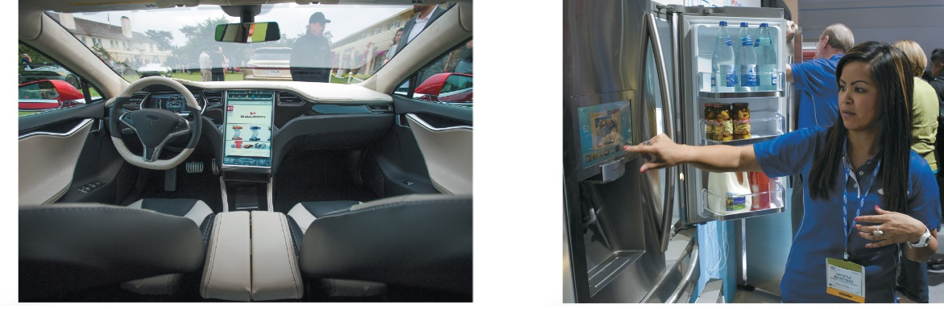
Digital Basics Digital Convergence (Objective 8.1)
Digital Convergence
Single unifying device to meet our digital needs
Media, Internet, entertainment, and telephone needs
Auto electronics have now converged with tablet technology
Internet of Things (IoT), networking common household items
Digital Living Network Alliance (DLNA)
Notes:
Digital convergence, the use of a single unifying device to handle media, Internet, entertainment, and telephone needs, is exemplified in the range of devices now on the market. You see digital convergence in the evolution of smartphones, which now let you do just about anything a computer can do.
The Internet of Things (IoT) includes networking common household items, like refrigerators.
The Digital Living Network Alliance is an organization working to standardize different kinds of appliances and network devices used in our homes.

Slide 6
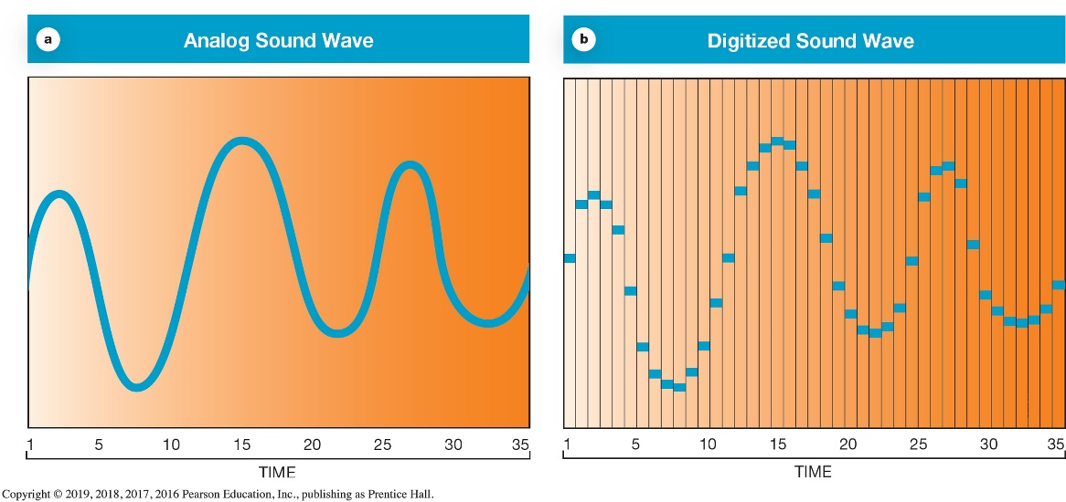
Digital Basics Digital vs. Analog (Objective 8.2)
Any kind of information can be digitized
Digital
Long strings of numbers
Analog
Continuous waves
Analog-to-digital conversion
Notes:
Any kind of information can be digitized.
Digital formats describe signals as long strings of numbers. This gives us a way to describe sound and light waves so that sounds and images can be reproduced perfectly.
A sequence of numbers can express complicated analog shapes with analog-to-digital conversion. The incoming analog signal is measured many times each second. The series of numbers produced by the analog-to-digital conversion process gives the digital form of the wave.

Slide 7
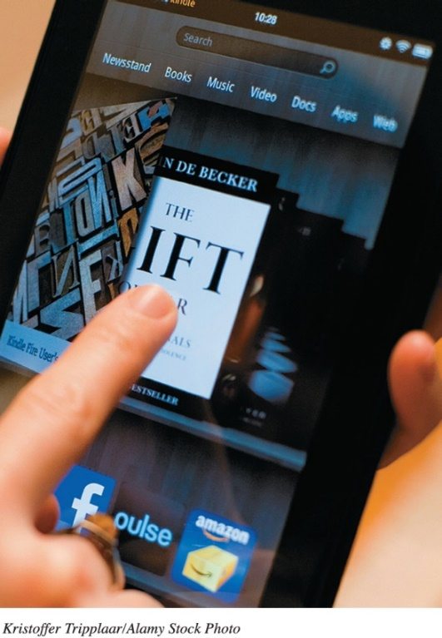
Digital Publishing E-Readers (Objective 8.3)
Electronic Text
Textual information captured digitally
E-readers
Devices that display e-text and have supporting tools
Allure of digital publishing
Distribution
Electronic Ink (E ink)
Sharp grayscale representation of text
Notes:
Electronic Text is textual information which has been captured digitally.
E-readers are devices that display e-text and have supporting tools.
The allure of digital publishing is the ease of distribution.
Electronic Ink (E ink) is a sharp grayscale representation of text.

Slide 8
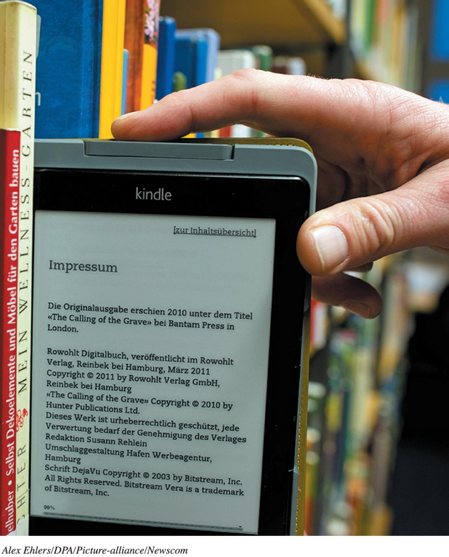
Digital Publishing Using e-Texts (Objective 8.4)
Using e-Texts
Amazon Kindle
Barnes and Noble Nook
Library
Project Gutenberg(gutenberg.org)
Self-publish through kdp.amazon.com
Notes:
There are free software versions of the Kindle and the NOOK that run on either PC or Apple computers. You can download texts and read them as a PDF file or by using browser add-ons.
Digital formats for publishing vary.
Amazon sells the Kindle.
Barnes and Noble sells the NOOK.
Project Gutenberg is a repository site with a collection of 42,000 free books.
Self-publishing is much easier in the age of digital texts.

Slide 9
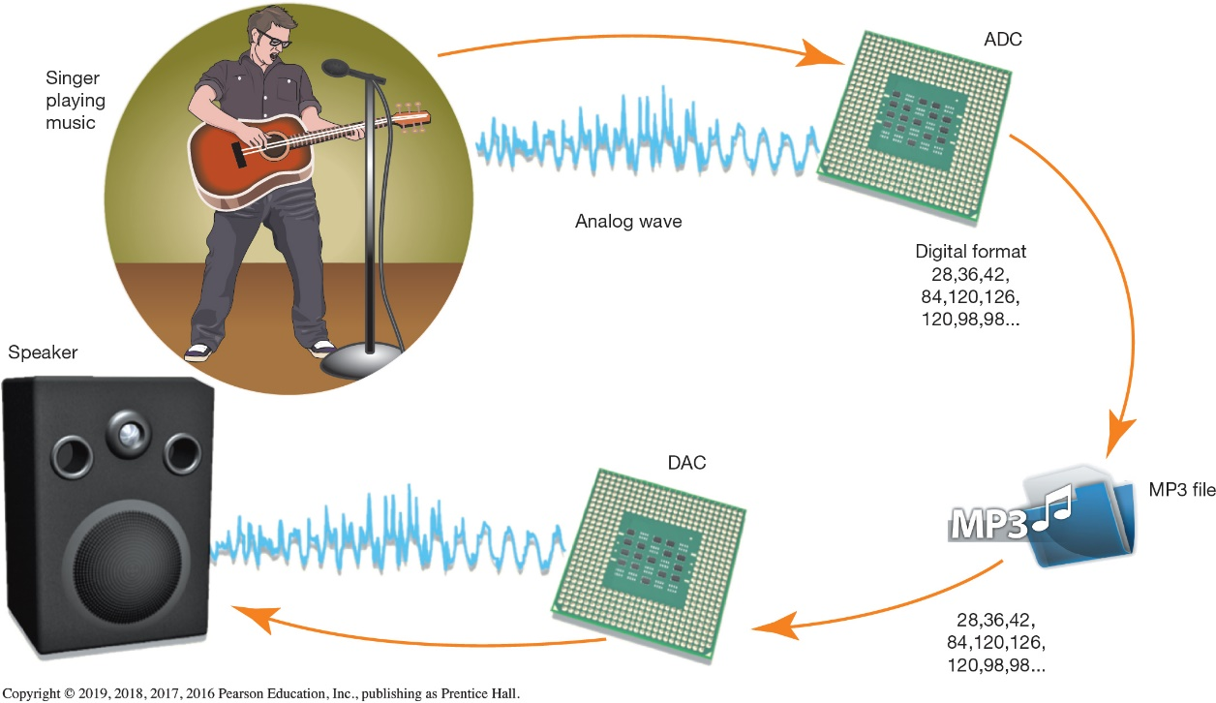
Digital Music Creating and Storing Digital Music (Objective 8.5)
Analog-to-digital converter (ADC)
File types, MP3,AAC,WMA,DivX,MPEG-4,WMV etc
Ripping, converting a song from a CD to MP3
Storage options
USB devices
Cloud services
Notes:
To record digital music, the sound waves need to be turned into a string of digital information through the analog-to-digital converter.
The sampling rate specifies the number of times the analog wave is measured each second.
There are several file formats used to store digital music and video including: MP3, AAC, WMA, DivX, MPEG-4 , WMV, and XviD. All file formats compete on sound and video quality and compression, which relates to how small the file can be and still provide high-quality playback.
Ripping is the process of converting a song from a CD to a digital MP3 file.
To move large volumes of data between your computer and music device, you can connect the devices using a USB port. Cloud services automatically push music to your mobile device.

Slide 10
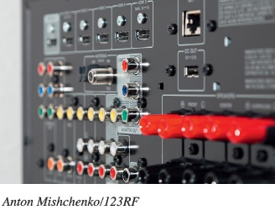
Digital Music Distributing Digital Music (Objective 8.6)
Options for Listening to Digital Music
Port or dock on an audio receiver
Networked audio/video receivers
New cars are equipped with an auxiliary input
Systems like Sonos can mate wirelessly with a mobile device
Digital Rights Management (DRM)
System of access that allows only limited use of material that’s been legally purchased
Notes:
Options for Listening to Digital Music include:
Port or dock on an audio receiver.
Networked audio/video receivers.
New cars are equipped with an auxiliary input.
Systems like Sonos can mate wirelessly with a mobile device.
Digital Rights Management (DRM) is a system of access that allows only limited use of material that’s been legally purchased.

Slide 11
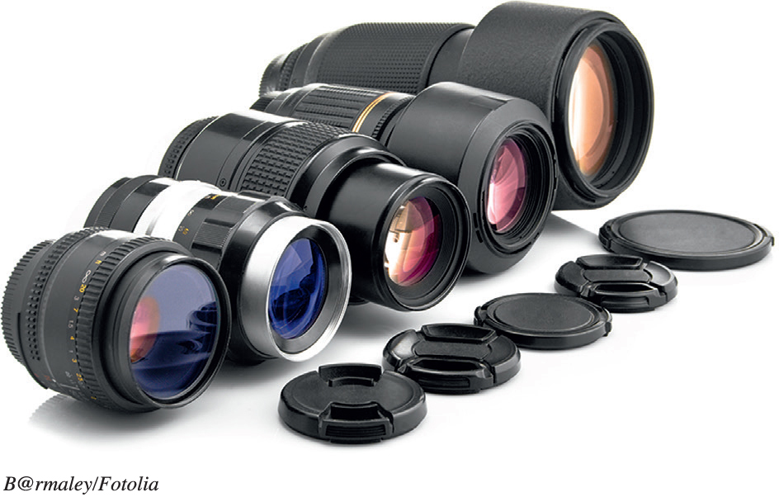
Digital Media Digital Photography (1 of 3) (Objective 8.7)
Digital cameras
Capture images and video
Convert to digital data
Factors that determine image quality
Quality of lenses
Image sensor size
File format and compression used
Color management software
Camera's resolution
Notes:
Digital cameras do not use film. Instead, they capture images on electronic sensors and then convert those images to digital data.
When choosing a camera, the first question to answer is whether you want a compact “point-and-shoot” model camera or a more serious digital SLR.
The overall image quality is determined by many factors:
Quality of lenses
Image sensor size
File format and compression used
Color management software
Camera's resolution

Slide 12
Digital Media Digital Photography (2 of 3) (Objective 8.7)
Resolution
Number of data points captured for each image
Pixel
Picture element is a single dot in a digital image
File Formats
RAW files record all the original image information
JPEG files can be compressed to varying degrees
Notes:
A picture’s resolution is the number of data points captured for each image.
A pixel is a picture element, namely, a single dot in a digital image.
File Formats for pictures include:
RAW files record all the original image information.
JPEG files can be compressed to varying degrees.

Slide 13
Digital Media Digital Photography (3 of 3) (Objective 8.7)
Printing digital photos
Photo printer(inkjet printers)
Photo-printing service
Flickr
Shutterfly
Notes:
The most popular and inexpensive ones are inkjet printers.
Most photo-printing labs, including film-processing departments at stores such as Target, offer digital printing services. Online services, such as Flickr and Shutterfly, store your images and allow you to create hard-copy prints, greeting cards, photo books, calendars, and gifts.

Slide 14
Digital Media Digital Video (1 of 2) (Objective 8.8)
Sources of digital video content include:
Television
Internet (Vimeo, Ustream)
Pay services (iTunes, Netflix, Hulu, and Amazon)
Digital camcorders or webcams allow recording of digital video
Video-editing software allows editing of digital video
Notes:
Sources of digital video content include:
Television.
Internet (Vimeo, Ustream).
Pay services (iTunes, Netflix, Hulu, and Amazon).
Digital camcorders of webcams allow recording of digital video.
Video-editing software allows editing of digital video.

Slide 15
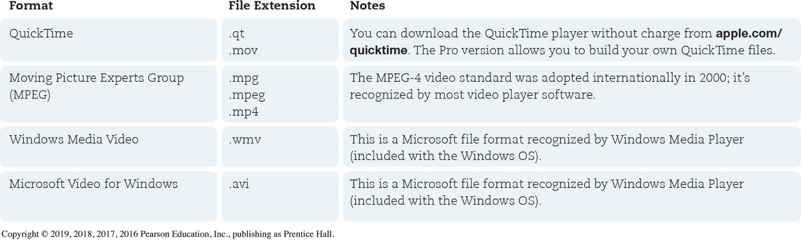
Digital Media Digital Video (2 of 2) (Objective 8.8)
Codecs are rules for compressing audio and video
High Definition is a standard that guarantees a specific resolution and aspect ratio
Notes:
Codecs are rules for compressing audio and video.
High Definition is a standard that guarantees a specific resolution and aspect ratio.
Figure 8.13 shows some of the popular video file formats in use, along with their file extensions.

Slide 16
Ethical Issues of Living in the Digital Age
Property comes in 2 general types:
Real and Personal
Real property is considered immovable, such as land or a home and its often called real estate
Personal property, which is stuff you own, comes in 2 types
Tangible and Intangible
Tangible, which is something like your phone or car
Intangible, cannot be touched – or potentially be seen
For example, ideas

Slide 17
Protection of Digital Property Intellectual Property (Objective 8.9)
Intellectual property (IP) is a product of a person’s mind
Categories of intellectual property
Copyright—protection to creators of “original works of authorship.” , lasts for the life of creator plus 70 years
Patents—grant inventors the right to stop others from manufacturing, using, or selling their inventions. 20 yrs, aren’t usually extendable
Trademarks—a word, phrase, symbol, or design or a combination of these.
Service marks—the same as a trademark, but it applies to a service as opposed to a product.
Trade dress visual appearance of a product or its packaging.
Notes:
Intellectual property (IP) is a product of a person’s mind.
Categories of intellectual property are:
Copyright—protection can be granted to creators of “original works of authorship.”
Patents—grant inventors the right to stop others from manufacturing, using, or selling their inventions.
Trademarks—a word, phrase, symbol, or design—or a combination of these—that uniquely identifies and differentiates the goods of one party from those of another.
Service marks—the same as a trademark, but it applies to a service as opposed to a product.
Trade dress—applies to the visual appearance of a product or its packaging.

Slide 18
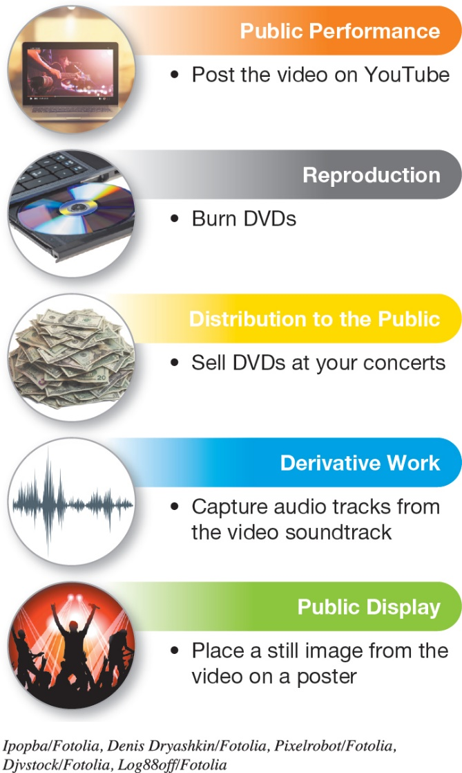
Protection of Digital Property Copyright Basics (Objective 8.10)
Begins when a work is created and fixed into a digital or physical form
Rights of a copyright holder
Public Domain (works without copyright protection)
Copyleft (enable copyright holders to grant certain rights to the work)
Notes:
Copyrights begin when works are created and fixed into a digital or physical form.
Rights of a copyright holder are shown in Figure 8.17.
Works are considered in the Public Domain if they have no copyright protection.
Copyleft are plans which enable copyright holders to grant certain rights to the work.

Slide 19
Protection of Digital Property Copyright Infringement (Objective 8.11)
Copyright infringement (when violations of the holder’s rights occur)
Music and video violations cause a significant loss of revenue
Software piracy is illegally using copyrighted software
Photos should be considered copyrighted
Fair use provides a way for people to use portions of a copyrighted work
Notes:
Copyright infringement happens when violations of the holder’s rights occur.
Music and video violations cause a significant loss of revenue.
Software piracy is illegally using copyrighted software.
Photos should be considered copyrighted.
Fair use provides a way for people to use portions of a copyrighted work.

Slide 20
Living Ethically in the Digital Era Plagiarism (Objective 8.12)
Copying text or ideas from someone else and claiming them as your own
Usually considered an academic offense and isn’t punishable under civil law
Cite the source if there is any doubt
Notes:
Plagiarism is the act of copying text or ideas from someone else and claiming them as your own.
Plagiarism is usually considered an academic offense of dishonesty and isn’t punishable under U.S. civil law.
Cite the source if there is any doubt.

Slide 21
Living Ethically in the Digital Era Hoaxes and Digital Manipulation (Objective 8.13)
A hoax is anything designed to deceive another person
Urban legends are incorporated into society as true events even though they are false
Can check out Urban legends at Snopes or Hoax-Slayer
Digital manipulation involves altering media from the way they were originally seen
Notes:
A hoax is anything designed to deceive another person.
Urban legends are incorporated into society as true events even though they are false.
Can check out Urban legends at Snopes or Hoax-Slayer.
Digital manipulation involves altering media from the way they were originally seen.

Slide 22
Living Ethically in the Digital Era Protecting Your Online Reputation (Objective 8.14)
Online reputation (the information available about you in cyberspace)
Persistence of information (facts about you might never disappear)
Protecting your online reputation:
Improve and update your personal profiles
Create positive content on relevant sites
Post frequently
Be vigilant
contact people who have posted negative things about you and see if you can get them deleted
Socialmention.com, trackur.com
Notes:
Your online reputation is the information available about you in cyberspace.
Persistence of information means that facts about you might never disappear from the Internet.
Ways to protect your online reputation include:
Improve and update your personal profiles.
Create content on relevant sites.
Post frequently.
Be vigilant.

Slide 23
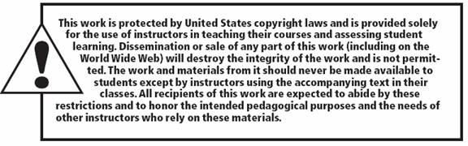
Copyright
All rights reserved. No part of this publication may be reproduced, stored in a retrieval system, or transmitted, in any form or by any means, electronic, mechanical, photocopying, recording, or otherwise, without the prior written permission of the publisher. Printed in the United States of America.

