Slide 1
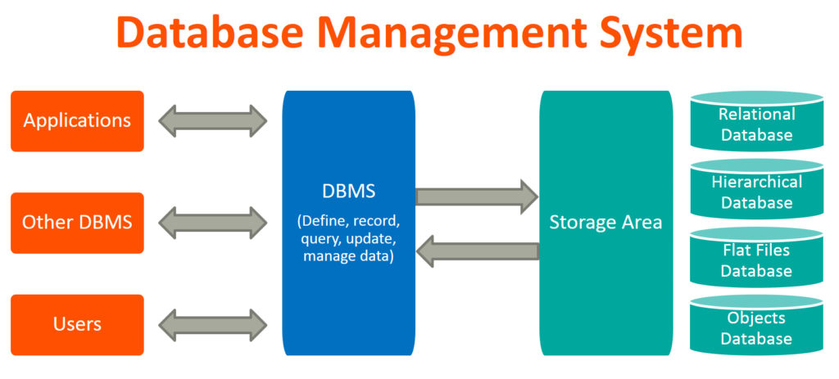
Database Systems

Slide 2
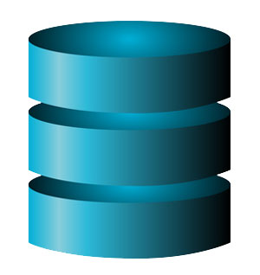
Examples of Database Applications
Purchases from the supermarket
Purchases using your credit card
Booking a holiday at the travel agents
Using the local library
Taking out insurance
Renting a video
Using the Internet
Studying at university

Slide 3
Definitions of Database
Def 1: Database is an organised collection of logically related data
Def 2: A database is a shared collection of logically related data that is stored to meet the requirements of different users of an organization
Def 3: A database is a self-describing collection of integrated records
Def 4: A database models a particular real world system in the computer in the form of data

Slide 4
Definitions
Data: stored representations of meaningful objects and events or
Referred to facts concerning objects and events that could be recorded and stored on computer media
  Structured: numbers, text, dates
  Unstructured: images, video, documents
Information: data processed to increase knowledge in the person using the data
Metadata: data that describes the properties and context of user data

Slide 5
What is a Database
Shared collection of logically related data (and a description of this data), designed to meet the information needs of an organisation.
System catalog (metadata) provides description of data to enable program–data independence.
Logically related data comprises entities, attributes, and relationships of an organisation’s information.

Slide 6
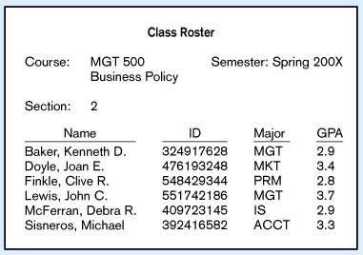
Figure 1-1a Data in Context
Context helps users understand data

Slide 7
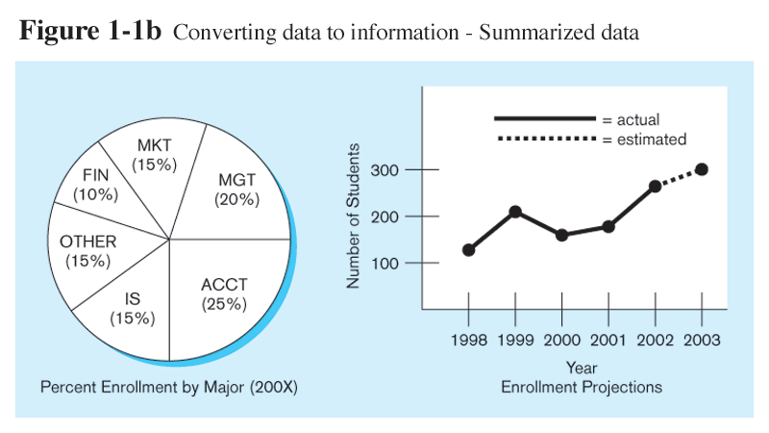
Graphical displays turn data into useful information that managers can use for decision making and interpretation

Slide 8
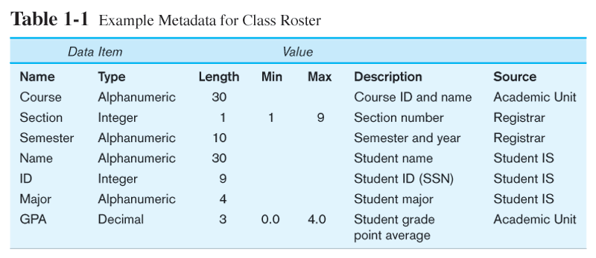
Descriptions of the properties or characteristics of the data, including data types, field sizes, allowable values, and data context

Slide 9
The concept of a shared organizational database
Management
Marketing
Planning
Control
Sales
Product
Development
Corporate
Database
Accounting
Manufacturing
Accounts
Receivable
Accounts
Payable
Scheduling
Production

Slide 10
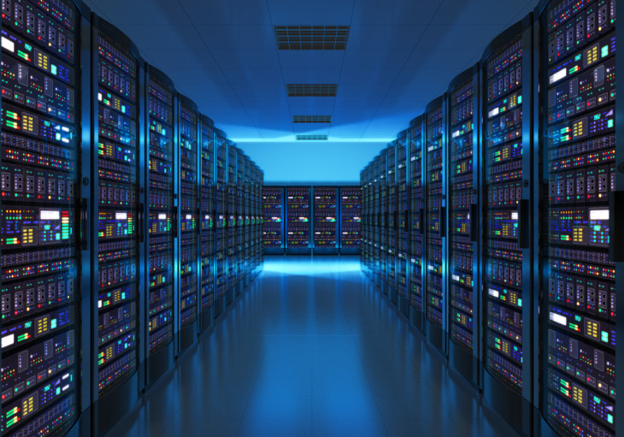
A bit of History
Computer initially used for computational/ engineering purposes
Commercial applications introduced File Processing System

Slide 11
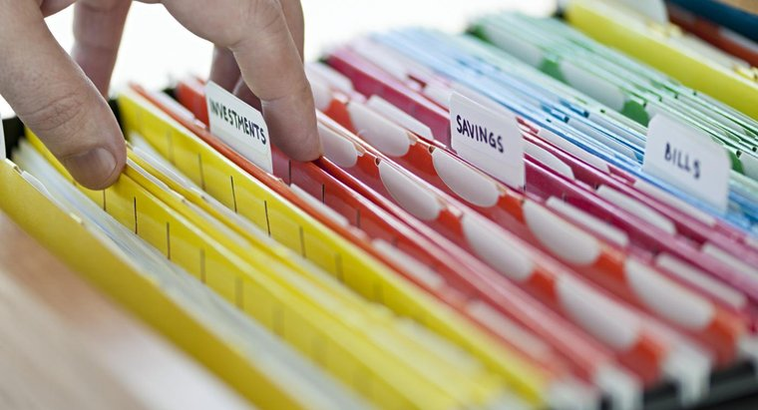
File Processing System
A collection of application programs that perform services for the end-users such as production of reports
Each program defines and manages its own data

Slide 12
File Processing Systems
Library
Examination
Registration
Library
Applications
Examination
Applications
Registration
Applications
Library
Data
Files
Examination
Data
Files
Registration
Data
Files
Program and Data Interdependence

Slide 13
File Processing Systems
Library
Examination
Registration
Reg_Number
Reg_Number
Reg_Number
Name
Name
Name
Father Name
Address
Father Name
Books Issued
Class
Phone
Fine
Semester
Address
Grade
Class

Slide 14
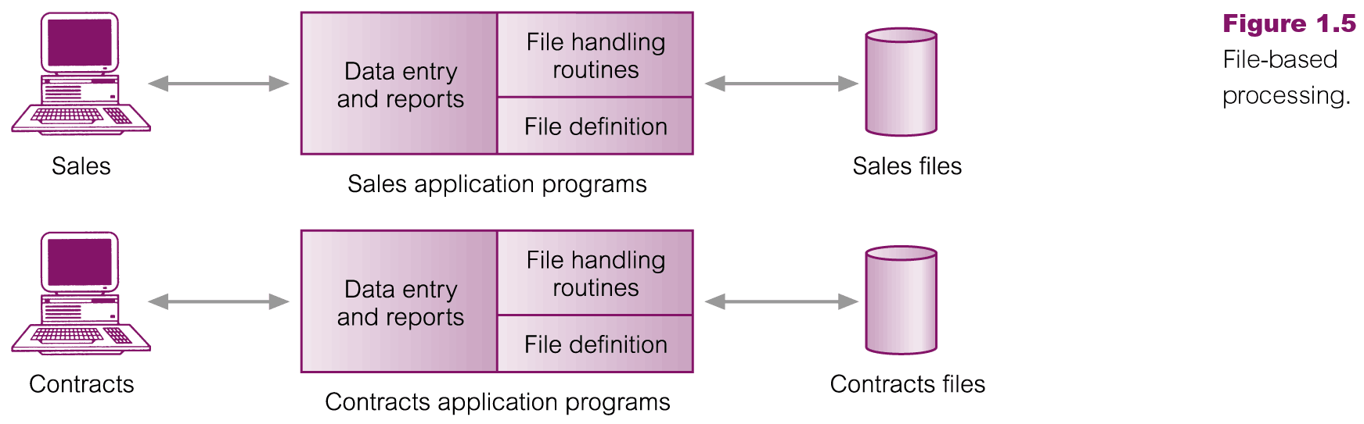
Files Based Processing

Slide 15
Disadvantages of File Processing
Program-Data Dependence
  File structure is defined in the program code.
  All programs maintain metadata for each file they use
Duplication of Data (Data Redundancy)
  Different systems/programs have separate copies of the same data
  Same data is held by different programs.
  Wasted space and potentially different values and/or different formats for the same item.
Limited Data Sharing
  No centralized control of data
  Programs are written in different languages, and so cannot easily access each other’s files.

Slide 16
Disadvantages of File Processing
Lengthy Development Times
  Programmers must design their own file formats
Excessive Program Maintenance
  80% of of information systems budget
Vulnerable to Inconsistency
  Change in one table need changes in corresponding tables as well otherwise data will be inconsistent

Slide 17
Problems with Data Dependency
Each application programmer must maintain their own data
Each application program needs to include code for the metadata of each file
Each application program must have its own processing routines for reading, inserting, updating and deleting data
Lack of coordination and central control
Non-standard file formats

Slide 18
Problems with Data Redundancy
Waste of space to have duplicate data
Causes more maintenance headaches
The biggest problem:
  When data changes in one file, could cause inconsistencies (Vulnerable to Inconsistency)
  Compromises data integrity (data reliability)

Slide 19
SOLUTION:
The DATABASE Approach
Central repository of shared data
Data is managed by a controlling agent
Stored in a standardized, convenient form
This requires a
Database and Database Management System (DBMS)

Slide 20

Advantages of Database Approach
Library
Examination
Registration
Library
Applications
Examination
Applications
Registration
Applications
Database
Management
System
- Data Sharing
- Data Independence
University
Students
Database
- Controlled Redundancy
- Better Data Integrity

Slide 21
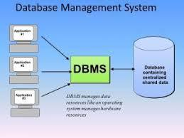
Database Management System
A software system that is used to create, maintain, and provide controlled access to users of a database
(Database) application program: A computer program that interacts with database by issuing an appropriate request (SQL statement) to the DBMS

Slide 22
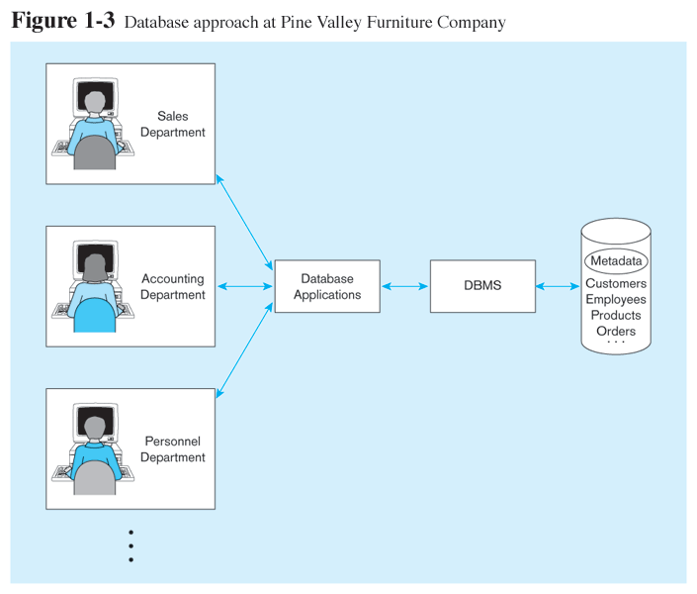
Database Management System
DBMS manages data resources like an operating system manages hardware resources

Slide 23
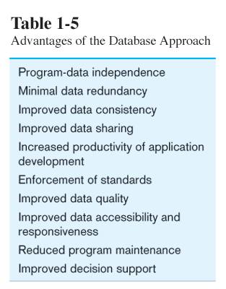

Slide 24
