Slide 1

Communication and Collaboration methods and tools

Slide 2

Collaboration VS CCCs(Communication, Coordination and Cooperation)
Collaboration and CCCs are so intertwined that it is hard to separate and define.
In order to collaborate, you must communicate, coordinate and cooperate. You can communicate all day long without collaboration.
Communication: Exchange of information
Coordination: Communication, which begins with differences.
Cooperation: the act or process of working together to the same end. Assistance, especially by complying readily with requests.
Notes:
Communication speaks to how persons understand each other and how information (not just “facts,” but policies, prospects, rumors, feelings, failures, and all other human experiences) is transferred in organizations. While “lack of communication” tops the problem list in most organizations, the diagnosis is a facile one for many reasons.
Coordination, like communication, begins with an assumption of differences. Different persons, different units, different units create overlap, redundancy and/or separation without coordination. As in athletics, we are coordinated when the arms and legs move together. Everything falls into balance if not symmetry. Coordination is about efficiency. Coordination achieves efficiency of motion but tells us nothing about the consequence of motion. To speak of a “well oiled” machine or team tells us that friction is reduced but not that results are achieved.
Cooperation is now a hallmark for not every corporate behavior, but corporate culture. The message is clear: get with the group. The observation that Sue or Dan is “not a team player” signals limited mobility in any large organization. While at some level who could object to cooperative behaviors, not everyone adds their highest value by adding soothing thoughts to a “group think.” Cooperation is important but so is divergence. If someone has a very different idea to contribute to the group—perhaps as a challenge to its current directions, norms, or assumptions, is it “non-cooperative” to raise it? Much of creativity comes from the sparks of disagreement, dissent, and even conflict. Cooperation too often becomes a call for increased socialization to a culture, not a prompt for high performance. Also, one opposite of cooperative is competitive. Do we deny that “competitive juices” can be useful? Consider also that virtually all of what we call “strategy” is about competitive or comparative advantage. Cooperative thinking is rarely the same as strategic insight.

Slide 3

Collaboration
Collaboration is the process of shared creation: two or more individuals with complementary skills interacting to create a shared understanding that none had previously possessed or could have come to on their own.
Collaboration creates a shared meaning about a process, a product, or an event.
In this sense, there is nothing routine about it. Something is there that wasn’t there before.

Slide 4
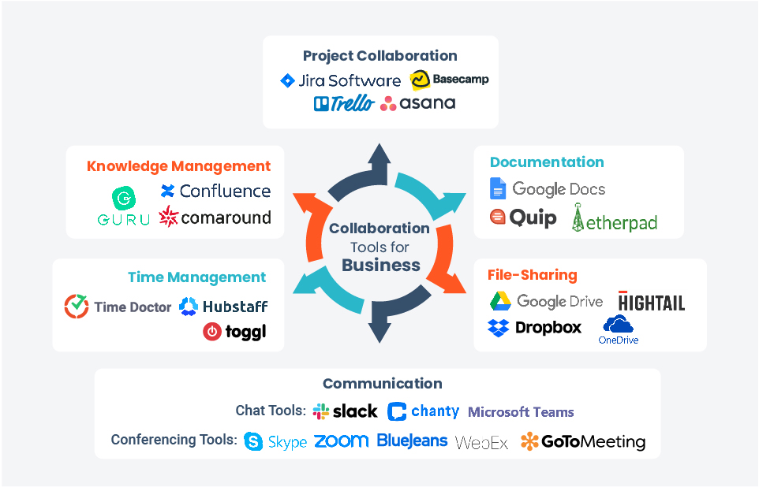
Collaborating and Communicating on the Web
Online communication and collaboration
Notes:
Instant messaging services let you communicate in real time over the Internet.
AIM, Google Chat, Windows Messenger, and Yahoo! Messenger are proprietary IM services, meaning you can chat with only those who share the same IM service and are on your contact or buddy list.
There are universal chat services that you install, which allow you to chat with users of all popular IMs.
Texting is the sending of messages between devices.
Voice Over Internet Protocol (VOIP) uses the Internet to make phone calls.

Slide 5
Collaborating with Web Technologies
Web 2.0 (User is also a participant)
Social Web is a collaborative, user created-web
Collaboration tools, helping people to collaborate
Social media, a means of communication
Social networking, project collaboration, file sharing tools, blogs, podcasts, webcasts, media sharing etc.
Social Networking
Refers to using the web to communicate and share information
Facebook, Twitter, Linked-In
Privacy precautions
Notes:
The new collaborative, user-created web content has been dubbed Web 2.0.
Web 2.0 can be classified as social media and include social networking, wikis, blogs, podcasts, and webcasts.
Social networking is using the web to communicate and share information.
Social networking services have become popular.
You need to be aware of many precautions as you use social networking sites.

Slide 6
Collaborating with Web Technologies
Types of Social Networking Sites
Social Communication: Facebook, Twitter, Snapchat, WhatsApp
Media Sharing: Instagram, YouTube, Pinterest,Spotify
Business Networking and Collaboration: LinkedIn, Slack, Kickstarter, StartupNation
Information Sharing:SlideShare,StumbleUpon, Reddit, Digg
Social Commerce and Payment: PayPal, Venmo, Groupon, GoFundMe
Social Travel: Uber, Airbnb, TripAdvisor, Waze
Health and Fitness: MapMyFitness, Fitocracy,MyFitnessPal,Happier
Notes:
The new collaborative, user-created web content has been dubbed Web 2.0.
Web 2.0 can be classified as social media and include social networking, wikis, blogs, podcasts, and webcasts.
Social networking is using the web to communicate and share information.
Social networking services have become popular.
You need to be aware of many precautions as you use social networking sites.

Slide 7
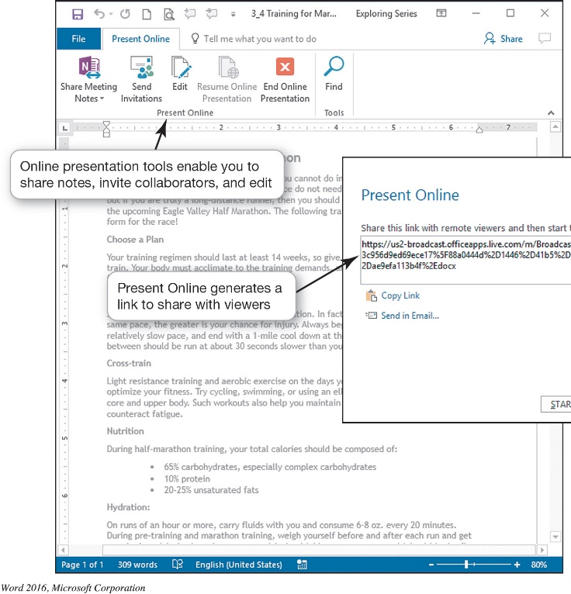
Collaborating with Web Technologies
Project Collaboration and File Sharing Tools
Wikis: Collaborative Web-based documents
Wikibooks, wikiversity, wikisource, wikihow etc.
Google Docs, MS Office Online
Project Management Tools
Slack, Monday, Trello, Asana, Wrike, Clarizen, Jira, Basecamp etc.
Blogs
Blog (weblog), Video log (vlog)
Create your own blog
blogger.com,wordpress.com
Microblogs
Notes:
Wikipedia is one example of a wiki, a web application that allows users to add, remove, or edit its content.
Google Drive has wiki-like features to promote similar online collaboration, and specific wiki software, such as Wikispaces and MediaWiki.
The Wikimedia Foundation hosts other collaborative projects, such as Wikibooks, Wikiversity, and Wikisource.
Project management tools incorporate tasks and calendars so the individual components as well as the entire project can stay on schedule.
A blog (short for weblog) is a personal log or journal posted on the web.
A video log (vlog or video blog) is a blog that uses video as the primary content.
You can easily create your own blog.
Problems with blogs include spam blogs (splogs).
Microblogs are blogs with limits on how much text can be used.

Slide 8
Collaborating with Web Technologies
Podcasts
Is a form of digital media comprising a series of audio/video files distributed over the internet automatically
Ex: podcasts for radio shows, audiobooks etc.
Podsearch.com – broad collection of podcasts
Overcast.fm – Podcast player for Apple mobile devices,
Webcasts
Broadcast of audio or video content over the Internet, usually live. Ex. Nugs.net
Media Sharing Platforms
YouTube, Flickr, Instagram, Sound Cloud
Notes:
A podcast is a form of digital media composed of a series of audio or video files that are distributed over the Internet.
Podcasts deliver their content using Really Simple Syndication, a format that sends the latest content of the podcast series automatically to an aggregator. An aggregator locates all the RSS series to which you’ve subscribed and automatically downloads the new content.
A webcast is the broadcast of audio or video over the Internet.
There are several media sharing platforms such as: YouTube, Flickr, Instagram, and Sound Cloud.

Slide 9
Communicating with Web Technologies
E-mail
Primary means of communication
Written message sent or received
Asynchronous
Convenient
Not private
Etiquette
CC, BCC, Subject Line, Spell-Check and Proofread, no abbreviations, concise and clear, signature
Web-based E-mail
E-mail client, Ex: Microsoft Outlook
Notes:
E-mail is the primary means of communication over the Internet because it is fast and convenient. E-mail is a written message sent or received over the Internet.
It is asynchronous, so users do not need to be communicating at the same time.
E-mail is convenient for exchanging and collaborating on documents via attachments.
It is a more private exchange of information than public social networking sites, but e-mails are not really private.
When you send e-mail for professional reasons, you should use proper e-mail etiquette.
There are two types of email: Web-based and using an E-mail client.

Slide 10

Communicating with Web Technologies
Communicate in real time
Instant Messaging
Texting
VoIP
Notes:
Instant messaging services let you communicate in real time over the Internet.
AIM, Google Chat, Windows Messenger, and Yahoo! Messenger are proprietary IM services, meaning you can chat with only those who share the same IM service and are on your contact or buddy list.
There are universal chat services that you install, which allow you to chat with users of all popular IMs.
Texting is the sending of messages between devices.
Voice Over Internet Protocol (VOIP) uses the Internet to make phone calls.

