Slide 1

E-Learning for Education
Lecture 3

Slide 2

LEARNING OUTCOMES
What is E-Learning?
Truth of E-Learning
Education Market
Why e-Learning
Approaches to e-Learning
Advantages vs disadvantages
Limitations
Evolution
Traditional vs e-Learning
E-learning tools

Slide 3
What is E-learning?
E-learning pioneer Luskin(2010) explains “E” as everywhere, exciting, energic, enthusiastic, emotional, extended and educational.
It is warehouse of education, knowledge and performance management.
E-learning has grown rapidly because of internet as well as present covid-19 crisis
Web-based learning is a subset of E-learning and takes place through a web-based environment..
E-Learning defines any learning process through use of digital technologies
The term online learning (or, as it is sometimes called, distance learning) includes a number of computer-assisted instruction methods.
Online teaching and learning is faculty delivered instruction via the internet.
Online instruction includes real-time (synchronous) and anytime, anywhere (asynchronous) interactions.

Slide 4
Reality of e-learning
Internet has started reshaping education but the use growing fast since 1990s.
Education will never be the same in the future and is already happening due to pandemic, COVID-19
There is no going back, the traditional classroom has to be transformed.
Many universities/colleges may not survive by the end of this decade, but have to be transformed the way they teach, conduct lectures and assess students

Slide 5
E-learning is becoming big
Education and training forms one of the largest sectors of the economy in most countries
Over the last decade, overall, the number of corporate universities have grown rapidly, though there is some decline in some parts of USA but growing in Europe and Asia.
Several Fortune 500 companies have established corporate Universities, for example, Oracle, McDonalds, General Electric
Skilled jobs now represent a significant percentage of all jobs in US, in contrast to very low in 1950.

Slide 6
Online Student population in US colleges has increased dramatically to many millions today
In Malaysia, with one university in 1957 to currently over 20 public and 47 private universities and 10 foreign university branches. (E.Services, 2019)
The US Army has established an online educational portal for its army personnel for a degree programmes
The future students may never use books and rely solely on computers
A big growth is expected in the education market

Slide 7
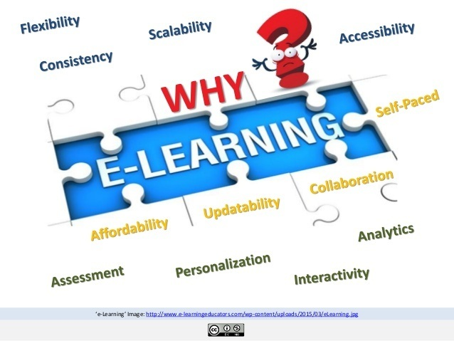
Why E-learning?
Has a Global Reach
Spans multiple devices including mobile devices
Is just-in-time/needs-based
Is more efficient
Reduce costs
Allows for consistent quality and content
Can be either synchronous or asynchronous learning

Slide 8

Approaches to online learning
Synchronous learning
is instruction and collaboration in “real time” via the internet.
It typically involves tools, such as:
live chat
audio and video conferencing
data and application sharing
shared whiteboard
virtual "hand raising"
joint viewing of multimedia presentations and online slide shows

Slide 9

Approaches to online learning
Asynchronous learning
Asynchronous learning methods use the time-delayed capabilities of the internet. It typically involves tools, such as:
E-mail
Threaded discussion
Newsgroups and bulletin boards
File attachments
Asynchronous courses are still instructor-facilitated but are not conducted in real time, which means that students and teacher can engage in course-related activities at their convenience rather than during specifically coordinated class sessions

Slide 10
Classroom vs E-learning
Traditional and E-learning approaches
 | Traditional Classroom | E-Learning
Classroom | Physical – limited size Synchronous | Unlimited Anytime, anywhere
Content | Slides, Chalk&Board etc Textbooks/library Video clips Collaboration | Multimedia / simulation Digital library On demand Sync & Async. Communication
Personalisation | One learning path | Learning path and pace determined by learner

Slide 11

Advantages of Online Learning
It's less expensive to produce
It's self-paced
It’s self-directed and moves faster
It can work from any location and any time
It can be updated easily and quickly
It can lead to increased retention and a stronger grasp on the subject
24/7 accessibility makes scheduling and managing easy for large groups of students
It provides a consistent message
Enhances computer and Internet skills
Travel time and associated costs are reduced or eliminated
Inexpensive Worldwide Distribution
Cross-platform Support

Slide 12

Disadvantages of Online Learning
No self-discipline
No face-to-face interaction
Lack of flexibility
Slow evolution
Good e-learning is difficult to do
Lack of transformational power
No peripheral benefits.

Slide 13

Limitation of Online-Learning
It may be a solo act
It may be impersonal
Too much time spent in front of a computer screen may be harmful
It requires self-discipline
Possible lack of control
Some topics are not appropriate for e-Learning

Slide 14

Evolution of Education technology
IMPACT
Internet:
Greatest
impact
TIME
TIME

Slide 15

E-Learning: Blended mode
Chalk-and-board has long
ruled the classrooms
will not be eliminated
Less emphasis
Interactive Digital Content
more emphasis
on demand learning
interactive

Slide 16
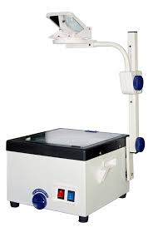
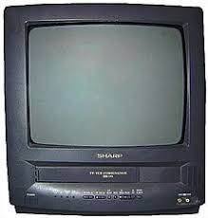
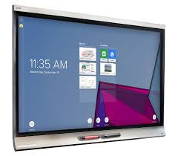

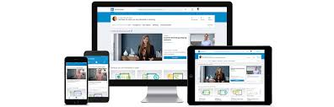

Teaching Aids have changed
INDUSTRIAL AGE
LEARNING MODEL
DIGITAL AGE
LEARNING MODEL

Slide 17
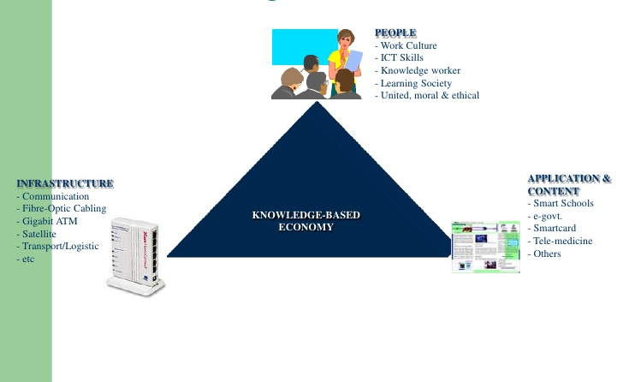
National ICT Agenda to adopt and/or improve e-learning

Slide 18
ICT Education Vision

Slide 19
Building e-Learning Culture
Teacher:
Develop knowledge & skills
Understand learning and its need
Facilitate learning
Create learning opportunities
Learner:
Self-directed
Self-motivated
Self-regulating
Lifelong learning
Building an
E-learning
Culture
Administrator:
Create Learning environment
Provide ICT infrastructure
Resources for lifelong learning

Slide 20

E-learning tools: E-mail
Communicate with students
Students can submit assignment as attachment, though it is not recommended since Learning Management Systems are recommended and practical
Create a paperless environment
Simple but effective
Efficient and cost effective

Slide 21

E-learning tools: Chat
Synchronous communication tool
Communicate with students
Communicate with staff
More students can participate
Collaborative learning
Classroom rapport cannot be created

Slide 22

E-learning tools: Online Forum
Asynchronous discussion forum
Lecturers can create discussion groups
Academics could post a question and request students to comment
Students can post their comments
Can encourage community participation
Collaborative learning can be fostered
Feedback from diverse culture

Slide 23

E-learning Tools: Web
Wide range of materials available
Teacher train students to narrow down
It is a resource centre
Sharing of resources
Supported by images, audio, simulation and multimedia

Slide 24
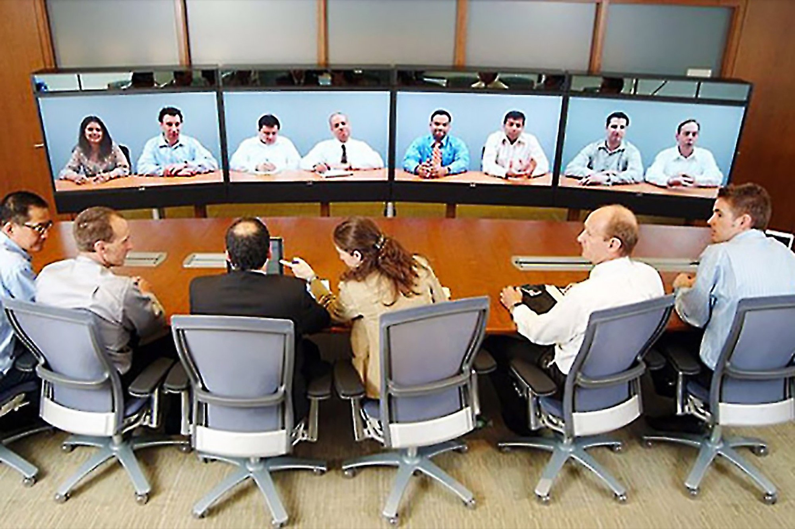
E-learning tools: Video Conference
Can conduct a live lecture
Communication with students
Support by audio, chat and whiteboard
Support sharing of applications
Can be recorded and later be used for on demand lectures
What do you think of Zoom or Teams?

Slide 25
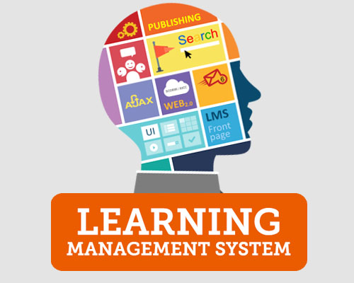
Tools: Learning Management System (LMS)
Management of content
Tracking students
Administrative features
Integration with various tools such as chat, forum, e-mail, etc.
Reporting
Student Portal (based on Moodle)

Slide 26

Conclusion
ICT and e-learning offers opportunity to raise educational standards in schools
Large range of ICT tools are available for teaching and learning
Closes the gap of “Digital Divide”
Involvement of teachers and parents is important, especially in schools
Schools will need funding, access and training

Slide 27
Reference list
Duffin, E. (2019). Education levels of active duty U.S. Armed Forces personnel in 2018. [online] Statista. Available at: https://www.statista.com/statistics/232726/education-levels-of-active-duty-us-defense-force-personnel/ [Accessed 11 Aug. 2020].
Duffin, E. (2020). U.S. college enrollment statistics 1965-2027 | Statista. [online] Statista. Available at: https://www.statista.com/statistics/183995/us-college-enrollment-and-projections-in-public-and-private-institutions/ [Accessed 11 Aug. 2020].
E.Services, W. (2019). List of Universities in Malaysia. [online] StudyMalaysia.com. Available at: https://www.studymalaysia.com/education/top-stories/list-of-universities-in-malaysia [Accessed 11 Aug. 2020].
Hirshmann, R. (2012). Malaysia: students in public higher education institutions by gender | Statista. [online] Statista. Available at: https://www.statista.com/statistics/794845/students-in-public-higher-education-institutions-by-gender-malaysia/.
Luskin, B. (2010). Think “Exciting” E-Learning and the Big “E”. [online] Educause review. Available at: https://er.educause.edu/articles/2010/3/think-exciting-elearning-and-the-big-e [Accessed 12 Apr. 2019].‌

