Slide 1

Introduction to
Cloud Computing & storage

Slide 2
Learning Outcomes
What is Cloud computing?
Attributes of Cloud
Different types of service models
Different types of deployment models
Architecture of Cloud computing
Purpose and benefits of Cloud
Cloud Sourcing
Cloud Storage
Opportunities and Challenges
Advantages and Disadvantages
2

Slide 3
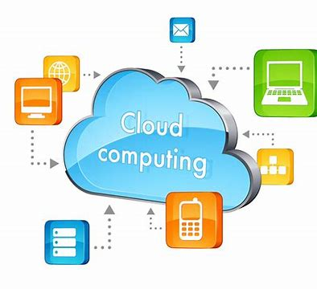
What is Cloud Computing?
Cloud Computing is a general term used to describe a new class of network based computing that takes place over the Internet,
basically a step on from Utility Computing
a collection/group of integrated and networked hardware, software and Internet infrastructure (called a platform).
Using the Internet for communication and transport provides hardware, software and networking services to clients
These platforms hide the complexity and details of the underlying infrastructure from users and applications by providing very simple graphical interface or API (Applications Programming Interface).
In addition, the platform provides on demand services, that are always on, anywhere, anytime and any place.
The hardware and software services are available to
general public, enterprises, corporations and businesses markets
Cloud computing is an umbrella term used to refer to Internet based development and services
3

Slide 4
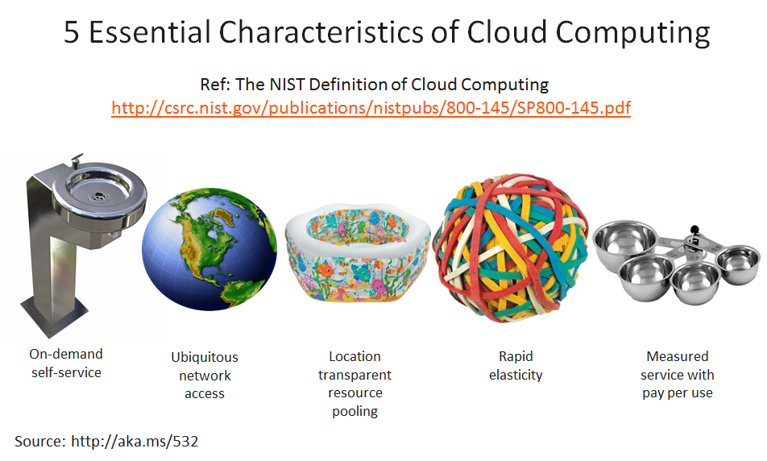
FIVE Key Attributes of Cloud Computing
Elasticity: Resources can be rapidly and elastically provisioned. scale up and down in capacity and functionalities
Pay-By-Use: The use of cloud system resources is measured, audited, and reported to the customer based on a metered system.
Self Service: A client can provision computer resources without the need for interaction with cloud service provider personnel.
Broad Network Access: Access to resources in the cloud is available over the network.
Location Transparent: Services or data are hosted on remote infrastructure, which is not known to the client

Slide 5
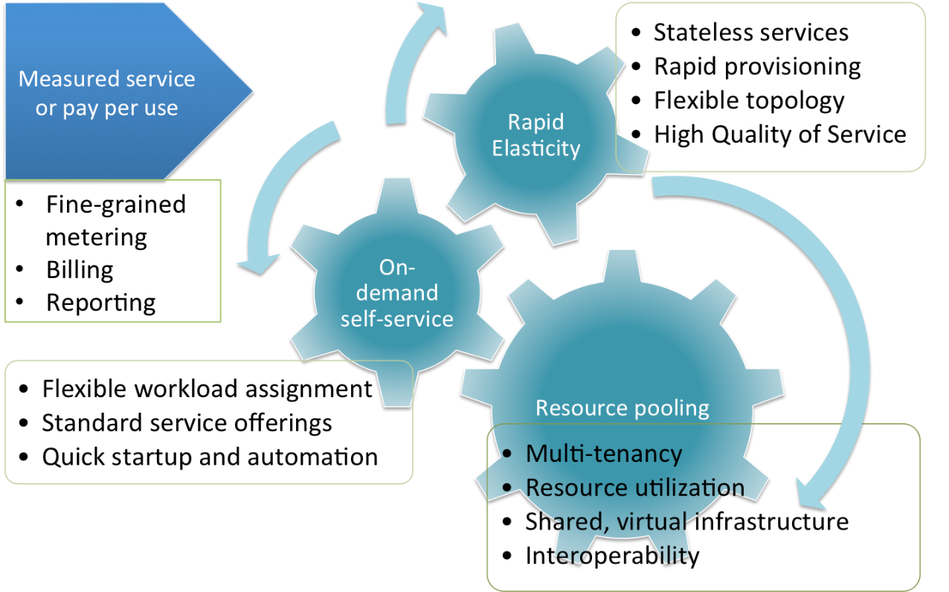
Attributes in more detail
The “no-need-to-know” in terms of the underlying details of infrastructure, applications interface with the infrastructure via the APIs.
The “flexibility and elasticity” allows these systems to scale up and down at will
utilising the resources of all kinds
CPU, storage, server capacity, load balancing, and databases
The “pay as much as used and needed” type of utility computing and the “always on!, anywhere and any place” type of network-based computing.
Cloud are transparent to users and applications, they can be built in multiple ways
branded products, proprietary open source, hardware or software, or just off-the-shelf PCs.
In general, they are built on clusters of PC servers and off-the-shelf components plus Open Source software combined with in-house applications and/or system software.
5

Slide 6
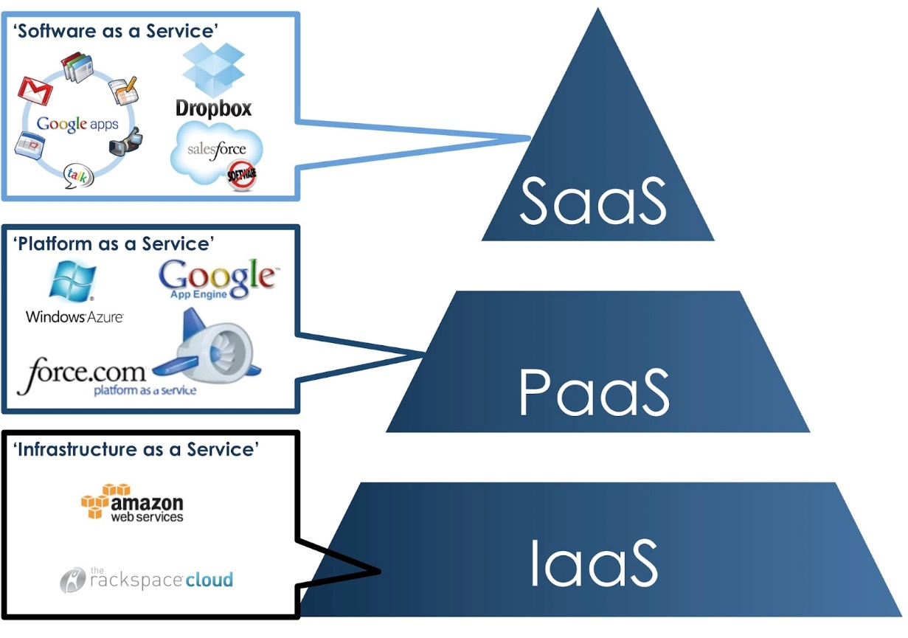
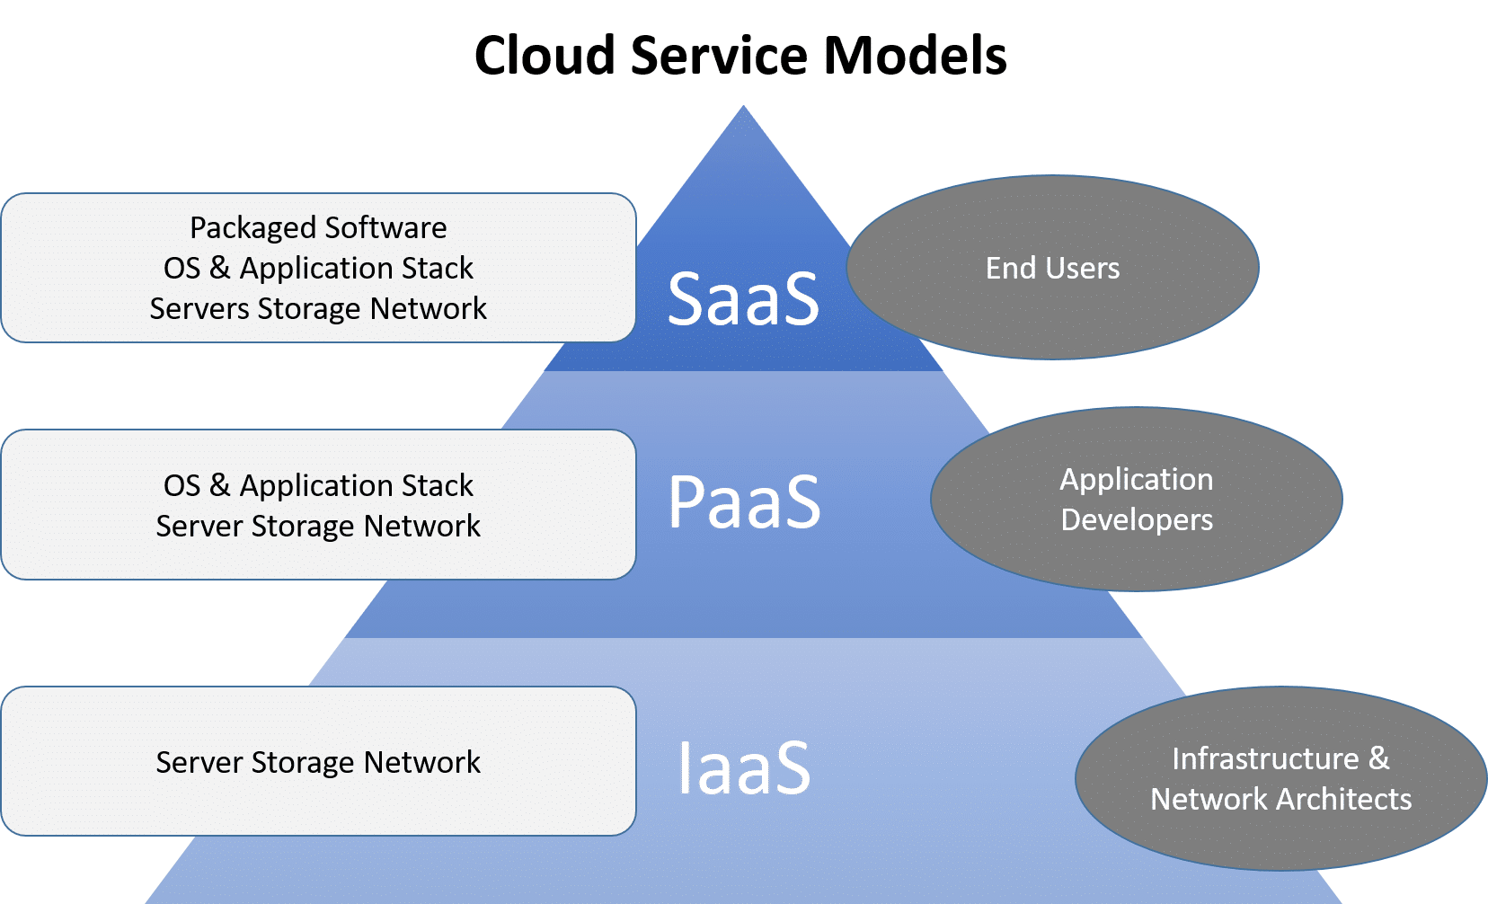
Cloud Service Models:
IaaS, PaaS, SaaS

Slide 7
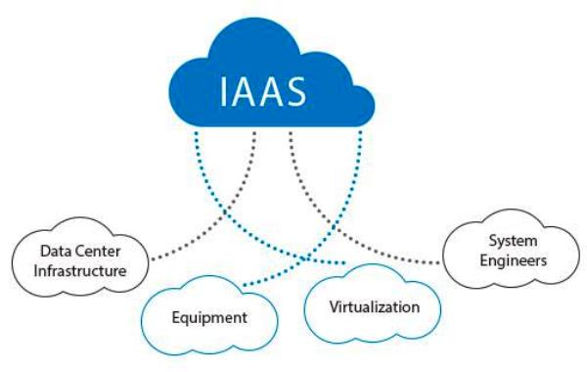
Infrastructure as a Service (IaaS)
Infrastructure as a Service: IaaS provides virtual machines, virtual storage, virtual infrastructure, and hardware assets as resources to clients. Client manages all other aspects of the deployment including applications and user interactions with system.
Examples: Amazon EC2, Windows Azure, Rackspace, Google Compute Engine.
IT
IaaS
Operating System
Processor Memory Storage
7 | The Future of OaaS in the Overseas Market | May 2013

Slide 8
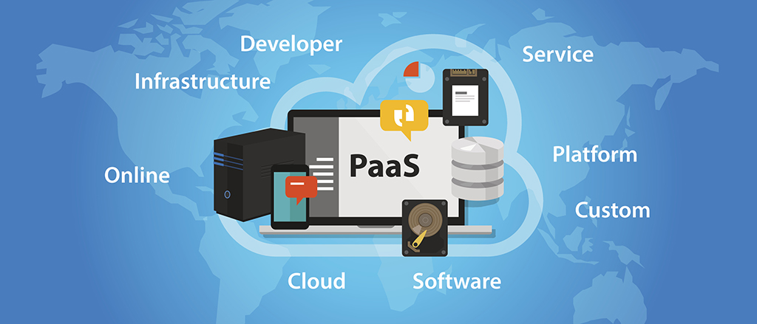
Platform as a Service (PaaS)
Platform as a Service: PaaS provides virtual machines, OS, applications, services, deployment frameworks, transactions, and control structures. Client can deploy its applications on the Cloud or use applications that were programmed using languages and tools that are supported by PaaS.
Examples: AWS Elastic Beanstalk, Windows Azure, Heroku, Force.com, Google App Engine, Apache Stratos.
Runtime API Web Server
Dev.
Operating System
PaaS
Processor Memory Storage

Slide 9
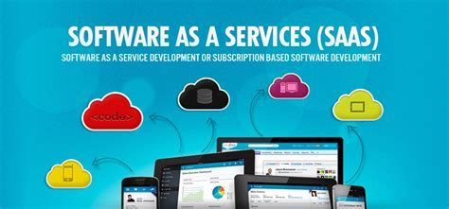
Software as a Service (SaaS)
Software as a Service: SaaS is a complete operating environment with applications, management, and the user interface. In SaaS, the application is provided to the client through a thin client interface, and the customer’s responsibility begins and ends with entering and managing its data and user interaction. Everything from the application down to the infrastructure is the vendor’s responsibility.
Examples: Google Apps, Microsoft Office 365.
Web UI Web App. Web Service
Runtime API Web Server
Consumer
SaaS
Operating System
Processor Memory Storage

Slide 10
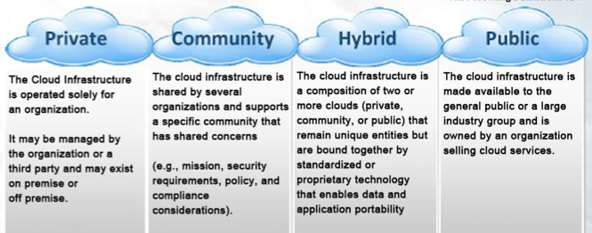
Cloud Computing Deployment Models:
Private
Community
Hybrid
Public
Private
Community
Hybrid
Public
Service
models
Infrastructure as
a Service (IaaS)
Platform as
a Service (PaaS)
Software as
a Service (SaaS)
Service
attributes
Resource pooling
Elasticity
Pay-By-Use
Self-Service
Broad Network Access

Slide 11
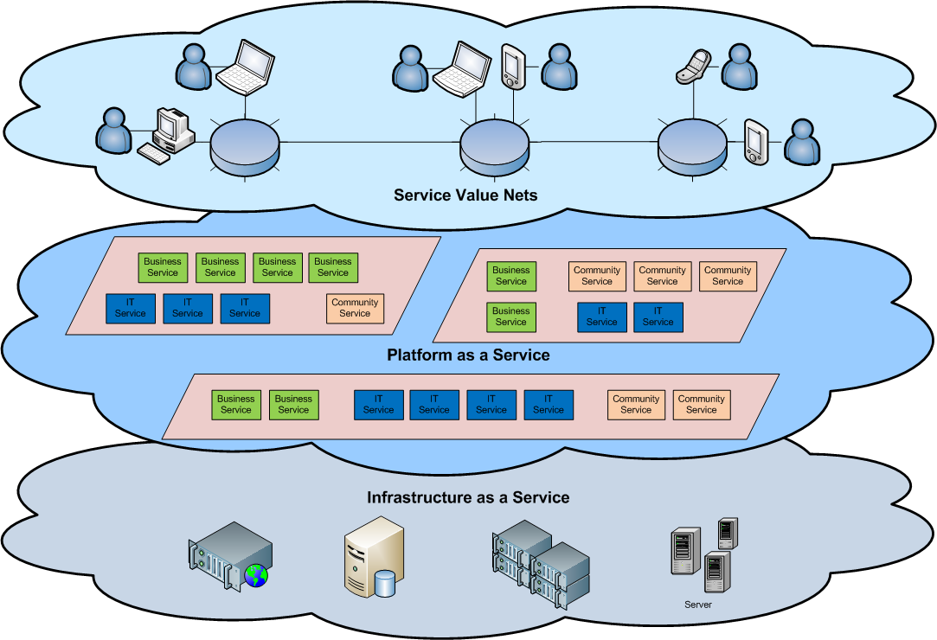
Cloud Architecture

Slide 12
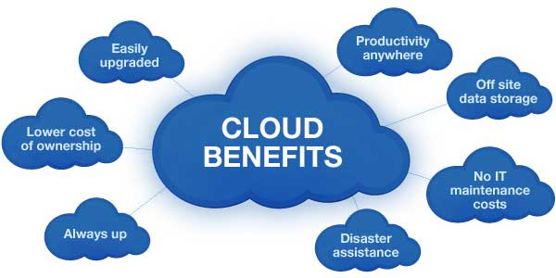
What is the purpose and benefits?
Cloud computing enables companies and applications, which are system infrastructure dependent, to be infrastructure-less.
By using the Cloud infrastructure on “pay as used and on demand”, all of us can save in capital and operational investment!
Clients can:
Put their data on the platform instead of on their own desktop PCs and/or on their own servers.
They can put their applications on the cloud and use the servers within the cloud to do processing and data manipulations etc.

Slide 13
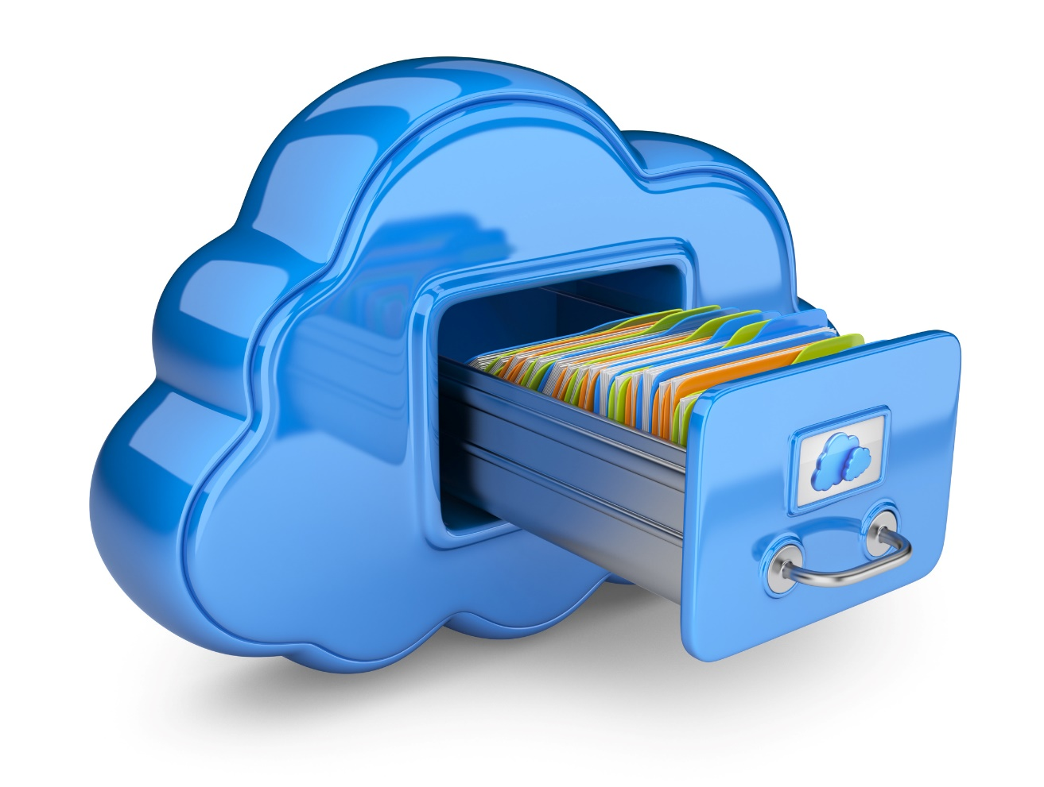
Cloud Storage
Several large Web companies are now exploiting the fact that they have data storage capacity that can be hired out to others.
allows data stored remotely to be temporarily cached on desktop computers, mobile phones or other Internet-linked devices.
Amazon’s Elastic Compute Cloud (EC2) and Simple Storage Solution (S3) are well known examples
Some concerns
Performance, reliability, and SLAs,
Control of data, and service parameters,
Privacy, security, compliance, trust…

Slide 14
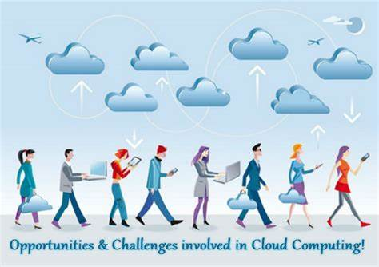
Opportunities and Challenges
The use of the cloud provides a number of opportunities:
It enables services to be used without any understanding of their infrastructure.
Cloud computing works using economies of scale:
It potentially lowers the outlay expense for start up companies, as they would no longer need to buy their own software or servers.
Cost would be by on-demand pricing.
Vendors and Service providers claim costs by establishing an ongoing revenue stream.
Data and services are stored remotely but accessible from “anywhere”.

Slide 15
Opportunities and Challenges
In parallel there has been backlash against cloud computing:
Use of cloud computing means dependence on others and that could possibly limit flexibility and innovation:
The others are likely become the bigger Internet companies like Google and IBM, who may monopolise the market.
Security could prove to be a big issue:
It is still unclear how safe out-sourced data is and when using these services ownership of data is not always clear.
There are also issues relating to policy and access:
If your data is stored abroad whose policy do you adhere to?
What happens if the remote server goes down?
There have been cases of users being locked out of accounts and losing access to data.

Slide 16
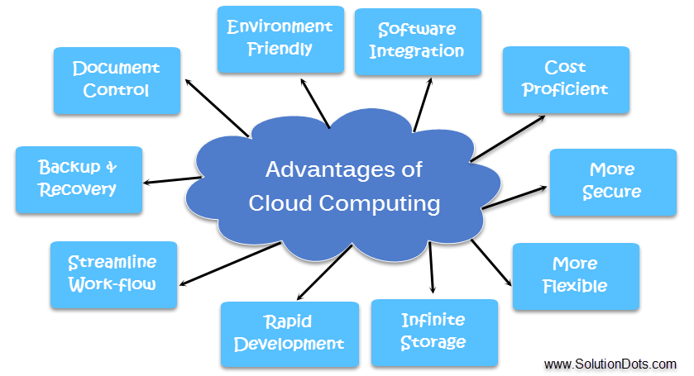
Advantages of Cloud Computing
Lower computer costs
Improved performance
Reduced software costs
Instant software updates
Improved document format compatibility
Unlimited storage capacity
Increased data reliability
Universal document access
Latest version availability
Easier group collaboration
Device independence

Slide 17
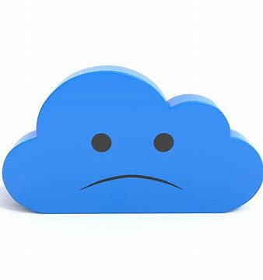
Disadvantages of Cloud Computing
Requires a constant Internet connection:
Does not work well with low-speed connections:
Features might be limited
Can be slow
Stored data might not be secure
Stored data can be lost
HPC(High Performance Computing) Systems:
Not clear that you can run compute-intensive HPC applications that use MPI(Multi- Processing)/OpenMP!
Scheduling is important with this type of application
as you want all the VM to be co-located to minimize communication latency!
General Concerns:
Each cloud systems uses different protocols and different APIs
may not be possible to run applications between cloud-based systems

Slide 18
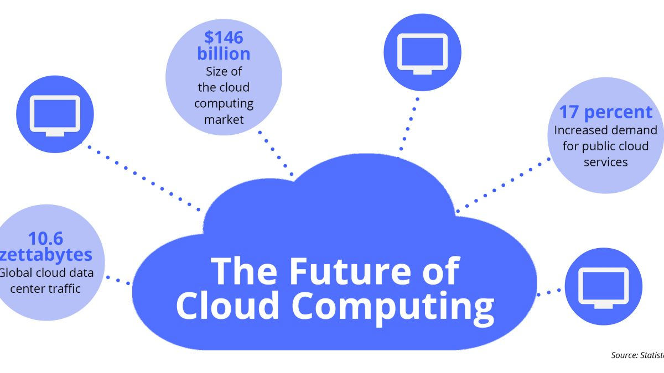
The Future
Many of the activities loosely grouped together under cloud computing have already been happening and centralised computing activity is not a new phenomena
Grid Computing was the last research-led centralised approach
However there are concerns that the mainstream adoption of cloud computing could cause many problems for users
Many new open source systems appearing that you can install and run on your local cluster
should be able to run a variety of applications on these systems

Slide 19
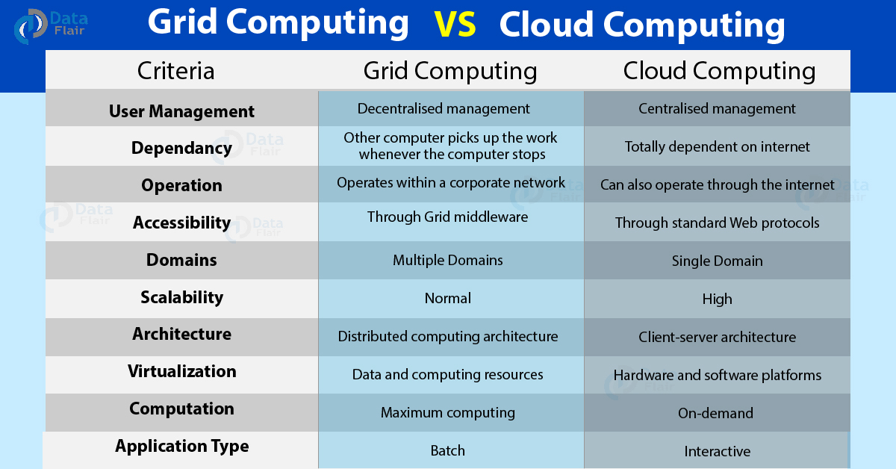

Slide 20
The End
Thank You

