Slide 1
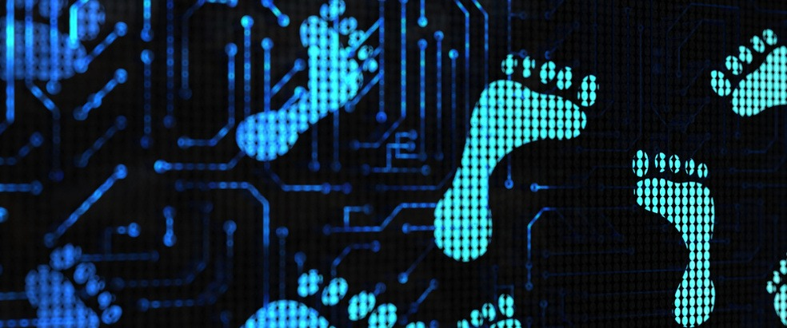
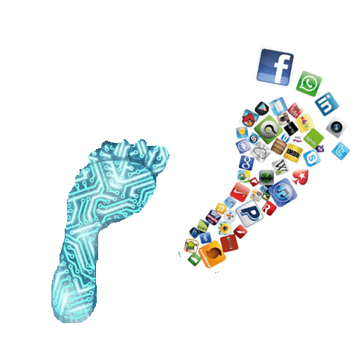
Digital Footprints

Slide 2
Learning Outcomes
After completing this topic, you should be able to:
Understand what a digital footprint is?
Controlling Digital Footprint
Managing Footprint
What are the benefits of being digital?
Notes:
Digital v/s Analog. Some background introduction to computers.

Slide 3
Digital footprint
What is a digital footprint?
It is the data trail left by your interactions in the digital world
It is a public record of
what you said
what was said about you
what you liked, retweeted or shared
where you are, or have been
Although it’s less public, there’s also a record of
what you’ve clicked on
what you’ve searched for
your IP address
Notes:
Digital v/s Analog. Some background introduction to computers.

Slide 4
Controlling Digital Footprint
Why is it important to be in control of your digital footprint?
Employers can, and do, Google people who apply for jobs with them. They could check social media sites that appear in the search to see whether you’re the kind of person they want working for them.
Criminals gather information about you to fraudulently impersonate you – things like applying for credit cards or gaining access to sites or systems in your name.
Websites you visit place cookies on your computer to allow advertisers to target you with products based on your browsing history.

Slide 5
Controlling Digital Footprint
And it’s surprisingly easy to publish information about you online. Even if you aren’t in the public eye, at some point someone might want to gather information about you with the intention of discrediting you.
To find out more about why it’s important, and about how information about you is used and shared, search for the Internet Society’s resources on managing your identity.
Visit www.internetsociety.org

Slide 6
Managing Digital Footprint
Be kind, helpful and understanding
Use privacy settings
Keep a list of accounts
Do not overshare
Use a password keeper, Ex: Dashlane
Google yourself, know what’s out there.
Monitor linking accounts
Consider using an anonymous secondary email
At least skim the terms and conditions
Know that sending is publishing-forever
Understand that searches are social. DuckDuckGo.com
Use digital tools to manage your digital footprint
(Boyle, 2019)

Slide 7

Why should we care to ‘being digital’?
It saves time:
Being digitally literate can save hours per month for tasks that could only be done offline in the past
Examples?

Slide 8

Why should we care to ‘being digital’?
You learn faster:
Study at your own pace, lookup words, data, facts, figures. Try new things without fear.
Examples?

Slide 9
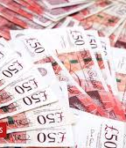
Why should we care to ‘being digital’?
You save money:
Coupon codes, daily deal sites, comparison shopping sites and mobile apps, make it easier than ever to get the best product at the best price.
Examples?

Slide 10
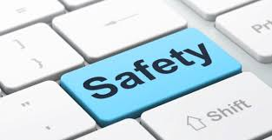
Why should we care to ‘being digital’?
It makes you safer:
From checking medications, travelling abroad, to fixing your home – do more things safely.
Examples?

Slide 11

Why should we care to ‘being digital’?
It keeps you informed:
From minor traffic annoyances to life threatening natural disasters.
Examples?
It can keep you employed:
Most jobs today require some form of computer skills including jobs outside the traditional office.
Examples?

Slide 12


Social Networking: Positive
Negative
On the Internet you can use social networking sites such as Facebook and twitter etc.
On these websites, you can talk to your friends and people you haven't seen in a long time. This has a positive impact on society because you can communicate to a wider range of people over the internet.
The Negative impact of social networking sites is that it would improve the likely hood of paedophiles, stalkers and cyber bullying, because using the internet would be an easy way to do it.
Also it may increase the rate of crime, due to websites because of cyber bullying, paedophiles and stalkers. Also people could pretend to be you on these websites.

Slide 13
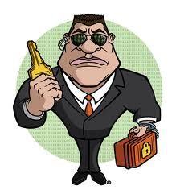
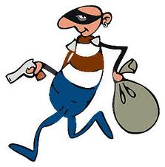
Personal Security: Positive/Negative
When you are searching online you have some form of internet security which should protect you from hackers, thieves, identity theft and viruses.
The negativity on the security is that there are some hackers able to break through and steal things such as your credit card details.
They could also commit fraud and pretend to be you which could ultimately destroy your business and your reputation.

Slide 14
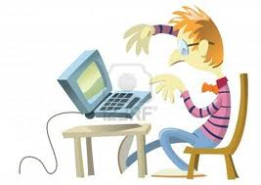
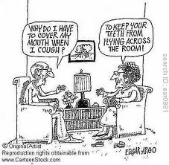
Generation Barriers
The impact from internet on the society has created some generation barriers; for example an elderly person would generally not understand anywhere near the amount about a computer than a child and this is a generation barrier.
The positive side is that the children can teach the older generation and help them.
The negative side is it may prevent one generation communicating with another.
That also mean they may not be communicating with other people in their families which is a negative impact on society.

Slide 15

Health: Benefits
Negatives
Using computers can have negative impacts on your health; for example if you are looking at a computer screen for long, it could damage your eyes.
Also if you are on a computer all day it would affect your health because you would not be getting any exercise.
Also the doctors online may diagnose you wrong because they are not seeing you in person.
Using the internet you can find out what you have wrong with you, if you are ill either by forums or have a conversation to a doctor using a webcam where you can get diagnosed by someone who live many miles away from you without the hassle of travelling to far.
Also if the symptoms are correct it allows you to know quicker so you would be able to act against the illness quicker.

Slide 16


Business: Positive
Using the internet, some world wide companies can produce large amounts of profit for example Tesco, Amazon and Asda. This is good way to make their company more known
It can produce and increase profit as some companies advertise their products on other websites to increase the interest in their products.
This is good because it lets people know which shop is selling what before they travel there or can purchase the product online.
Negative
Not all business models gain from online
The Negative side of ICT in business is that it makes it harder for new companies to succeed due to big companies such as Tesco, ASDA and Amazon being well known online websites
People would more likely visit their websites over new companies websites or stores. As a result of this newer companies could go into bankruptcy before they have barely even started to sell their products to the general public.

Slide 17

Why should we care to ‘being digital’?
It makes you happier:
No matter how technically advanced the world gets, we will always love creativity and innovation.
Examples?

Slide 18
School : Positives
Negative
The negative impact from ICT on schools is that the work that students save on it could be deleted by a system error
They could have received the wrong information from the research they did because they used the wrong websites to get the information from.
The positives for ICT in schools is that it gives students another option to study and get qualifications in it
It makes easier for students to research what needs to be searched also students can save their work onto the system and do their school work on the computers.
It can help students email their work to themselves so they can improve it at home.

Slide 19

Positive Overall
Overall, the positives are that you can communicate to your friends fast over the internet, also you can research nearly anything online and you can purchase products online, this makes it easier to purchase products and services.
Also it is easier people delivering the product to your house than going to the store and purchasing it in store.

Slide 20
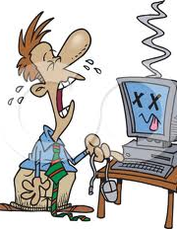
Negative Overall
The Negative impacts on society is that it creates a generation barrier where different generations are rarely communicating and it can make people vulnerable to hackers viruses and identity thieves
They could get the wrong information for things such as coursework if they are using the wrong websites for information.
It could cause some bad health because of damage to the eyes and also it could cause small businesses to go bankrupt.

Slide 21
References
Boyle, J. (2019). 12 Tips For Students To Manage Their Digital Footprints. [online] TeachThought. Available at: https://www.teachthought.com/the-future-of-learning/11-tips-for-students-tomanage-their-digital-footprints/ [Accessed 19 May 2019].

Slide 22


