Slide 1


Slide 2

Demographic Considerations
Number of potential buyers; their age, gender and education
Location of potential buyers
Position of potential buyers
Expected consumption of potential buyers
Economic strength of potential buyers

Slide 3

Psychological Considerations
Will potential buyers use price as an indicator of quality?
Will potential buyers be favorably attracted by odd pricing?
Would potential buyers perceive price as too high relative to the service product gives?
Are potential buyers prestige oriented and willing to pay a premium to fill this need?
How much will potential buyers be willing to pay for the product?

Slide 4
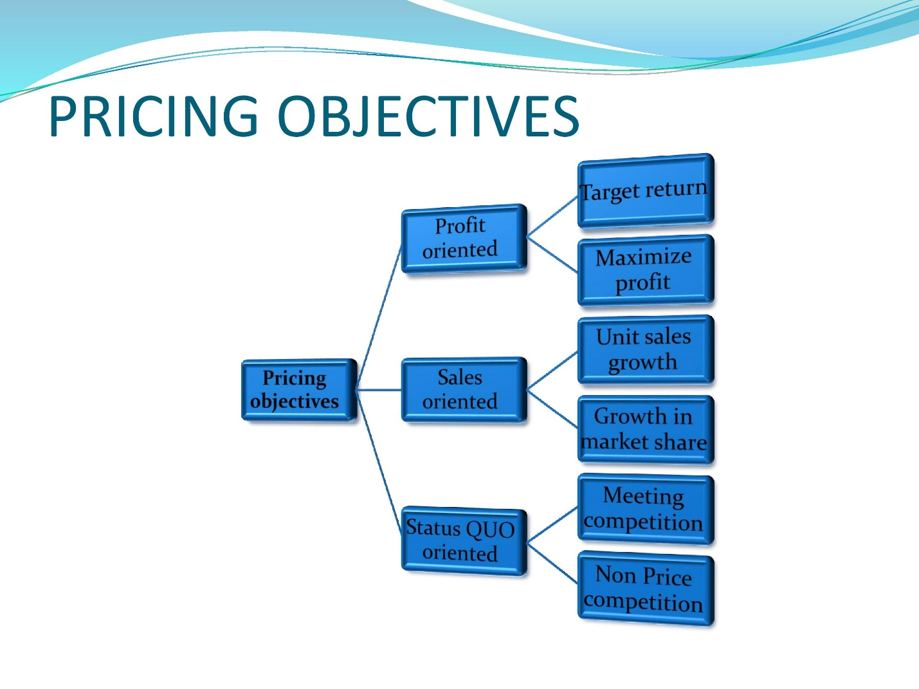
Pricing Objectives
Pricing to achieve a target return on investment
Stabilisation of price and margin
Pricing to achieve a target market share
Pricing to meet or prevent
competition

Slide 5
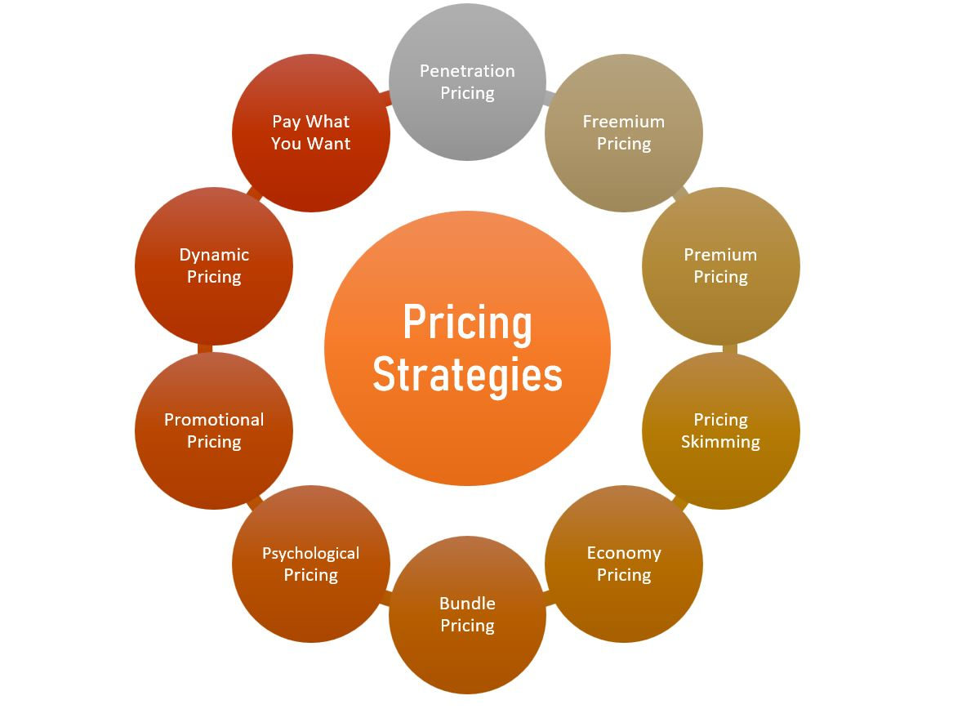
Pricing Strategy

Slide 6

Key Product Considerations
Perishability – must be priced to sell without costly delays; includes fruit to high fashion
Distinctiveness – homogeneous goods have easy substitutes and make distinguishing between competitors difficult
Life Cycle –
  Skimming policy is when seller charges a high price on a new product.
  Penetration policy is when producer charges a low price for a new product.

Slide 7
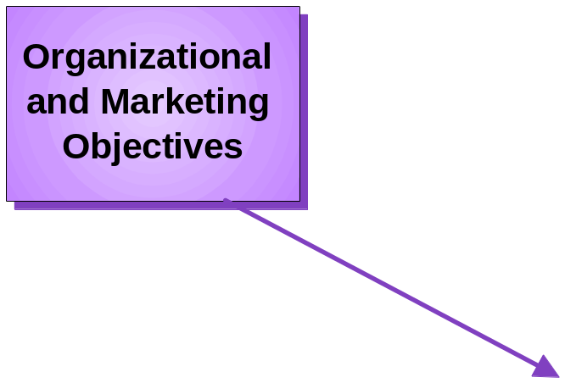

Factors Affecting Price
Pricing
Decisions
Notes:
Copyright © 2000 by Houghton Mifflin Company. All rights reserved.
20-<number>

Slide 8
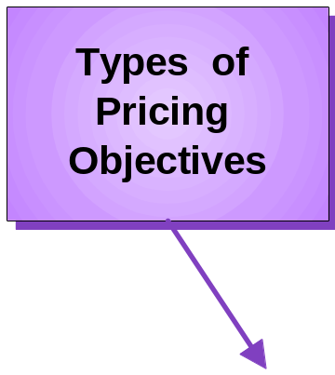

Factors Affecting Price
Pricing
Decisions
Notes:
Copyright © 2000 by Houghton Mifflin Company. All rights reserved.
20-<number>

Slide 9
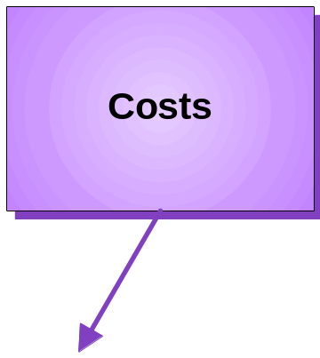

Factors Affecting Price
Pricing
Decisions
Notes:
Copyright © 2000 by Houghton Mifflin Company. All rights reserved.
20-<number>

Slide 10
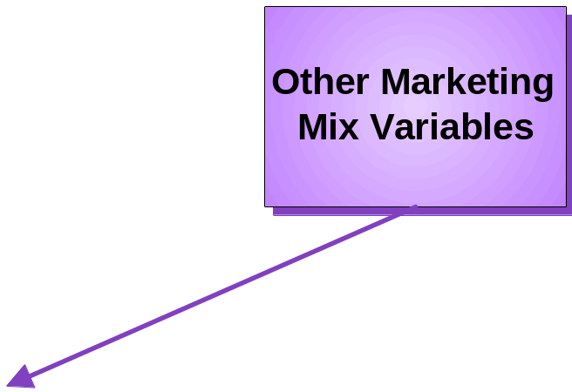
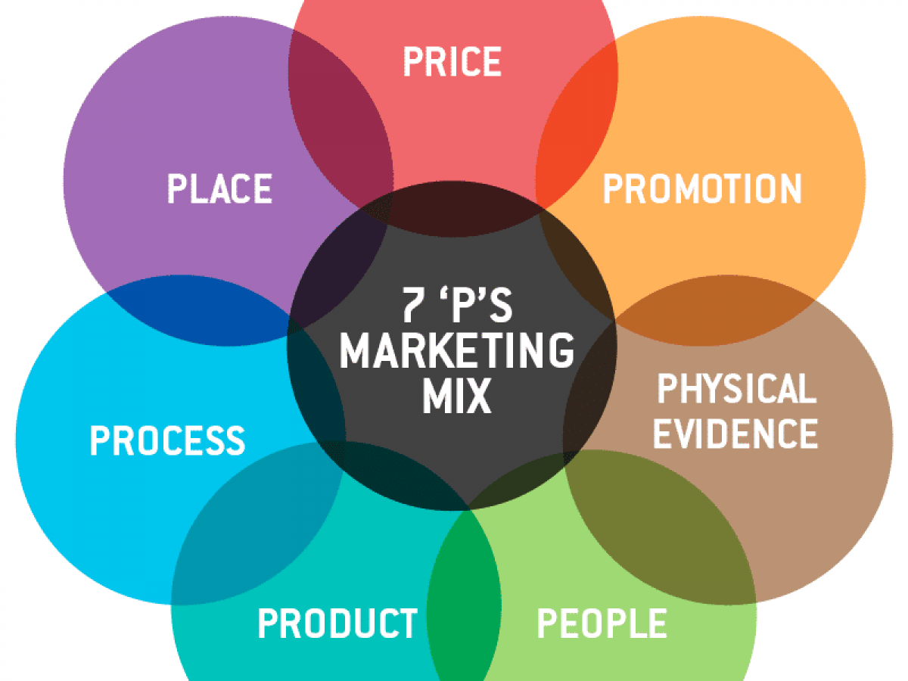
Factors Affecting Price
Pricing
Decisions
Notes:
Copyright © 2000 by Houghton Mifflin Company. All rights reserved.
20-<number>

Slide 11

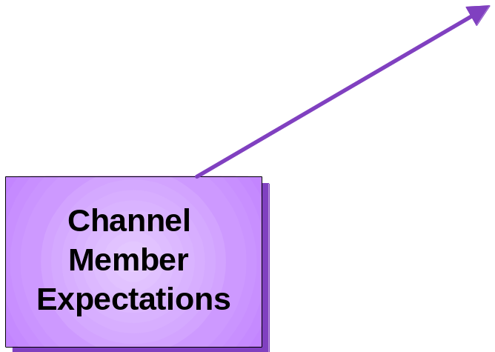
Factors Affecting Price
Pricing
Decisions
Notes:
Copyright © 2000 by Houghton Mifflin Company. All rights reserved.
20-<number>

Slide 12

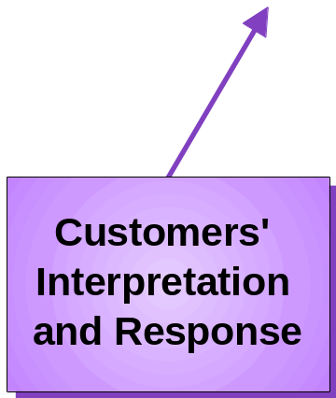
Factors Affecting Price
Pricing
Decisions
Notes:
Copyright © 2000 by Houghton Mifflin Company. All rights reserved.
20-<number>

Slide 13


Customers’ Interpretation and Response
Internal Reference Price
External Reference Price
Value-Conscious
Price-Conscious
Prestige-Sensitive
Notes:
Copyright © 2000 by Houghton Mifflin Company. All rights reserved.
20-<number>

Slide 14
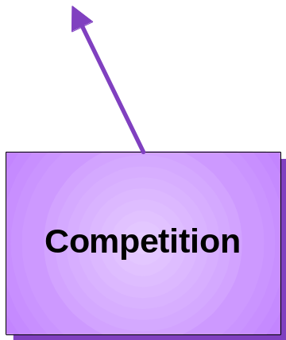
Factors Affecting Price
Pricing
Decisions
Notes:
Copyright © 2000 by Houghton Mifflin Company. All rights reserved.
20-<number>

Slide 15

Competitive Considerations
Number of competitors
Size of competitors
Location of competitors
Conditions of entry into the industry
Number of products sold by competitors
Cost structure of competitors
Historical reaction of competitors to price changes

Slide 16


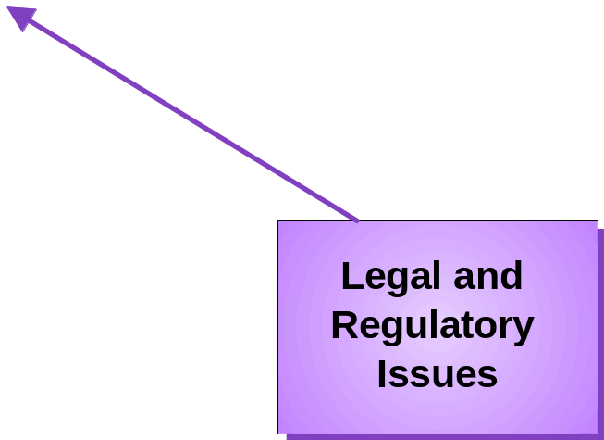

Factors Affecting Price
Pricing
Decisions
Notes:
Copyright © 2000 by Houghton Mifflin Company. All rights reserved.
20-<number>

