Slide 1


Marketing management introduction
13.07.2020
Gabriella Kereszturi

Slide 2
Agenda
Introduction
Module outline
Assessment
What is Marketing ?
Definitions of Marketing
The Marketing System

Slide 3
What is Marketing ?
Individually take 12-15 minutes to brainstorm on a definition of marketing
Discussion of definitions

Slide 4
Definitions of Marketing
Marketing is the management process responsible for identifying, anticipating and satisfying customer requirements profitably (Chartered Institute of Marketing, 2008)
Marketing is the activity, set of institutions, and processes for creating, communicating, delivering, and exchanging offerings that have value for customers, clients, partners, and society at large
(American Marketing Association, 2007)
The achievement of corporate goals through meeting and exceeding customer needs better than the competition
(Jobber,2007)

Slide 5
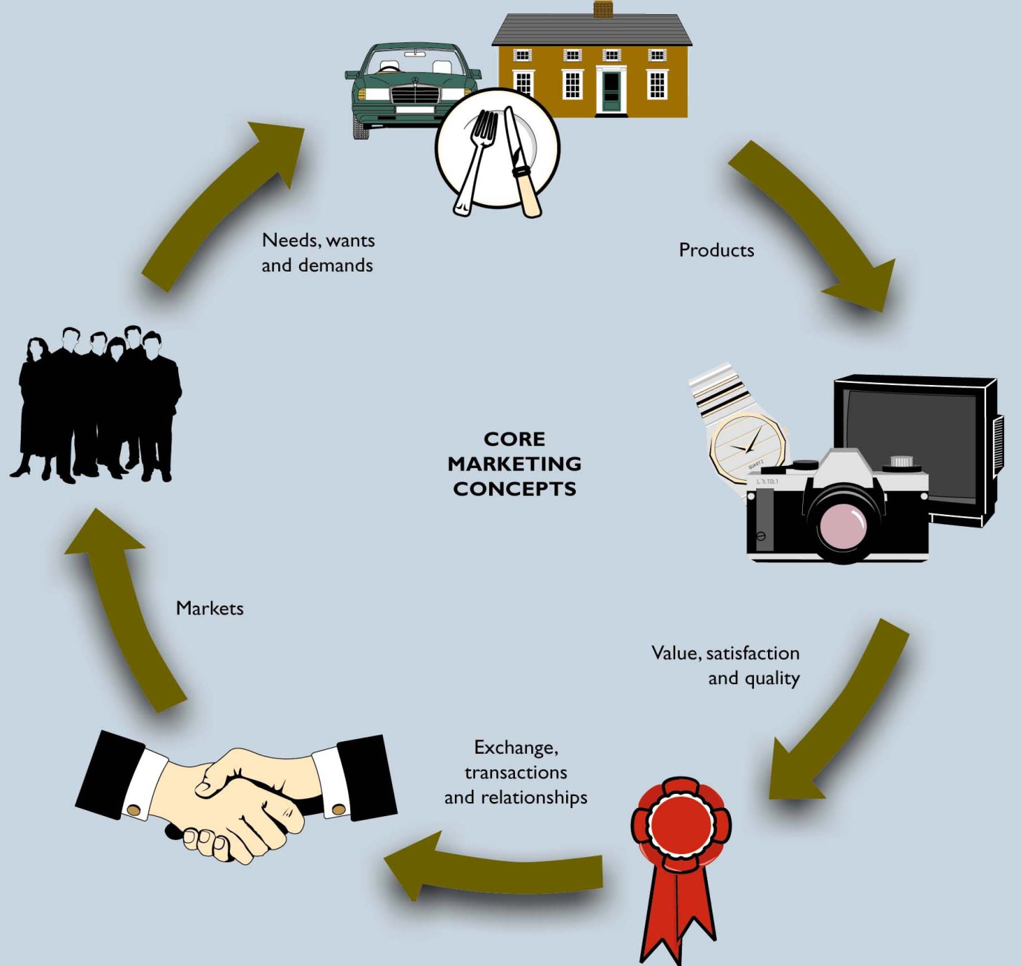

Slide 6
