Slide 1
THE MARKETING ENVIRONMENT MARKETING MANAGEMENT
20.07.2020
Gabriella Kereszturi

Slide 2
AGENDA
Revision of definitions
Marketing Evaluation
The Marketing System
Maslow’s Hierarchy of needs
Philosophies
Marketing Environment

Slide 3
THE MARKETING CONCEPT ANDT
It is not just:
    Selling
    Advertising
    Promotion

Slide 4
DEFINITIONS OF MARKETING
Marketing is the management process responsible for identifying, anticipating and satisfying customer requirements profitably (Chartered Institute of Marketing, 2008)
Marketing is the activity, set of institutions, and processes for creating, communicating, delivering, and exchanging offerings that have value for customers, clients, partners, and society at large
(American Marketing Association, 2007)
The achievement of corporate goals through meeting and exceeding customer needs better than the competition
(Jobber,2007)

Slide 5
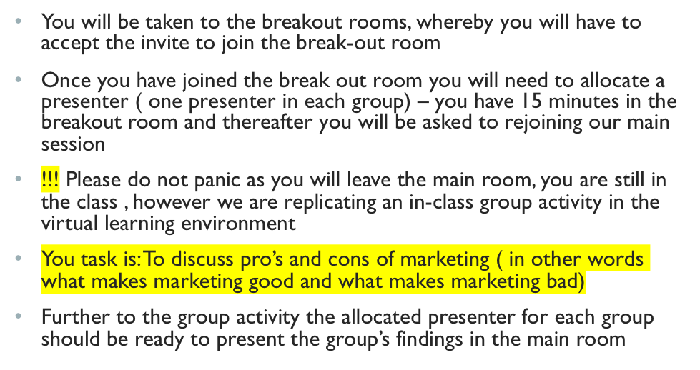
ACTIVITY

Slide 6
MARKETING
Marketing for and against
Critics - “poison pack” – evil effects of advertising
Supporters – “magic wand”
Marketing – viewed almost as a science, involving the study and understanding of relationships and exchanges between buyers and sellers.

Slide 7
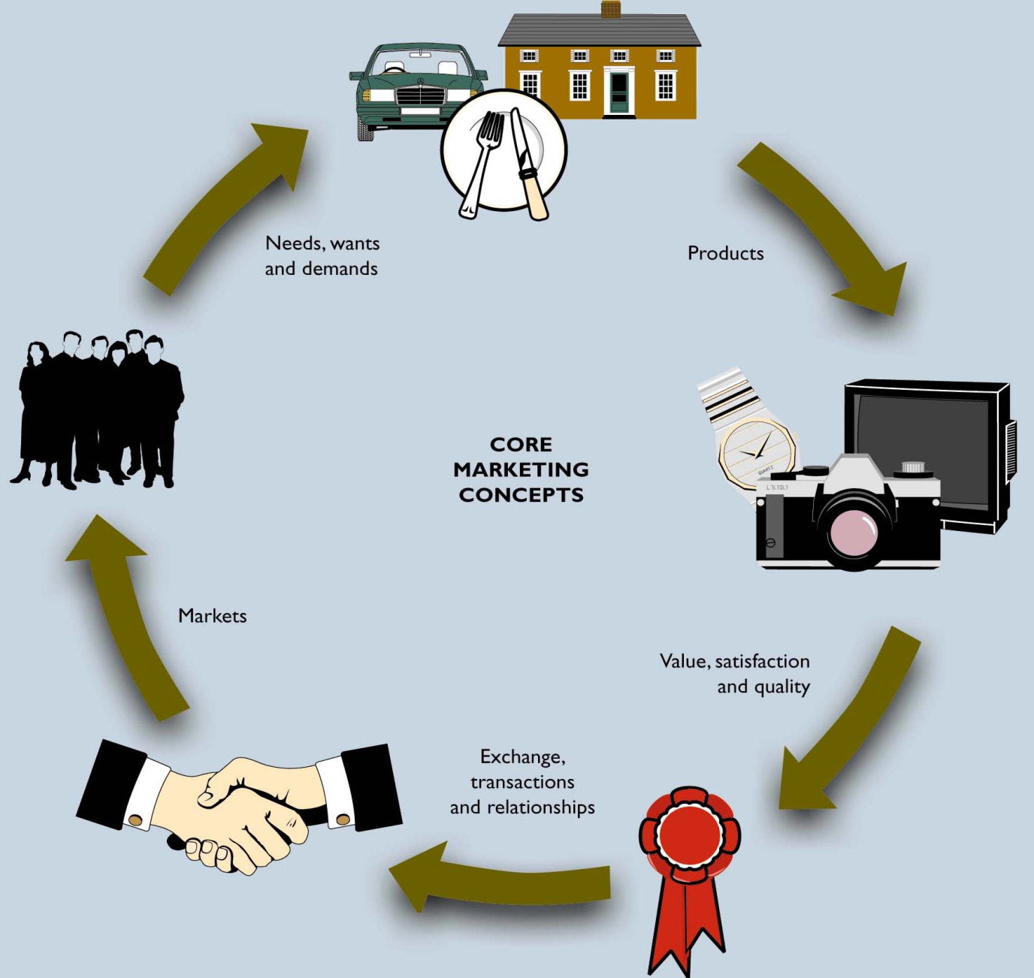

Slide 8
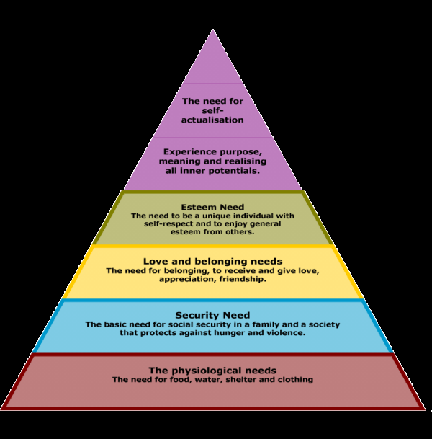

Slide 9
NEEDS, WANTS, DEMANDS
Needs – a sate of felt deprivation
Wants – human need shaped by culture and individual personality
Demands – human wants supported by buying power

Slide 10
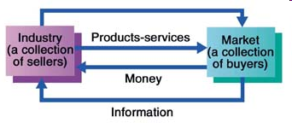
MARKETING SYSTEMS

Slide 11
MARKETS
Markets
A physical place, where buyers and sellers gathered to buy and sell goods
Economists → collection of buyers and sellers who transact over a particular product or class of products

Slide 12
KEY MARKETS
Consumer markets
Business markets
Global markets
Non-profit and governmental markets

Slide 13
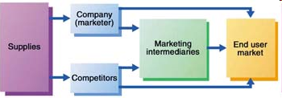
MODERN MARKETING SYSTEM
Modern Marketing System
(Kotler et al., 2005)

Slide 14
WHAT IS MARKETED?
What is marketed?
Goods
Services
Events
Experiences
Persons
Places
Properties
Organisations
Information
Ideas

Slide 15
MARKETING MANAGEMENT PHILOSOPHIES
Marketing Management Philosophies
Production – consumers favour highly affordable and available products → management’s focus on improving production and distribution efficiency – mass-production
  Works for a company which finds out that competition is selling a larger quantity with higher price and if there is a competitive advantage of higher quality.
  For a company with “exclusive” products wouldn’t work
  Wouldn’t work without market research

Slide 16
MARKETING MANAGEMENT PHILOSOPHIES
Marketing Management Philosophies
Production orientation works:
  Low cost market and high turnover
  High demand for the product
  Buyers are sensitive to price
  Mass-production capacity
  Low production costs
Production orientation does NOT work:
  “exclusive” products
  Close contact with customer needs
  High levels of customer loyalty

Slide 17
MARKETING MANAGEMENT PHILOSOPHIES
Marketing Management Philosophies
Product – consumers favour high quality and performance products → management’s focus on product improvement, creativity, assume consumer’s appreciation of the product advantages;
  Successful if: current demand for the product;
  Potential demand for the product
  Products are given full marketing support
  Products meet customers’ requirements
Selling – consumers will buy more if the management organises a large scale selling and promotion campaign
  No differentiation in products
  Little need for after-sales service
  No interest in forming relationships with buyers
  Repeat purchasing is unlikely

Slide 18
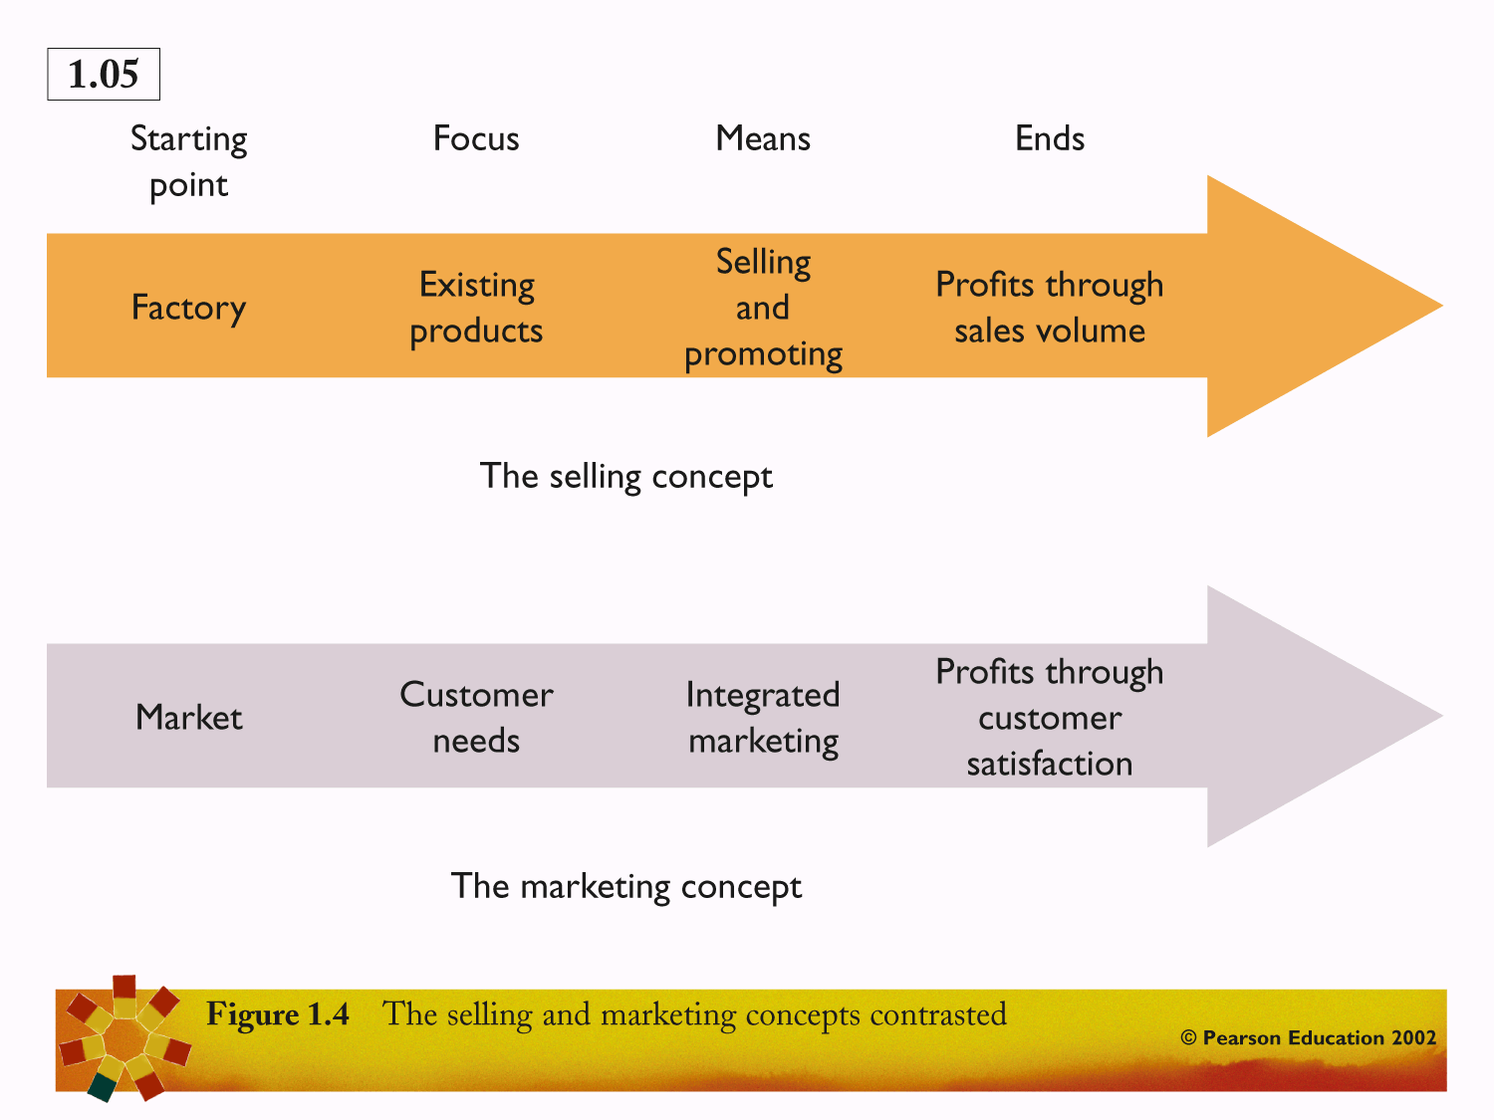

Slide 19
MARKETING MANAGEMENT PHILOSOPHIES
Marketing Management Philosophies
Marketing – management focus on determining needs and wants of target markets and satisfying them more efficiently and effectively than competitors
Societal marketing – management focus on determining needs, wants and interests of target markets more effectively and efficiently than its competitors in a way that improves customer’s and society’s well being

Slide 20
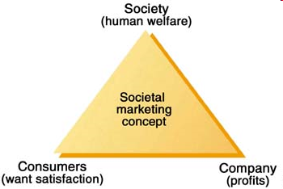

Slide 21
ACTIVITY
Break out rooms
Invite on screen or in the menu bar
Make note of break out room you are in
Task: Within your groups choose an example of a company for each of the following: product, production, sales, marketing, societal oriented.
15minutes

