Slide 1
MARKETING ENVIRONMENT ANALYSIS
MARKETING MANAGEMENT
27.07.2020
Gabriella Kereszturi

Slide 2
AGENDA
Revision of orientations
Pest
SWOT
Porter’s 5 forces analysis
Activity

Slide 3
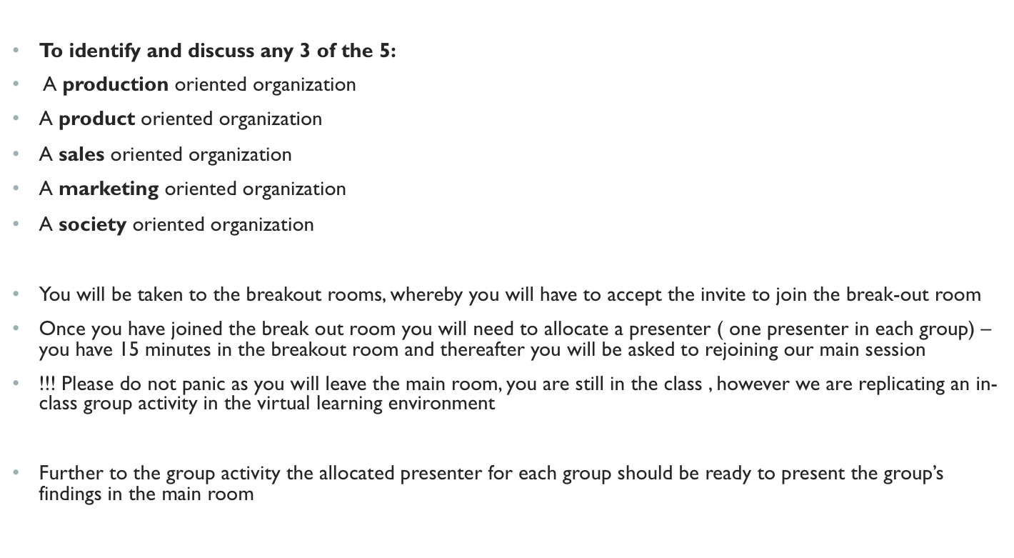
ACTIVITY

Slide 4
THE MARKETING ENVIRONMENT
The Marketing Environment
MICRO-ENVIRONMENT (Internal environment): Forces close to the company that affect its ability to serve its customers. May have some influence on these.
MACRO-ENVIRONMENT (External environment): Larger scale forces that affect the whole micro-environment. Company very unlikely to be able to influence these.

Slide 5
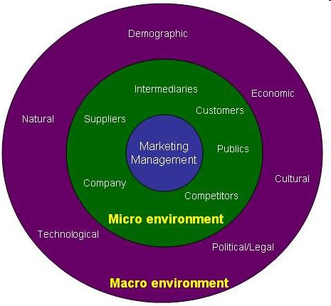

Slide 6
EXTERNAL ANALYSIS MODELS
PEST
PESTEL
STEEPLE

Slide 7
PEST ANALYSIS
PEST Analysis
● SOCIAL
  Demographics
  Cultural
  Attitudes
  Lifestyles
● TECHNOLOGICAL
  Advances
  Replacements
● POLITICAL
  Laws
    Pollution control
    Product safety
  Lobbies
● ECONOMIC
  Changes to income, prices, savings etc
  Market health

Slide 8
SWOT ANALYSIS
SWOT Analysis
● WEAKNESSES
  Level of awareness
  Absence of competitive advantage
● THREATS
  Competition
  Technology
  Demographics
● STRENGTHS
  Brand name
  Service quality
  Unique design
● OPPORTUNITIES
  New markets
  New products
  Technology

Slide 9
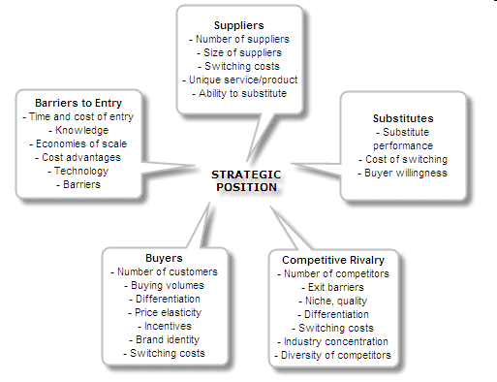
PORTER’S FIVE FORCES – EXTERNAL ANALYSIS

Slide 10
ACTIVITY
Choose one of the three models for environmental analysis discussed :
PEST/ PESTEL
SWOT
PORTER’s 5 FORCES
Apply to an organization of your choice and present in the main room

