Slide 1
SEGMENTATION TARGETING
Week 4
Marketing Management

Slide 2
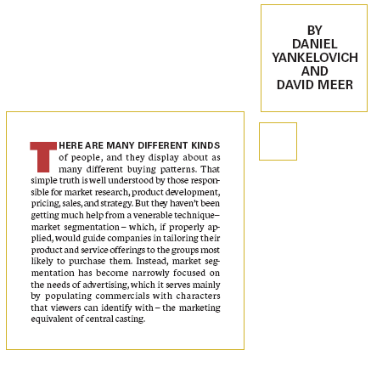
LOCATION OF SEGMENTATION IN MARKETING
“… it is at the heart of strategic marketing, since it forms the basis by which marketers understand their markets and develop strategies for serving their chosen customers better than the competition.”
(Jobber & Fahy, 2006)
‘Focussed competitors dominate their target market segments – by fending off broad-coverage competitors who have to compromise to serve the segment, and outperforming rivals with the same focus … Focussed strategies also gain meaning from the differences between the segments covered and the rest of the market.’
(Day, 1994)

Slide 3
DEFINITIONS OF SEGMENTATION
‘
Market segmentation – described as how we as marketers can divide the market into groups of similar customers, where there are important differences between those groups …’ (Hooley, Saunders & Piercey, 1998)
‘The process of grouping customers in markets with some heterogeneity into smaller, more similar or homogeneous segments. The identification of target customer groups in which customers are aggregated into groups with similar requirements and buying characteristics.’
(Dibb, Simkin, Pride & Ferrell, 2001)
‘The technique that is used by marketer to get to grips with the diverse nature of markets is called market segmentation. Market segmentation may be defined as ‘the identification of individuals or organisations with similar characteristics that have significant implications for the determination of marketing strategy.’ (Jobber, 2004)

Slide 4
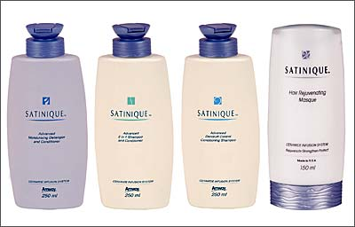
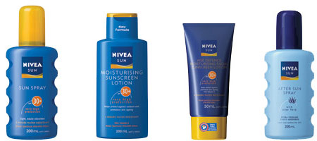
Segmentation and Product Differentiation
R&D developed the
‘Ceramide Infusion System’
Consumer research into use
of sun care products

Slide 5


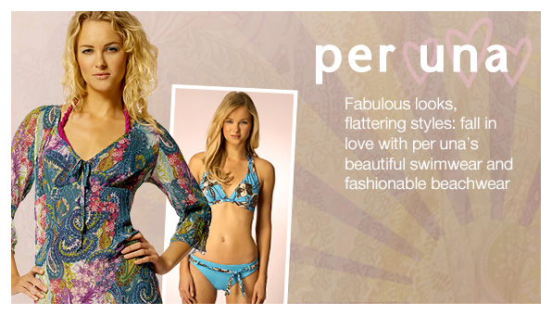

Slide 6
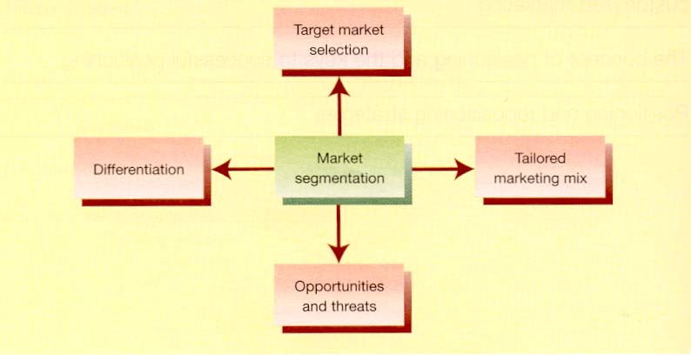
WHY SEGMENT? (1/2)
Advantages of segmentation:
[D. Jobber (2004) Principals and Practice of Marketing, 4th ed., London:McGraw Hill]

Slide 7
WHY SEGMENT? (2/2)
Benefits of segmentation:
  More precise market definition (know your consumers)
  Identification of gaps in the market (unserved or underserved consumers)
  In mature markets identify segments that are still growing
  Better analysis of competition (real not peripheral)
  More rapid response (easier to monitor)
  Efficient resource allocation (better use of finite/scarce resources)
  Effective strategic planning (segmentation is the first step)
  Dangers of not segmenting when competitors do (loss of competitive advantage)
  Particularly useful for SMEs (save on costs)

Slide 8
SEGMENTATION REQUIREMENTS
Customers must differ from one another in some important respect, which can be used to divide the whole market.
Segment targets can be identified by measurable characteristics to enable evaluation of their value to be assessed and the segment to be identified.
It must be possible for selected segment(s) to be isolated from the remaining market, thus enabling accurate/precise targeting with distinct offerings.

Slide 9
SEGMENTATION PROCESS
Identify relevant market segmentation base(s)
Determine homogeneous groupings
Evaluate the attractiveness of each market segment
Select target segment(s)
  Does the target market fit the Co’s image?
  Does the target market meet targeting requirements?
  Can the Co be competitive in the target market?
Align marketing strategy to target market
Implement and monitor
Competitive environment
Technological environment

Slide 10
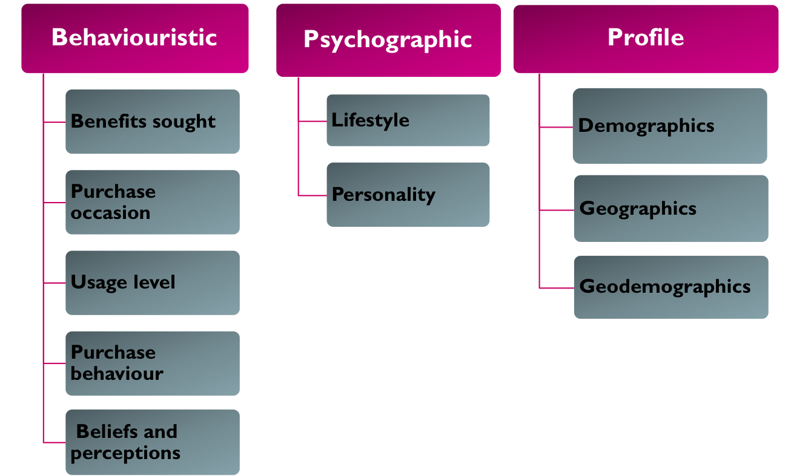
Segmenting Consumer Markets

Slide 11
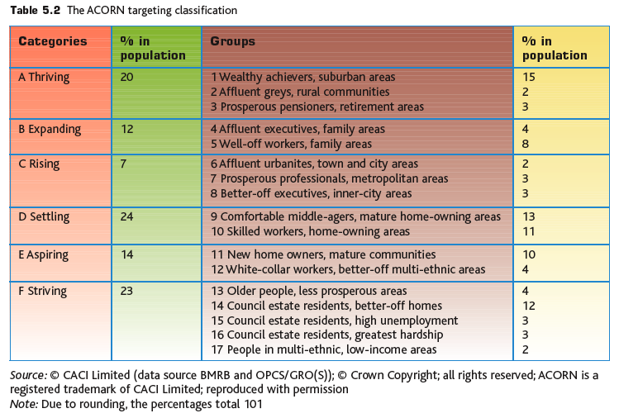
GEODEMOGRAPHICS

Slide 12
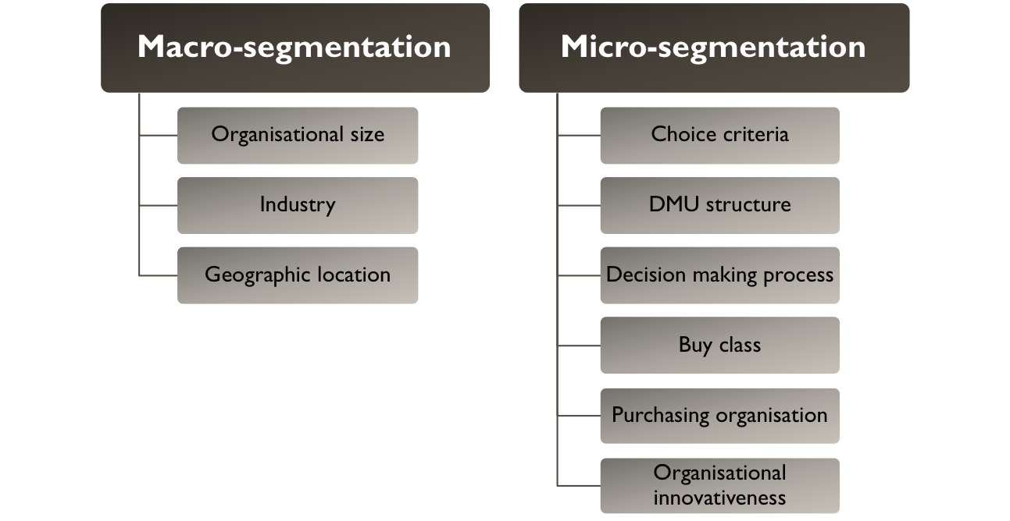
SEGMENTING BUSINESS MARKETS

Slide 13
SEGMENTATION EFFECTIVENESS/ATTRACTIVNESS
Measurable
Identifiable
Accessible
Substantial
Stable
Compatible
Responsive
Useful/Viable
Able to buy
Willing to buy

Slide 14
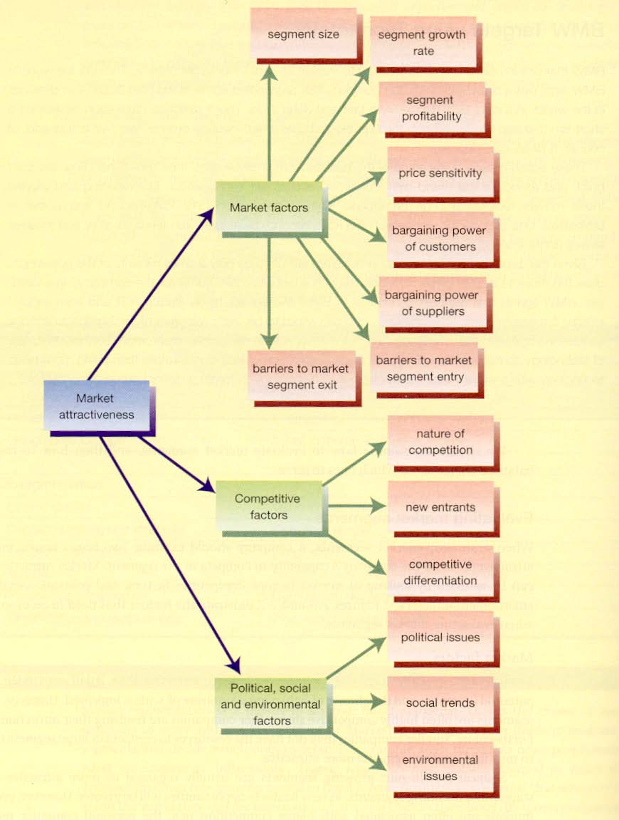
ASSESSING MARKET ATTRACTIVENESS
[D. Jobber (2004) Principals and Practice of Marketing, 4th edition, London:McGraw Hill]

Slide 15
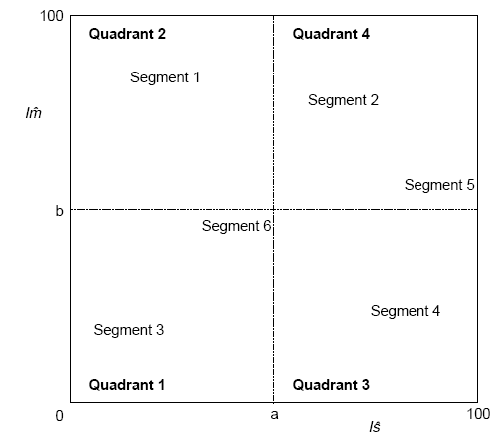
MARKET EVALUATION AND SELECTION
Future?
Attack?
Medium/Long Term
Eliminate?
Target?
Short Term

Slide 16
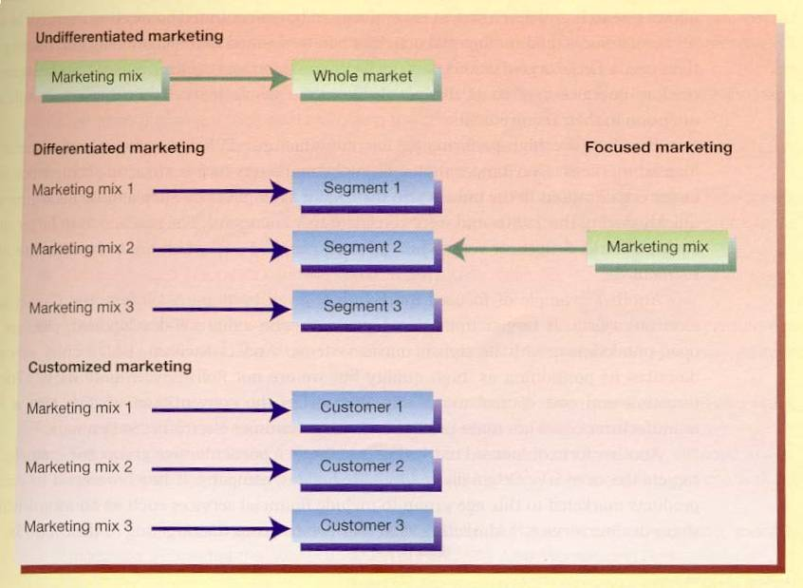
TARGETING STRATEGIES (1/2)

Slide 17
ACTIVITY
Shortly you will be taken to the break out rooms, where we will carry out a group task. An invite will be displayed in your screen asking you to join the break out room. Please accept the invite.
Once in the break out room, each group will assign a group presenter and take notes that will be presented in the class group discussion
You have 15 minutes to complete the task
Task:
Choose a fashion/accessories/cosmetics business.
Visit the chosen company’s website and think about your experience of purchasing from the brand
Based on your research and your own experience determine how the chosen business segments and targets
Could they serve another segment that is underserved at the moment ?

