Slide 1

POSITIONING

Slide 2
COMPETITIVE POSITIONING
The extent to which a company can position itself as providing superior value to selected target markets is the extent to which it will gain competitive advantage
Superior value can come from
  price
  level of benefit

Slide 3
COMPETITIVE POSITIONING
A product’s or service’s position is the way it is defined by consumers’ on important attributes
The position is the place the product/service occupies in consumers’ minds relative to the competition
The position defines the difference between the product/service and its competition – differential advantage
Points of parity versus points of difference (Keller et al, 2008)
Key to successful positioning – 4 C’s Framework (Jobber 2007)
  Clarity, Consistency, Credibility, Competitiveness

Slide 4
POSITIONING
Real positioning
  Based on verifiable, factual attributes eg largest, cheapest
  Generally only one brand can occupy such a position, so offers limited scope for firms to compete
Psychological positioning
  Based on emotional or attitudinal attributes eg caring, trustworthy, exciting
  Allows firms to position several brands in same market with minimal cannibalisation of sales
‘The notion of brand positioning implies space’ (Doyle, 1975)

Slide 5
PSYCHOLOGICAL POSITIONING
Ries and Trout (1981)
‘Positioning is not about what you do to a product. Positioning is what you do to the mind of the prospect’
Share of mind – product ladder concept
Favourable connotations in mind of target customer

Slide 6

Market Segmentation
Selection of Target Segments
Define Set of Competing Brands
Identify Competitive Dimensions
Identify Current Positioning
Find Target Segment’s Ideal Point
Define Chosen Positioning

Slide 7
DEFINE SET OF COMPETING BRANDS
Qualitative research – explore customers’ views of the brands that compete, alternatives that would be purchased if a brand was unavailable
Quantitative research – examine customer’s shopping baskets, brand repertoires

Slide 8
IDENTIFYING COMPETITIVE DIMENSIONS
Qualitative Research
This is for women
These two are for anyone
Yorkie
Twix
Flake
This one is very fattening
These two are not too fattening
Yorkie
Twix
Flake

Slide 9
COMPETITIVE ADVANTAGE
● Product differentiation:
- features e.g. Lufthansa, Volvo
- performance e.g. Whirlpool, Unilever
- style, design e.g. Dyson vacuum cleaners
- innovation, consistency, durability, reliability, repairability.

Slide 10
COMPETITIVE ADVANTAGE
Services Differentiation:
  Delivery – speedy, reliable, careful e.g. Domino’s
  Installation e.g. IBM
  Repair services
  Customer training service e.g. medical equipment
  Consulting services
  Speed of service e.g. fast food

Slide 11
COMPETITIVE ADVANTAGE
Personnel differentiation:
  Courteous, friendly, respectful staff
  Competent – skills, knowledge
  Communication skills
  Respond quickly to customer enquiries
  E.g. McDonalds

Slide 12
COMPETITIVE ADVANTAGE
Image differentiation:
  Established image – a singular, distinctive message communicating the product’s main benefits and positioning; supported by companies activities and statements
  Symbols – recognition and instant associations
  Sponsorship e.g. Flora, Perrier

Slide 13
VALUE POSITIONING
Alternatives of positioning on the basis of value and price –
Brand value proposition – full mix of benefits upon which the brand is positioned – fair price

Slide 14
VALUE POSITIONING
More for More – superior quality, prestige
More for the same – e.g Toyota, Lexus
The same for less – e.g. Amazon
Less for much less – e.g. EasyJet
More for Less – e.g. Dell, P&G

Slide 15
POSITIONING STRATGIES
Products attributes
Benefits offered
Usage occasions
Personalities
Cult positioning
Origin
Other brands
Competitors
Product class

Slide 16
PERCEPTUAL MAPS
‘A product positioning tool that uses multidimensional scaling (MDS) of consumers’ perceptions and preferences to portray the psychological distance between products and segments’
(Kotler, 2001)

Slide 17
PERCEPTUAL MAPS
Enables you to identify which cognitive dimensions consumers use to evaluate products and the relative position of these products to each other
Simplest form: two dimensions

Slide 18
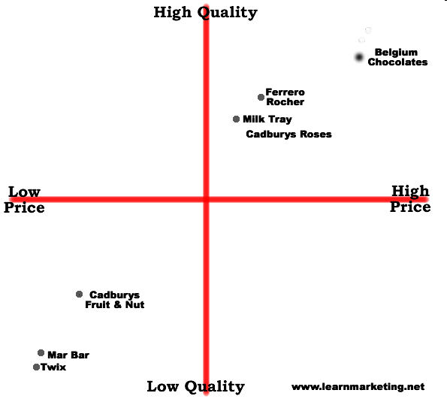


Slide 19
READING
Kotler, et al., 2005 Chapter 10: Segmentation and Positioning

Slide 20

ACTIVITY
Shortly you will be sent to the break out rooms.
Appoint a presenter for your group
On a brand of your choice discuss its segmentation, targeting and positioning strategy in relation to its competitors using a perceptual map.
Present in class
Time: 20 minutes

