Slide 1
MARKETING MANAGEMENT
Products and New Product Development
Week 6

Slide 2
AGENDA
4Ps vs 7Ps of the Marketing Mix
Product Definition
Product Life Cycle
New Product Development
NPD Strategy

Slide 3
THE MARKETING MIX
4Ps 7Ps
• Product Product
• Price Price
• Place Place
• Promotion Promotion
People
Processes
Physical Evidence

Slide 4
PRODUCT
• a product = anything capable of satisfying customer needs
• tangible-intangible
product line – a range of same brand products
Product mix – the sum of product lines

Slide 5
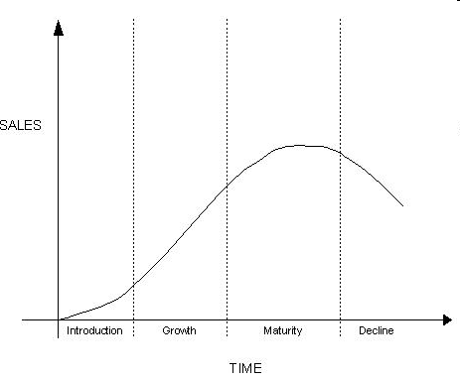
PRODUCT LIFE CYCLE

Slide 6
PRODUCT
Introduction – sales growth low, losses due to heavy investment in promotions and development
Growth – faster sales and profit growth, rapid market acceptance and repeat purchase
Maturity - sales peak and flatten- saturation, hastening competitive shakeout; brand building
Decline – fall in profits, new technology or change in consumer tastes

Slide 7
PRODUCT LIFECYCLE STAGES
Useful for management:
  Product termination –production end
  Growth projections – growth end
  Marketing objectives and strategies adaptation :
    Introduction – build sales by expanding market for product; raise awareness of product and brand G
    Growth – build sales and market share; product differentiation
    Maturity – hold on profits and market share ; innovation
    Decline- harvest – raise prices, cut expenditure to boost profits or divest product selling or elimination.

Slide 8
NEW PRODUCT DEVELOPMENT
Invention – the discovery of new ideas and methods
Innovation - occurs when an invention is commercialised by brining it to the market.
Innovation relies on:
  Creation and delivery of added customer value
  Speed to market counts
  A product’s inferior perceived value cannot be compensated for with high communications spending

Slide 9
NEW PRODUCT
Categories of new products:
  Replacements : 45% of overall NP include revisions and improvements to existing products (Ford Mondeo replacing Sierra); repositioning (Lucozade- new segments); cost reductions (producing with reduced costs)
  Additions to existing lines: 25% NP, e.g. Fruitibix – to compete on a new market
  New product lines: 20% NP, move in new markets- Mars ice-cream
  New-to-the-world products: 10% - entirely new markets e.g, Internet, video games – highly valued customer benefits

Slide 10
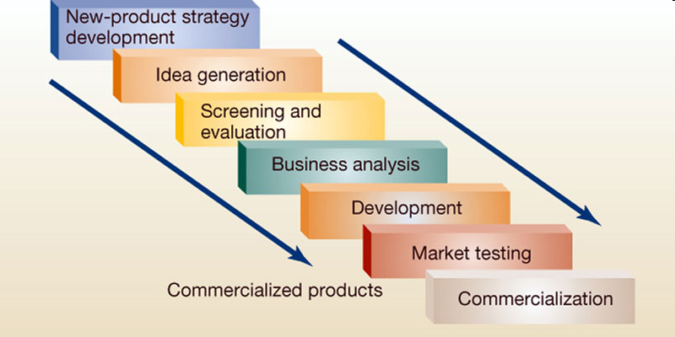
NPD STRATEGY

Slide 11
NPD
New product strategy- management decisions regarding product selection
Idea generation- brainstorming
Screening and testing – judge acceptance or rejection and buyers’ evaluation
Business Analysis – identification of target market, size, projected product acceptance over years
Product Development – team work to develop the physical product
Market testing – measurement of customer acceptance: simulated market test assessing penetration (how many new customers buy the product); repeat purchase (rate at which purchasers buy again) and test marketing: launch of the new product in few geographical areas
Commercialisation – developing a commercialisation strategy for the new product,: The diffusion of innovation by Innovators, Early adopters, Early and late majorities and laggards

Slide 12
DISCUSSION
Enumerate the different types of product that can be launched
Which are the stages in NPD. Explain each stage.
Explain diffusion of innovation categories and their marketing implications

Slide 13
DISCUSSION
Think about a product which could be improved. How would you test the new product?
Give examples of product failure and success.
You are the marketing manager for a fast-food chain. Your friend comes back from France with an idea for a new dish. How would you evaluate the idea?
What are advantages and disadvantages to test marketing?
What are the problems associated with commercializing technology? What are the key factors for success?

Slide 14
READING
Jobber, 2007
Kotler et al., 2005

