Slide 1
Price
Week 8

Slide 2
Price
the revenue earner
Profitability
Sends out quality cues to consumers
Should be set in accordance with the other elements of the mix

Slide 3
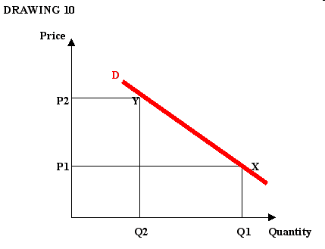
Curve of demand

Slide 4
The curve of demand
Useful as a conceptual tool for thinking about pricing issues
For some products a fall in price leads to a high rise in demand - price elastic
For other products a fall in price leads to a small increase in demand – price inelastic
However
Demand curves are not accurate
Do not reflect real situations
Problem of estimation to the curve in the presence of other constant influences
Experiments across the country are unfeasible due to variety of incomes, tastes etc.

Slide 5
Pricing Strategies – COSTS
Full-cost pricing: fixed costs + variable costs + likely rate of sales
Problems:
leads to an increase in price when sales fall
It is illogical as a sales estimate is made before setting a price
Focus on costs rather than customer’s willingness to pay
Direct cost pricing (marginal cost pricing): calculation of only those costs that are likely to increase as output rises (variable costs)
Problems:-
does not cover full costs
However: should be used when faced with large orders instead of machinery not being used e.g. services, hotels etc. Risk: high price paying customers find out and complain

Slide 6
Pricing strategies – COMPETITION
Going Rate Pricing – no product differentiation E.g. coffee bean
Creation of differential advantage; price discretion upon the value of the product to the customer e.g. differentiation on distribution pricing
Competitive Bidding
Draw up detailed plan/specifications for product/service and placing a confidential bid
Buyer chooses the cheapest supplier
Formula : Expected profit = Profit (Price-cost)X Probability to win

Slide 7
Pricing strategies – MARKETING
10 factors:
Marketing strategy
Price-quality relationships
Product-line pricing
Negotiating margins
Political factors
Costs
Effect on distributors/retailers
Competition
Explicability
Value to customer

Slide 8
Marketing-based Pricing
Pricing new products
Dependent on positioning strategy
Dependent on target market and their willingness and potential to buy
For multiple segments: modified versions of the product, designed and priced differently, in relation to the value of the product for the customer

Slide 9
Marketing-based Pricing
Launch strategies, price -promotion:
Rapid skimming strategy: high price, high promotion; high margins, high awareness
E.g. Nike, Coca-Cola, BMW
Slow skimming strategy: high price, low levels of promotional expenditure; high margins, reliance on WOM or incompatibility e.g. Rolls Royce
Rapid Penetration Strategy: low prices, heavy promotion; gain market share e.g. Tesco, EasyJet
Slow penetration Strategy: low price, low promotion; e.g. own-label products; high profit margin

Slide 10
Ethical issues in pricing
Price fixing – agreement: no competition on price; banned in EU as it is classed as a practice preventing, restricting competition; it restrains consumer’s freedom of choice
Predatory pricing – setting low prices to eliminate competition- loss; make money later
Deceptive pricing – misleading prices for ‘sales’ or bait and switch; low price attraction to switch buying a pricy product
Penetration pricing and obesity – charging low prices for fattening food targeting young people
Price discrimination – supplier discriminating on prices btw buyers e.g. cars UK-EU
Product dumping – exporting at much lower prices than selling in the home country

Slide 11
Activity
Shortly you will be taken to the break out rooms. A message will pop up on your screen/ use more-break-out rooms to access
Make a note of the room number you have been allocated
Once you are in the breakout room please wait for your group members to arrive
Allocate a presenter who can discuss your findings upon return to the main room
Task: Choose two organisations from that have different pricing strategies ( use price skimming vs, price penetration strategies) discuss their approach and provide recommendations if appropriate

