Slide 1
Numeracy and Data Analysis
Sampling Distribution

Slide 2
What is the population?
The whole group which is being studied and a selection taken from is called as the population.
Example –
You want to study the sleeping habits of students in July cohort. Only 20 students will be selected for the research. The whole July cohort is considered as the population.

Slide 3
What is a sample?
A selection which is taken from the population in order to carry out a research to find out things about the larger group is called as a sample.
Example –
To find out what causes lead students to late to university, 30 students are selected from the total university students. This 30 students are called as the sample for this research.

Slide 4
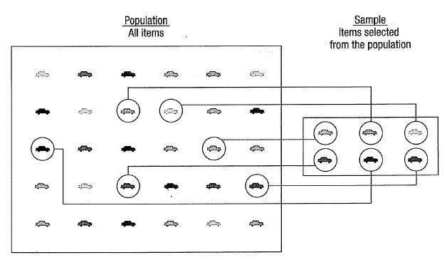
The population and sample

Slide 5
Why sampling is important?
In most of the cases, it is impossible to study each case of a larger population. Therefore, sampling is crucial which;
Reduces the cost of research.
Reduces the time spent on research.
Generalize about a larger population. (If sample size higher, the validity of generalization will be more accurate. In other words, larger sample represents the population with less errors)
Allows researcher to study ongoing issues quickly.

Slide 6
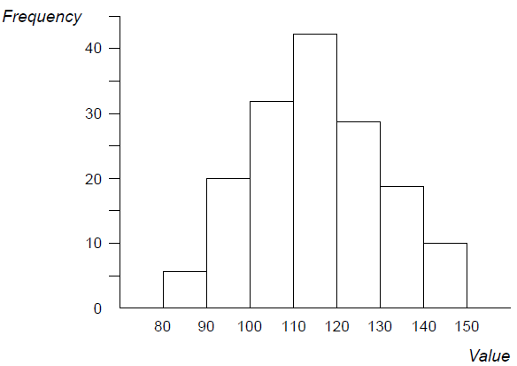
Sampling Distribution
Once data is collected from the sample, frequency histogram can be created as follows.
X-axis represents the value range and Y-axis represents the frequency of each value range occurred.

Slide 7
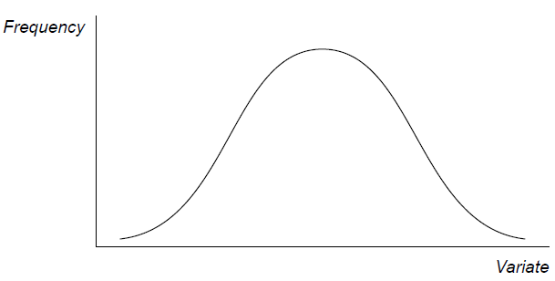
Sampling Distribution (Cont...)
If you draw a curve through the tops of the column bars, you will be able to get a frequency curve as below. This can be called as sampling distribution.
Variate is the variable such as heights , weights, scores etc. Usually, variable figures are presented in groups such as 80-90, 91-100 etc.

Slide 8
The Normal Distribution
The frequency curve shown in the previous slide can be very accurate in the natural phenomena such as
Weights of any particular animal species
Heights of students in one age group
Life expectancy of healthier individuals
This type of bell shaped, symmetrical, central peaked frequency curve can be called as the normal distribution.

Slide 9
The Normal Distribution (Cont...)
The normal distribution curve can be in same shape but in different scales as below.

Slide 10
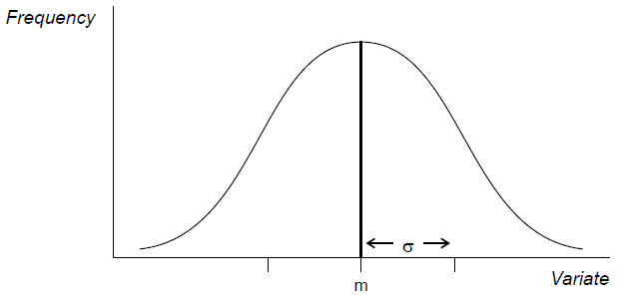
The Normal Distribution (Cont...)
In normal distribution curve, m which is in the centre of the curve represents the mean and σ represents the standard deviation.

Slide 11
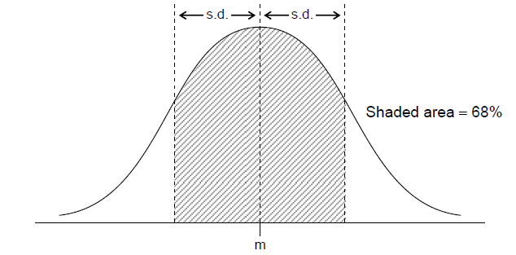
Attributes of the Normal Distribution
68% of observations are within ± 1 standard deviation (s.d.) of the mean.

Slide 12
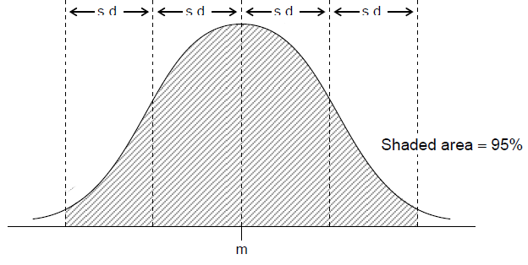
Attributes of the Normal Distribution (Cont...)
95% of observations are within ± 2 standard deviation (s.d.) of the mean.

Slide 13
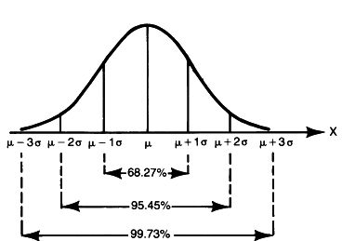
Attributes of the Normal Distribution (Cont...)
Following graph demonstrates the percentages of observations covered by number of standard deviations.

Slide 14
Central Limit Theorem
Proposition 1:
The mean of the sampling distribution will equal the mean of the population.
Proposition 2:
The sampling distribution of means will be approximately normal regardless of the shape of the population. (A sample should be about 30 cases or over)
Proposition 3:
Standard Error (S.E.) equals the standard deviation of the population divided by the square root of the sample size.
(The standard deviation of the sampling distribution is called as the standard error)

Slide 15
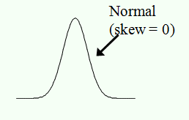
Skewed Data / Measure of Skew
Skew is a measure of symmetry in the distribution of scores.
There are three types;
Negative Skew
2. No Skew
3. Positive Skew
Negative Skew
Positive Skew

Slide 16
Skewed Data / Measure of Skew (Cont…)
1. Negative Skew – This is often called as skewed to the left. The long tail is on the negative side/left side of the peak. Mean is also on the left side of the peak.
2. No Skew – This is called as normal distribution which is symmetrical where mean, median and mode at the peak.
3. Positive Skew – This is called as skewed to the right where long tail is on the positive or right side of the peak. Mean is located on the right side of the peak.

Slide 17


This is time for your questions...
-THANK YOU-

