Slide 1
Numeracy and Data Analysis
Presentation of Data

Slide 2
Re-cap of last week...
Integers and Fractions
Numerator and Denominator
Fraction Rules
Cancelling down,
Changing the denominator,
Changing an improper fraction to mix numbers,
Changing mix numbers into improper fractions.
Adding, Subtracting, Dividing and Multiplying Fractions
Percentages (%)
Ratios (:)

Slide 3
What is Data?
What is Data?
Data can be explained as a collection of words, numbers, observations, measurements etc. which are unorganized facts in the simplest form.
Two types of data such as;
Quantitative - data which is having numerical aspect
Qualitative – data which is descriptive, NOT numerical
Example of Quantitative Data –
Individual marks received for Mathematics subject: 55, 60, 38, 72, 41
Temperature of a city/town: Celsius 12, 15,38, 27
Weight of students in the class: 55 Kg, 63 Kg

Slide 4


What is Information?
What is Information?
Information is the data which has been processed in a meaningful and useful way to meet the requirements.
Example –
Average marks for Mathematics subject for following 5 students:
55, 60, 38, 72, 41 (Data)
Information is the average marks of 5 students, 53.2

Slide 5
Data Presentation
In here, we consider numerical/quantitative data presentation.
To present numerical data, mainly tables and graphs/charts are being used.
Table is a format where data can be arranged in rows and columns. Column
Example:
Row
Student ID | Maths marks
S1 | 80
S2 | 72

Slide 6
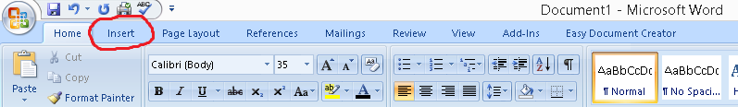
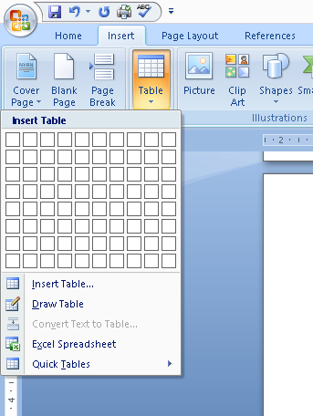
Create a Table on Microsoft Office
Click ‘Insert’
Click the ‘Table’
Then choose number of
rows and columns needed
either from display or
insert table option.

Slide 7
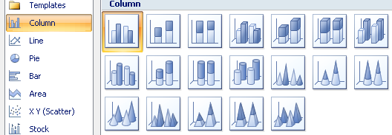
Charts / Graphs
Graphs / Charts are another main way of presenting data in a graphical display.
There are different types of charts available
such as;
Column Chart –
It is a graphical display
of data using vertical
bars / columns. It is
good in a way of
present relative sizes.

Slide 8


Charts / Graphs (Cont...)
Line Charts –
Information which is displayed in this chart is connected each other.
Pie Charts –
This type of chart uses ‘pie slices’ to present the size of data.

Slide 9
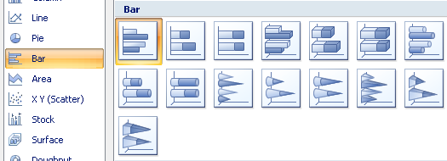
Charts / Graphs (Cont...)
Bar Charts –
This is the graphical presentation of data using horizontal bars.
Scatter Plot– This type of charts allows to find relationship between independent (X) and dependent (Y) variables.

Slide 10
Charts / Graphs (Cont...)
HOME EXERCISE
Find out more types of charts/graphs available apart from what we discussed in the previous slides and their use in the real world.
Hint – Pictograms, Histograms, Area etc.

Slide 11
Illustration of Inserting a Column Chart on MS Office Package
To create a chart, you must have numerical data in hand.
Let’s take the example used before , that is marks achieved by five students.
To insert a column chart in Microsoft Office,
First click ‘insert’

Slide 12
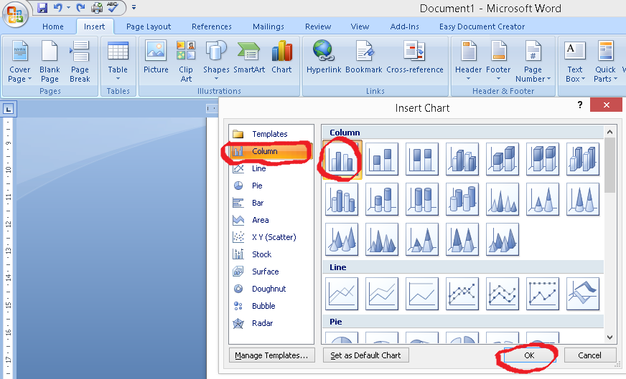
Illustration of Inserting a Column Chart on MS Office Package (Cont...)
Secondly, click ‘Chart’
Choose any
type of
column chart
of your choice
from right hand
preview and
click ‘OK’

Slide 13
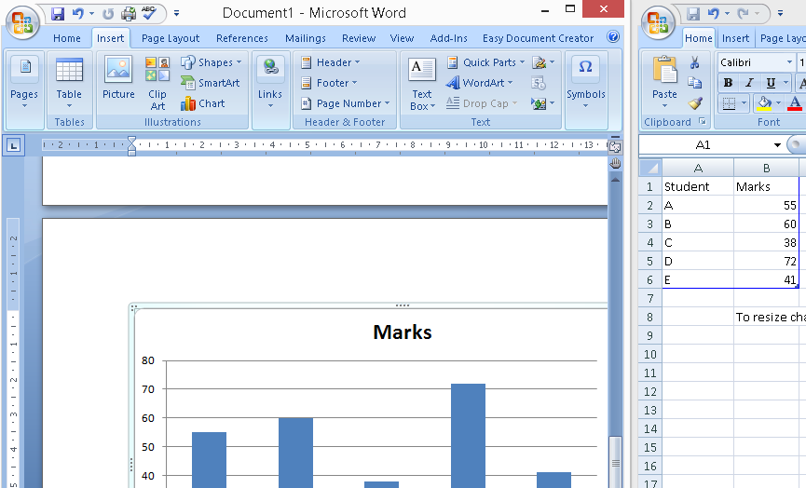
Illustration of Inserting a Column Chart on MS Office Package (Cont...)
Then, it opens up the Excel sheet where data can be input.
Input student
names and marks
on the right side
Excel sheet.
Once you input
data, column
chart will be
created
automatically on
the left side.

Slide 14
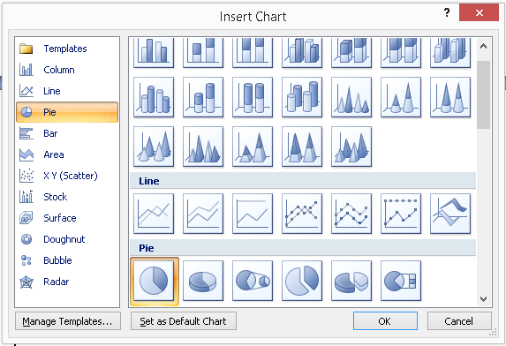
Illustration of Inserting an Any Type of Chart on MS Office Package
Follow the same first and second steps until you get the following ‘Insert Chart’ box.
According to the
requirement or
preference, choose
the type of chart
(line, pie, bar etc.)
from left side and
design from right
side. Then click ‘OK’.
Finally, input data in the Excel which is loaded automatically and create the chart.

Slide 15
Exercises
Create column, line, pie and bar charts for following data available;
Sport | Number of Fans
Football | 520
Cricket | 380
Netball | 220
Basketball | 280
Badminton | 460

Slide 16


This is time for your questions...
-THANK YOU-

