Slide 1


SOCIAL RESPONSIBILITY AND MANAGERIAL ETHICS
Organisational Theory and Practice
Lesson 2

Slide 2


Learning Objectives
Explain the classical and socioeconomic views of social responsibility
List the arguments for and against business’s being socially responsible
Differentiate among social obligation, social responsiveness, and social responsibility
Explain the relationship between corporate social responsibility and economic performance
Describe values-based management and how it is related to organizational culture
5-2

Slide 3

Learning Objectives (cont.)
Explain what the “greening” of management is and how organizations are “going green”
Differentiate among the four views of ethics
Identify the factors that affect ethical behavior
Discuss various ways organizations can improve the ethical behavior of their employees
5-3

Slide 4
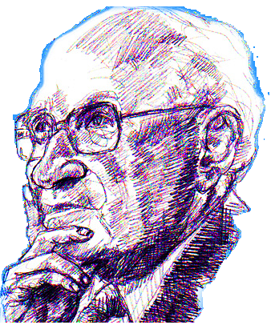
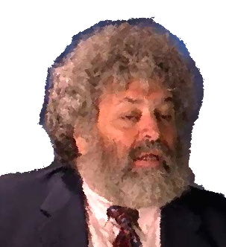
What Is Social Responsibility?
Two Opposing Views of Social Responsibility
Classical view - management’s only social responsibility is to maximise profits
Milton Friedman - managers’ primary responsibility is to serve the interests of the stockholders
doing “social good” adds to the cost of doing business
costs must be passed on to consumers
Socioeconomic view - businesses are not just economic institutions
According to Edward Freeman - management’s social responsibility goes beyond making profits to include protecting and improving society’s welfare
businesses have responsibility to a society that:
endorses their creation through laws and regulations
supports them by buying their products/services
more organisations around the world have increased their social responsibility
5-4

Slide 5

What Is Social Responsibility (cont.)
From Obligations to Responsiveness…
social responsibility - a business’s obligation to pursue long-term goals that help society
goes beyond legal and economic requirements
views business as a moral agent
social obligation - obligation of a business to meet its economic and legal responsibilities
pursues social goals only when they contribute to economic goals
social responsiveness - capacity of a firm to adapt to changing societal conditions
tries to satisfy social needs in line with social norms
5-5

Slide 6
Social Responsibility versus Social Responsiveness
Social Responsibility
Social Responsiveness
Major consideration Focus
Emphasis
Decision framework
Ethical Ends Obligation Long term
Pragmatic
Means Responses Medium
Short term
5-6

Slide 7
Social Responsibility And Economic Performance Most Research Shows a Positive Relationship
methodological questions associated with trying to measure “social responsibility” and “economic performance”
issue of causation
Evaluation of Socially Conscious Mutual Stock Funds
social screening - applying social criteria to investment
these funds often outperform the market average
Conclusion
a company’s socially responsible actions do not hurt its long-term economic performance
5-7

Slide 8
Values-Based Management
Definition
an approach to managing in which managers establish, promote, and practice an organization’s shared values
values reflect what it stands for and what it believes in
Purposes of Shared Values
act as guideposts for managerial decisions and actions
shape employee behavior by communicating what the organization expects of its members
influence marketing efforts
build team spirit
inspire greater commitment to work and responsibility

Slide 9
Purposes Of Shared Values
Shared Organizational Values
Guide Managers’ Decisions and Actions
Build Team Spirit
Influence Marketing Efforts
Shape Employee Behavior

Slide 10

Values-Based Management (cont.)
Developing Shared Values
it is difficult to establish shared values
managers are responsible for shaping the organization so that its values, norms, and ideals appeal strongly to employees
companies that practice values-based management have broad commitment to being socially responsible and socially responsive

Slide 11

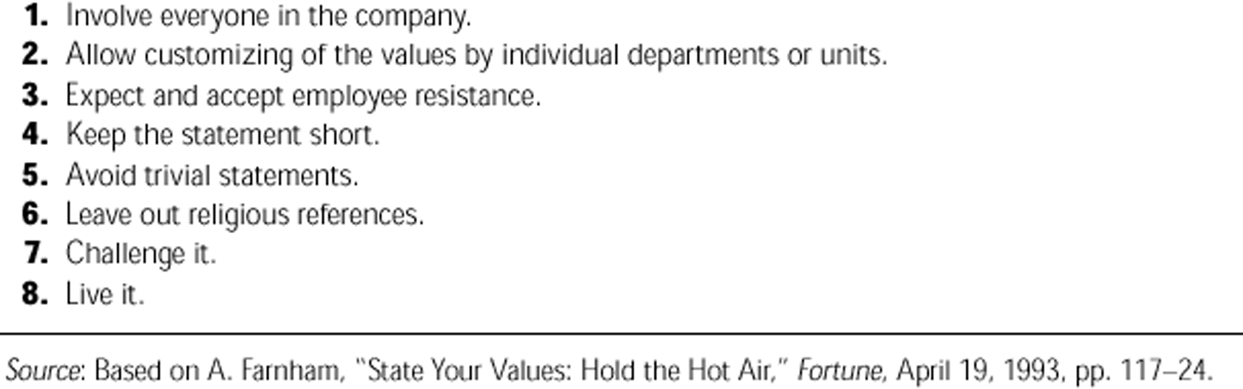
Suggestions for Creating a Good Corporate Values Statement

Slide 12

The “Greening” Of Management
Definition
recognition of the close link between an organization’s decisions and activities and its impact on the natural environment
resulted from highly visible ecological problems and environmental disasters
Global Environmental Problems
there are many global environmental problems
developed nations are blamed for the problems
problems expected to increase as emerging countries become more developed

Slide 13
The “Greening” Of Management (cont.)
How Organizations Go Green
products and production processes have become cleaner
shades of green - describe different approaches that organisations may take
legal approach - follow legal obligations
– little environmental sensitivity
market approach - organizations respond to the environmental preferences of customers
stakeholder approach - organization chooses to respond to multiple demands made by stakeholders
activist approach - looks for ways to respect and preserve the earth and its natural resources

Slide 14
Approaches To Being Green
Low
High
Environmental Sensitivity
Legal
Market Approach
Stakeholder Approach
Activism
Approach
Approach
(Light Green)
(Dark Green)

Slide 15
The “Greening” Of Management (cont.)
Summing Up Social Responsibility
four-stage progression of an organisation’s social responsibility
each stage implies an increasing level of managerial discretion
Stage 1 - promote stockholders’ interests by seeking to minimise costs and maximise profits
all laws and regulations are followed
feel little obligation to satisfy other societal needs
Stage 2 - managers accept their responsibility to employees and focus on human resource concerns
improve working conditions

Slide 16
The “Greening” Of Management (cont.)
Summing Up Social Responsibility (cont.)
four-stage progression (cont.)
Stage 3 - expand responsibilities to other stakeholders
actions include providing fair prices, high-quality products and services, safe products, and good supplier relations
Stage 4 - managers feel responsibility to society as a whole
try to advance the public good
promote social justice, preserve the environment, and support social and cultural activities

Slide 17
To Whom Is Management Responsible?
Lesser
Social Responsibility
Greater
Stage 1
Owners and Management
Stage 2
Employees
Stage 3
Constituents in Specific Environment
Stage 4
Broader Society

Slide 18

Managerial Ethics
Ethics
rules and principles that define right and wrong conduct
Four Views of Ethics
Utilitarian View
Rights View
Theory of justice view
Integrative social contracts theory

Slide 19
Managerial Ethics (cont.)
utilitarian view - ethical decisions are made on the basis of their outcomes or consequences
offers the greatest good for the greatest number
encourages efficiency and productivity
may ignore the rights of some stakeholders
most business-people subscribe to this view
rights view - respects and protects individual liberties and privileges
may present obstacles to high productivity and efficiency
theory of justice view - managers impose and enforce rules fairly and impartially
protect the interests of stakeholders who may be underrepresented or lack power
encourages a sense of entitlement that might make employees reduce risk taking, innovation, and productivity
integrative social contracts theory - decisions should be based on empirical and normative factors
based on integration of two “contracts’
– general social contract - allows businesses to operate
» defines the acceptable ground rules
– specific contract - addresses acceptable ways of behaving in a particular community

Slide 20
Managerial Ethics (cont.)
Factors That Affect Managerial Ethics
Stage of moral development - at each successive stage, moral judgment is less dependent on outside influences
people proceed through the levels sequentially
no guarantee of continued moral development
majority of adults at Stage 4
preconventional level - choice between right and wrong is based on personal consequences
conventional level - moral values reside in living up to others’ expectations
principled level - individual tries to define moral principles apart from the authority of society

Slide 21
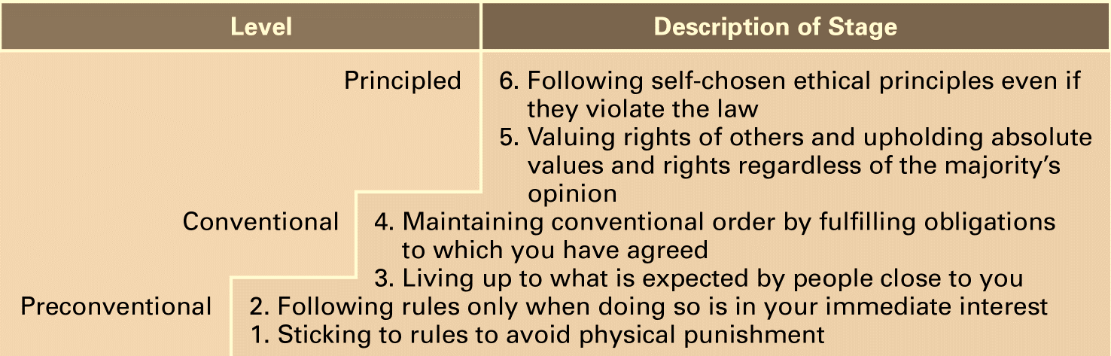
Stages of Moral Development

Slide 22
Managerial Ethics (cont.)
Factors That Affect Managerial Ethics (cont.)
Individual characteristics
values - basic convictions about right and wrong
ego strength - strength of a person’s convictions
locus of control - degree to which people believe that they control their own fate
internals - believe that they control their own destinies
externals - believe that what happens to them is due to luck or chance

Slide 23
Managerial Ethics (cont.)
Factors That Affect Managerial Ethics (cont.)
Structural variables
design of organization affects ethical behavior
designs that minimize ambiguity and uncertainty more likely to encourage ethical behavior
rules and regulations
written codes of ethics
behavior of superiors
performance appraisal systems that focus on means as well as ends
reward systems that punish failure to achieve ends is likely to compromise ethics

Slide 24
Managerial Ethics (cont.)
Factors That Affect Managerial Ethics (cont.)
Organizational culture
strong culture more influential than a weak culture
high ethical standards result from a culture that is high in risk tolerance, control, and conflict tolerance
Issue intensity
importance of an ethical issue
more intense issues prompt greater ethical behavior

Slide 25
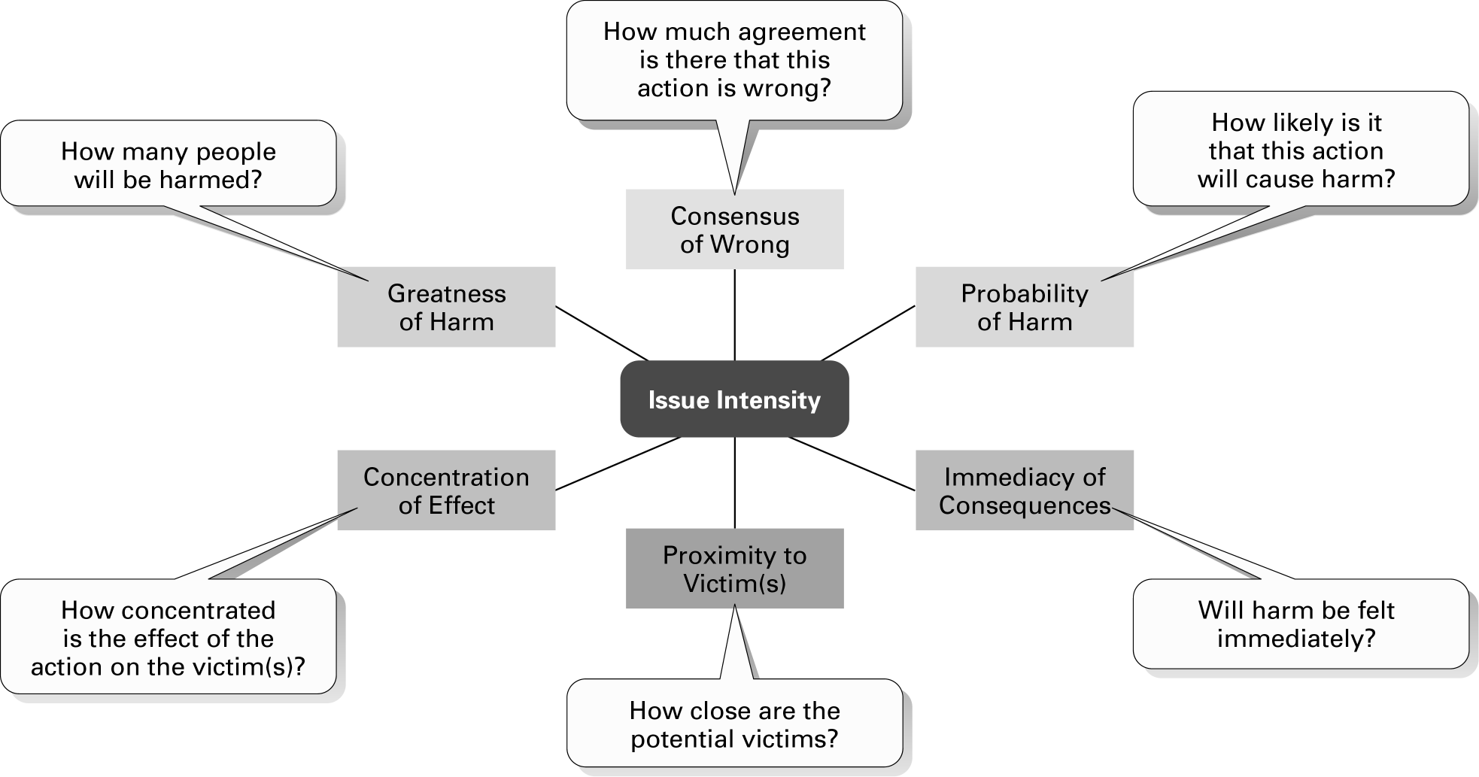
Determinants of Issue Intensity

Slide 26
Factors That Affect Ethical And Unethical Behavior
Individual Characteristics
Issue Intensity
Ethical Dilemma
Stage of Moral Development
Ethical/Unethical Behavior
Moderators
Structural Variables
Organizational Culture

Slide 27
Managerial Ethics (cont.)
Ethics in an International Context
social and cultural differences determine ethical and unethical behavior
Foreign Corrupt Practices Act - makes it illegal for U.S. firms to knowingly corrupt foreign officials
global firms must clarify their ethical guidelines
Global Compact - United Nations document containing principles for doing business globally in the areas of human rights, labor, and environment

Slide 28
Managerial Ethics (cont.)
Toward Improving Ethical Behavior
comprehensive ethics programs have the potential to improve an organization’s ethical climate
no guarantees that even well-designed ethics programs will lead to the desired outcome
Employee selection - eliminate ethically questionable applicants
Codes of ethics - formal statement of an organization’s primary values and ethical rules
shouldn’t be developed and applied in isolation
must consistently reaffirm the importance of the code
must consistently discipline those who break the code

Slide 29
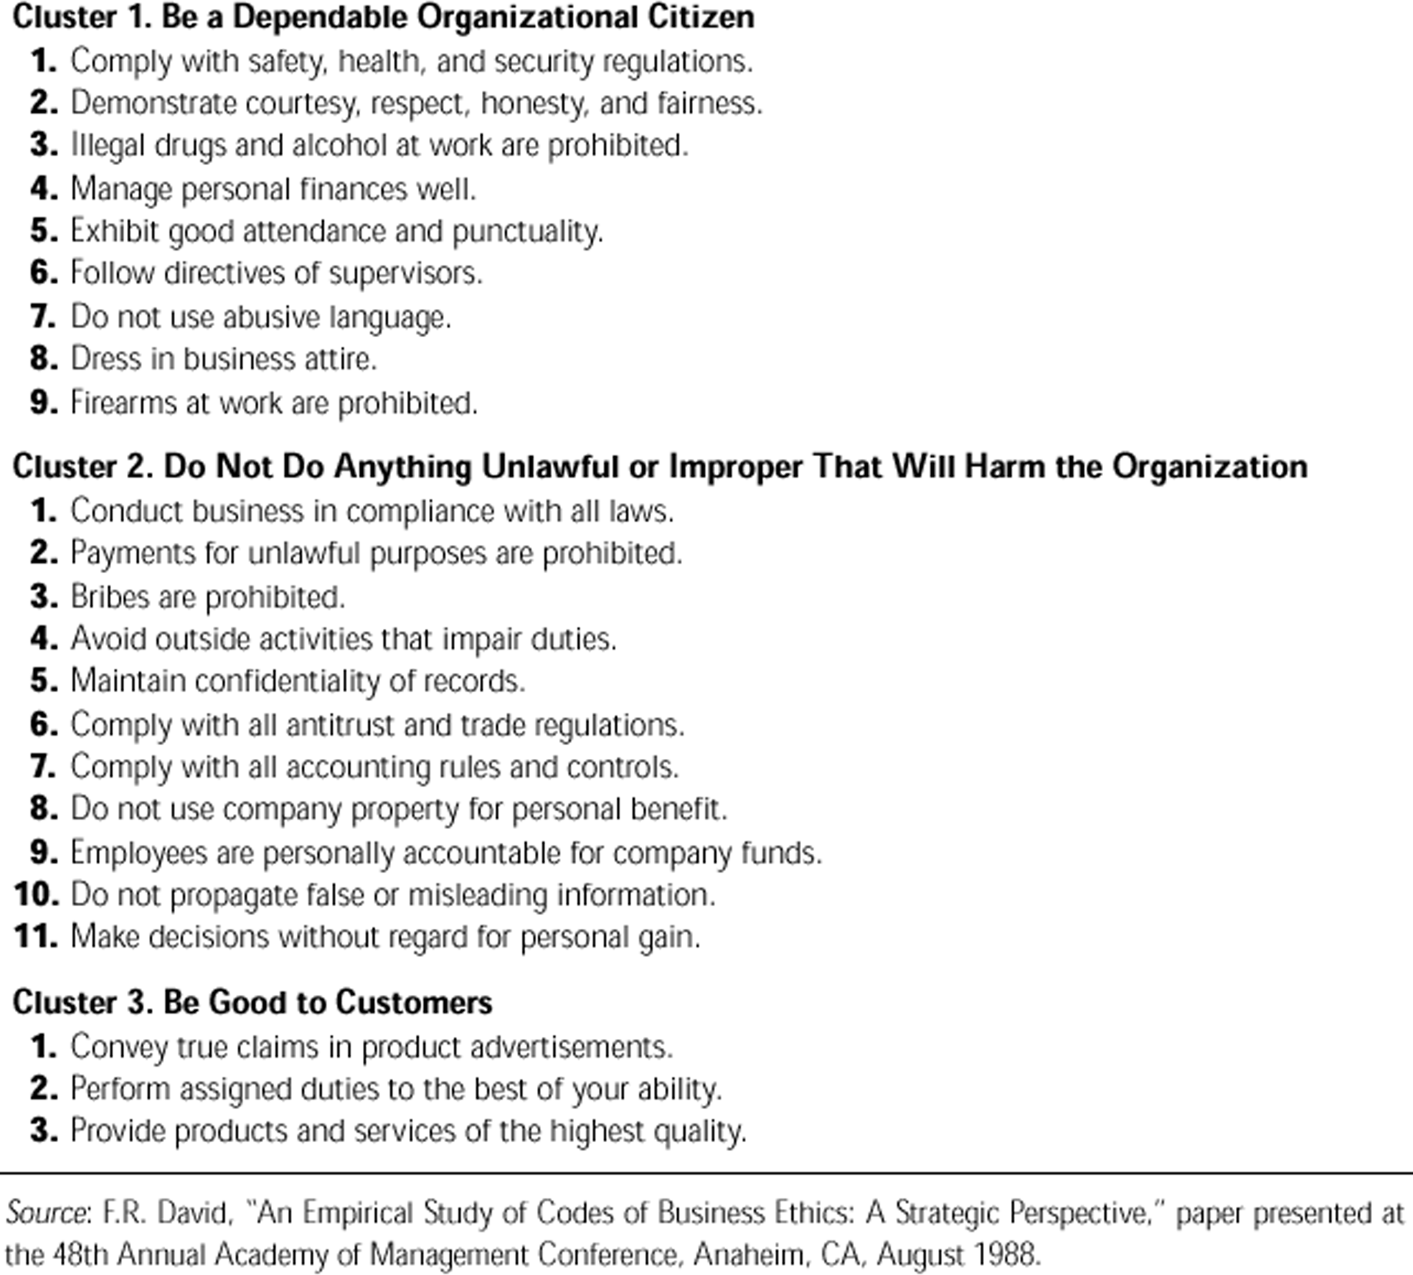
Clusters of Variables Found in 83 Corporate Codes of Business Ethics

Slide 30
Managerial Ethics (cont.)
Toward Improving Ethical Behavior (cont.)
Top management’s leadership - what they do is far more important than what they say
set the cultural tone by their reward and punishment practices
Job goals - goals should be clear and realistic
reduce ambiguity
Performance appraisal - must focus on ethical standards
Ethics training - an increasing number of organizations use training to encourage ethical behavior
reinforce the organization’s standards of conduct
clarify acceptable and unacceptable practices

Slide 31
Managerial Ethics (cont.)
Toward Improving Ethical Behavior (cont.)
Formal protective mechanisms - protect employees who face ethical dilemmas
can do what is right without fear of retribution
ethical counselors - act as a sounding board and provide guidance
ethics officers - design, direct, and modify the organization’s ethics program

