Slide 1
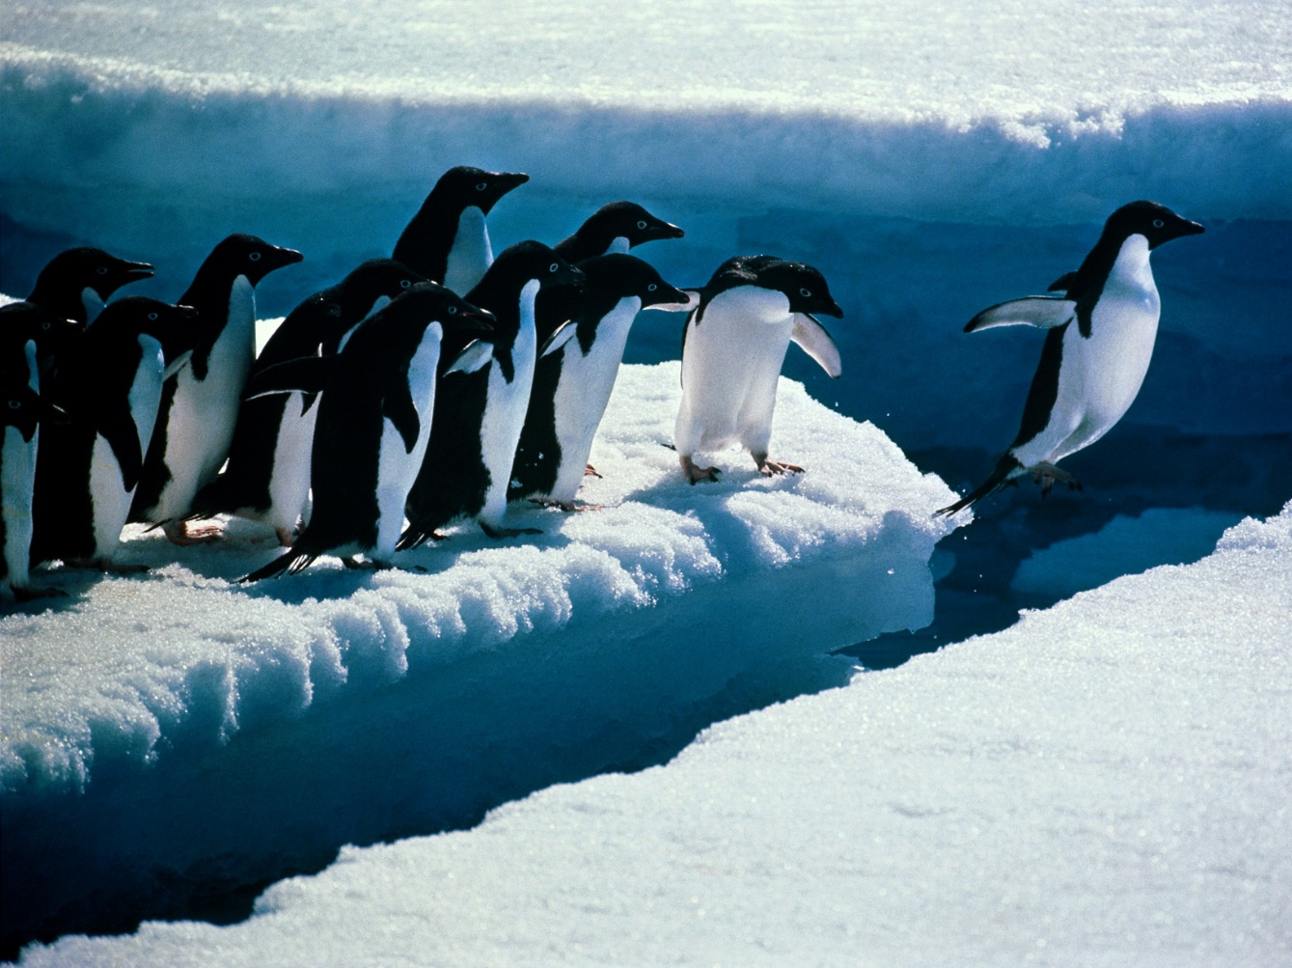
Lesson 3 LEADERSHIP
“A leader lives in each of us”
What are the foundations for effective leadership?
What are current issues and directions in leadership development?
Notes:
We will see that leadership and management, although not the same, have a lot in common.

Slide 2
LEADERSHIP Foundations For Effective Leadership
Leadership is one of the four functions of management
Leadership relies on use of position power and personal power
Leadership traits and styles can influence leadership effectiveness
Fiedler’s contingency model matches leadership styles with situational differences
House’s path-goal theory matches leadership styles with task and follower characteristics
Notes:
Leadership traits and styles are a lot like effective manager’s traits and styles. However manager’s tend to rely more on position power.

Slide 3
Foundations For Effective Leadership
Leadership is one of the four functions of management
Leading – to inspire effort
Communicate the Vision
Build enthusiasm
Motivate commitment and hard work
Planning – to set the directions
Controlling – to ensure results
Management
Process
Organising – to create structures
Notes:
It is true that leadership is one of the 4 functions of management but that does not mean that all managers are effective leaders.

Slide 4
Foundations For Effective Leadership
Power
the ability to get others to do what you want them to do
Reward Power
The capacity to offer something of value as a means of influencing other people
Coercive Power
The capacity to punish or withhold positive outcomes as a means of influencing other people.
Legitimate Power
The capacity to influence other people by virtue of formal authority or the rights of office.
Expert Power
The capacity to influence other people by virtue of specialized knowledge.
Referent Power
The capacity to influence other people because of their desire to identify personally with you
Notes:
Reward power and Coercive power, the authority to reward and punish, are a part of legitimate power.

Slide 5
Foundations For Effective Leadership
Managerial Power = Position Power + Personal Power
Power of the POSITION:
Based on things managers can offer to others.
Rewards: "If you do what I ask, I'll give you a reward."
Coercion: "If you don't do what I ask, I'll punish you."
Legitimacy: "Because I am the boss; you must do as I ask."
Power of the PERSON:
Based on how managers are viewed by others.
Expertise—as a source of special knowledge and
information.
Reference—as a person with whom others like
to identify.
Notes:
Position power should be used sparingly. Personal power, though more difficult to obtain, is more effective in the long term.

Slide 6
FOUNDATIONS FOR EFFECTIVE LEADERSHIP
Leadership Style
The recurring pattern of behaviors exhibited by a leader
Autocratic Style
Acts in unilateral command and control fashion
Human Relation Style
Emphasizes people over tasks
Democratic Style
Encourages participation with an emphasis on both task accomplishments and development of people
Lassize-faire Style
Is low on both tasks and people
Notes:
A manager that is low on risks and people is unlikely to do much for the organization.

Slide 7
FOUNDATIONS FOR EFFECTIVE LEADERSHIP
Leadership Styles
Traits Often Shared by Effective Leaders
Drive
Successful leaders have high energy, display initiative, and are tenacious.
Self-confidence
Successful leaders trust themselves and have confidence in their abilities.
Creativity
Successful leaders are creative and original in their thinking.
Cognitive ability
Successful leaders have the intelligence to integrate and interpret information.
Business knowledge
Successful leaders know their industry and its technical foundations.
Motivation
Successful leaders enjoy influencing others to achieve shared goals.
Flexibility
Successful leaders adapt to fit the needs of followers and demands of situations.
Honesty and integrity
Successful leaders are trustworthy; they are honest, predictable, and dependable.
Notes:
Of course, not all effective leaders have all these traits but, then again, the more of these traits a leader has, the more effective he/she is likely to be.

Slide 8
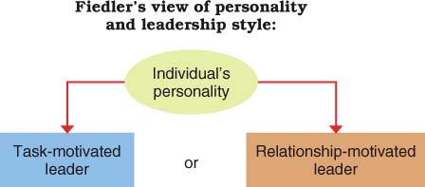
FOUNDATIONS FOR EFFECTIVE LEADERSHIP Leadership Styles
Fiedler’s Contingency Theory
Suggests that the best leadership style depends on the situation
Notes:
Fiedler not only believed but conducted studies to show that effective leadership style is situational. His Task-motivated leader would be similar to the classical/mechanistic style of management while his Relationship-motivated style would be similar to the humanistic/organic management style.

Slide 9
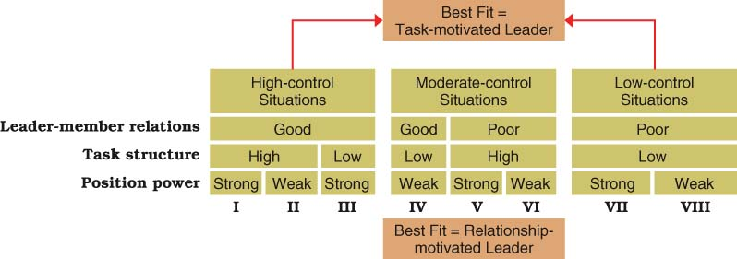
FOUNDATIONS FOR EFFECTIVE LEADERSHIP Leadership Styles
Fiedler believes that leadership success requires the right style–situation match. He classifies leadership styles as either task-motivated or relationship motivated and views them as strongly rooted in our individual personalities. He describes situations according to the leader’s position power, quality of leader–member relations, and amount of task structure. In situations that are most favorable and unfavorable for leaders, his research shows the task-motivated style as a best fit. In more intermediate situations, the relationship-motivated style provides the best fit.
Notes:
In the end, Fiddler's Contingency Theory can be summed up as “When it comes to the most effective leadership style, it all depends on the situation.”

Slide 10

FOUNDATIONS FOR EFFECTIVE LEADERSHIP Leadership Styles
House’s Path Goal Theory
Leaders are most effective when they help followers move along paths through which they can achieve both professional and personal goals
House’s Four Path-Goal Leadership Styles
1. “Directive leader” lets others know what is expected; gives
directions, maintains standards.
2. “Supportive leader” makes work more pleasant; treats
others as equals, acts friendly, shows concern.
3. “Achievement-oriented leader” sets challenging goals;
expects high performance, shows confidence.
4. “Participative leader” involves others in decision making;
asks for and uses suggestions.
Notes:
Each person has different professional and personal needs. An effective leader needs to recognize this and to adjust his style depending on the situation and the individual that he/she is leading.

Slide 11
LEADERSHIP Trends In Leadership Development
• Transformational leadership inspires enthusiasm and extraordinary performance.
• Emotionally intelligent leadership handles emotions and relationships well.
• Interactive leadership emphasizes communication, listening, and participation.
• Moral leadership builds trust from a foundation of personal integrity.
• Servant leadership is follower centered and empowering.
Notes:
Just as there are many types of management, there are many types of leaders.

Slide 12
LEADERSHIP Trends In Leadership Development
Leadership surveys of U.S. workers report:
• 39% believe leaders most often act in best interest of organisation.
• 22% see leaders as ready to admit mistakes.
• 46% believe their organisations give them freedom to do their jobs.
• 25% of women and 16% of men believe their organisations pick the best people for leadership.
• 33% of managers are perceived as “strong leaders.”
Notes:
By this data, workers do not have a very high opinion of their managers / leaders and its true. Employee confidence in management has been steadily decreasing for more than a decade.

Slide 13

LEADERSHIP Trends In Leadership Development
Charismatic Leader
develops special leader–follower relationships and inspires followers in extraordinary ways.
Transactional Leader
directs the efforts of others through tasks, rewards, and structures.
Transformational Leader
Inspires Enthusiasm and Extraordinary Performance
Notes:
Transactional leaders are generally good at short term crisis or stable situations. Transformational leaders tend to build long term effective organizations.

Slide 14
LEADERSHIP Trends In Leadership Development
Characteristics of a Transformational Leader
Vision Has ideas and a clear sense of direction; communicates them to others; develops excitement about accomplishing shared “dreams.”
Charisma Uses power of personal reference and emotion to arouse others’ enthusiasm, faith, loyalty, pride, and trust in themselves.
Symbolism Identifies “heroes” and holds spontaneous and planned ceremonies to celebrate excellence and high achievement.
Empowerment Helps others grow and develop by removing performance obstacles, sharing responsibilities, and delegating truly challenging work.
Intellectual stimulation Gains the involvement of others by creating awareness of problems and stirring their imaginations.
Integrity Is honest and credible; acts consistently and out of personal conviction; follows through on commitments.
Notes:
Notice the similarity between effective managers and transformational leaders.

Slide 15

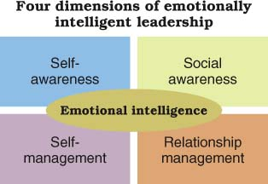
LEADERSHIP Trends In Leadership Development
Interactive Leadership
is strong on motivating, communicating, listening, and relating positively to others
Emotional Intelligence (EI)
is the ability to manage our emotions in social relationships.
Notes:
Emotional intelligence is thought by some to be more important IQ.

Slide 16

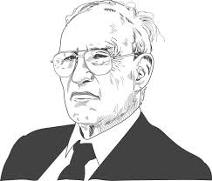
LEADERSHIP Trends In Leadership Development
Peter Drucker’s “Good Old-Fashioned Leadership”
Good leaders have integrity; they mean what they say, earning
and keeping the trust of followers.
Good leaders define and establish a sense of mission; they set
goals, priorities and standards.
Good leaders accept leadership as responsibility, not a
rank; they surround themselves with talented people.
Peter Drucker – One of the most influential management consultants of the 20th century.
Notes:
Peter Drucker also had good old fashion common sense.

Slide 17

MORE DRUCKER Why Peter Drucker’s leadership advice still matters
• Management is about human beings.
• Don’t ever think or say “I.” Think and say “We.”
• Attracting and holding talent have become two of the central tasks of management.
• Every decision is risky.
• Levels of management should be kept to the minimum.
• Effective organizations exist not to satisfy themselves but to fill a customer need.
• I’m not going to give you any answers. . . . I’m going to give you the questions you should ask.
Notes:
These statements cover the essence of what management is supposed to be.
When Peter Drucker died at the age of 95 in the year 2005, the former CEO of GE, Jack Welch, said: “The world knows he was the greatest management thinker of the last century." That could be an understatement. Drucker was renowned worldwide for his many books, consultancies, newspaper columns, and sage advice on matters of management, organizations, business and society, and executive leadership. Here’s a sampler of his enduring advice:

Slide 18
LEADERSHIP Trends In Leadership Development
Moral Leadership
Builds trust from a foundation of personal integrity
Ethical Leadership
Has integrity and appears to others as “good” and “right” by moral standards
Integrity
In leadership is honesty, credibility and consistency in putting values into action
Servant Leadership
Means serving others, helping them use their talents to help organizations best serve society
Empowerment
Gives employees job freedom and power to influence affairs in the organization
Notes:
Given the corporate fraud of recent years, it is obvious that some very large corporations have not followed these trends.

Slide 19
The End

