Slide 1
Creating Effective Organizational Designs
Chapter Ten
McGraw-Hill/Irwin
Copyright © 2012 by The McGraw-Hill Companies, Inc. All rights reserved.

Slide 2
Learning Objectives
After reading this chapter, you should have a good understanding of:
LO10.1 The growth patterns of major corporations and the relationship between a firm’s strategy and its structure.
LO10.2 Each of the traditional types of organizational structure: simple, functional, divisional, and matrix
LO10.3 The implications of a firm’s international operations for organizational structure.
10-<number>

Slide 3
Learning Objectives (cont.)
LO10.4 Why there is no “one best way” to design strategic reward and evaluation systems, and the important contingent roles of business- and corporate-level strategies.
LO10.5 The different types of boundaryless organizations—barrier-free modular, and virtual—and their relative advantages and disadvantages.
LO10.6 The need for creating ambidextrous organizational designs that enable firms to explore new opportunities and effectively integrate existing operations.
10-<number>

Slide 4

Traditional Forms of
Organizational Structure
Organizational structure
  refers to formalized patterns of interactions that link a firm’s tasks, technologies, and people
10-<number>

Slide 5
Traditional Forms of
Organizational Structure
Structure provides a means of balancing two conflicting forces
  Need for the division of tasks into meaningful groupings
  Need to integrate the groupings for efficiency and effectiveness
10-<number>

Slide 6
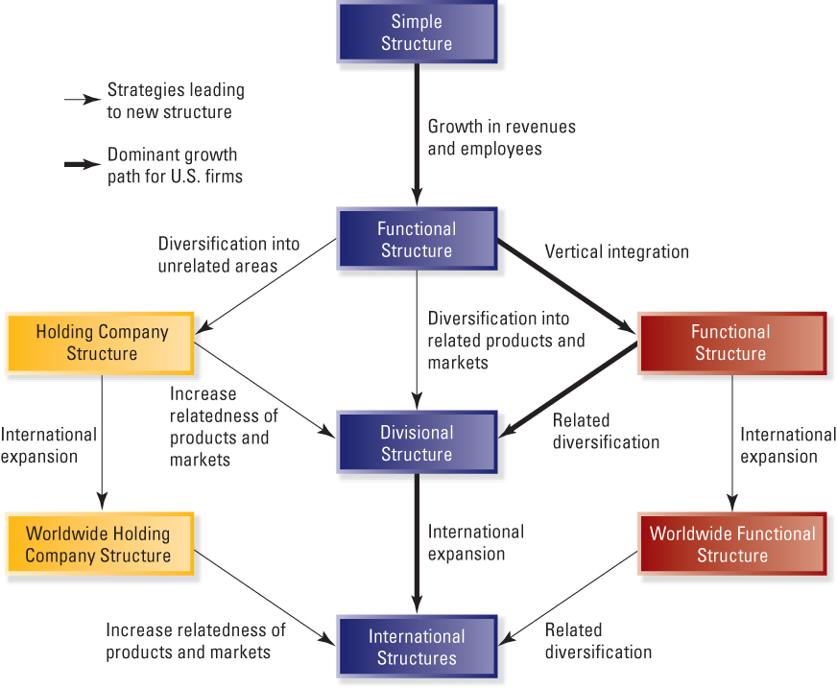
Dominant Growth Patterns of Large Corporations
Exhibit 10.1
10-<number>

Slide 7
Simple Structure
Simple Structure
  An organizational form in which the owner-manager makes most of the decisions and controls activities, and the staff serve as an extension of the top executive.
10-<number>
Notes:
Simple structure is the oldest and most common organizational form
Staff serve as an extension of the top executive’s personality
Highly informal
Coordination of tasks by direct supervision
Decision making is highly centralized
Little specialization of tasks, few rules and regulations, informal evaluation and reward system

Slide 8
Simple Structure
Advantages
  Highly informal
  Centralized decision making
  Little specialization
Disadvantages
  Employees may not understand their responsibilities
  May take advantage of lack of regulation
10-<number>

Slide 9
QUESTION
At ACME Corporation, work is divided into units that specialize in production, marketing, research and development, and other management tasks. This is an example of a
Simple structure
Functional structure
Divisional structure
Matrix structure
10-<number>
Notes:
Answer: B. Functional structure

Slide 10
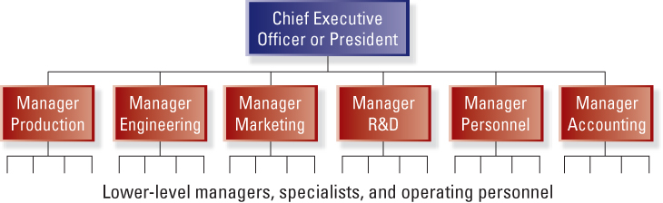
Functional Structure
Exhibit 10.2
10-<number>

Slide 11

Functional Structure
Functional Structure
  An organizational form in which the major functions of the firm, such as production, marketing, R&D, and accounting, are grouped internally.
10-<number>

Slide 12
Functional Structure
Advantages
  Enhanced coordination and control
  Centralized decision making
  Enhanced organizational-level perspective
  More efficient use of managerial and technical talent
  Facilitated career paths and development in specialized areas
10-<number>

Slide 13
Functional Structure
Disadvantages
  Impeded communication and coordination due to differences in values and orientations
  May lead to short-term thinking (functions vs. organization as a whole)
  Difficult to establish uniform performance standards
10-<number>

Slide 14
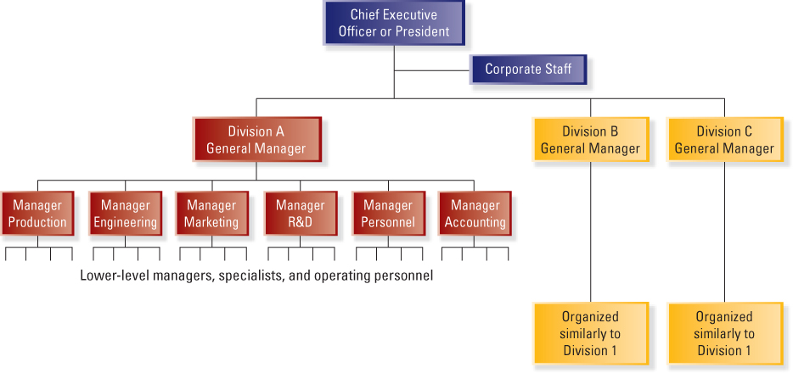
Divisional Structure
Exhibit 10.3
10-<number>

Slide 15
Divisional Structure
Divisional organizational structure
  An organizational form in which products, projects, or product markets are grouped internally.
  Also called multidivisional structure or M-Form
10-<number>
Notes:
Organized around products, projects, or markets
Each division includes its own functional specialists typically organized into departments
Divisions are relatively autonomous and consist of products and services that are different from those of other divisions
Division executives help determine product-market and financial objectives

Slide 16
Divisional Structure
Advantages
  Separation of strategic and operating control
  Quick response to important changes in external environment
  Minimal problems of sharing resources across functional departments
  Development of general management talent is enhanced
10-<number>

Slide 17
Divisional Structure
Disadvantages
  Can be very expensive
  Can be dysfunctional competition among divisions
  Differences in image and quality may occur across divisions
  Can focus on short-term performance
10-<number>

Slide 18

SBU Structure
Strategic business unit (SBU) structure
  An organizational form in which products, projects, or product market divisions are grouped into homogeneous units.
10-<number>
Notes:
Strategic business unit (SBU) structure
Divisions with similar products, markets, and/or technologies are grouped into homogenous SBUs
Task of planning and control at corporate office is more manageable
May become difficult to achieve synergies across SBUs
Appropriate when the businesses in a corporation’s portfolio do not have much in common
Lower expenses and overhead, fewer levels in the hierarchy
Inherent lack of control and dependence of CEO-level executives on divisional executives

Slide 19
SBU Structure
Advantages
  task of planning and control by the corporate office more manageable
  individual businesses can react more quickly to important changes
Disadvantages
  may become difficult to achieve synergies
  additional level of management increases overhead expenses
10-<number>

Slide 20
Holding Company Structure
Holding company structure
  An organizational form in which the divisions have a high degree of autonomy both from other divisions and from corporate headquarters.
10-<number>

Slide 21
Holding Company Structure
Advantages
  cost savings associated with lower overhead
  autonomy increases the motivational level of divisional executives
Disadvantages
  inherent lack of control and dependence
  limited staff support
10-<number>

Slide 22
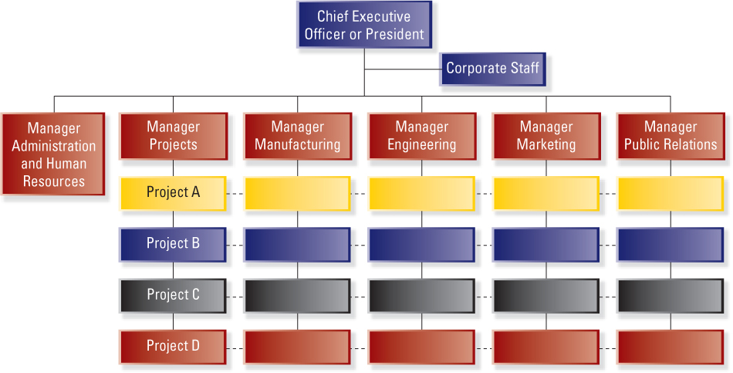
Matrix Structure
Exhibit 10.4
10-<number>

Slide 23

Matrix Structure
Matrix organizational structure
  an organizational form in which there are multiple lines of authority and some individuals report to at least two managers.
10-<number>

Slide 24
Matrix Structure
Advantages
  Facilitates the use of specialized personnel, equipment and facilities
  Provides professionals with a broader range of responsibility and experience
Disadvantages
  Can cause uncertainty and lead to intense power struggles
  Working relationships become more complicated
  Decisions may take longer
10-<number>

Slide 25
International Operations: Implications for Organizational Structure
Three major contingencies influence structure adopted by firms with international operations
  Type of strategy driving the firm’s foreign operations
  Product diversity
  Extent to which the firm is dependent on foreign sales
10-<number>

Slide 26
International Operations: Implications for Organizational Structure
Structures used to manage international operations
  International division
  Geographic-area division
  Worldwide functional
  Worldwide product division
  Worldwide matrix
10-<number>

Slide 27
Global Start-Up
Global start-up
  a business organization that, from inception, seeks to derive significant competitive advantage from the use of resources and the sale of outputs in multiple countries.
10-<number>

Slide 28
QUESTION
Strategic business unit (SBU) and holding company structures result from extensive
Diversification
Vertical integration
International expansion
Organizational flattening
10-<number>
Notes:
Answer: A. Diversification

Slide 29
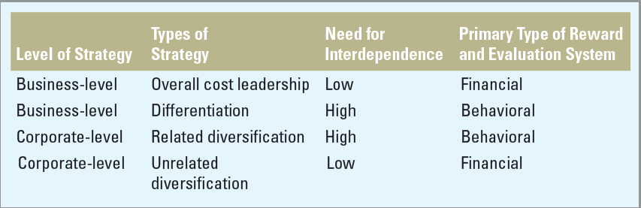
Business-Level Strategy: Reward and Evaluation Systems
Exhibit 10.6
10-<number>

Slide 30
Types of Boundaries
Vertical boundaries between levels in the organization’s hierarchy
Horizontal boundaries between functional areas
External boundaries between the firm and its customers, suppliers, and regulators
Geographic boundaries between locations, cultures and markets
10-<number>

Slide 31
Boundaryless Organizational Designs
Boundaryless organizational designs
  Organizations in which the boundaries, including vertical, horizontal, external, and geographic boundaries, are permeable.
10-<number>

Slide 32
The Barrier-Free Organization
Barrier-free organization
  An organizational design in which firms bridge real differences in culture, function, and goals to find common ground that facilitates information sharing and other forms of cooperative behavior.
10-<number>

Slide 33
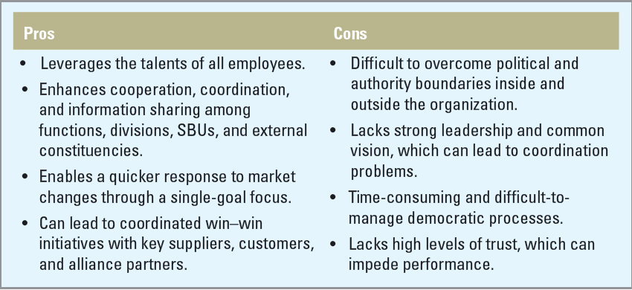
Pros and Cons of
Barrier-Free Structures
Exhibit 10.7
10-<number>

Slide 34

The Modular Organization
Modular organization
  An organization in which non-vital functions are outsourced, which uses the knowledge and expertise of outside suppliers while retaining
  strategic
  control.
10-<number>

Slide 35
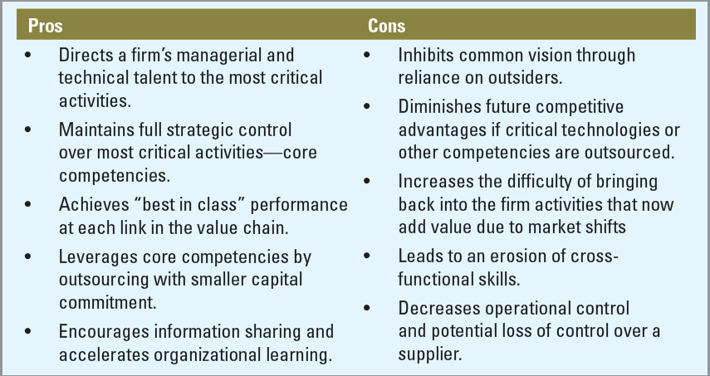
Pros and Cons of Modular Structures
Exhibit 10.8
10-<number>

Slide 36

The Virtual Organization
Virtual organization
  a continually evolving network of independent companies that are linked together to share skills, costs, and access to one another’s markets.
10-<number>

Slide 37

Example: Virtual Organization
This textbook and supplemental material was completed by a virtual team
The authors are in Texas and New York
The editors work in Illinois
The compositors are in India
The PowerPoint author works in South Carolina
Deadlines are coordinated by the MH editor in Burr Ridge, IL to pull the book
together
10-<number>

Slide 38
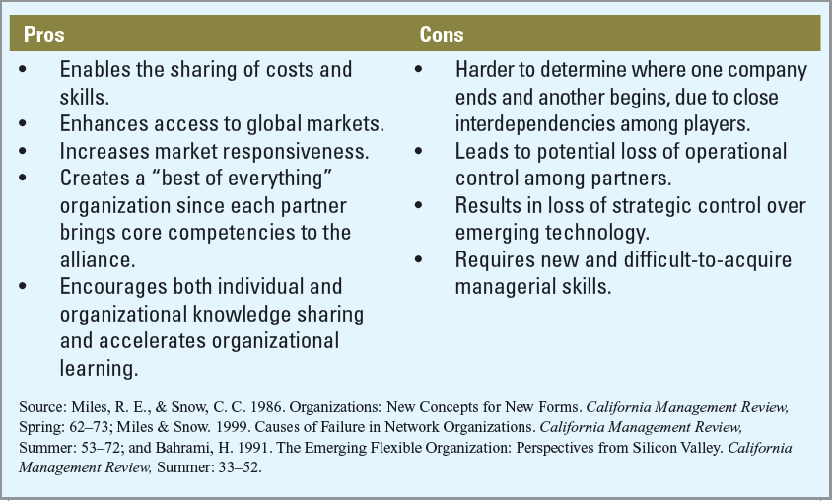
Pros and Cons of Virtual Structures
Exhibit 10.9
10-<number>

Slide 39
Boundaryless Organizations:
Making Them Work
Factors facilitating effective coordination and integration of key activities
  Common culture and shared values
  Horizontal organization structures
  Horizontal systems and processes
  Communications and information technologies
  Human resource practices
10-<number>

Slide 40
Creating Ambidextrous
Organizational Designs
Ambidextrous organizational designs
  Organization designs that attempt to simultaneously pursue modest, incremental innovations as well as more dramatic, breakthrough innovations.
10-<number>

