Slide 1

Notes:
Welcome to this Organizational Behavior course that uses the 17th edition of the textbook, Organizational Behavior by Robbins and Judge. This is considered among the most widely used OB textbooks in the world. Robbins and Judge are recognized as definitive aggregators of OB concepts, applications, and practices. The course and this book will provide you with a resource that will benefit you throughout your degree program and your professional life.

Slide 2
9
Foundations
of Group Behavior
Notes:
Chapter 9: Foundations of Group Behavior

Slide 3
Learning Objectives
Distinguish between the different types of groups.
Describe the punctuated-equilibrium model of group development.
Show how role requirements change in different situations.
Demonstrate how norms exert influence on an individual’s behavior.
Show how status and size differences affect group performance.
Describe how issues of cohesiveness and diversity can be integrated for group effectiveness.
Contrast the strengths and weaknesses of group decision making.
Notes:
After studying this chapter, you should be able to:
Distinguish between the different types of groups.
Describe the punctuated-equilibrium model of group development.
Show how role requirements change in different situations.
Demonstrate how norms exert influence on an individual’s behavior.
Show how status and size differences affect group performance.
Describe how issues of cohesiveness and diversity can be integrated for group effectiveness.
Contrast the strengths and weaknesses of group decision making.

Slide 4
Distinguish Between Different Types of Groups
LO 1
A group is defined as two or more individuals, interacting and interdependent, who have come together to achieve particular objectives.
Groups can be either formal or informal.
Formal groups: those defined by the organization’s structure.
Informal groups: alliances that are neither formally structured nor organizationally determined.
Notes:
A group is defined as two or more individuals, interacting and interdependent, who have come together to achieve particular objectives. Groups can be either formal or informal.
Formal groups, like an airline flight crew, are those defined by the organization’s structure, with designated work assignments establishing tasks. The behaviors that one should engage in are stipulated by and directed toward organizational goals. In contrast, informal groups are alliances that are neither formally structured nor organizationally determined, but instead are natural formations in the work environment in response to the need for social contact. So, for example, three employees from different departments who regularly eat lunch together is an informal group.

Slide 5
Distinguish Between Different Types of Groups
LO 1
Social identity theory: considers when and why individuals consider themselves members of groups.
People have emotional reactions to the failure or success of their group because their self-esteem gets tied into the performance of the group.
Social identities help us understand who we are and where we fit in with people.
Notes:
Why do people form groups? Our tendency to take personal pride or offense for the accomplishments of a group is the territory of social identity theory.
Social identity theory proposes that people have emotional reactions to the failure or success of their group because their self-esteem gets tied into the performance of the group. Social identities help us understand who we are and where we fit in with other people, but they can have a negative side as well.

Slide 6
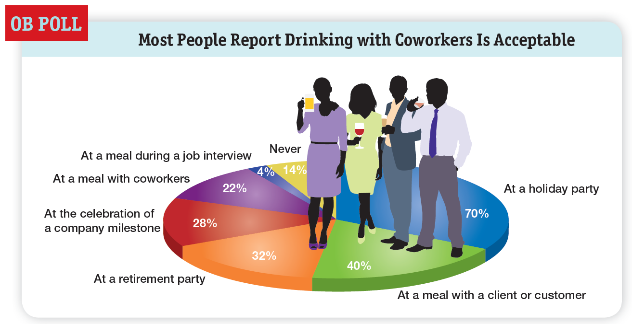
Distinguish Between Different Types of Groups
LO 1
Notes:
Until now, we’ve discussed social identities primarily in a cultural context. However, the identity we may feel with respect to our organization is only one aspect of our work-related identities (see OB Poll). Within our organizations and workgroups, we can develop many identities through: (1) relational identification, when we connect with others because of our roles, and (2) collective identification, when we connect with the aggregate characteristics of our groups.

Slide 7
Distinguish Between Different Types of Groups
LO 1
Ingroups and Outgroups
Ingroup favoritism occurs when we see members of our group as better than other people, and people not in our group as all the same.
Whenever there is an ingroup, there is by necessity an outgroup, which is sometimes everyone else, but is usually an identified group known by the ingroup’s members.
Notes:
Probably the biggest downside is that social identities encourage ingroup favoritism, which occurs when we see members of our ingroup as better than other people and people not in our group as all the same. Recent research suggests that people with low openness and/or low agreeableness are more susceptible to ingroup favoritism.
Whenever there is an ingroup, there is by necessity an outgroup, which is sometimes everyone else, but is usually an identified group known by the ingroup’s members. When there are ingroups and outgroups, there is often animosity between them.
One of the most powerful sources of ingroup-outgroup feelings is the practice of religion, even in the workplace. One global study, for instance, found that when groups became heavily steeped in religious rituals and discussions, they became especially discriminatory toward outgroups and aggressive if the outgroups had more resources.

Slide 8
Distinguish Between Different Types of Groups
LO 1
Social Identity Threat
Ingroups and outgroups pave the way for social identity threat, which is akin to stereotype threat.
Individuals believe they will be personally negatively evaluated due to their association with a devalued group, and they may lose confidence and performance effectiveness.
Notes:
Ingroups and outgroups pave the way for social identity threat, which is akin to stereotype. With social identity threat, individuals believe they will be personally negatively evaluated due to their association with a devalued group, and they may lose confidence and performance effectiveness.

Slide 9
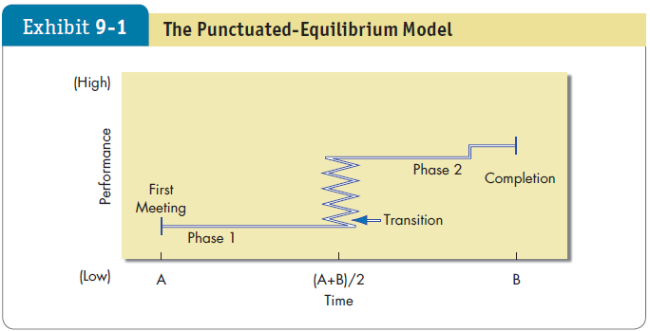
Describe the Punctuated Equilibrium Model
LO 2
Notes:
Temporary groups with deadlines don’t seem to follow the usual five-stage model. Studies indicate they have their own unique sequencing of actions (or inaction). Their first meeting sets the group’s direction. This first phase of group activity is one of inertia. A transition takes place at the end of this phase, which occurs exactly when the group has used up half its allotted time. A transition initiates major changes. A second phase of inertia follows the transition, and the group’s last meeting is characterized by markedly accelerated activity. This pattern, called the punctuated-equilibrium model, is shown in Exhibit 9-1.
The first meeting sets the group’s direction. A framework of behavioral patterns and assumptions emerges. These lasting patterns can appear as early as the first few seconds of the group’s life. Once set, the group’s direction is solidified and is unlikely to be reexamined throughout the first half of its life. This is a period of inertia—the group tends to stand still or become locked into a fixed course of action even if it gains new insights that challenge initial patterns and assumptions.
Then a transition takes place when the group has used up half its allotted time. The midpoint appears to work like an alarm clock, heightening members’ awareness that their time is limited and that they need to “get moving.” A transition initiates major changes. This ends Phase 1 and is characterized by a concentrated burst of changes, dropping of old patterns, and adoption of new perspectives. The transition sets a revised direction for Phase 2. Phase 2 is a new equilibrium or period of inertia. In this phase, the group executes plans created during the transition period. The group’s last meeting is characterized by markedly accelerated activity.

Slide 10
Show How Role Requirements Change
LO 3
Role: a set of expected behavior patterns attributed to someone occupying a given position in a social unit.
Role perception: one’s perception of how to act in a given situation.
Role expectations: how others believe one should act in a given situation.
Psychological contract
Notes:
All group members are actors, each playing a role. We are required to play a number of diverse roles, both on and off our jobs. Many of these roles are compatible; some create conflicts. Different groups impose different role requirements on individuals.
Role perception refers to one’s view of how one is supposed to act in a given situation. We get these perceptions from stimuli all around us—friends, books, movies, television. The primary reason that apprenticeship programs exist is to allow beginners to watch an “expert,” so that they can learn to act as they are supposed to.
Role expectations refers to how others believe you should act in a given situation. The psychological contract is an unwritten agreement that exists between employees and their employer. It sets out mutual expectations—what management expects from workers, and vice versa. It defines the behavioral expectations that go with every role. If role expectations as implied are not met, expect negative repercussions from the offended party.

Slide 11
Show How Role Requirements Change
LO 3
Role conflict: situation in which an individual faces divergent role expectations.
We can experience interrole conflict when the expectations of our different, separate groups are in opposition.
Notes:
Role conflict: At the extreme, two or more role expectations are mutually contradictory. It exists when compliance with one role requirement may make more difficult the compliance with another.
We can experience interrole conflict when the expectations of our different, separate groups are in opposition. Within organizations, most employees are simultaneously in occupations, workgroups, divisions, and demographic groups, and these identities can conflict when the expectations of one clash with the expectations of another.
During mergers and acquisitions, employees can be torn between their identities as members of their original organization and of the new parent company.
Multinational organizations also have been shown to lead to dual identification—with the local division and with the international organization.

Slide 12
Show How Role Requirements Change
LO 3
Role Play and Assimilation
Philip Zimbardo’s prison experiment.
Participants easily and rapidly assumed roles that were very different from their inherent personalities.
Notes:
One of the most illuminating role and identity experiments was done a number of years ago by Stanford University psychologist Philip Zimbardo and his associates. They created a “prison” in the basement of the Stanford psychology building, hired, at $15 a day, two dozen emotionally stable, physically healthy, law-abiding students who scored “normal average” on extensive personality tests, randomly assigned them the role of either “guard” or “prisoner”, and established some basic rules.
It took little time for the “prisoners” to accept the authority positions of the “guards” and for the mock guards to adjust to their new authority roles. Consistent with social identity theory, the guards came to see the prisoners as a negative out-group, and their comments to researchers showed they had developed stereotypes about the “typical” prisoner personality type. After the guards crushed a rebellion attempt on the second day, the prisoners became increasingly passive. Whatever the guards “dished out,” the prisoners took. The prisoners actually began to believe and act as if they were inferior and powerless, as the guards constantly reminded them. And every guard, at some time during the simulation, engaged in abusive, authoritative behavior. One said, “I was surprised at myself…I made them call each other names and clean the toilets out with their bare hands. I practically considered the prisoners cattle, and I kept thinking: ‘I have to watch out for them in case they try something.’” Surprisingly, during the entire experiment—even after days of abuse—not one prisoner said, “Stop this. I’m a student like you. This is just an experiment!”
The simulation actually proved too successful in demonstrating how quickly individuals learn new roles. The researchers had to end it after only 6 days because of the participants’ pathological reactions. And remember, these were individuals chosen precisely for their normalcy and emotional stability.
What should you conclude from this prison simulation?
The participants had learned stereotyped conceptions of guard and prisoner roles from the mass media and their own personal experiences in power and powerless relationships at home.
This allowed them easily and rapidly to assume roles that were very different from their inherent personalities.

Slide 13
Show How Norms Exert Influence On An Individual’s Behavior
LO 4
Norms:
Acceptable standards of behavior within a group that are shared by the group’s members.
Notes:
All groups have norms, or acceptable standards of behavior that are shared by the group’s members. Norms tell members what they ought and ought not to do under certain circumstances.

Slide 14
Show How Norms Exert Influence On An Individual’s Behavior
LO 4
Norms and Emotions
A recent study found that, in a task group, individuals’ emotions influenced the group’s emotions and vice versa.
Researchers have also found that norms dictated the experience of emotions for the individuals and for the groups – in other words, people grew to interpret their shared emotions in the same way.
Notes:
All groups have norms, or acceptable standards of behavior that are shared by the group’s members.
A recent study found that, in a task group, individuals’ emotions influenced the group’s emotions and vice versa.
Researchers have also found that norms dictated the experience of emotions for the individuals and for the groups – in other words, people grew to interpret their shared emotions in the same way.

Slide 15
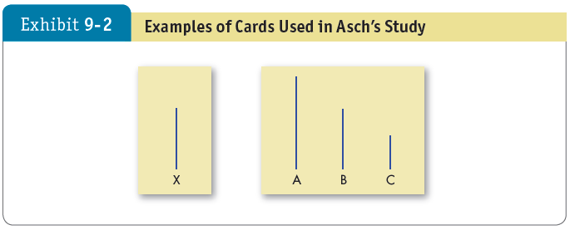
Show How Norms Exert Influence On An Individual’s Behavior
LO 4
Notes:
There is considerable evidence that groups can place strong pressures on individual members to change their attitudes and behaviors to conform to the group’s standard. The pressure that group exerts for conformity was demonstrated by Solomon Asch.
Groups of seven or eight people were asked to compare two cards held by the experimenter, as shown in Exhibit 9-2. One card had one line; the other had three lines of varying length. Under ordinary conditions, subjects made less than one percent error. The experiment began with several sets of matching exercises. All the subjects gave the right answers. On the third set, however, the first subject gave an obviously wrong answer, the next subject gave the same wrong answer, and so did the others until it got to the unknowing subject.
The results obtained by Asch demonstrated that over many experiments and many trials, subjects conformed in about 37% of the trials; the subjects gave answers that they knew were wrong but that were consistent with the replies of other group members. Has time altered the validity of these findings of nearly 50 years ago, and are they generalizable across cultures? Yes, levels of conformity have steadily declined. Furthermore, Asch’s findings are culture-bound. Conformity to social norms is higher in collectivist cultures than in individualist cultures.
Individuals conform to the important groups to which they belong or hope to belong. However, all groups do not impose equal conformity pressures on their members. Important groups are referred to as reference groups. The reference group is characterized as one where the person is aware of the others; the person defines himself or herself as a member, or would like to be a member; and the person feels that the group members are significant to him/her.

Slide 16
Show How Norms Exert Influence On An Individual’s Behavior
LO 4
Norms and Emotions
A recent study found that, in a task group, individuals’ emotions influenced the group’s emotions and vice versa.
Researchers have also found that norms dictated the experience of emotions for the individuals and for the groups – in other words, people grew to interpret their shared emotions in the same way.
Notes:
Norms in the workplace significantly influence employee behavior. Experiments conducted between 1924 and 1932 by Elton Mayo at Western Electric at the company’s Hawthorne Works in Chicago. The Hawthorne researchers began by examining the relationship between the physical environment and productivity. Illumination and other working conditions were selected to represent this physical environment.
The researchers’ initial findings contradicted their anticipated results. As a follow-up, the researchers began a second set of experiments in the relay assembly test room at Western Electric. Observations covering a multiyear period found this small group’s output increased steadily. It became evident this group’s performance was significantly influenced by its status as “special.” In essence, workers in both the illumination and assembly-test-room experiments were reacting to the increased attention they received.
A third study, in the bank wiring observation room, was introduced to ascertain the effect of a sophisticated wage incentive plan. The most important finding of this study was that employees did not individually maximize their outputs. Their output became controlled by a group norm that determined what was a proper day’s work.
Interviews determined the group was operating well below its capability and was leveling output to protect itself.
Members were afraid that if they significantly increased their output, the unit incentive rate would be cut, the expected daily output would be increased, layoffs might occur, or slower workers would be reprimanded.
The norms the group established included a number of “don’ts”:
Don’t be a rate-buster, turning out too much work.
Don’t be a chiseler, turning out too little work.
Don’t squeal on any of your peers.
How did the group enforce these norms?
The methods included sarcasm, name-calling, ridicule, and even punches to the upper arm of any member who violated the group’s norms.
Members also ostracized individuals whose behavior was against the group’s interest.

Slide 17
Show How Norms Exert Influence On An Individual’s Behavior
LO 4
Positive Norms and Group Outcomes
One goal of every organization with corporate social responsibility (CSR) initiatives is for its values to hold normative sway over employees.
If employees aligned their thinking with positive norms, these norms would become stronger and the probability of positive impact would grow exponentially.
Positive group norms may well beget positive outcomes, but only if other factors are present.
Notes:
One goal of every organization with corporate social responsibility (CSR) initiatives is for its values to hold normative sway over employees. After all, if employees aligned their thinking with positive norms, these norms would become stronger and the probability of positive impact would grow exponentially.
We might expect the same outcomes from political correctness (PC) norms. But what is the effect of strong positive norms on group outcomes?
The popular thinking is that to increase creativity in groups, for instance, norms should be loosened. However, research on gender-diverse groups indicates that strong PC norms increase group creativity. Positive group norms may well beget positive outcomes, but only if other factors are present, too.
As powerful as norms can be, though, not everyone is equally susceptible to positive group norms. Individual personalities factor in, too, as well as the level of a person’s social identity with the group.

Slide 18
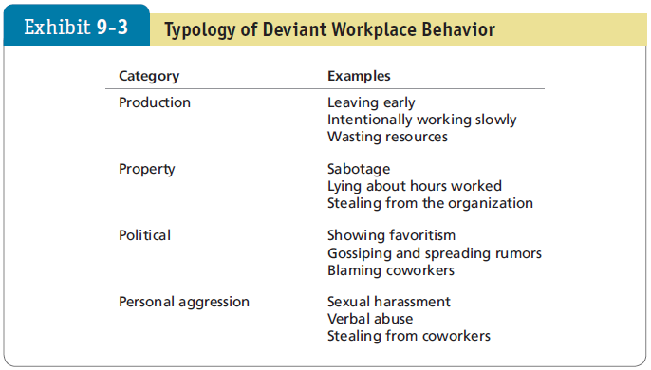
Show How Norms Exert Influence On An Individual’s Behavior
LO 4
Notes:
Deviant workplace behavior—also known as antisocial behavior or workplace incivility—refers to voluntary behavior that violates significant organizational norms and, in doing so, threatens the well-being of the organization or its members. Exhibit 9-3 shows a typology of deviant workplace behaviors.
When deviant workplace behavior occurs, it can affect employee commitment, cooperation, and motivation. This can lead to performance issues and a lack of job satisfaction. Someone who ordinarily wouldn’t engage in deviant behavior might be more likely to do so when working in a group.

Slide 19
Show How Norms Exert Influence On An Individual’s Behavior
LO 4
Norms and Culture
Do people in collectivist cultures have different norms than people in individualist cultures? Of course they do.
But did you know that our orientation may be changed, even after years of living in one society.
Notes:
Do people in collectivist cultures have different norms than people in individualist cultures? Of course they do. But did you know that our orientation may be
changed, even after years of living in one society? In a recent experiment, an organizational role-playing exercise was given to a neutral group of subjects; the exercise stressed either collectivist or individualist norms. Subjects were then given a task of their personal choice or were assigned one by an ingroup or outgroup person. When the individualist-primed subjects were allowed personal choice of the task, or the collectivist-primed subjects were assigned the task by an ingroup person, they became more highly motivated.

Slide 20
Show How Status and Size Differences Affect Performance
LO 5
Status: a socially defined position or rank given to groups or group members by others.
Status characteristics theory: status is derived from one of three sources:
The power a person wields over others.
A person’s ability to contribute to a group’s goals.
An individual’s personal characteristics.
Notes:
Status is a socially defined position or rank given to groups or group members by others.
Status characteristics theory suggests that differences in status characteristics create status hierarchies within groups. Status is derived from one of three sources. First is the power a person wields over others. Second is a person’s ability to contribute to a group’s goals. And third is an individual’s personal characteristics.

Slide 21
Show How Status and Size Differences Affect Performance
LO 5
Status and Norms: high status individuals often have more freedom to deviate from norms.
Status and Group Interaction: high status people are often more assertive.
Status Inequity: perceived inequity creates disequilibrium and can lead to resentment and corrective behavior.
Status and Stigmatization: stigma by association.
Notes:
Status and norms can influence behavior in organizations. High-status members of groups often are given more freedom to deviate from norms than other group members. High-status people also are better able to resist conformity pressures. This explains why many star athletes, famous actors, top-performing salespeople, and outstanding academics seem oblivious to appearance or social norms.
Status and group interaction is influenced by status. High-status people tend to be assertive. Status differences can inhibit the diversity of ideas and creativity. Moreover, lower-status members tend to be less active.
When status inequity is perceived, it creates disequilibrium that results in corrective behavior. Hierarchical groups can lead to resentment among those at the lower end of the status continuum. Large differences in status within groups is also associated with poorer individual performance, lower health, and higher intentions to leave the group. Managers who occupy central positions in their social networks are typically seen as higher in status by their subordinates, and this position translates into greater influence over the group’s functioning.
Finally, the status of the people with whom you are affiliated can affect how others view you. Studies have shown that people who are stigmatized against can “infect” others with their stigma. This “stigma by association” effect can result in negative opinions and evaluations of the person affiliated with the stigmatized individual.

Slide 22
Show How Status and Size Differences Affect Performance
LO 5
Group size affects the group’s overall behavior.
Large groups are good for gaining diverse input.
Smaller groups are better doing something with input.
Social loafing: the tendency for individuals to expend less effort when working collectively than alone.
Notes:
The size of a group affects the group’s overall behavior, but the effect depends on the dependent variables. Large groups of a dozen or more members are good for gaining diverse input. Smaller groups of about seven members are better at doing something productive with that input.
One of the most important findings about the size of a group concerns social loafing, or the tendency for individuals to expend less effort when working collectively than alone.

Slide 23
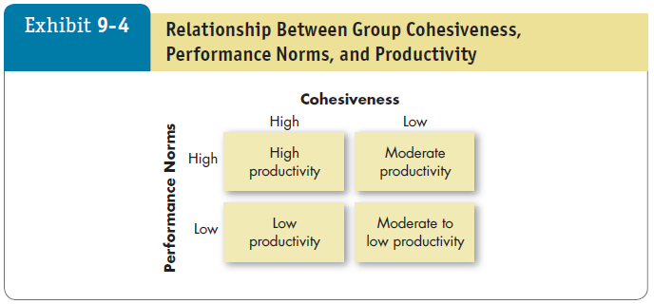
Integrating Cohesiveness and Diversity for Group Effectiveness
LO 6
Notes:
Groups differ in their cohesiveness, or the degree to which members are attracted to each other and are motivated to stay in the group. Cohesiveness is important because it’s related to the group’s productivity. As shown here in Exhibit 9-4, the relationship of cohesiveness and productivity depends on the performance-related norms established by the group. If performance-related norms are high, a cohesive group will be more productive. If cohesiveness is high and performance norms are low, productivity will be low.
Encourage group cohesiveness by:
Making the group smaller
Encouraging agreement with group goals
Increasing the time members spend together
Increasing the status of the group and the perceived difficulty of attaining membership in the group
Stimulating competition with other groups
Giving rewards to the group rather than to individual members
Physically isolating the group

Slide 24
Integrating Cohesiveness and Diversity for Group Effectiveness
LO 6
Diversity: degree to which members of the group are similar to, or different from, one another.
Increases group conflict, especially in the short term.
Culturally and demographically diverse groups may perform better over time.
May help them be more open-minded and creative.
Faultlines
Notes:
Diversity in the group’s membership is the degree to which members of the group are similar to, or different from, one another. A great deal of research is being done on how diversity influences group performance. Some studies look at cultural diversity and some at racial, gender, and other differences.
Overall, studies identify both benefits and costs from group diversity. Diversity appears to increase group conflict, especially in the early stages of a group’s tenure, which often lowers group morale and raises dropout rates. Teams in which members’ values or opinions differ tend to experience more conflict, but leaders who can get the group to focus on the task at hand and encourage group learning are able to reduce these conflicts and enhance discussion of group issues.
It seems diversity can be bad for performance even in creative teams, but appropriate organizational support and leadership might offset these problems. If members can weather their differences over time, diversity may help them be more open-minded and creative, and to do better.

Slide 25
Group Decision Making
LO 7
Strengths of group decision making:
More complete information and knowledge
Increased diversity of views
Increased acceptance of solutions
Weaknesses of group decision making:
Time consuming
Conformity pressures
Dominance of a few members
Ambiguous responsibility
Notes:
Are group decisions better than those made by individuals alone? The strengths of group decision making include: more complete information and knowledge; increased diversity of views; and increased acceptance of a solution. The weaknesses of group decision making include: the fact that it’s more time consuming; there are conformity pressures; one or a few members can dominate group discussion; and responsibility can be ambiguous.

Slide 26
Group Decision Making
LO 7
Effectiveness and efficiency of group decisions:
Accuracy
Speed
Creativity
Acceptance
Notes:
Are groups more effective and efficient at making decisions than individuals? The answer depends on how effectiveness is defined.
Group decisions can be more accurate than the decisions of the average individual in the group, but less accurate than the judgments of the most accurate. Individuals are quicker at making decisions, but groups can be more creative and may be better at accepting the final solution.
In summary, groups offer an excellent vehicle for performing many of the steps in the decision-making process. They are a source of both breadth and depth of input for information gathering. When the final solution is agreed upon, there are more people in a group decision to support and implement it. Group decisions consume time, create internal conflicts, and generate pressures toward conformity.

Slide 27
Group Decision Making
LO 7
Groupthink: situations in which group pressures for conformity deter the group from critically appraising unusual, minority, or unpopular views.
Groupshift: a change between a group’s decision and an individual decision that a member within the group would make.
Notes:
Groupthink is related to norms and affects decision making. It describes situations in which group pressures for conformity deter the group from critically appraising unusual, minority, or unpopular views. Groupthink is a disease that attacks many groups and can dramatically hinder performance.
Groupshift, also known as group polarization, describes the way of discussing a given set of alternatives and arriving at a solution whereby group members tend to exaggerate the initial positions they hold. Groups generally shift toward a more extreme version of the group’s original position.

Slide 28
Group Decision Making
LO 7
Most group decision making takes place in interacting groups.
Members meet face-to-face and rely on both verbal and nonverbal interaction to communicate with each other.
Interacting groups often censor themselves and pressure individual members toward conformity of opinion.
Notes:
Most group decision making takes place in interacting groups. In these groups, members meet face-to-face and rely on both verbal and nonverbal interaction to communicate with each other. Interacting groups often censor themselves and pressure individual members toward conformity of opinion.

Slide 29
Group Decision Making
LO 7
Brainstorming can overcome pressures for conformity.
In a brainstorming session:
The group leader states the problem.
Members then “free-wheel” as many alternatives as they can.
No criticism is allowed.
One idea stimulates others, and group members are encouraged to “think the unusual.”
Notes:
Brainstorming and the nominal group technique (discussed in the next slide) can reduce problems inherent in the traditional interacting group. Brainstorming is meant to overcome pressures for conformity in the interacting group that dampens the development of creative alternatives. In a typical brainstorming session, a half dozen to a dozen people sit around a table, the group leader states the problem clearly, and members then “free-wheel” as many alternatives as they can in a given length of time. No criticism is allowed, and all the alternatives are recorded for later discussion and analysis. One idea stimulates others, and group members are encouraged to “think the unusual.”

Slide 30
Group Decision Making
LO 7
The nominal group technique: restricts discussion or interpersonal communication during the decision making process.
Group members are all physically present, but members operate independently.
Permits the group to meet formally but does not restrict independent thinking, as does the interacting group.
Nominal groups outperform brainstorming groups.
Notes:
The nominal group technique is different. It restricts discussion or interpersonal communication during the decision-making process. Group members are all physically present, but members operate independently. The chief advantage of the nominal group technique is that it permits the group to meet formally but does not restrict independent thinking, as does the interacting group.
Research shows that the nominal group is generally more effective than the brainstorming group.

Slide 31
Group Decision Making
LO 7
Steps for a nominal group:
Each member independently writes down his/her ideas on the problem.
After this silent period, each member presents one idea to the group.
The ideas are discussed for clarity.
Each group member rank-orders the ideas.
The idea with the highest aggregate ranking determines the final decision.
Notes:
Here are the steps in the nominal group technique. First, a problem is presented, and then each member independently writes down his or her ideas on the problem. After this silent period, each member presents one idea to the group. Each member takes his or her turn. The group now discusses the ideas for clarity and evaluates them. Each group member silently and independently rank-orders the ideas. The idea with the highest aggregate ranking determines the final decision.

Slide 32
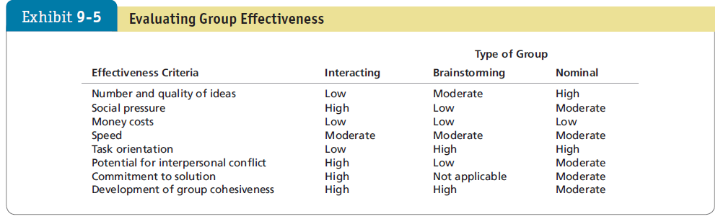
Group Decision Making
LO 7
Notes:
Exhibit 9-5 shows that each of the group-decision techniques has its own set of strengths and weaknesses. The choice depends on what criteria you want to emphasize and the cost-benefit trade-off.

Slide 33
Implications for Managers
Recognize that groups can dramatically affect individual behavior in organizations, to either positive or negative effect. Therefore, pay special attention to roles, norms, and cohesion—to understand how these are operating within a group is to understand how the group is likely to behave.
To decrease the possibility of deviant workplace activities, ensure that group norms do not support antisocial behavior.
Notes:
We can draw several implications from our discussion of groups. First, norms control behavior by establishing standards of right and wrong. Second, status inequities create frustration and can adversely influence productivity and willingness to remain with an organization. Third, the impact of size on a group’s performance depends on the type of task. Fourth, cohesiveness may influence a group’s level of productivity, depending on the group’s performance-related norms. Fifth, diversity appears to have a mixed impact on group performance, with some studies suggesting that diversity can help performance and others suggesting it can hurt it. Sixth, role conflict is associated with job-induced tension and job dissatisfaction.
Managers should:
Recognize that groups can dramatically affect individual behavior in organizations, to either positive or negative effect. Therefore, pay special attention to roles, norms, and cohesion—to understand how these are operating within a group is to understand how the group is likely to behave.
To decrease the possibility of deviant workplace activities, ensure that group norms do not support antisocial behavior.

Slide 34
Implications for Managers
Pay attention to the status aspect of groups. Because lower-status people tend to participate less in group discussions, groups with high status differences are likely to inhibit input from lower-status members and reduce their potential.
Use larger groups for fact-finding activities and smaller groups for action-taking tasks. With larger groups, provide measures of individual performance.
To increase employee satisfaction, make certain people perceive their job roles accurately.
Notes:
In addition:
Pay attention to the status aspect of groups. Because lower-status people tend to participate less in group discussions, groups with high status differences are likely to inhibit input from lower-status members and reduce their potential.
Use larger groups for fact-finding activities and smaller groups for action-taking tasks. With larger groups, provide measures of individual performance.
To increase employee satisfaction, make certain people perceive their job roles accurately.

