Slide 1
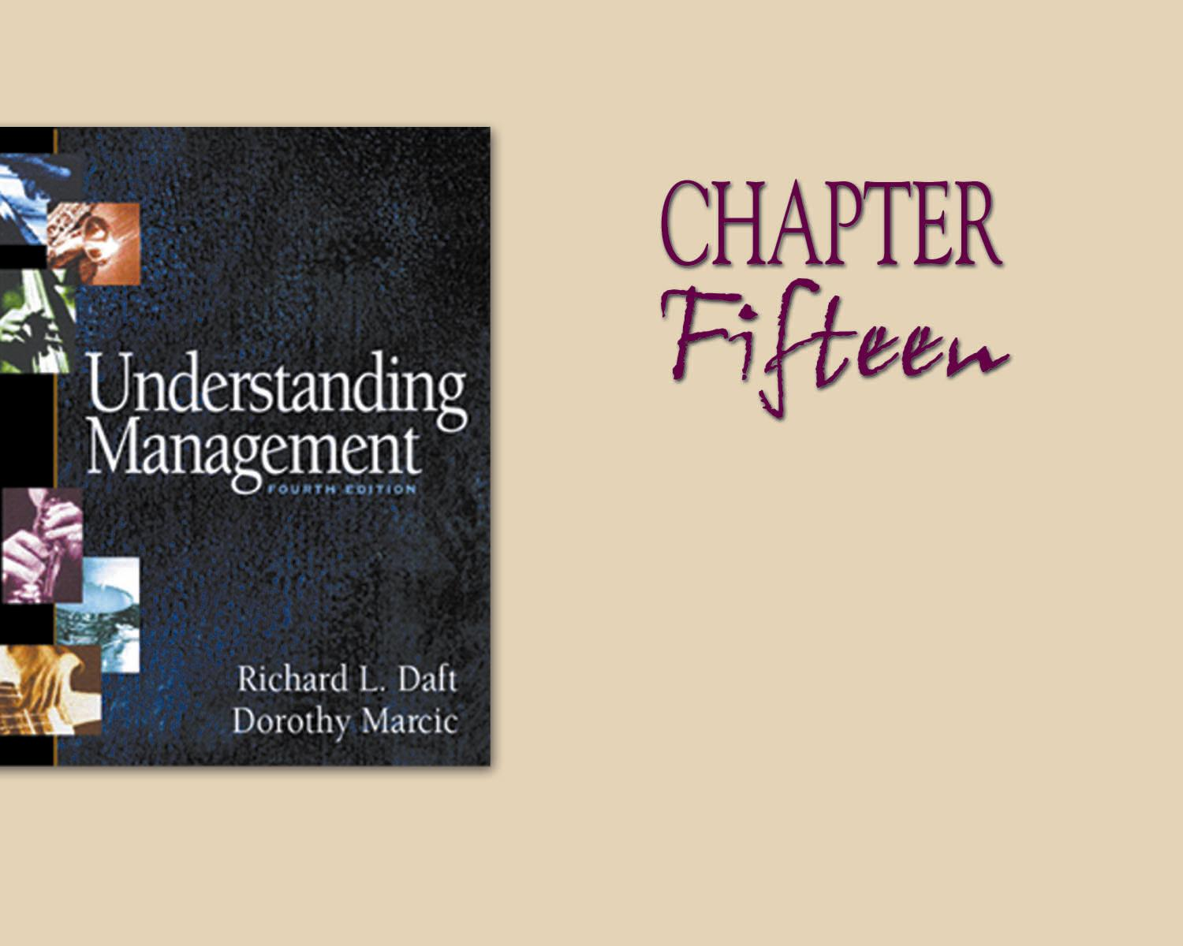
Teamwork in Organizations
Developed by Cool Pictures & MultiMedia Presentations
Copyright © 2004 by South-Western, a division of Thomson Learning. All rights reserved.

Slide 2
What is a Team?
A unit of two or more people.
Members interacting and coordinating their work.
Members accomplishing a performance goals.

Slide 3
Work Team Effectiveness
Based on Two Outcomes
Productive Output
Personal Satisfaction
1
2

Slide 4
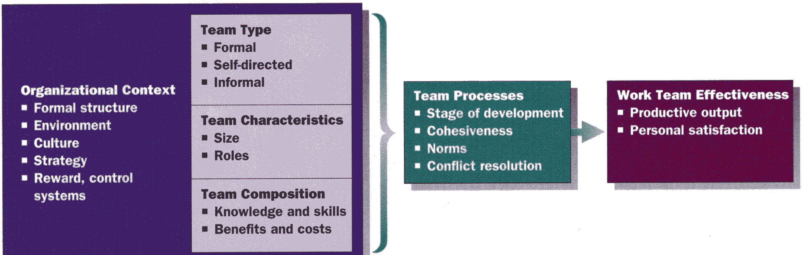
Work Team Effectiveness Model

Slide 5
Formal Teams
Vertical:
Composed of manager and subordinates in a formal chain of command.
Sometimes called a functional team.
May include three or four levels.
Horizontal:
Drawn from several departments.
Given a specific task.
May be disbanded after the task assignment is complete.
Two most common types of teams are:
  Tasks forces.
  Committees.

Slide 6
Self-Directed Team Elements
Includes employees with several skills and functions.
Have access to resources.
Is empowered with decision making authority.

Slide 7
Tasks Force &
Committee Advantages
Allow for exchange of information.
Generate suggestions for coordinating units that are represented.
Development of new ideas and solutions for existing problems.
Assist in the development of new practices and policies.

Slide 8
Team Characteristics
Two characteristics of concern to managers:
Size--
  Ideal size is thought to be 7.
  Variations of from 5 to 12 typically are associated with good team performance.
  Small teams (2-4 members) show more agreement, ask more questions.
  Large teams (12 or more) tend to have more disagreements.
Member Roles--
  Task specialist role spend time and energy helping the team reach its goal.
  Socio-emotional role support team members’ emotional needs.

Slide 9
Team Member Roles
High
Task Specialist Role
Focuses on task accomplishment
over human needs.
Important role, but if adopted by everyone, team’s social needs won’t be met.
Dual Role
Focuses on task and people.
May be a team leader.
Important role, but not essential if members adopt task specialist and socioemotional roles.
Member
Task
Behavior
Nonparticipator Role
Contributes little to either task or
people needs of team.
Not an important role-if adopted by too many members, team will disband.
Socioemotional Role
Focuses on people needs of
team over task.
Important role, but if adopted by everyone, team’s tasks won’t be accomplished.
Low
Low
Member Social Behavior
High
Developed by Cool Pictures & MultiMedia Presentations
Copyright © 2004 by South-Western, a division of Thomson Learning. All rights reserved.

Slide 10
Two Roles of Successful Teams
Task Specialist Behaviors
Initiation
Give opinions
Seek information
Summarize
Energize
Socioemotional Behaviors
Encourage
Harmonize
Reduce tension
Follow
Comprise

Slide 11
Five Stages of Team Development
Forming:
Orientation, break the ice
Leader: Facilitate social interchanges
1
Storming:
Conflict, disagreement
Leader: Encourage participation
2
Norming:
Establishment of order and cohesion
Leader: Help clarify team roles, norms, values
3
Performing:
Cooperation, problem solving
Leader: Facilitate task accomplishment
4
Adjourning:
Task completion
Leader: Bring closure, signify completion
5
Developed by Cool Pictures & MultiMedia Presentations
Copyright © 2004 by South-Western, a division of Thomson Learning. All rights reserved.

Slide 12
Determinants of
Team Cohesiveness
Team interaction, the more time spent together, the more cohesive the team.
Shared goals, members agree on goals, they will be more cohesive.
Personal attraction to the team, similar attitudes and values and enjoy being together.

Slide 13
Team Cohesiveness Consequences
Morale is higher in cohesive teams generally.
Productivity, results are mixed here but productivity tends to be more uniform.

Slide 14

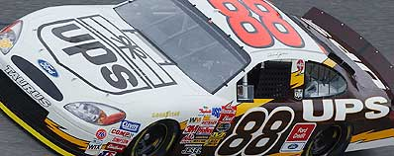
Four Ways Team Norms Develop
Carryover from
other experiences
Primacy: first
behavior precedents
Team
Norms
“After a sour season -- Jarrett finished ninth in the final 2002 point standings -- longtime crew chief Todd Parrott has assumed new duties. Younger brother Brad Parrott is Jarrett's new chief, and those moves, coupled with a few hires and strategic reorganization, have revamped Robert Yates Racing's signature team.”
SOURCE: http://www.nascar.com/2003/news/cnnsi/01/16/djarrett_maloof/index.html
Explicit
statements
from leaders
or members
Critical events
in team’s history
Developed by Cool Pictures & MultiMedia Presentations
Copyright © 2004 by South-Western, a division of Thomson Learning. All rights reserved.

Slide 15
Causes of Team Conflict
Scarce Resources: include money, information, and supplies.
Jurisdictional Ambiguities: conflicts emerge when job boundaries and responsibilities are unclear.
Communication Breakdown: poor communications result in misperceptions and misunderstandings of other people and teams.
Personality Clashes: personality clashes are caused by basic differences in personality, values, and attitudes.
Power and Status Differences: occur when one party has disputable influence over another.
Goal Differences: conflict often occurs simply because people are pursuing conflicting goals.

Slide 16
A Model of Styles to Handle Conflict
Assertive
Competing
Collaborating
Assertiveness
(Attempting to
Satisfy one’s own
concerns)
Compromising
Unassertive
Avoiding
Accommodating
Uncooperative
Cooperative
Cooperativeness
(Attempting to satisfy the other
party’s concerns)
Source: Adapted from Kenneth Thomas, “Conflict and Conflict Management,” in Handbook of Industrial and Organizational Behavior, ed. M. D. Dunnette (New York: John Wiley, 1976), 900.

Slide 17
Facilitating Communications
Focus on facts.
Develop multiple alternatives.
Maintain a balance of power.
Never force a consensus.

Slide 18
Benefits of Teams
Level of Effort: teams often unleash enormous energy and creativity.
Satisfaction of Members: teams reduce boredom and often increase employees’ feeling of dignity and self-worth.
Expanded Job Knowledge and Skills: teams gain the intellectual resources of several members.
Organizational Responsiveness: teams work next to one another and are able to exchange jobs.

Slide 19
Potential Cost of Teams
Power Realignment: major losers are low- and middle-level managers.
Free Riding: team members who attains benefits from team membership but do not do a proportionate share.
Coordination Cost: time and energy required to coordinate the activities.
Revising Systems: particularly performance appraisal and reward systems

