Slide 1
m a n a g e m e n t 2e
H i t t / B l a c k / P o r t e r
Chapter 11:
Groups and Teams
Notes:
These slides were developed using Microsoft Office 2003 but can be shown on newer versions of MS Office.
To print the notes section for class lectures, select “file/print,” and under “print what,” select “notes pages.”
If you prefer black-and-white printing, select either “pure black and white” or “color” under “color/grayscale.” If you select grayscale, the slide will be difficult to read.

Slide 2

Learning Objectives
After studying this chapter, you should be able to:
Describe the similarities and differences between groups and teams
Identify and compare different types of groups
Name the factors that influence group formation and development
Analyze the various structural and behavioral characteristics of groups

Slide 3
Learning Objectives
Explain the differences in the various types of team competencies
Distinguish between the two major types of group conflict, and discuss their causes and consequences
Explain how managers can help their work groups develop into high performing teams

Slide 4

Group versus Team
Group
A set of people, usually from 3 to 20
Some degree of interaction and shared objectives
Team
A type or form of group
Higher degree of coordinated interaction
Stronger sense of members’ personal responsibility for achieving specified group outcomes
High level of members’ identification with the group
vs.
Notes:
It is important to differentiate between groups and teams.
A group is defined as a set of people, limited in number (usually from 3 to 20 or so), who have some degree of interaction and shared objectives.
A team is a type of group. A team has additional characteristics beyond a “mere” group, including a higher degree of coordinated interaction and, especially, a stronger sense of members' personal responsibility for achieving specified group outcomes.
Also, groups that become teams typically have created a high level of identification with the group on the part of each member.

Slide 5
Individuals to Group-to-Group Team Continuum
TEAMS demonstrate enhanced:
  Coordinated interaction
  Personal responsibility for group outcomes
  Individual identification with group
Team
Group
Commonality of Goal
Individuals
Degree of Interdependence and Collaboration
Adapted from Exhibit 11.1
Notes:
To understand the difference between individuals, groups, and teams, it is helpful to view them as a continuum.
Individuals are put into – or put themselves into − a group. The degree of interdependence and commonality of goals is minimal.
Groups obviously have a higher degree of interdependence and commonality of goals. They may or may not go on to become a team.
Teams have a high degree of interdependence and commonality of goals.
Put simply, all teams are groups, but not all groups are, or become, teams. A major objective in most of today's organizations is to have their work groups develop and evolve quickly so that they behave more like teams
[i] Cotrill, M. (1997). Giver your work teams time and training. Academy of Management Executive. 11(3), 87-89; Banker, R. D., Field, J. M., Schroeder, R. G., Y Sinha, K. K. (1996). Impact of work teams on manufacturing performance: A longitudinal field study. Academy of Management Journal. 39, 867-90

Slide 6
Basic Types of Groups
Type of Group | Features | Examples
Command/ Supervisory | One supervisor with a number of subordinates Relatively enduring Membership changes relatively slowly | Clerical units Manufacturing assembly units Local sales managers reporting to a regional sales manager
Project/ Task Force | Temporary Specific limited purpose Group members are aware of temporary nature of the group | Product design teams Management information systems teams to develop upgraded computer systems Team project groups in university classes
Adapted from Exhibit 11.2
Notes:
Groups can be formal or informal. This slide summarizes some types of formal groups.
A command group consists of a supervisor or manager and all those who report to that person. These groups are usually considered to be the basic work units of an organization.
A project/task force is a group put together by an organization for a particular purpose, such as to design a new product or to work on a particular problem.

Slide 7
Basic Types of Groups (cont.)
Type of Group | Features | Examples
Committee | Either permanent or ad hoc Meet only periodically Members have different permanent jobs and/or supervisors Membership typically does not represent an employee’s highest commitment | Budget committees Safety committees Promotion review committees
Adapted from Exhibit 11.2
Notes:
A committee can be either permanent or temporary (ad hoc) in terms of the length of their existence. The next slide provides a more comprehensive list of examples of committees.

Slide 8


Examples of Committees
Governance
Executive
Steering
Disaster planning
Compensation
Finance
Safety
Long-range planning
Overnight
Audit
Ethics
Public relations
Adapted from Exhibit 11.3
Notes:
The most important feature of committees is that members meet only occasionally and otherwise report to different permanent supervisors in the organization's structure. Thus, interaction is episodic, and for most members this is not the formal organizational group to which they have the highest degree of commitment. For instance, a budget committee might meet several times during a company's fiscal year, with the members likely coming from each of the firm’s major departments or divisions.
This slides shows many common types of committees that may be found in organizations such as government agencies, colleges, and business firms.

Slide 9
Basic Types of Groups (cont.)
Type of Group | Features | Examples
Informal | Group not originated by the organization Voluntary membership Obvious differences and boundaries between members and nonmembers | Group of employees who lunch together on Fridays Van pool group The “water cooler group”
Adapted from Exhibit 11.2
Notes:
An informal group is one whose members choose to interact voluntarily with one another, not by organizational mandate. A typical example is friendship groups. Although there is no formal “joining” process, these groups often have fairly obvious boundaries between members and nonmembers. Managers need to be able to recognize important informal groups, gain an understanding of their norms, and identify where the leadership is within the group.

Slide 10
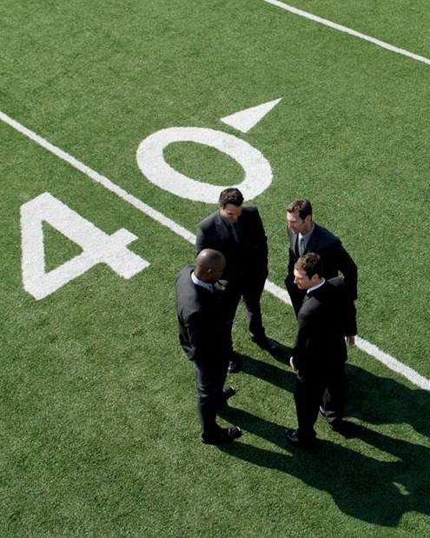
What Influences the Formation of Groups and Teams?
Organizational goals
  How does the group fit into the larger organization’s goals?
Opportunities for interaction and sharing mutual knowledge
  Groups can meet face-to-face or virtually
Psychological factors
  Security needs, social support, self-esteem needs, status needs
Notes:
There are three major influences on the formation of groups and teams:
Organizational goals directly affect the nature of its formal groups. The key questions that a manager must answer in assembling a new group is: “What is the objective of the group?” and “What are the responsibilities of each group member?”
Opportunities for interaction and sharing mutual knowledge have a major influence on group formation. While the traditional method requires group members to meet face-to-face, modern technology allows individuals to meet as “virtual” teams in order to exchange information.
Psychological factors such as security needs, social support, self-esteem and status needs influence group formation.

Slide 11

The Five-Stage Model of Team Development
Forming Stage
First stage is characterised by much uncertainty and anxiety; testing to find out nature of the situation and what behaviour is acceptable
Storming Stage
The second stage: characterised by intragroup conflict; opinions polarised; resistance to control
Norming Stage
The third stage: characterised by close relationships and cohesiveness; norms emerge; resistance overcome; cooperation develops
Notes:
Teams in Organisations
J Johnson

Slide 12

…Team Development (cont’d)
Performing Stage
The fourth stage: when the group is fully functional; interpersonal problems are resolved
Adjourning Stage
The final stage in group development for temporary groups, characterised by concern with wrapping up activities rather than performance
Tuckman 1965
Notes:
Teams in Organisations
J Johnson

Slide 13
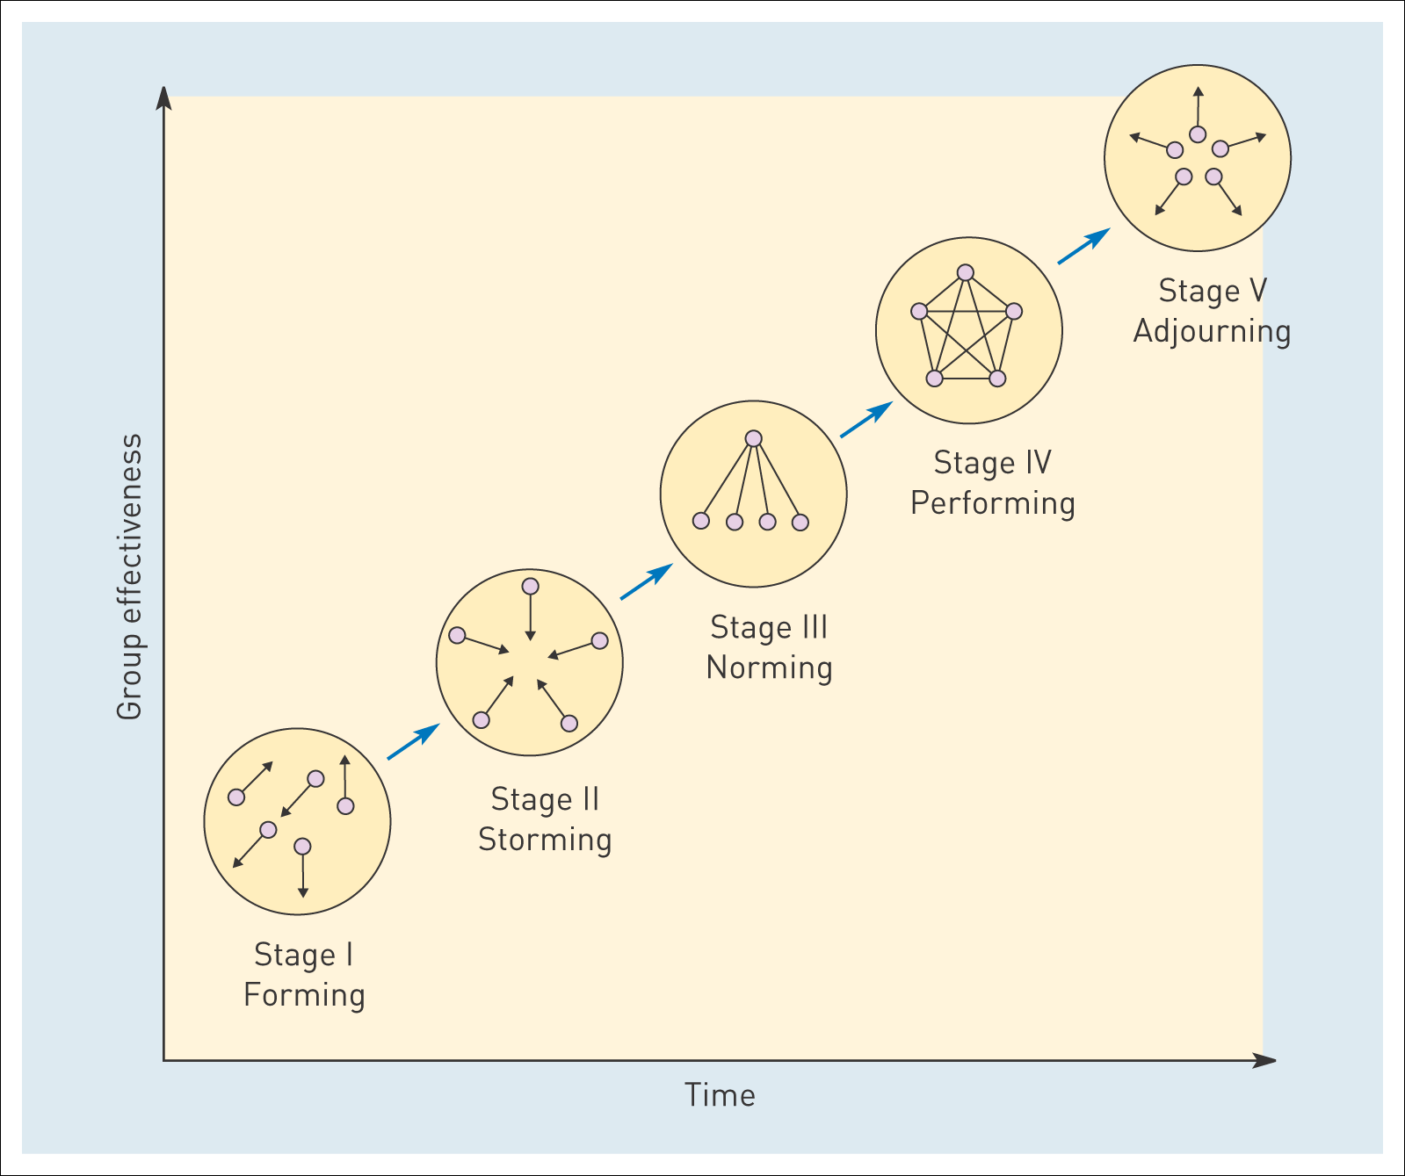
Stages of team development

Slide 14
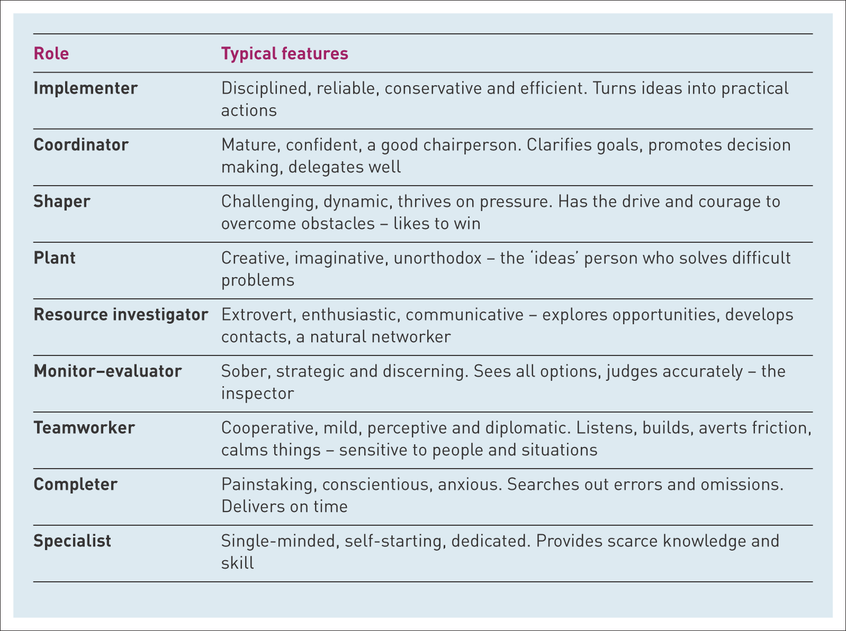
Belbin’s Team Roles
Belbin’s team roles
Source: Based on Belbin (1993)

Slide 15


Structural Characteristics of
Groups and Teams
Size
Composition
Differentiated roles
Differentiated status
Notes:
Just like an organization has a structure, so do groups, except though, on a smaller scale. Four of the most essential structural features of groups are size, composition, differentiated roles, and differentiated status. Each is discussed in more detail on the next two slides.

Slide 16

Structural Characteristics of
Groups and Teams
Size
  Social loafing: the phenomenon of reduced effort per person in large groups
  Process costs: increasing costs of coordination as group size increases
Composition
  Homogeneous
  Heterogeneous or diverse
Notes:
Size: The rule of thumb for the optimal size for a group is to use the fewest number of people who can get the task done. Groups should not be larger than needed, because when a group’s size increases, the sense of personal responsibility for its output or performance on the part of each individual member tends to decrease. This is known as social loafing – the reduced effort per person in large groups. Another reason to keep groups as small as possible is increasing process costs-- costs related to coordinating people.
Composition: Homogeneous groups may be composed of individuals who are very similar or very dissimilar. Heterogeneous groups have diversity of race/ethnicity, gender, or age of members as well as less obvious differences such as members’ values, skills, knowledge, information, and their length of time in the group and in the organization.

Slide 17
Examples of Diversity within Groups and Potential Consequences
Types of Diversity | Potential Consequences
Observable Attributes Race Ethnicity Gender Age | Affective Consequences Satisfaction Identification with the group Conflict within the group
Underlying Attributes Values Skills Knowledge and information Tenure | Cognitive Consequences Innovation Amount and quality of new ideas
 | Communication-Related Consequences Decreased frequency within the group Increased frequency outside the group
Adapted from Exhibit 11.5
Notes:
As the slide indicates, there can be different types of diversity within groups, including obvious differences
such as the race/ethnicity, gender, and age of members as well as less obvious differences such as members’ values, skills, knowledge, information, and their length of time in the group and in the organization.

Slide 18

Structural Characteristics of
Groups and Teams
Differentiated roles
  Role ambiguity: the expected behaviors for a group member are not clearly defined
  Role conflict: a group member faces two or more contrasting sets of expectations
Differentiated status
  Status: prestige that a person has in a group
Notes:
Differentiated roles: Different members perform different roles; that is, they occupy different positions with sets of expected behaviors attached to those positions. Two particular issues that groups face with respect to roles are role ambiguity and role conflict.
Role ambiguity occurs when expected behaviors for a group member are not clearly defined. This can increase the stress level for that person.
Role conflict occurs when a member has to fulfill two or more contrasting sets of expectations, such as taking time to be friendly with customers versus meeting a certain quota of customers served. Obviously, both of these should be avoided in order for the group to function well.
Differentiated status: Not only do members have different roles in groups, they also often have different levels of status or rank. Status is the standing or prestige that a person has in a group, and it can be based on a number of factors such as perceived leadership abilities, seniority, or special skills, among others.

Slide 19

Behavioral Characteristics of
Groups and Teams
Norms
Cohesiveness
Notes:
In additional to structural characteristics, there are two behavioral characteristics of groups and teams: the norms that develop in groups, and the degree to which groups are cohesive.

Slide 20

Behavioral Characteristics of
Groups and Teams
Norms: a group’s shared standards that guide the behavior of its individual members
Characteristics of group norms
  Established for important issues
  Some apply only to certain members
  Vary in degree of acceptance
  Vary in how much deviation members are permitted
Notes:
Norms are a group's shared standards that guide the behavior of its individual members. Important characteristics of group norms are:
They are established for important issues to the group, such as rates of minimally acceptable output or performance.
Some apply only to certain members (like the leader), usually based on the status or particular role of those members. For example, it may be acceptable for a senior member of a group, but not for a junior member, to arrive late for meetings.
They vary in the degree of their acceptance by group members; some norms are accepted and endorsed by virtually all members, others by only a majority.
They vary in how much deviation members are permitted in following them. Some norms are very loose and permit a great deal of leeway in behavior, whereas other norms, especially those regarding key group issues, are much more restrictive.

Slide 21
Development of Group Norms
Members agree on behavior
Norm is established
Group members meet
Members observe
the behavior of
others to determine
what is appropriate
Members decide if
any past experience
can contribute
effective behaviors
Suggested behavior is tolerated even though disagree with
Members disagree on behavior
Dissenting member withdraws from group
New behavior is suggested
Adapted from Exhibit 11.6
Notes:
Group norms arise out of interaction among group members. The development of norms follows this process:
Group members meet.
Members observe the behavior of others to determine what is appropriate behavior.
Members then decide if any past experience can contribute to effective behaviors.
Then they agree and disagree on behaviors. As an example, let’s say that one group member is aggressive. If all group members agree to dampen aggressive behavior, the norm is established. If they disagree with a behavior, such as aggressiveness:
Certain group members may choose to tolerate it, even if they don’t like the behavior, or
The dissenting member (perhaps the aggressive one) withdraws from the group, or
Other group members convince the aggressive member to control him- or herself.

Slide 22

Behavioral Characteristics of
Groups and Teams
Development of group norms
Early behaviors
  First behaviors exhibited by members
Imported behaviors
  Brought by members from previous groups
Critical events
  A sudden challenge to the group, such as a crisis
Effects of group norms
Conformity: close adherence to the group’s norms by the individual members
Notes:
Key factors that influence the development of group norms are:
Early behaviors, which establish standards for subsequent behavior. In committees, for example, the first few meetings help establish norms about how candid, or how indirect, the discussion of sensitive issues is likely to be. Such quickly established norms are often difficult to reshape or change later.
Imported behaviors, brought in by members who borrowed the behaviors from other groups. This is often done by high-level managers who join a new company.
Critical events: a sudden challenge to the group, such as criticism from another group, that can create vivid responses that form the basis for how members should be expected to respond in the future.
Explicitly stated standards: Leaders or high‑status members of a group may simply assert that "this is how we will do it around here!" Newly appointed supervisors and athletic coaches, for example, frequently use this approach with their groups or teams.
One effect of establishing group norms is conformity: a close adherence to the group’s norms by the individual members.

Slide 23

Behavioral Characteristics of
Groups and Teams
Cohesion – the degree to which members are motivated to remain in the group
Group cohesion
Strengthens interpersonal attraction among group members
Generates a record of high performance and past success of the group
Fosters competition with other groups
Notes:
The degree of cohesion is another behavioral characteristic of groups.
Cohesion is the degree to which members are motivated to remain in a group. The development of group cohesion may:
Strengthen the interpersonal attraction among group members;
Generate a record of high performance and past success of the group; and
Foster competition with other groups.

Slide 24
Effects of Group Cohesion
Positive effects
  Increased quality and quantity of group interactions
  Strengthened adherence to group norms
  Increased effectiveness in achieving group goals
  Augmented individual satisfaction with group membership
Negative effects
  Useful or creative ideas may be ignored if they deviate from established norms or values
  Increased probability of developing groupthink
  Potential decrease in intergroup cooperation
  Counterproductive norms may be emphasized
Adapted from Exhibit 11.7
Notes:
Group cohesion is generally considered positive, but there are negative effects as well. This slide summarizes some of both of these effects.

Slide 25
Prominent Groups and Teams in Today’s Organizations
Type | Potential Advantages | Potential Disadvantages
Self-Managing | More team-like behavior | Not all employees want to manage themselves
Cross-Functional/ New Product | Increased creativity Dispersed knowledge Speed to market | Increased group conflict
Global | Increased creativity from diversity of backgrounds | Paralysis Inaction Failure
Virtual | Increased speed of communication Decreased costs | Increased misinterpretation Lack of trust Difficult to manage
Adapted from Exhibit 11.8
Notes:
Exhibit 11.8 shows the different types of group’s in today’s organizations and the potential advantages and disadvantages of each type of group.

Slide 26
Team Competencies
Knowledge | Skills | Attitudes
Knowledge of team mission, objectives, norms Task sequencing Team role Interaction patterns Understanding team work skills Teammate characteristics | Adaptability and flexibility Mutual performance monitoring and feedback, self-correction Coordination and task integration Communication Decision making and problem solving | Team orientation Shared vision Team cohesion Mutual trust Importance of teamwork
Adapted from Exhibit 11.9
Notes:
To function successfully, teams should have certain competencies:
Knowledge refers to the necessary understanding of facts, concepts, relations and underlying relevant information necessary to perform team tasks. The slide above lists relevant types of knowledge.
Skills refer to highly-developed behavioral and cognitive capabilities, such as emotional intelligence that are necessary to carry out team tasks and meet team goals.
Attitudes involve relatively stable feelings and beliefs about something.

Slide 27
Dealing with Team Conflict
Type of Conflict: | Description:
Task | Differences in ideas and courses of action in addressing the issues facing a group.
Process | Differences of opinion about the procedures to be used by the group to achieve its goals.
Relationship | Interpersonal differences among group members.
Notes:
Even the most cohesive, functional teams can experience conflict. There are two types of conflict that can develop in teams:
Task conflict focuses on differences in ideas about the nature of the issues facing a group and the group’s objectives. It is also sometimes called cognitive or substantive conflict.
Process conflict occurs when there are differences of opinion about the procedures to be used by the group to achieve its goals. These conflicts may actually be healthy.
Relationship conflict focuses on interpersonal differences and is sometimes called affective or emotional conflict. These conflicts are usually negative and should be managed carefully.

Slide 28
Dealing with Team Conflict (cont.)
Type of Conflict: | Caused by:
Task and Process | Ambiguities regarding the task Differences in goals, objectives, and perspectives among group members Scarcity (actual or perceived) of resources to accomplish the group’s goals
Relationship | Dissimilarities in the composition of the membership of the group Differences in the interpersonal styles of individual members Differences in values
Notes:
Both task and process conflicts are caused by several factors, as listed in the slide above. These focus on task-related causes. Relationship conflicts are caused by interpersonal issues, as listed in the slide.

Slide 29

Dealing with Team Conflict
To manage intragroup conflict:
Clarify and reduce task ambiguities
Get the group to focus on goals that emphasize the common interests of all group members
Avoid relationship conflicts
Notes:
A manager’s responsibility is to deal with team conflict in a professional way. This slide and the next provide tips on how to deal with intragroup (within the group) conflict and intergroup (group to group) conflict.

Slide 30

Dealing with Team Conflict
To manage intergroup conflict:
Reduce unnecessary relational conflicts in intergroup interaction situations
Increase the focus on substantive differences
Emphasize organization-wide goals to increase cooperation and performance

Slide 31

Characteristics of Highly Effective Groups
Any product or service they develop is highly desired and valued by customers
Increased cooperation among members is encouraged and achieved
Group membership increases individual members’ feelings of satisfaction, personal growth, and overall well-being
Adapted from Exhibit 11.10
Adapted from Exhibit 13.11: Characteristics of Highly Effective Groups
Notes:
Highly effective groups have several characteristics, which should be a goal of the manager. These are listed in the slide.

Slide 32
Ingredients Necessary for Group Effectiveness
For a group to operate effectively, it must:
Exert enough effort to accomplish its tasks at acceptable levels of quantity and quality
Obtain sufficient knowledge and skills to carry out its work
Use appropriate strategies to apply its effort, knowledge, and skills effectively

Slide 33

Managers’ Responsibilities for Encouraging Group Effectiveness
Develop appropriate group structures
Develop appropriate support from the organization
Obtain appropriate coaching and consultation assistance
Adapted from Exhibit 11.11
Notes:
To create an effective group, managers should:
Develop appropriate group structures: the right size and with clearly defined tasks and objectives.
Develop appropriate support from the organization: such as resources to accomplish tasks, reward and recognition, and training.
Obtain appropriate coaching and consultation assistance: such as the involvement of outside experts or coaching by the manager him- or herself.

Slide 34
Checklist for Leadership of Groups
How well do you:
Encourage members to learn from each other?
Recognize and praise members for their contributions?
Keep key people outside the [group] informed about its accomplishments?
Promptly inform members about major developments that [may] affect them?
Give [group] members authority to make [at least some] important decisions?
Adapted from Exhibit 11.12
Notes:
This slide and the next provide a checklist for managers to effectively lead their groups.

Slide 35
Checklist for Leadership of Groups (cont.)
How well do you:
Openly accept and respond to feedback from [group] members?
Review the [group’s] performance at the end of major tasks?
Offer specific and concrete suggestions for how members can improve?
Understand what motivates members to work hard?
Adapted from Exhibit 11.12

Slide 36
Thank you
Any questions???

