Slide 1

Stress Management

Slide 2

What is Stress?
Adaptive response to situations perceived as challenging or threatening to well-being
Prepares us to adapt to hostile or harmful environmental conditions
Typically described as a negative experience
Eustress vs. distress

Slide 3

Stress - Defined
The word was first used 500 years ago!
Hans Selye ‘father of stress research’ first documented the stress experience in 1930s called ‘general adaption syndrome’
The nonspecific response of an organism to demands that tax or exceed its resources
“An unpleasant psychological process that occurs in response to environmental pressures” (Robbins and Judge, 2017)
Three stages in the stress response:
Alarm
Resistance
Exhaustion
Organizational Behavior: An Experiential Approach 8/E
Joyce S. Osland, David A. Kolb, Irwin M. Rubin and Marlene E. Turner
7-15

Slide 4
General Adaptation Syndrome Hans Selye
Stage 1
Alarm Reaction
Stage 2
Resistance
Stage 3
Exhaustion
Normal
Level of
Resistance

Slide 5
What happens when we are stressed?
Increased heart rate
Muscles tighten
Breathing speeds up
Perspiration increases
More blood to the brain which releases adrenaline and other hormones
Activates systems that sharpen our senses

Slide 6
Stress management
Health and Safety Executive (2015) data suggest, in the UK:
234 000 new cases of stress, depression or anxiety in 2014/15, 440 000 cases overall
9.9 million working days lost
43% of all working days lost to ill health
One study estimated that 100,000 deaths annually and as much as 8 percent of health care costs in the United States are due to the consequences of work-related stress

Slide 7
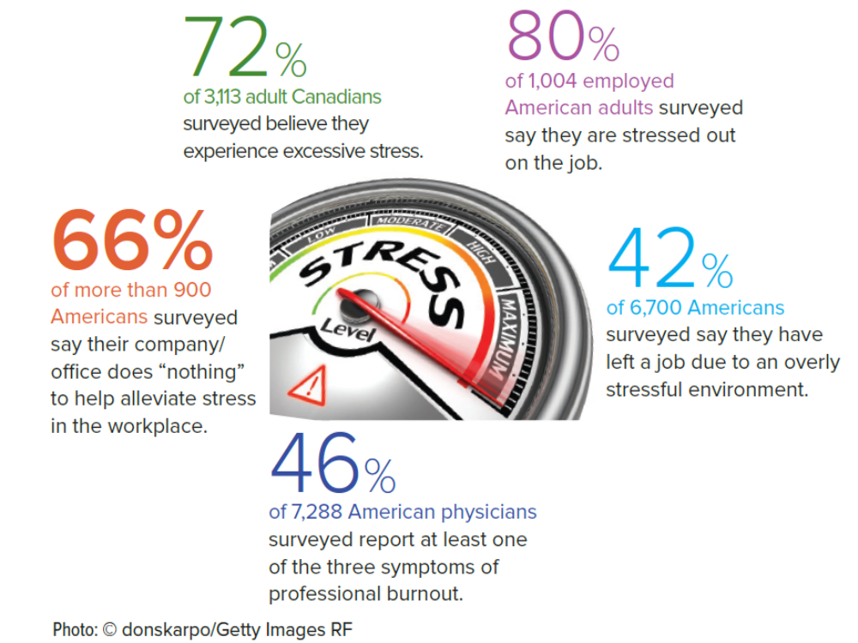

Slide 8
Is Stress Good or Bad?
Positive
When it motivates us to work harder
A mild degree of stress can be helpful, providing a challenge with simulation, excitement, and focus.
Some people deliberately search out for stress to make life exciting
Negative
When it exceeds our coping abilities and interferes with our ability to perform
When it results in illness
Organizational Behavior: An Experiential Approach 8/E
Joyce S. Osland, David A. Kolb, Irwin M. Rubin and Marlene E. Turner
7-16

Slide 9
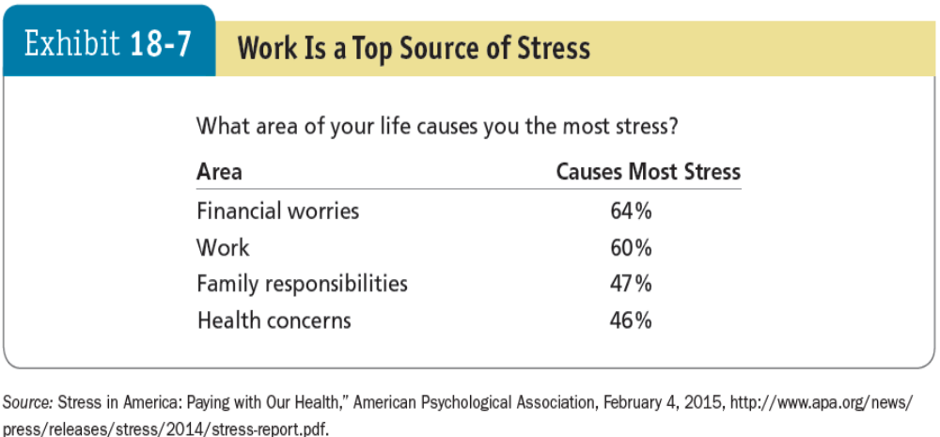
Sources of stress

Slide 10
Major Causes of Work Stress
Stressors - any environmental conditions that place a physical or emotional demand on the person
Change – internal or external PESTEL
Lack of control
Lack of resources
Lack of information
Lack of understanding
High workload
Lack of support
Lack of recognition
Interpersonal conflict
Organizational Behavior: An Experiential Approach 8/E
Joyce S. Osland, David A. Kolb, Irwin M. Rubin and Marlene E. Turner
7-17
Notes:
Ch. 6

Slide 11
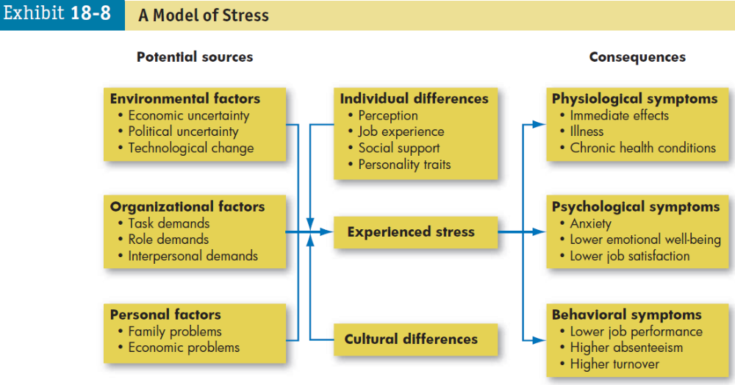
Work stress
Source: Robbins and Judge (2017, p. 662)

Slide 12
Costs of Work Stress
Psychological symptoms
Decreased job satisfaction
Changes in metabolism, increase heart and breathing rates and blood pressure, bring on headaches, and induce heart attacks
tension, anxiety, irritability, boredom, and procrastination
Behavioural symptoms
Decreased job performance
Increased absenteeism
Increased alcohol and drug abuse
Illness, sleep disorders
(Robbins and Judge, 2017)
Organizational Behavior: An Experiential Approach 8/E
Joyce S. Osland, David A. Kolb, Irwin M. Rubin and Marlene E. Turner
7-18

Slide 13
Activity – 10 minutes
In groups identify the stressors in your student life

Slide 14
Coping Strategies – individual approaches
Direct action – remove the stressor by changing the situation i.e. time management, extending social support network
Cognitive reappraisal – change the way we think about the stressor or situation
Symptom management – treat the stress reaction via exercise or meditation
(Robbins and Judge, 2017)
Organizational Behavior: An Experiential Approach 8/E
Joyce S. Osland, David A. Kolb, Irwin M. Rubin and Marlene E. Turner
7-20

Slide 15
Managing Work-Related Stress
Remove the stressor
  Minimize/remove stressors
  Work/life balance initiatives
Withdraw from the stressor
  Vacation, rest breaks
Change stress perceptions
  Positive self-concept (personal goal setting), humor
Control stress consequences
  Healthy lifestyle, fitness, wellness
Receive social support

Slide 16
Balancing Work and Nonwork – organizational approaches
Design the organization and jobs to support employee growth and achievement i.e. training
Develop policies that support both work and personal life interests i.e. goal-setting
Recognize that the nature of work and careers have changed i.e. redesigning jobs
Employee involvement
Wellness programs
Organisational communication
(Robbins and Judge, 2017)
Organizational Behavior: An Experiential Approach 8/E
Joyce S. Osland, David A. Kolb, Irwin M. Rubin and Marlene E. Turner
7-21

Slide 17
Managing stress as a student
Stay relaxed and sleep properly
Take breaks
Manage your time
Set goals and priorities
Question your way of thinking
Look after your body – meditate, exercise
Healthy diet
Treat yourself

Slide 18
NHS stress management advice
https://www.nhs.uk/oneyou/every-mind-matters/stress/?WT.tsrc=Search&WT.mc_id=Stress&gclid=Cj0KCQiApY6BBhCsARIsAOI_GjZCBLLgD0GcLfadFRya8E067soqtPutqMtle5eMBtpAxo1xGje9RuIaAgyzEALw_wcB

Slide 19
References
Cameron, S. (2016) The Business Student’s Handbook, 6th edn. Harlow: Pearson Education Limited
Cottrell, S. (2013) The Study Skills Handbook, 4th edn. London: Palgrave Macmillan Ltd.
McShane, S. L. and Von Glinow, M. A. (2018) Organisational Behaviour, 8th edn. New York: McGraw-Hill Education.
Robbins, S.P. and Judge, T.A. (2017) Organizational Behavior, 17th Edn. Harlow: Pearson Education Limited.

