Slide 1


PRESENTATIONS

Slide 2
Why do we need to present?
Most managers are make presentations as part of the job
Gives you an opportunity to rise within your organisation
Your presentation skills can be tested during job interview
Can appeal you to the employers
Or part of the course

Slide 3
Good vs bad reasons
Communicate time-critical info to a large group
You need to persuade the audience in person
You need to convey message in a cost effective manner
Clear set of objectives
It will help to bond with the audience
You have the time, energy and commitment to make the presentation
Because we always have presentations on Tuesdays
The info is already know and nothing new is conveyed
The audience does not know why they are there, or you do not know why you are presenting
No objectives
If you are not comminated to deliver the presentation

Slide 4


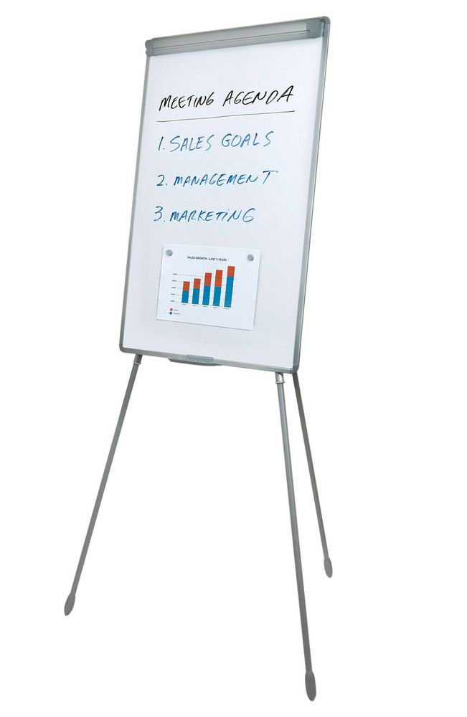

THE INFORMATION YOU PRESENT
You can present information in a variety of ways, but the most popular and effective tend to be by using:
a flip-chart
an overhead projector (OHP)
or power-point presentation
posters

Slide 5
Clear structure
A clear structure in a presentation is very important as it is easy to loose track of what is being said. So the classic advice of ‘Say what you are going to say, say it, then tell them what you have said’ still holds good.
INTRODUCTION – introduce yourself, presentation topic, delivery, etc
MAIN PRESENTATION – like a report delivery and expand on your main discussions. Use pointers i.e. what you have said (briefly) and what you will talk about next
CONCLUSION – summarise what you have said and invite audience for any questions

Slide 6
DELIVERY TECHNIQUE
Learn from the people around you who deliver good presentations
Relate to your audience – be human, look at people, engage with them
Make it easy for people to hear – be clear, use straightforward language and avoid unnecessary jargon
Try to be interesting – vary your pace, use visual aids, occasional humour but not too much
Avoid distributing handouts while you are speaking
Keep your notes brief – if your are a beginner at presenting try not to read everything from the notes
Watch your audience – body language
Be honest
Manage your time – practice, practice and practice! Record yourself

Slide 7
Visuals

Slide 8
Visuals

Slide 9
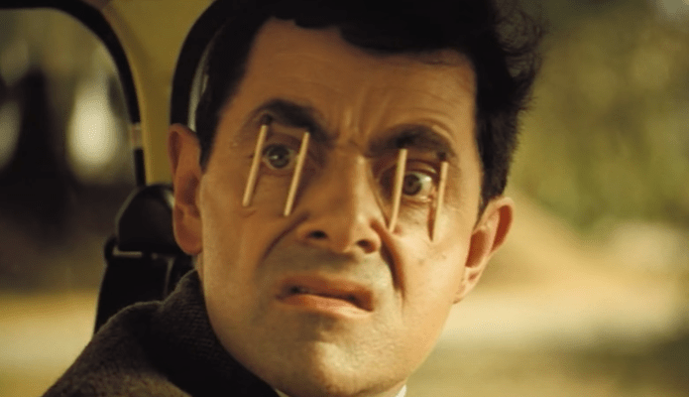
Effective visual aids
Using images and other visual aids will make communication very effective. The main functions are:
To help audience understand a point
They can help audience remember a point
They can keep your audience awake
Do not overcrowd with information and visuals
Use bullet points rather than large passages of text

Slide 10
Handling questions
Once you have summarised your presentation, you can invite your audience for Q&A time.
You can set the ground rules
Listen carefully and if uncertain clarify with the questioner
Decide whether to answer
If the question is challenging do not get defensive or aggressive
Answer the question and only the question
Check whether your response was acceptable

Slide 11
Controlling nerves
Check the equipment is working
Slow down and breathe calmly
You can hold a pencil or a pen to give your hands something to do
Have water handy
Look around your audience before your start to speak
Knowledge
Practice and preparation
Nevers usually die out within a first few minutes when you are in control

Slide 12

Preparation
It is the key to a successful presentation
Know your content
Practice in front of friends, family, colleagues or mirror
Record yourself

Slide 13
A GOOD PRESENTATION:
Is obviously well-prepared in advance, e.g. notes and slides are carefully prepared and ready.
Has a clear structure prepared in advance. There is a beginning, middle and clear ending.
Is relevant to the interests and needs of the audience.
Is concise: it gets to the main points quickly and succinctly.

Slide 14

IN A GROUP PRESENTATION, THE FIRST PRESENTER WILL:
Get the presentation off to a good start by introducing him or herself, and other members of the group.
Set out the main aims of the presentation.
Tell the audience how the group would prefer to deal with questions, e.g. during the presentation, or at the end.

Slide 15

ALL PRESENTERS WILL:
Look clean and smart.
Use language appropriate to the level of ability and understanding of the audience.
Will speak clearly and with enthusiasm.
Appear confident – and will never apologize for their lack of experience in making presentations. (this is the ‘kiss of death’ for any presenter!)
Will look at the audience. Establish strong eye contact with them and will smile and look pleasant.

Slide 16
ALL PRESENTERS WILL:
Stand well and straight – head upright and looking comfortable.
Avoid presenting unnecessary detail
Will not distract the audience from the message – by fiddling with keys, pens, coins – or anything else!
Other members of the group will not talk when another is presenting. This is very distracting as well as bad manners.
A POOR PRESENTATION IS THE CONVERSE OF ALL THE POINTS JUST LISTED.

Slide 17
references
Cameron, S. (2016) The Business Student’s Handbook, 6th Edn. Harlow: Pearson Education Limited.
Siddons, S. (2008) The Complete Presentation Skills Handbook. London: Kogan Page Limited.

