Slide 1

Reflection and Learning Assignment 2

Slide 2

Today’s session Learning Objectives
Reflective Writing and Assignment 2:
To understand the nature and importance of reflection
To understand the models of reflection
To apply reflective models in our own context
Focus on Assignment 2- Reflective Journal!
2

Slide 3
Introduction to Reflective Writing
There is increasingly much academic writing about the benefits of reflective writing.
It is being utilised in Business Management studies
Provides an opportunity for you to gain further insights for your work through deeper reflection of your experiences.
At university you will be required to self-reflect continuously-not just for self-reflective assignments, but also to progress in the future.
3

Slide 4

Definition of Reflective Writing:
What is Reflection?
Reflection “is a form of mental processing with a purpose or anticipated outcome that is applied to relatively complex or unstructured ideas for which there is not an obvious solution” (Moon, 1999, p23)
4

Slide 5
What is reflection?
‘It is not sufficient simply to have an experience in order to learn. Without reflecting upon this experience it may quickly be forgotten, or its learning potential lost. It is from the feelings and thoughts emerging from this reflection that generalisations or concepts can be generated. And it is generalisations that allow new situations to be tackled effectively.’ (Gibbs, 1988)

Slide 6
What is reflection and why do it?
Exploration / examination of ourselves and our actions (often written but also spoken)
considered
rational - Although emotions/feelings, attitudes etc may play a significant role in WHAT we are reflecting upon
Why do it?
to develop understanding / learning / skills
and give us a path by which to move forward

Slide 7
What is reflection?
Thinking about…..
Pondering on…..
Asking yourself questions about…..
Discussing with yourself…
Trying to work something out…..
Making sense of things…
Learning from experience...
Helping you plan for the future…..

Slide 8
Sources of reflection
Everyday events
Positive experiences
Negative experiences
Eventful incidents
Unusual incidents
Routine activities
Important events
Meaningful events

Slide 9
What might you reflect upon in day to day life?
‘’I’m always late for work’’
‘’That was a great holiday’’
‘’My car has turned out to be an old banger’’
‘’I’ve had a very productive weekend’’
‘’I keep running out of money before the end of the month’’

Slide 10
The basics:
Experience
Reflection
Action

Slide 11
Borton’s (1970) cue questions:
What?
So what?
Now what?
(Cited in Jasper, 2003, p.99)

Slide 12

Models of Reflection
Kolb's Experiential Learning Cycle (1984)
Gibbs’s Reflective Cycle (1988)

Slide 13
Kolb’s Theory
Employers are interested in your ability to use the knowledge that you possess rather than merely recite it
Application – therefore, is using the knowledge to do something better
Employers expect graduates to understand problematic situations and respond appropriately, understand the new ones and learn from the previous ones
Kolb understood the importance of reflection in continuous development
He argued learning is a circular process
You do something, reflect on your experience, try to conceptualise it and then test these concepts through action, which generates more experience

Slide 14
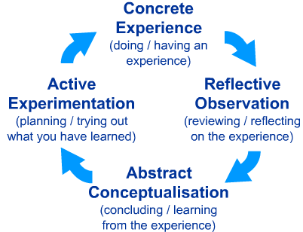
Kolb’s Experiential Learning Cycle (1984)
WHAT did I do ?
WHAT can I do to improve?
WHAT happened ?
WHAT did I learn?

Slide 15
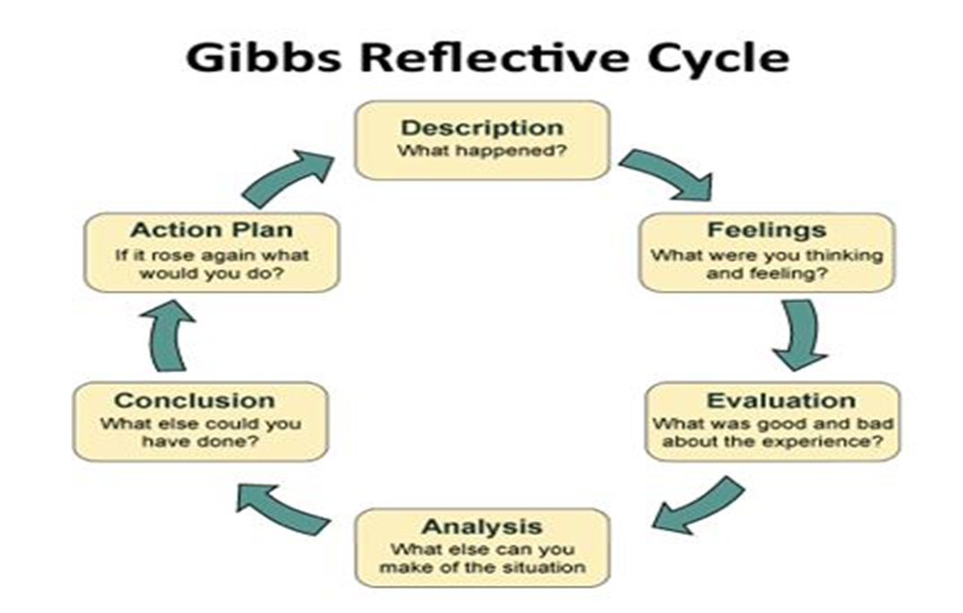
Gibbs Reflective Cycle (1988)

Slide 16
Gibbs Reflective Cycle (1988)
DESCRIPTION
What happened? Where? When? Who?
FEELINGS
What were you feeling before, during and after the situation?
What do you think others were feeling?
EVALUATION
What was good or bad about the experience?
What went well and what didn’t?
ANALYSIS
Why did things go well or why they didn’t?
CONCLUSION
What did I learn?
What else could I have done?
ACTION PLAN
How would I do things differently in the future?
How would I develop the required skills (TUOE, 2020)

Slide 17
Moon’s reflective writing
Moon (2002) identifies four 'levels' of reflection as a general guide –
Descriptive writing
Descriptive account with some reflection
Reflective writing 1
Rationalising and sense making
Reflective writing 2
Future oriented

Slide 18
Learning and learning styles
Entwistle (1996) suggests that a surface approach is directed merely towards meeting course requirements and study is done without regard to its purpose beyond that of passing the course
A deep learning approach is driven by the desire to understand the ideas, and is associated with an active interest in the subject matter
People learn in different ways and Drucker (1999) argues that some people learn best by listening, some by reading, some by writing and some by doing
VARK - visual, auditory, read/write and kinaesthetic
ACTIVITY – the VARK questionnaire available on the portal

Slide 19
Benefits of self reflection
Strengthening Emotional Intelligence
When taking time to self-reflect you are looking inwards. This helps to build two components to emotional intelligence: self-awareness and self-regulation.
Self awareness gives you the ability to understand your emotions, strengths, weaknesses, drives, values and goals, and recognise their impact on others.
Self-regulation involves the ability to control or redirect your disruptive emotions and impulses and adapt to changing circumstances.
Building these skills will improve both your personal life and professional role as a leader

Slide 20
2. Acting With Integrity
Becoming clear on your core values will help to strengthen your integrity and lead you to better decisions.
Our integrity is often put to the test during stressful times.
Taking time to review your key decisions and actions in the recent past and evaluating them against your core values is critical to acting with integrity.
Doing this consistently can solidify your values and make the decision making process easier in the future.

Slide 21
3. Being More Confident
Confidence is crucial for managing a busy, complex life that includes meeting career, family, community and self needs.
It helps in effective communications, decision-making, and influence building (getting others to trust you).
The more your reflect on your strengths and how you can build upon them the more confident you will be in the future.
We become more confident in where our strengths lie and how to close the gaps in our areas of weakness.

Slide 22
Tools for reflection
A good set of questions to ask yourself
●● How did that go?
●● How did I feel about the experience?
●● What did I learn from it? What did I fail to learn?
●● How might I have learned more effectively?
●● What will I do differently in future to help me learn better?
Simple recording – e.g.

Slide 23
Action plan
Deadline
30th of March 2021

Slide 24
Summary
Learning and reflection is a continuous process
People have various learning styles
Reflection is a crucial element in learning and practice desired in every profession
Learning needs should be identified and effective action plans should be drawn

Slide 25
References
Cameron, S. (2016) The Business Student’s Handbook, 6th edn. Harlow: Pearson Education Limited
Cottrell, S. (2013) The Study Skills Handbook, 4th edn. London: Palgrave Macmillan Ltd.
TUOF (2020) Gibbs' Reflective Cycle. Available at: https://www.ed.ac.uk/reflection/reflectors-toolkit/reflecting-on-experience/gibbs-reflective-cycle [Accessed: 9th Feb 2021].

Slide 26
PPD Assignment 2
Assignments submitted online to Turnitin via the Student Portal
Assignment 2:
Reflective Journal
1500 words
22nd March 2021
50% weighting
Core
Submitted as a Word document!
26

Slide 27
Assignment 2 Task-Reflective Report
Prepare a reflective journal that discusses how the module, or attending the university in general, has contributed to your achievement of the employability and study skills which relate to:
• Communication skills-verbal and written
• Research skills
• The use of ICTs
• Team work
• Time and self-management
• Problem solving skills
You should consider applying a relevant model in your personal reflection process such as; Kolb’s Reflective Cycle or Gibbs Reflective Cycle etc.
Include evidence with examples to support the achievement of these skills.
You can use the first person for this task.
27

Slide 28
Format of Reflection Report-1500 words
Title page-Module name; Assignment title; Student name and ID Number
A brief Introduction (150 words max)-the purpose of the report and key areas to be covered
Main body- reflect on employability skills, based on what you have covered in the PPD module;
Communication Skills-Verbal/oral/Presentation
ICT Skills
Research Skills
Numeracy
Team Work Skills
Organisation/ Time Management
Problem Solving Skills
Reference evidence from module content
The use of relevant reflective writing models will add value to your report
Include a plan with objectives to hone these skills in the future
A brief Conclusion (150 words max)- key personal strengths and areas for development
You can use the first person.
28

