Slide 1

Student Guide to Extenuating Circumstances
(Mitigation)

Slide 2


Extenuating circumstances (mitigation) are those which are out of a student’s control and can prevent them from submitting an assignment and/or sitting an exam.
Below is a list of acceptable circumstances. Please note this list is not exhaustive.
Bereavement
Illness
Traumatic incident
Significant close family problems
Burglary or computer stolen (with some other evidence to confirm that the work was stolen – notes/ plans / drafts etc.)
Car accident / other type of accident
Attendance at Court
It is essential that evidence is provided to support your application. This will be covered further in this presentation.
What are Extenuating Circumstances?

Slide 3
Below are circumstances which New College Durham would class as unacceptable grounds for mitigation. Again, this list is not exhaustive.
Holidays
Weddings
Family celebrations
Technical problems – printing problems
Computer failure / corrupt disks & USB sticks etc.
Financial problems and part time working
Unacceptable Grounds

Slide 4


How do I apply?
It is strongly recommended that you make your Tutor aware of your circumstances so that they are able to support you.
It is essential that you make your application within 2 weeks of the original submission date (excluding holidays). Anything submitted beyond this time may not be considered by the Panel.
To apply, you will need to visit the HE Information page on the New College Durham website and download a copy of the application form (Higher Education Information (newcollegedurham.ac.uk)).
You will need to provide as much detail as possible so that the Panel are fully aware of your circumstances. You must email your completed form and accompanying evidence as attachments to mitigation@newdur.ac.uk

Slide 5
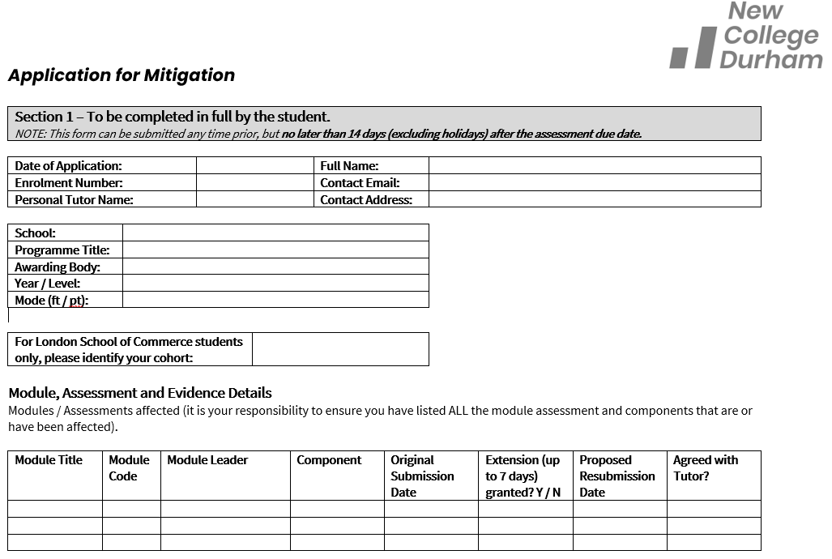
The Application Form
Filling out the Application Form
This section must be completed in full. For London School of Commerce students, you must identify your cohort.
This section must contain the exact detail of the modules / components which have been affected. All details must be included. If you are unsure of any details, such as the Module Title of Module Code, please contact your Tutor.
It is essential that your module details are correct. The Panel will only record any approved mitigation against the modules you have listed.
By filling out these details as accurately and in as much detail as possible, this will ensure the Panel are able to quickly identify your student record.

Slide 6
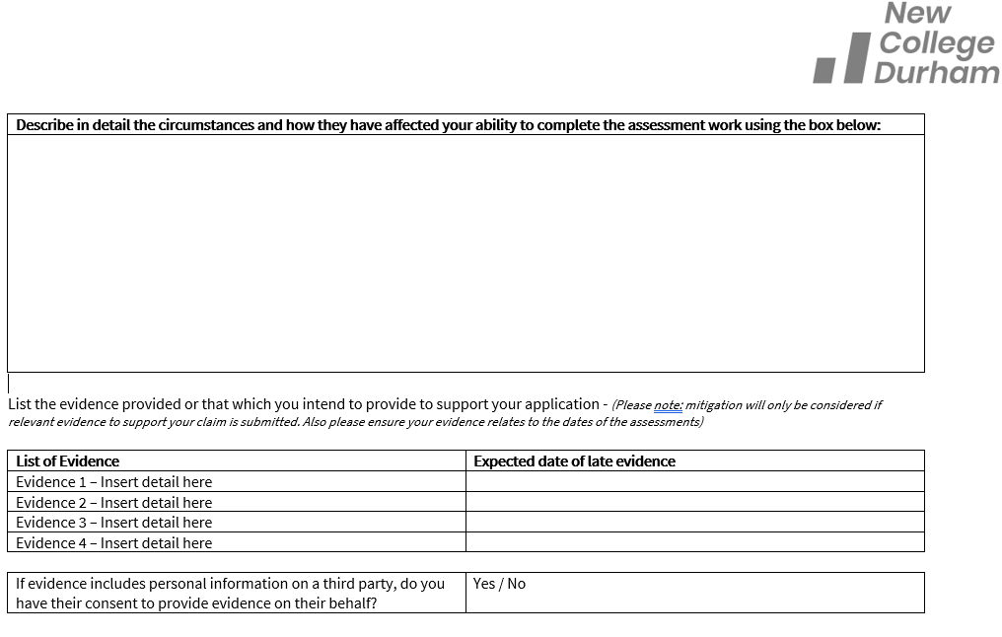
The Application Form
Filling out the Application Form
Use this section to provide as much detail as possible on the circumstances which have stopped you from completing an assessment.
Remember: The Panel do not know who you are, therefore they need as much detail as you can provide to make a decision on your application.
Use this section to inform the panel what evidence you have provided with your form. If the evidence is going to be late, you must identify this on your form.
If your evidence names someone else, you must have their permission to use the document as evidence.

Slide 7
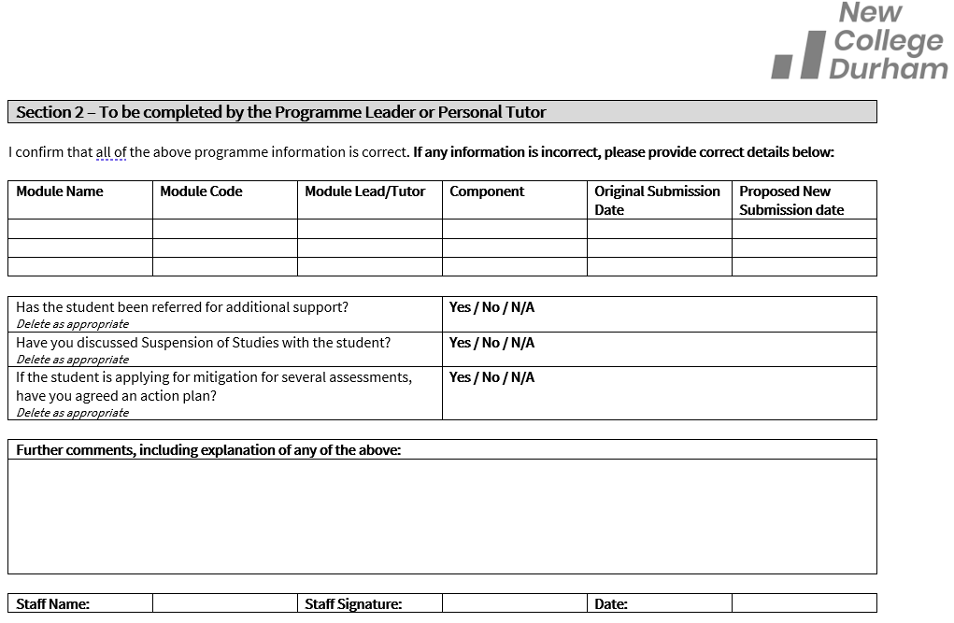
The Application Form
Filling out the Application Form
This section be completed by your Tutor or Programme Leader. They must add detail and provide their electronic signature where possible.
Your form will be returned to you if this section is incomplete.

Slide 8
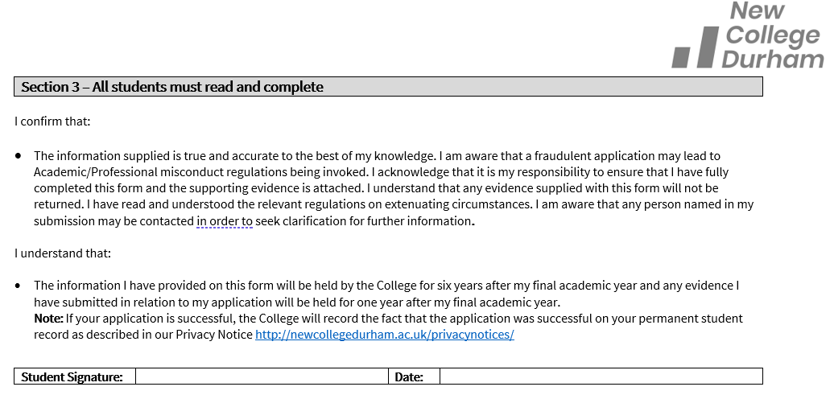
The Application Form
Filling out the Application Form
Please ensure you ready this section before you sign it.

Slide 9
The Process
You identify a circumstance which has affected your academic performance.
Where possible, discuss this with your Tutor or Programme Leader, who will be able to advise you on completing the application form.
You will complete the application form in full (electronically), ensure your Tutor has completed their section and have sound evidence covering the point of assessment.
You will email the application form and evidence as attachments to mitigation@newdur.ac.uk and receive a receipt.
If any details are missing your form will be returned to you at this stage.
The application and evidence will be considered at the next available Mitigation Panel.
Mitigation Approved
You will receive a letter via email confirming your mitigation has been approved and notification of your new submission date.
Mitigation Rejected
You will receive a letter via email explaining why your application has been rejected. You may be given seven days to supply evidence, which will then be considered by the Chair. If approved, you will be informed of your new submission date. If still not accepted, the original decision will remain in place.
The outcome of your application will then be reported to the next available Assessment Board.

Slide 10
Below is a list of possible evidence you could supply.
This list is not exhaustive.
Medical certificate – a prescription will not be acceptable without some other confirmation of the illness
Letter from a medical professional treating yourself or a family member
Proof of attendance at hospital
Death certificate / copy of funeral order of service leaflet or similar / letter from a member of the clergy or priest or similar
Letter from employer confirming that you had to work to cover a sick colleague
Police report and crime number – evidence also needs to be given of previous work/ notes/rough drafts if work has been stolen
Solicitor’s letter
Letter from transport company to say if the bus or train broke down or the service was interrupted
Statement of attendance from a counsellor if personal problems are affecting your work
It is very unlikely that your application will be approved if no evidence is provided.
What evidence do I need?

Slide 11
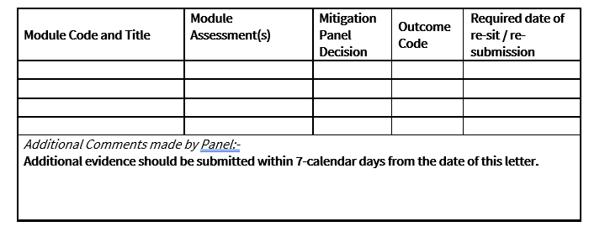
What will my letter say?
Mitigation Panel Decision
This will either state MB or MC
MB – Mitigation has been approved
MC – Mitigation has been rejected
You will receive a letter to advise on the outcome of your application. Each letter will have this information box on the first page.
Outcome Code
This will range from 1 to 8 (The second page of the letter explains the code in further detail)
This section is most commonly used to explain why an application has been rejected and if a student has the opportunity to submit evidence within seven days of notification.
The module information you provided on your application form will be used to compose this section of the letter. Therefore, it is essential that these details are correct.

Slide 12
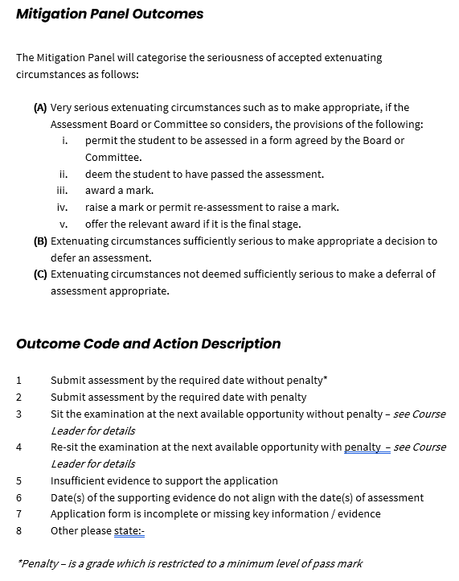
What will my letter say?
The information provided on the second page of your letter provides further detail on the codes which are used.
If you need further clarification, please contact your Tutor or Programme Leader.

Slide 13
FAQs
Can I apply more than once? | You may apply more than once if circumstances are still preventing you from submitting your assignments / sitting an exam. However, new evidence must be provided to show how the circumstances have worsened or are still affecting your academic ability.
Does my Tutor need to see my form and evidence? | Yes. If your form is not signed by your Tutor, your application will not be processed to be presented to the Panel. However, if you wish for your evidence to remain confidential, you can request that only the Chair of the Mitigation Panel sees this.
Who needs to send my documents? | It is your responsibility to send your application and evidence as attachments to mitigation@newdur.ac.uk .

Slide 14
FAQs
How much detail do I need to provide on my circumstances? | Remember that the Panel will not know who you are or any of your background information. Therefore, it is essential that you provide as much detail as possible on your circumstances. This also needs to be supported by your evidence.
When will I find out the outcome of my application? | Usually, the College will send out your outcome letter within seven days of the panel date. This will be sent to you by the Secretary of the Panel from mitigation@newdur.ac.uk.
If my application is approved, how long will I be given to resubmit / retake an exam? | As part of the mitigation process, you should discuss a date to resubmit with your Tutor. This date will be reviewed by the Panel and may be agreed, lengthened or shortened based on their decision. Your resubmission date will be documented on your outcome letter and your Tutor will also be informed.

Slide 15
FAQs
When are the Mitigation Panels held? | The Mitigation Panels are usually held a few weeks before an Assessment Board to ensure the outcomes can be processed and marked against your assessments.
Will the Assessment Board know why I applied for mitigation? | No. Members of the Assessment Board will only be informed of the outcome of your application against the relevant modules. Your circumstances remain strictly confidential and are not discussed at the Assessment Board.
Will applying for mitigation affect my grades? | If you apply for mitigation for a first attempt of an assessment and you are successful, your mark will not be capped. However, if you apply against your second attempt, your mark will remain capped (40% in most cases).

Slide 16
FAQs
When can I apply? | You may apply at any time leading up to an assessment deadline, but no later than two weeks after this. Retrospective mitigation will only be considered in exceptional circumstances.
What happens if my application is rejected? | If your application is rejected, you may be given up to seven days to supply further evidence to support your case. This will then be reviewed by the Chair. If rejected, you will still have the opportunity to resubmit but your grade will be capped at the pass mark.
What if I miss the deadline to apply for mitigation? | If you miss the deadline for your application to be submitted to a Mitigation Panel, you must provide a reason as to why it is late. Panel members are within their right to not consider an application if there is no valid reason for why it is late. If your application is not considered, this will be presented to the next available Mitigation Panel.

Slide 17
FAQs
Who are the members of the Mitigation Panel?
The Panel will consist of the following members;
A Vice Principal (or delegate who will act as the Chair)
A minimum of two and a maximum of five staff (including HE support and/or academic staff
Representatives from the HE Quality and Development Unit
A Panel Secretary

