Slide 2
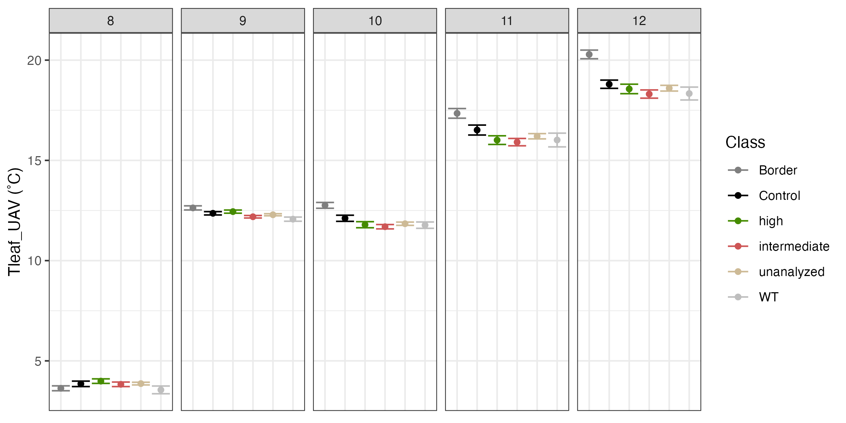
Time series of UAV-derived Tleaf shows variation based on genotype

Slide 3
