Slide 1
Living carbon greenhouse photosynthesis study
12-19-23

Slide 2
Guide
Background
Study design and results from field sampling
Results from LC greenhouse
Goals of greenhouse study

Slide 3
Photorespiration bypass construct
CaMV35s::CrGDH
SpmPRO::CmMS
RbcS1B_PRO::Plgg1 sense
LB
RB
PDK intron
Plgg1 antisense
Glycolate dehydrogenase via
Chlamydomonas reinhardtii
Malate synthase via Curbita maxima
RNAi for plasticidal glycolate glycerate transporter (plgg1)
All genes w/ chloroplast-targeted transporter
Notes:
Rt qpcr
Using exact same strategy as Ort group – adapted to poplar
Not including the selectable markers
Color code to match last slide
Animate chlorp

Slide 4
How does the bypass work? Glycolate production
photosynthesis
photorespiration
CO₂
O₂
PLGG1
photosynthesis
photorespiration
Calvin-Benson Cylce (CBC)
glycolate
RuBisCO
peroxisome
ATP
CO₂
RuBp
Notes:
Build even more.
Introduce photsynthesis
Then photorespiration
Then introduce the alternative pathway
Change no signal to volume attenuation icon
Large font

Slide 5
How does the bypass work? Export from chloroplast
photosynthesis
photorespiration
Alternative photosynthesis pathway
CO₂
O₂
PLGG1
photosynthesis
photorespiration
CBC
glycolate
RuBisCO
peroxisome
PLGG1
Silencing
ATP
CO₂
malate
glyoxylate
Malate
synthase
Glycerate
dehydrogenase
RuBp
Notes:
Build even more.
Introduce photsynthesis
Then photorespiration
Then introduce the alternative pathway
Change no signal to volume attenuation icon
Large font

Slide 6
Broad research goals
Goal 1. Make inference about how the construct affects overall productivity and biomass accumulation
Goal 2. Understand causes of variation in biomass/growth performance
Goal 3. Generating hypotheses about how the construct has affected tree physiology

Slide 7
Goal 3
Generate hypotheses to link measured attributes of tree biology to observed differences in biomass.
Leaf photosynthetic performance
Expression level of construct genes
Changes in levels of metabolites related to photosynthesis

Slide 8
How will we group trees for comparison?
By construct?
By event?
By groupings of events?

Slide 9
PLGG1 silencing has a large effect on plant performance
photosynthesis
photorespiration
Alternative photosynthesis pathway
CO₂
O₂
PLGG1
photosynthesis
photorespiration
CBC
glycolate
RuBisCO
peroxisome
PLGG1
Silencing
ATP
CO₂
malate
glyoxylate
Malate
synthase
Glycerate
dehydrogenase
RuBp
Notes:
Build even more.
Introduce photsynthesis
Then photorespiration
Then introduce the alternative pathway
Change no signal to volume attenuation icon
Large font

Slide 10
Interaction between silencing and transgene expression influence volume (last year’s data)
Stem volume index (cm³)
5A
4A
5C
7
Stem volume index (cm³)
13-15B
13-15E
2H
Transgene expression (PC2)
Silencing (PC1)
Notes:
Add animations around abc

Slide 11
Comparison groups are groups of events based on PLGG1 expression trends
High silencing/poor tier
13-15E
2H
Intermediate to low silencing/top tier
5A
4A
5C
Controls
8-9D
16-20
WT
CT3

Slide 12
Study design of field photosynthesis experiment
Events included |  | Trees
Events | Tier | Trees
5A | top | 34
4A | top | 19
5C | top | 33
2H | poor | 29
13-15E | poor | 32
16-20 | control | 33
8-9D | control | 29
CT3 | WT | 34
Traits analyzed | Derivation | Analyzed?
A_{max} | CO₂ response curve | yes
V_{cmax} | CO₂ response curve | yes
J_{max} | CO₂ response curve | yes
A_{sat} | Light response curve | no
Dark respiration | Light response curve | no
Quantum efficiency | Light response curve | no

Slide 13
Events were pooled into groups of interest for greater sample sizes to analyze CO₂ response
Sample date
 | group | Events | 6-14 | 6-22 | 7-18 | 7-20 | 7-29 | 8-29
Sample size | Top | 5A, 4A,5C | 2 | 3 | 3 | 3 | 3 | 3
 | Poor | 2H, 13-15E | 2 | 2 | 1 | 2 | 1 | 2
 | Control | 16-20, 8-9D | 2 | 2 | 2 | 2 | 1 | 2

Slide 14
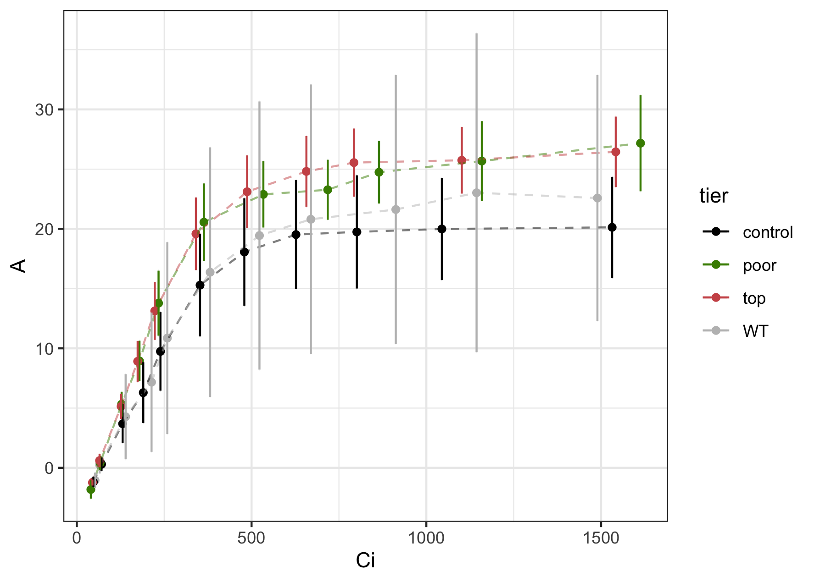
Transgenic plants for photorespiration transgenes have higher assimilation rates.
WT removed from statistical analysis- extremely variable
Error bars: 95% CI

Slide 15
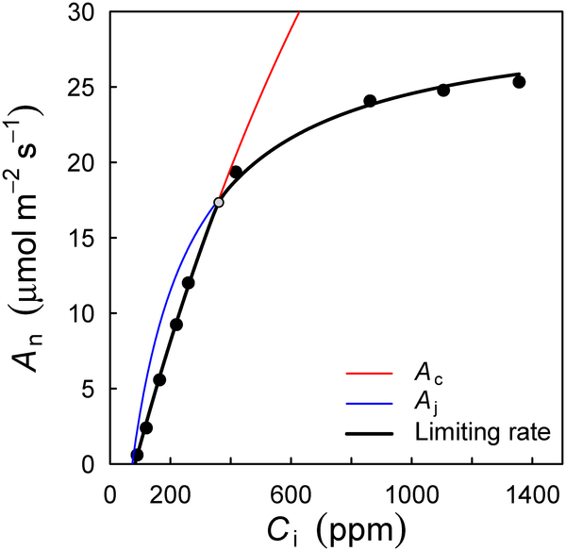
Using photosynthesis model to estimate parameters of photosynthetic performance
Biochemical model:
Parameters:
A_{max}
V_{cmax}
J_{max}
Farquhar, G.D., von Caemmerer, S. & Berry, J.A. A biochemical model of photosynthetic CO₂ assimilation in leaves of C₃ species. Planta 149, 78–90 (1980). https://doi.org/10.1007/BF00386231

Slide 16
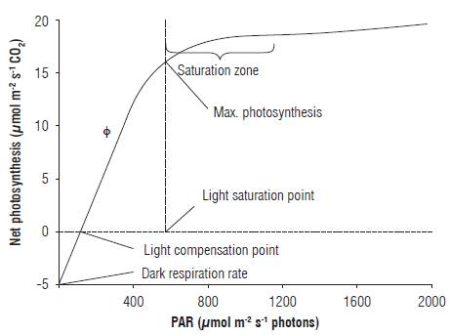
Using photosynthesis model to estimate parameters of photosynthetic performance – light response curve
Biochemical model
Parameters:
A_{sat}
Dark respiration rate
Quantum efficiency

Slide 17
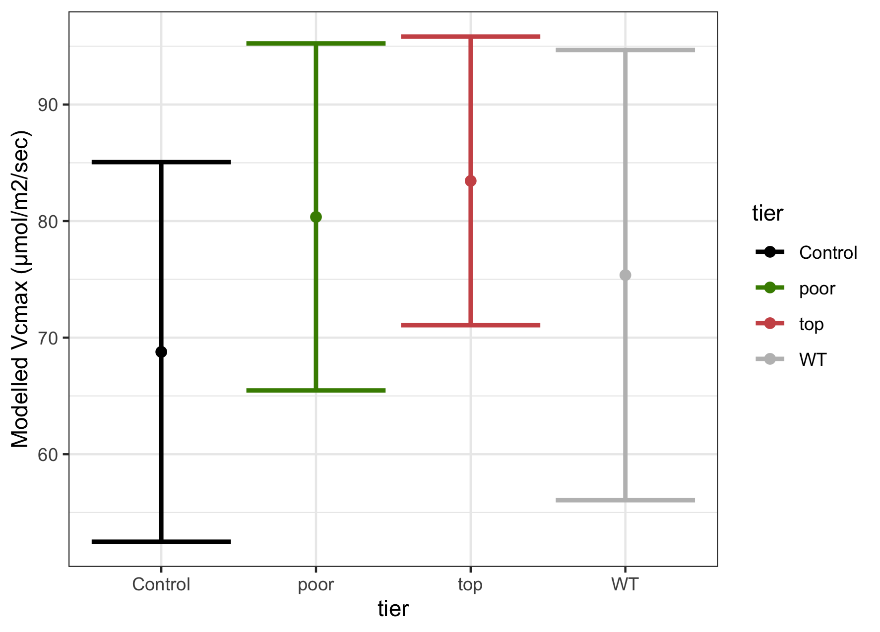
V_{cmax}
Error bars: 95% CI

Slide 18
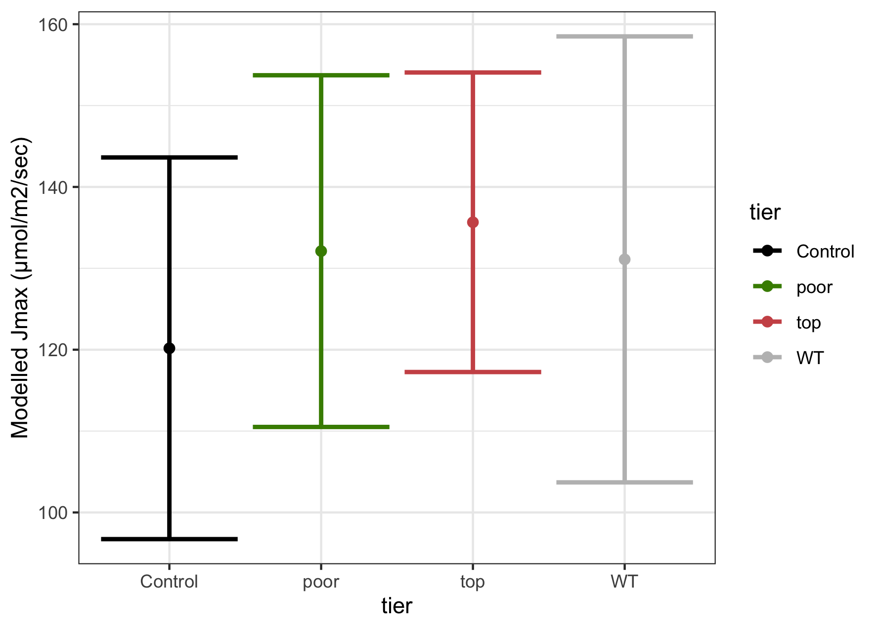
J_{max}

Slide 19
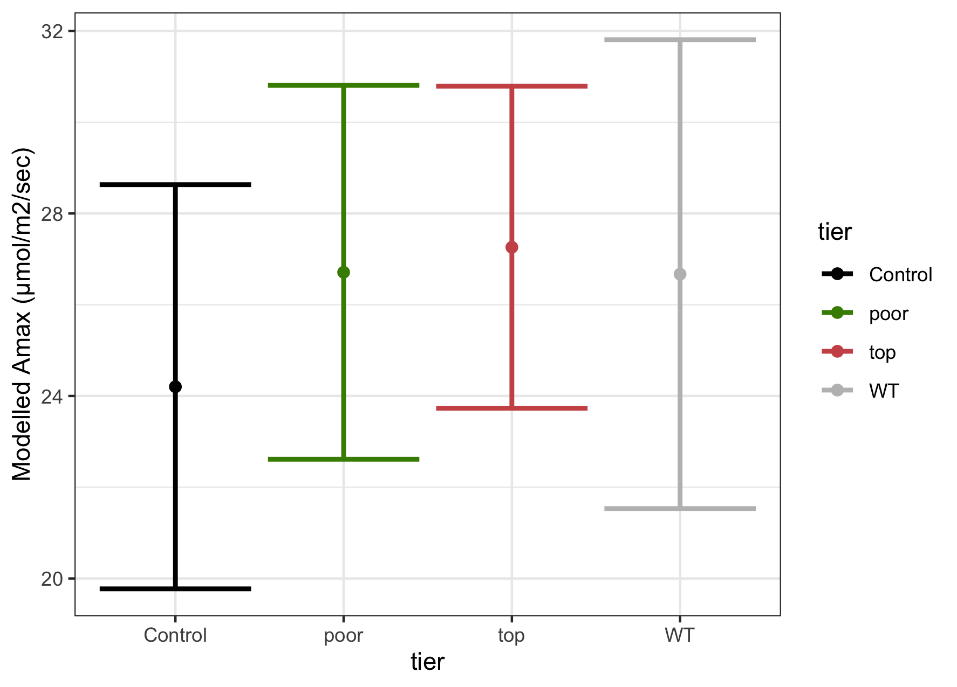
A_{max}

Slide 20
Summary
Lot of variability in photosynthetic performance given our sample size, even when controlling differing conditions between sample date
Limited evidence that transgenic events have increased photosynthetic performance
No evidence to suggest that event differences in PLGG1 expression impacts photosynthetic performance

Slide 21
Greenhouse results from Living Carbon team

Slide 22
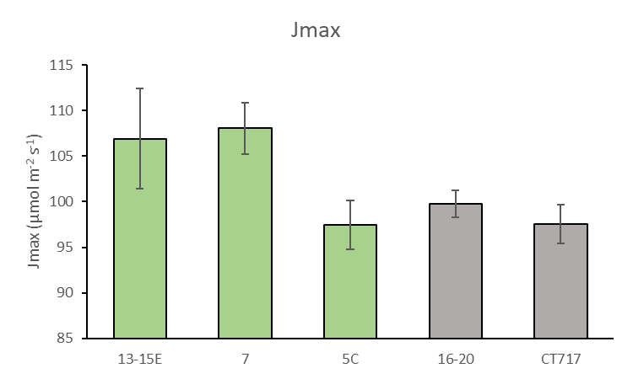
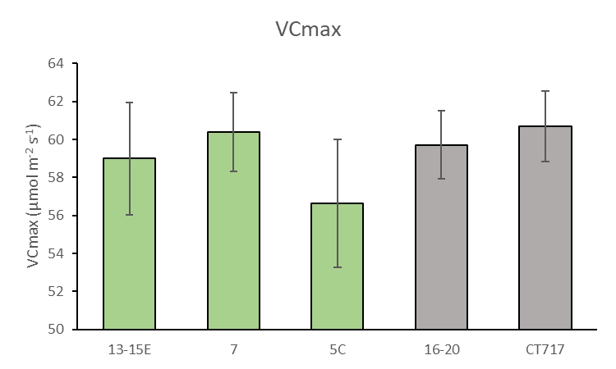
Jmax is enhanced in transgenics but VCmax is not
*p=0.0235
*p=0.0082
v
v
Differences in Jmax (electron transport rate/ RuBP regeneration) but not VCmax (rubisco carboxylation)
Averages ±SE
N = 5-7 biological replicates
9-11 week old trees
Notes:
P value is compared to CT717, t-test.
One tailed t-test: 13-15E v CT717 Jmax = 0.0235; 7 v CT717 = 0.0082
Why jamx could be increased - hypothesis Increased CO₂ produced from glycolate breakdown in the chloroplast could lead to an increase in electron transport (Jmax)

Slide 23
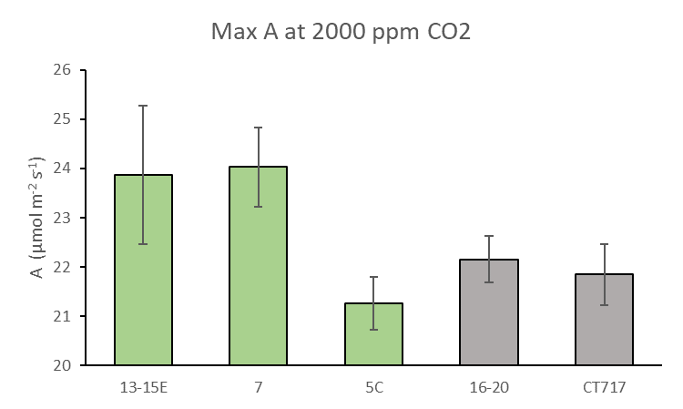
Maximum CO₂ assimilation rates (obtained from ACi curves) are enhanced in 13-15E and 7 at saturated CO₂
p=0.066
*p=0.044
v
13-15E (ns) and 7 show higher Max A than controls (and 5C transgenic)
supports previous data
Averages ±SE
N = 5-7 biological replicates
9-11 week old trees
Notes:
This is similar to results found previously

Slide 24
Research question for our greenhouse study
Does the construct have a greater impact on photosynthesis in controlled environment than in a field setting?
e.g., is the difference between top events and control and/or between poor events and control in photosynthetic performance greater than in the field?

Slide 25
Reject null hypothesis situation
Field
Greenhouse
∆V_{cmax}
0

Slide 26
Testing how silencing of PLGG1 interacts with photosynthetic performance between field and greenhouse?
Does the efficiency of PLGG1 silencing for transgenic events change between the greenhouse and the field?
Does a given amount of PLGG1 silencing cause a different response in photosynthetic performance between the greenhouse and the field?

Slide 27
Limited greenhouse inventory
Events included |  | Trees
Events | Tier | Unique tree IDs | stems
5A | top | 2 | 4
4A | top | 3 | 4
5C | top | 1 | 1
2H | poor | 0 | 0
13-15E | poor | 3 | 5
16-20 | control | 1 | 1
8-9D | control | 4 | 4
CT3 | WT | 2 | 4
total |  | 16 | 23

Slide 28
Traits of interest
Trait | Derivation
A_{max} | CO₂ response curve
V_{cmax} | CO₂ response curve
J_{max} | CO₂ response curve
A_{sat} | Light response curve
Dark respiration | Light response curve
Quantum efficiency | Light response curve
PLGG1 expression level? | RT-qpcr

