Slide 1
LC intro slides
Chaney Hart

Slide 2
Schematic of construct
CaMV35s::CrGDH
SpmPRO::CmMS
RbcS1B_PRO::Plgg1 sense
LB
RB
PDK intron
Plgg1 antisense
Glycolate dehydrogenase via
Chlamydomonas reinhardtii
Malate synthase via Curbita maxima
RNAi for plasticidal glycolate glycerate transporter (plgg1)
All genes w/ chloroplast-targeted transporter
Notes:
Rt qpcr
Using exact same strategy as Ort group – adapted to poplar
Not including the selectable markers
Color code to match last slide
Animate chlorp

Slide 3
How does this bypass work?
photosynthesis
photorespiration
CO₂
O₂
PLGG1
photosynthesis
photorespiration
Calvin-Benson Cylce (CBC)
glycolate
RuBisCO
peroxisome
ATP
CO₂
RuBp
Notes:
Build even more.
Introduce photsynthesis
Then photorespiration
Then introduce the alternative pathway
Change no signal to volume attenuation icon
Large font

Slide 4
How does this bypass work?
photosynthesis
photorespiration
Alternative photosynthesis pathway
CO₂
O₂
PLGG1
photosynthesis
photorespiration
CBC
glycolate
RuBisCO
peroxisome
PLGG1
Silencing
CO₂
ATP
CO₂
malate
glyoxylate
Malate
synthase
Glycerate
dehydrogenase
RuBp
Notes:
Build even more.
Introduce photsynthesis
Then photorespiration
Then introduce the alternative pathway
Change no signal to volume attenuation icon
Large font

Slide 5
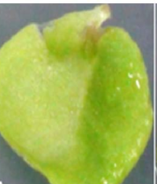
Study design
Photorespiration bypass construct
Tissue culture propagation
5A
5C
4A
2H
13-15E
16-20
8-9D
Events
-distinct and independent phenotypes
Clonal propagation
20-30 ramets each
Ramets (pseudoreplicates)

Slide 6
Project research goals
Determine effect of construct on total biomass, productivity
Distinguish between events and identify promising, high-performance lines
Form hypotheses about how the construct affects tree performance
Construct gene expression
Leaf-level metabolites
Physiological differences

Slide 7
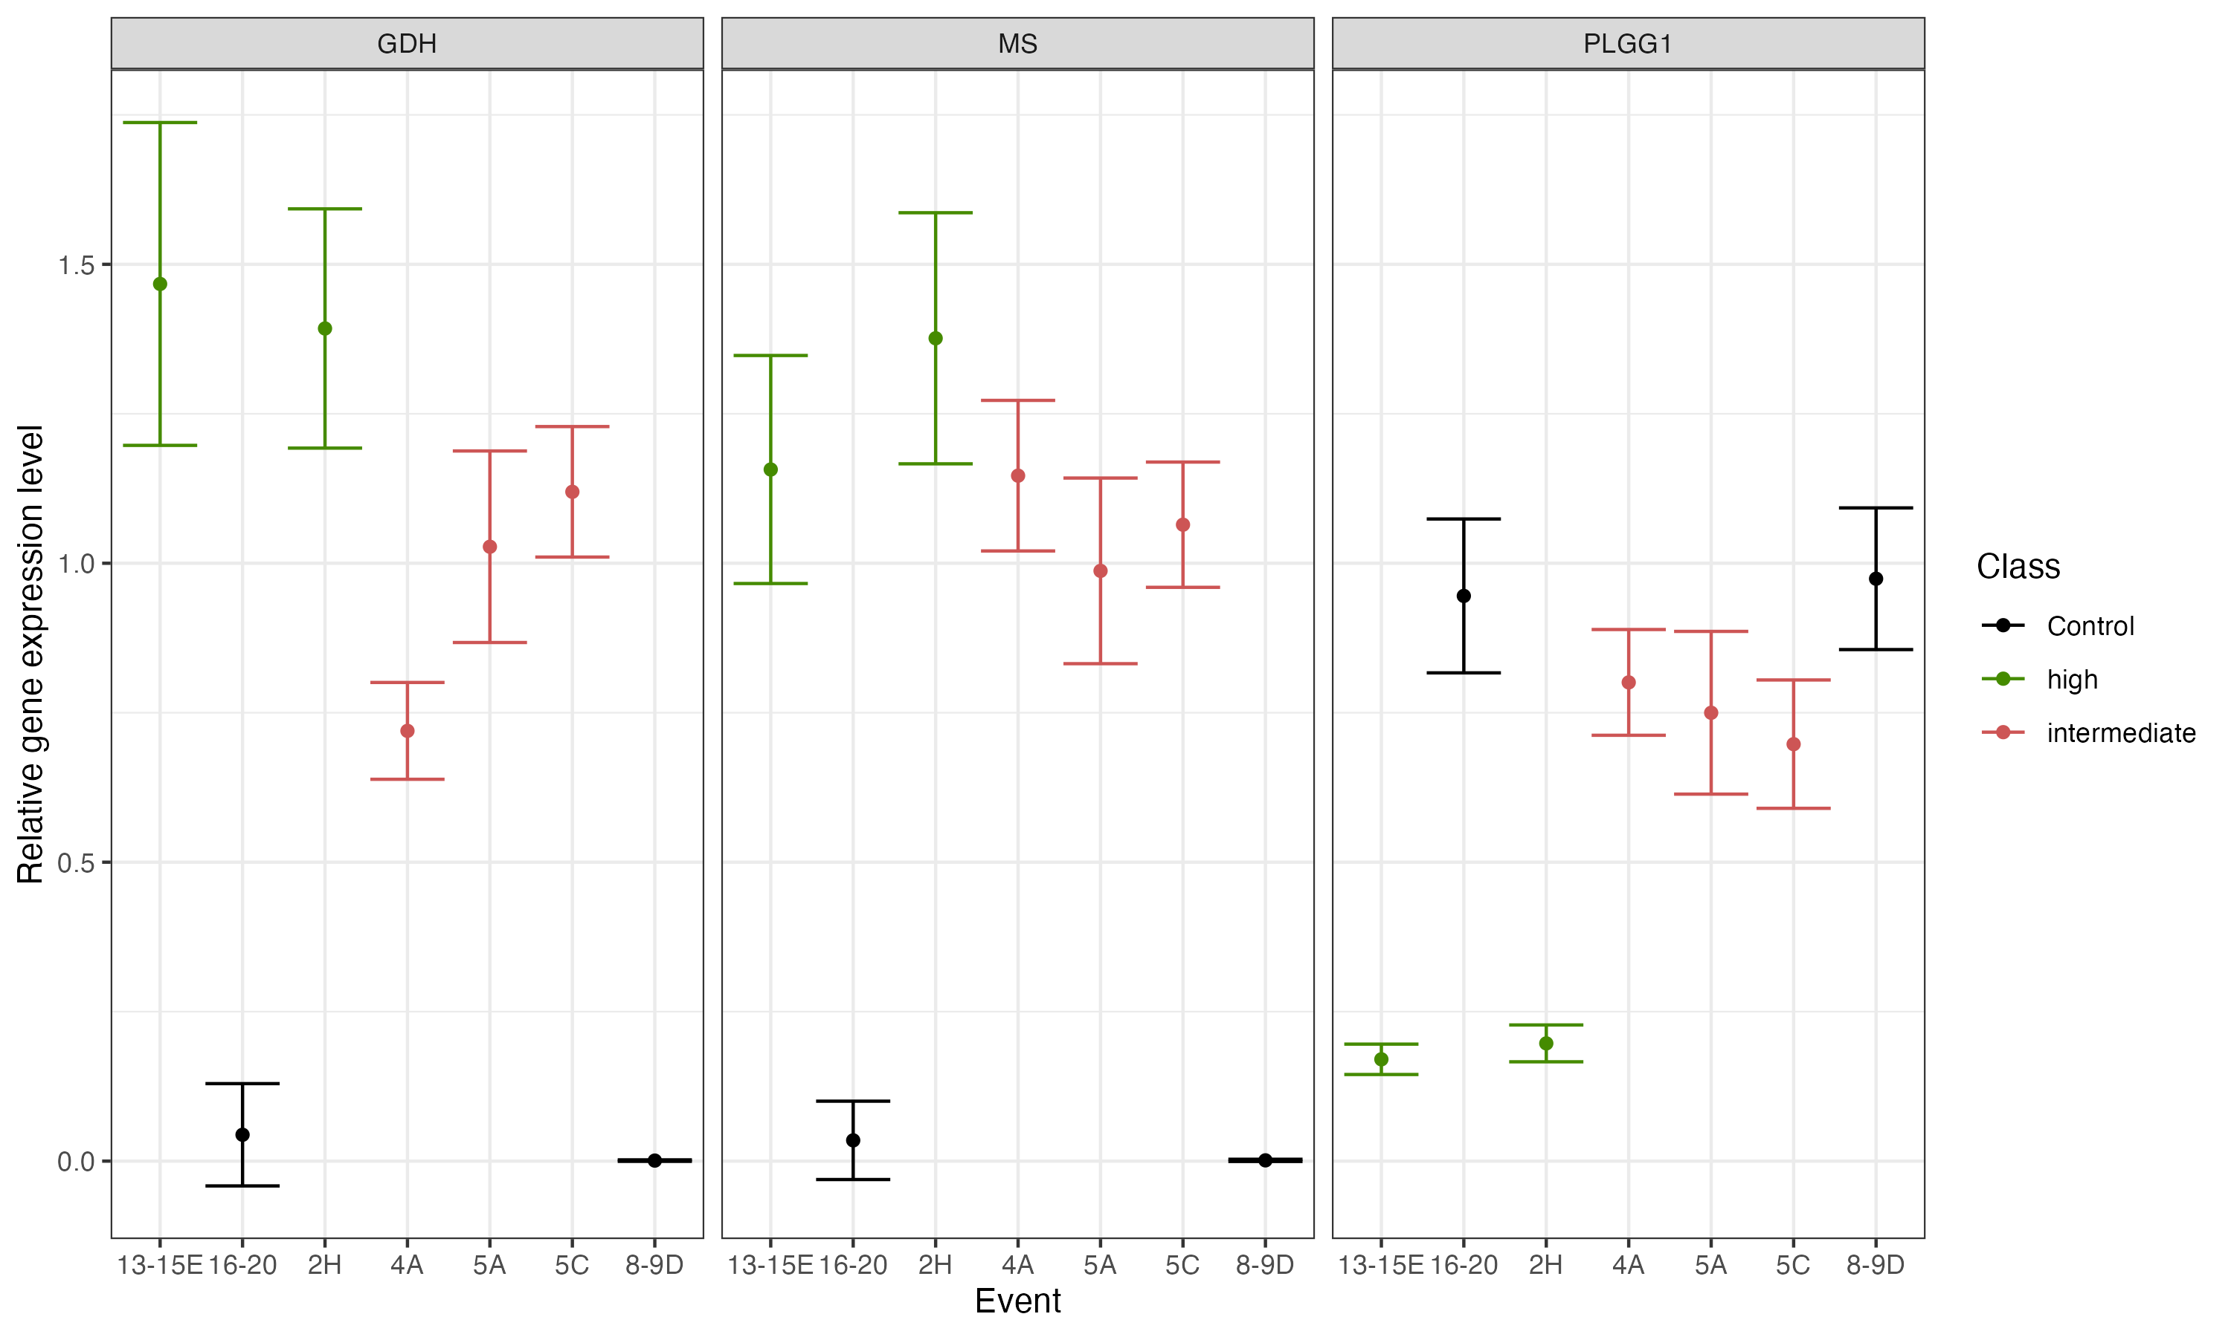
Events are differentiated by construct efficiency (especially PLGG1)
Mean expression level for three transgenes for all events. Averaged over 4 sample dates in three growing seasons.

