Slide 2
High survival rate of field trial in 2023
Event | 2022 | 2023 | Percent survival
CT717 3 | 35 | 33 | 94
LC-102 1 | 31 | 31 | 100
LC-102 13-15B | 21 | 19 | 90
LC-102 13-15E | 34 | 32 | 94
LC-102 16-20 | 35 | 33 | 94
LC-102 1C | 38 | 36 | 95
LC-102 2H | 33 | 29 | 88
LC-102 4A | 23 | 19 | 83
LC-102 4B | 39 | 37 | 95
LC-102 5 | 31 | 29 | 94
LC-102 5A | 36 | 34 | 94
LC-102 5C | 33 | 33 | 100
LC-102 7 | 35 | 32 | 91
LC-102 8-9D | 31 | 29 | 94
Total | 491 | 426 | 93.3

Slide 3
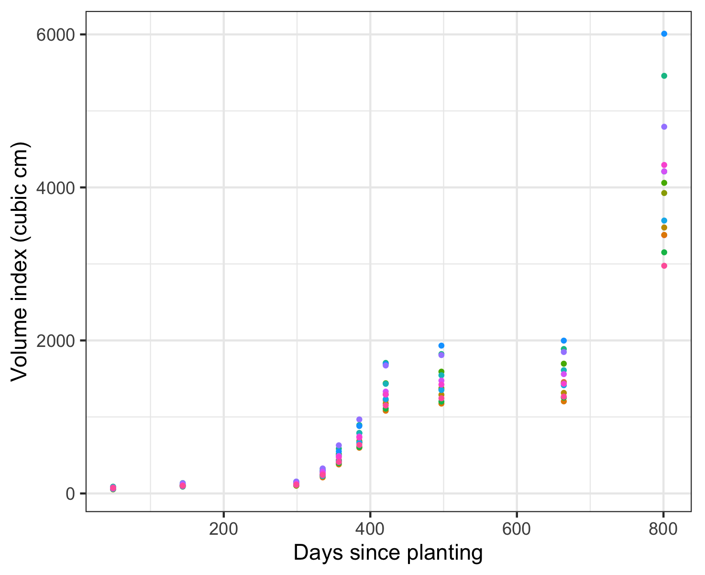
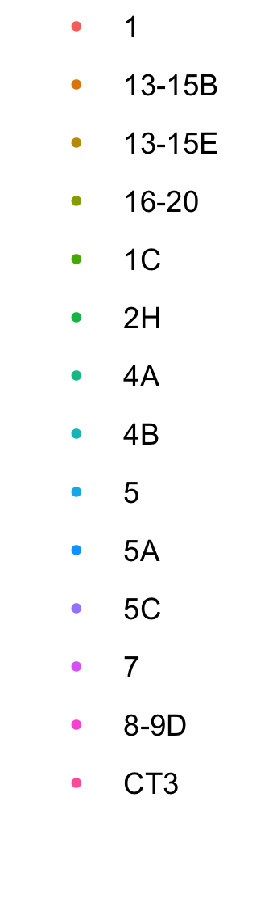
Growing season 3
Start = 1477 cm³
End = 3061 cm³
% change = 174%
Event
Growing season 2
Start = 122 cm³
End =1477 cm³
% change = 1100
Growing season 1
Start =0 cm³
End =122 cm³
Notes:
End of year 1 volume – 122.98
End of year 2 volume – 1354.08

Slide 4
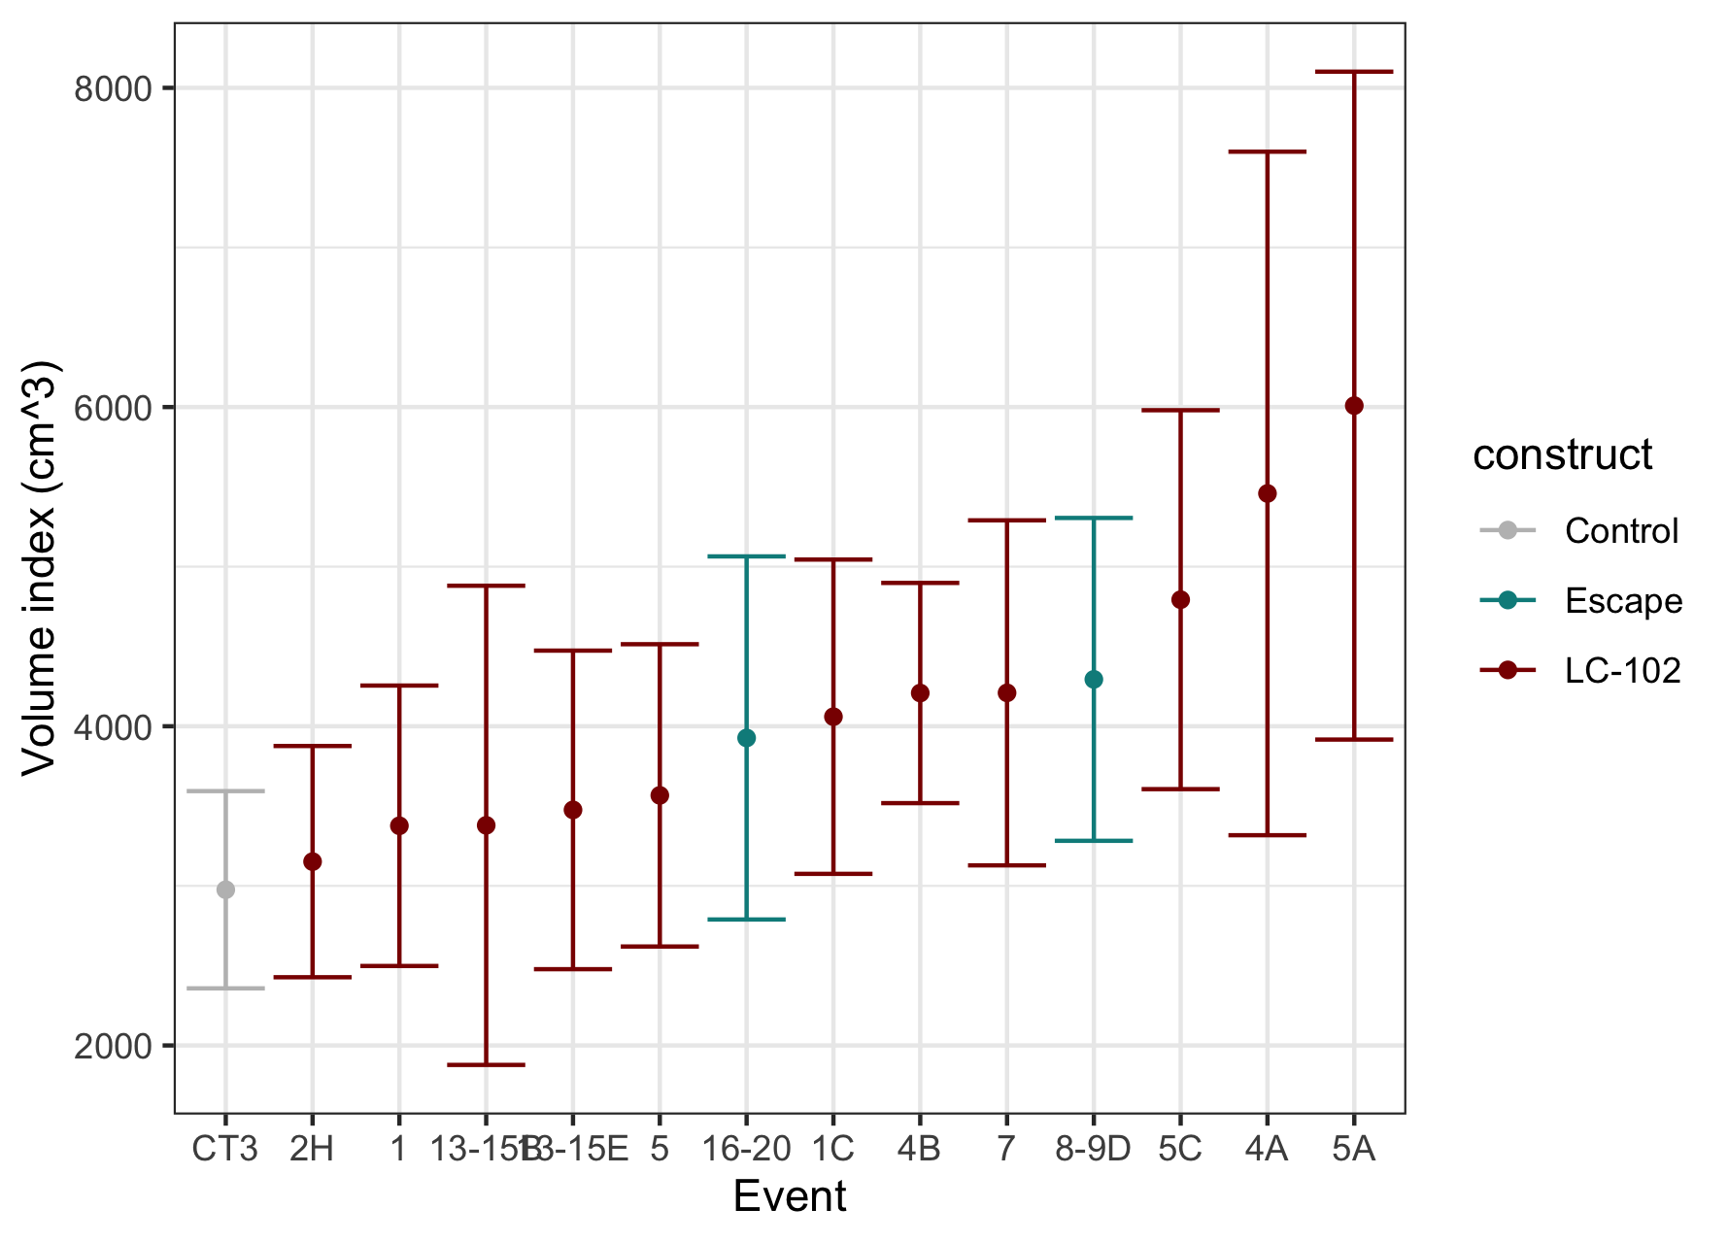
Final volume comparison
October 2023

Slide 5
Data preparation
Scripts available on github
Damaged trees removed
Control group 1 removed
Missing data – height imputation
H_{missing} = H_{previous}
Check assumptions and transformations
Test for block effect

Slide 6
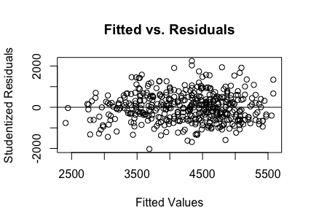
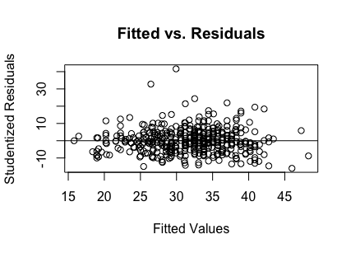
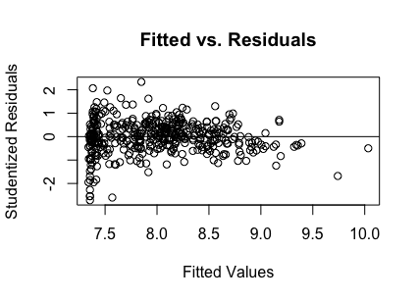
Example residual plot (height) shows absence of heteroscedasticity
Height
Diameter
Volume (log transformed)
Notes:
Show histogram of dist before and after transformation
Show residual plot before and after
Show normal q-q before and after

Slide 7
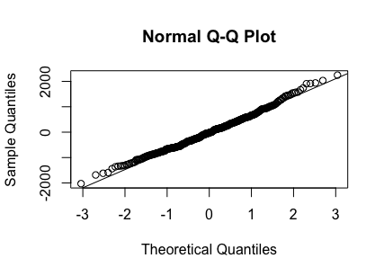
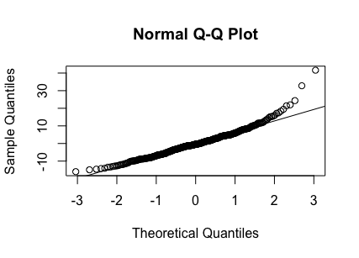
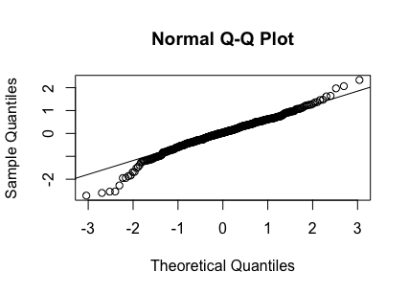
Example Q-Q plot show acceptable approximation to normality
Height
Diameter
Volume (log transformed)

Slide 8
Construct effect on volume observed but not statistically significant
Construct comparison (transgenic versus control)
Model: log(v) $= β_{1}log(v_{initial})+β_{2}construct+εblock$
Contrast | Estimate of ratio (S.E) | Effect size | Effect direction | df | P-value
Transgenic -WT |  |  | Transgenic + | 442 | 0.39
Transgenic - Escape |  |  | Transgenic + | 442 | 0.51
Escape - WT |  |  | Escape + | 442 | 0.92
Using Tukey p-value adjustments
Estimate is of ratio between mean volume between contrast groups
Notes:
Show log transformed and non-log transformed

Slide 9
Variability in volume measurements was large
Average volume
4061.01 cm³
Standard deviation
3224.19 cm³
Coefficient of variation
79.39%

Slide 10
Experiment had power to detect construct effect size of 28% as significant
Comparison: pooled transgenic and pooled escape

Slide 11
Weather trends

Slide 12
Sample summary

