Slide 2
High survival rate of field trial in 2023
Event | 2022 | 2023 | Percent survival
CT717 3 | 35 | 33 | 94
LC-102 1 | 31 | 31 | 100
LC-102 13-15B | 21 | 19 | 90
LC-102 13-15E | 34 | 32 | 94
LC-102 16-20 | 35 | 33 | 94
LC-102 1C | 38 | 36 | 95
LC-102 2H | 33 | 29 | 88
LC-102 4A | 23 | 19 | 83
LC-102 4B | 39 | 37 | 95
LC-102 5 | 31 | 29 | 94
LC-102 5A | 36 | 34 | 94
LC-102 5C | 33 | 33 | 100
LC-102 7 | 35 | 32 | 91
LC-102 8-9D | 31 | 29 | 94
Total | 491 | 426 | 93.3

Slide 3
Data preparation
Scripts available on github
Damaged trees removed
Control group 1 removed
Missing data – height imputation
H_{missing} = H_{previous}
Check assumptions and transformations
Test for block effect

Slide 4
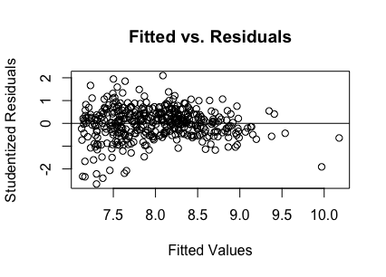
Example residual plot (volume) shows absence of heteroscedasticity
Height
Diameter
Volume (log transformed)
Notes:
Show histogram of dist before and after transformation
Show residual plot before and after
Show normal q-q before and after

Slide 5
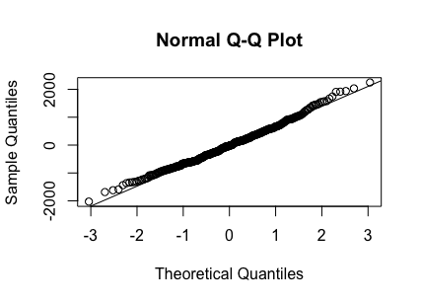
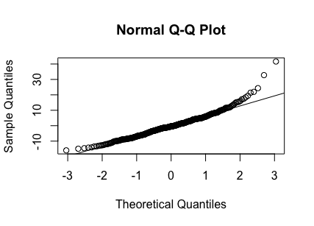
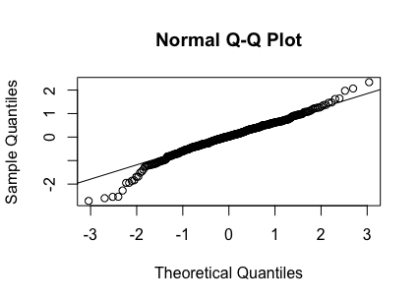
Example Q-Q plot show acceptable approximation to normality
Height
Diameter
Volume (log transformed)

Slide 6
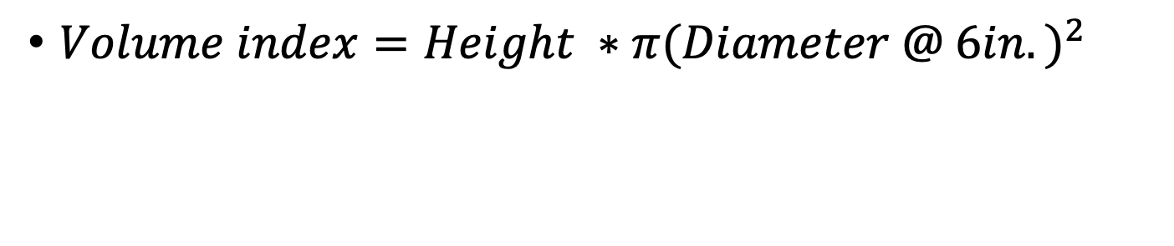
Volume index measurements
$Volume index=Height ∗π{(Diameter @ 6in.)}^{2}$

Slide 7
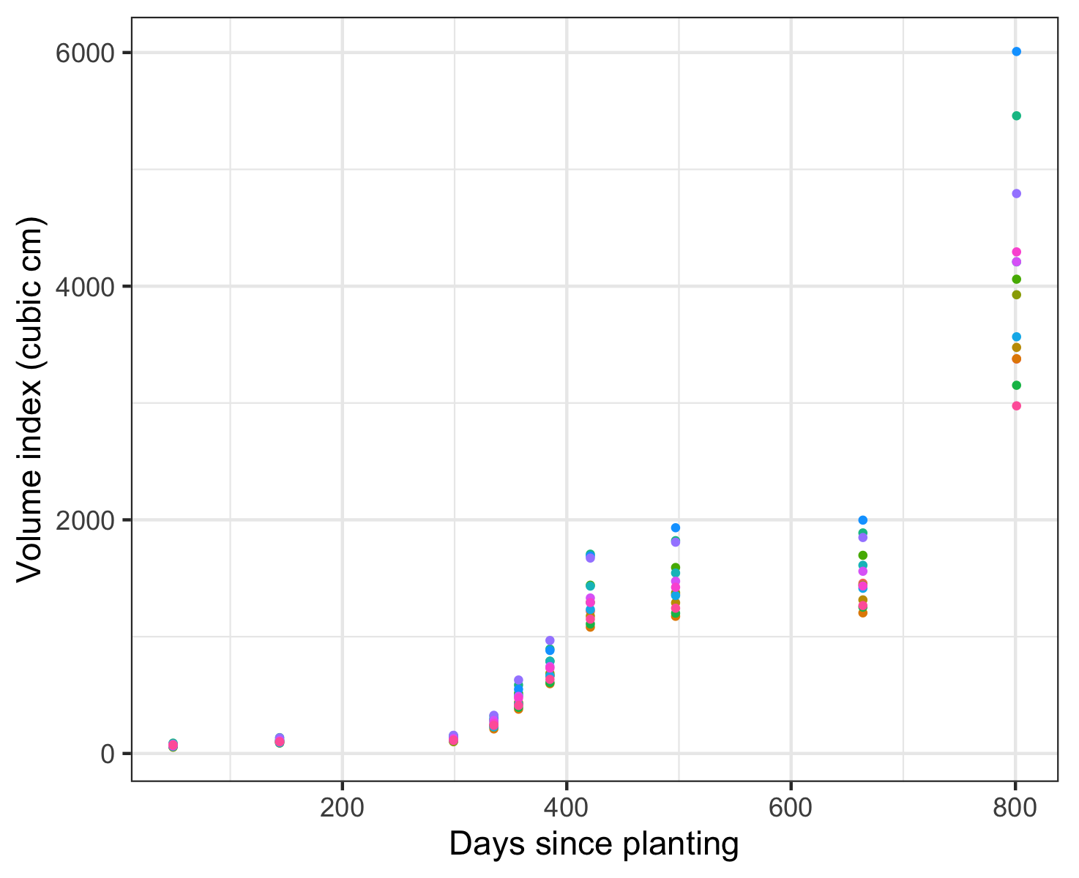
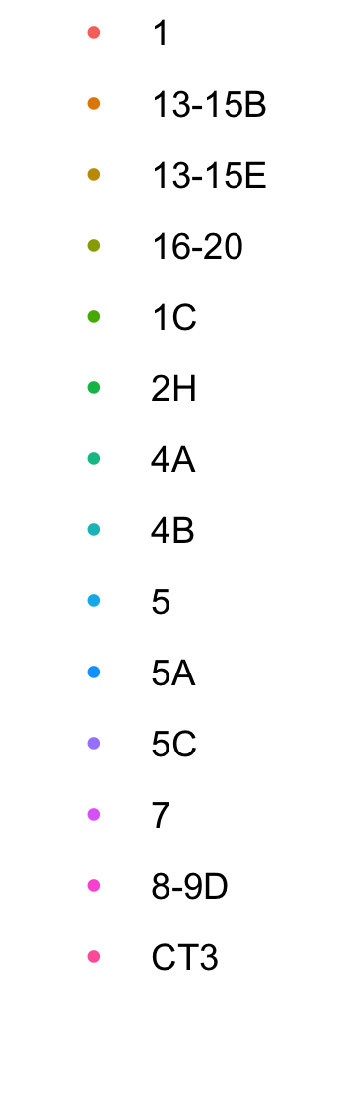
Growing season 3
Start = 1477 cm³
End = 3061 cm³
% change = 174%
Event
Growing season 2
Start = 122 cm³
End =1477 cm³
% change = 1100%
Growing season 1
Start =0 cm³
End =122 cm³
Notes:
End of year 1 volume – 122.98
End of year 2 volume – 1354.08

Slide 8
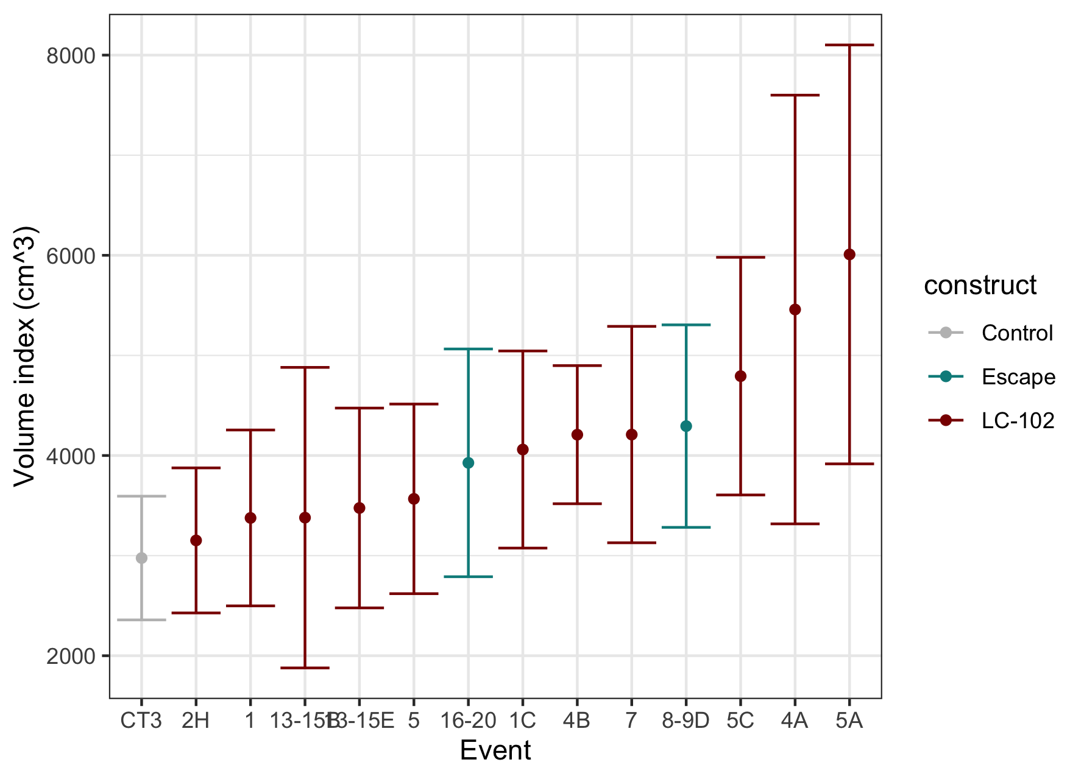
Final volume comparison
October 2023

Slide 9
Observed volumes
Group | Mean (95% CI) | Standard error | N
Transgenic (pooled) | 4162.2 (3797.8 – 4526.583) | 185.2 | 331
Escape(pooled) | 4098.4 (3349.3 – 4847.5) |  | 62
WT (CT3)

Slide 10
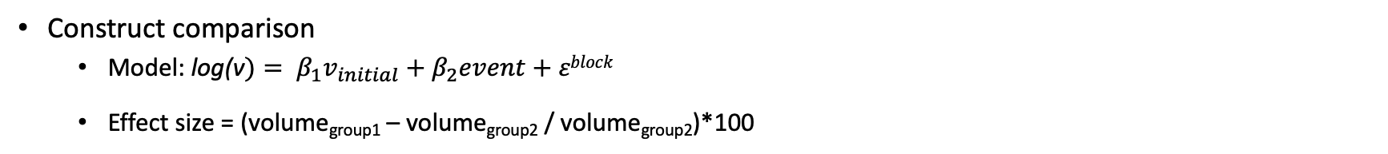
Statistical model accounting for variation in initial volume and block: event comparison
Construct comparison
Model: log(v$)= β_{1}v_{initial}+β_{2}event+εblock$
Effect size = (volume_{group1} – volume_{group2} / volume_{group2})*100
Select highlights
Contrast | Estimate(S.E.) | Effect size | Effect direction | df | P-value
5A – escape | 1.14(1.15) | 14.6% | 5A + | 411 | 0.99
4A – escape | 1.07(1.19) | 7.9% | 4A + | 432 | 1
5A – CT3 | 1.61(1.18) | 60.2% | 5A + | 432 | 0.21
4A – CT3 | 1.51(1.22) | 50.7% | 4A + | 432 | 0.69
5A - 2H | 1.54(1.19) | 54.0% | 5A + | 432 | 0.39
5A -13-15E | 1.58(1.19) | 58.2% | 5A + | 432 | 0.26
Using Tukey p-value adjustments
Estimate is of ratio between mean volume between contrast groups
Notes:
Show log transformed and non-log transformed

Slide 11
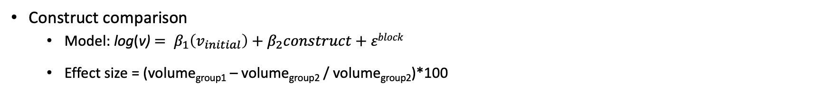
Statistical model accounting for variation in initial volume and block: construct comparison
Construct comparison
Model: log(v) $= β_{1}\left(v_{initial}\right)+β_{2}construct+εblock$
Effect size = (volume_{group1} – volume_{group2} / volume_{group2})*100
Contrast | Estimate of ratio (S.E) | Effect size | Effect direction | df | P-value
Transgenic/WT | 1.26(1.13) | 26.3 | Transgenic + | 421 | 0.16
Escape/Transgenic | 1.108(1.101) | 10.7 | Escape + | 421 | 0.54
Escape/WT | 1.40(1.16) | 39.9 | Escape + | 421 | 0.066
Using Tukey p-value adjustments
Estimate is of ratio between mean volume between contrast groups
Notes:
Show log transformed and non-log transformed

Slide 12
Variability in volume measurements was large
Average volume
4061.01 cm³
Standard deviation
3224.19 cm³
Coefficient of variation
79.39%

Slide 13
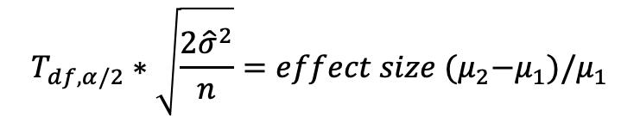
Experiment had limited power to detect event and construct effects as significant
Sig. effect threshold: estimate of effect size, given experiment’s sample size and variability that would be detected as significant.
$$T_{df,α/2}∗\sqrt{\frac{2{\hat{σ}}^{2}}{n}}=effect size {(μ}_{2}−μ_{1})/μ_{1}$$
Variance based on observed volumes
Comparison | Effect size observed effect size | Effect direction | Sig. effect threshold
Pooled transgenic vs. pooled escape | 10.7% | Escape + | 28.8%
5A vs. pooled escape | 14.6% | 5A + | 42.3%
5A vs. CT3 | 60.2% | 5A + | 50.4%
Top transgenic vs. bottom transgenic
Notes:
We used the observed volume indices to estimate the variance for this comparison (pooled variance of the two groups). Would have used the modelled volume, but this is a relatively simple model – suitable for statistical comparison more so than for prediction. A model with diameter would better serve for prediction.

Slide 14
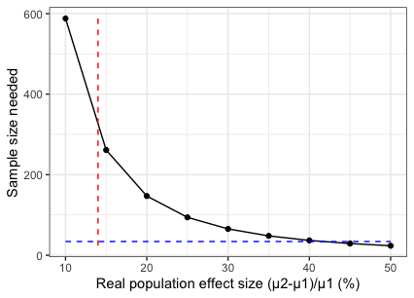
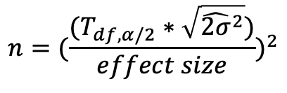
A larger sample size or real effect size would have been needed to detect significant difference between 5A and escape events
$$n=({\frac{(T_{df,α/2}∗\sqrt{{\hat{2σ}}^{2}})}{effect size})}^{2}$$
14%
n=34

Slide 15
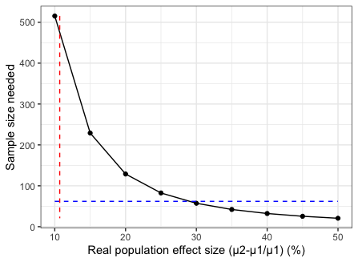
Despite larger sample size, limited power in comparing transgenic and pooled escape events
$$n=({\frac{(T_{df,α/2}∗\sqrt{{\hat{2σ}}^{2}})}{effect size})}^{2}$$
10.7%
n=62

Slide 16

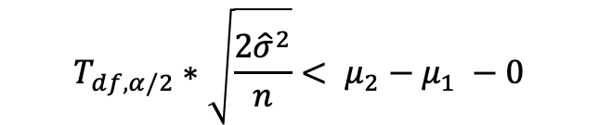
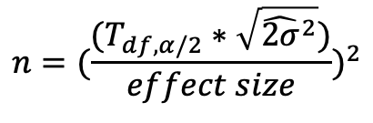
Weather trends
$$T_{df,α/2}∗\sqrt{\frac{2{\hat{σ}}^{2}}{n}}< μ_{2}−μ_{1} −0$$
N = $T_{df,α/2}∗\sqrt{{\hat{2σ}}^{2}}$
$$n=({\frac{(T_{df,α/2}∗\sqrt{{\hat{2σ}}^{2}})}{effect size})}^{2}$$

