Slide 1
Can we improve Yelp's services by precise user-business match-up?
Chang Du, Hanxing Li, Junru Lu, Shijia Gu

Slide 2
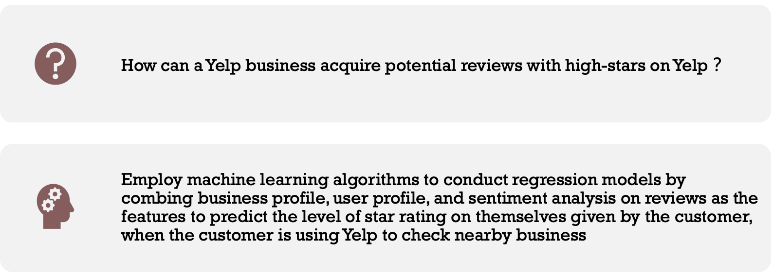
Problem Statement

Slide 3
Datasets

Slide 4
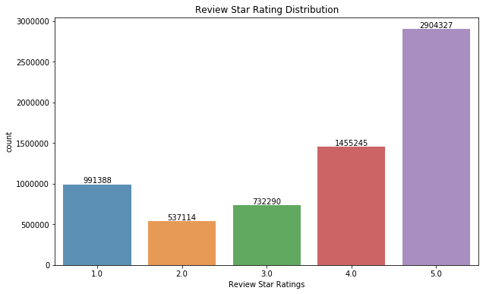
Review Dataset
 | Sample
Business id | kKo73YIOPoverMeL867hoOw
User id | KMAI8qT7LUKFrZCqEMqFfA
Review id | KPUFLYyHDsaQC8ks1ZQwxQ
Review star | 5.0
Text | This place is fantastic, Ordered a dozen tre...
Useful | 1
Cool | 0
Date | 2014-08-25-01:50:14
Figure 1: the Distribution of Star Ratings

Slide 5
Review Dataset
 | Sample
Business id | kKo73YIOPoverMeL867hoOw
User id | KMAI8qT7LUKFrZCqEMqFfA
Review id | KPUFLYyHDsaQC8ks1ZQwxQ
Review star | 5.0
Text | This place is fantastic, Ordered a dozen tre...
Useful | 1
Cool | 0
Date | 2014-08-25-01:50:14
Lexicon-based sentiment analysis to get three sentiment scores of reviews:
- TextBlob, VADER and AFINN Sentiment Scores:
- punctuation, capitalization, conjunctions
- emojis, slangs and acronyms
Review Length

Slide 6
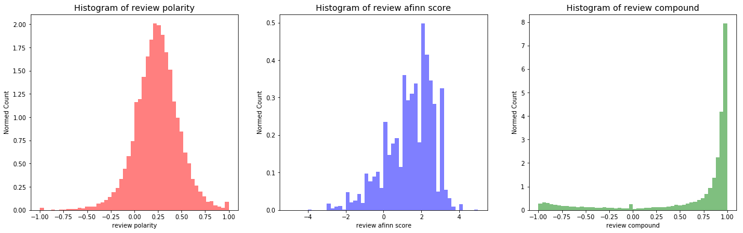
Review Dataset
Figure 2: Distribution of Reviews Sentiment Scores

Slide 7
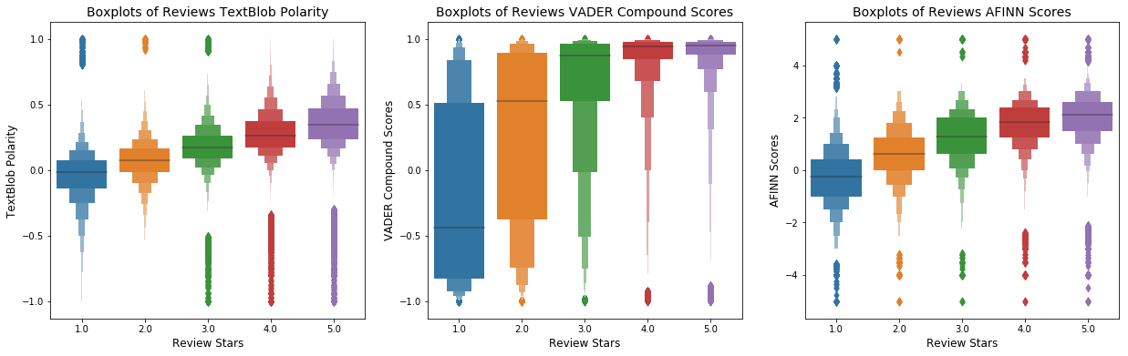
Review Dataset
Figure 3: Boxplots of Reviews Sentiment Scores over Review Stars

Slide 8
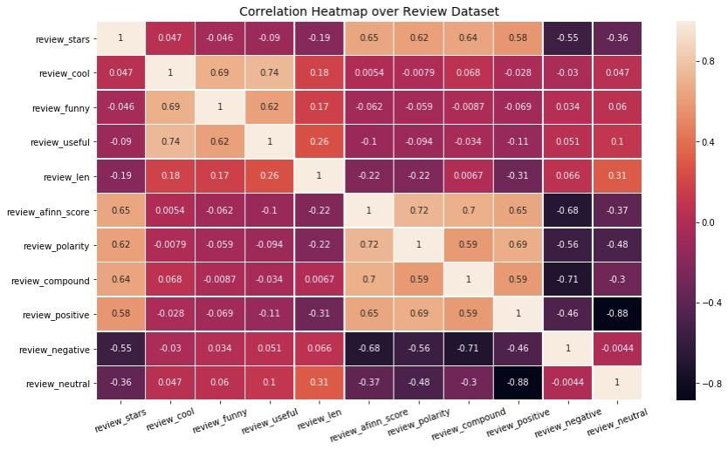

Slide 9
Tip Dataset
 | Business id | User id | Text | Compliment count | Date
0 | fknU3sWplCBn26b6HwJkQ | xmNjAckgX7vZFnfqTsR5YQ | Once you enter the parking lot… Turn around... | 0 | 2016-04-19 02:04:52
1 | oWh3TnsN5WrmPn7VgQNsWA | qCzx039NVrJkWnZEqQ1JKA | Positive experience every time! Thank you! | 0 | 2013-06-10 17:05:24
2 | gVgSI9anfzYn8dMdmmFNsg | B7NlilrOlwxxD_kiYMHT4g | This place is great! You gotta go! | 0 | 2014-03-29 06:57:23
3 | oz7PaA6zFtdi2nUxIYdlMg | ZF2fPwWrPRlqhlY8SxButQ | Spin class bikes fill up fast | 0 | 2010-07-06 16:10:41

Slide 10
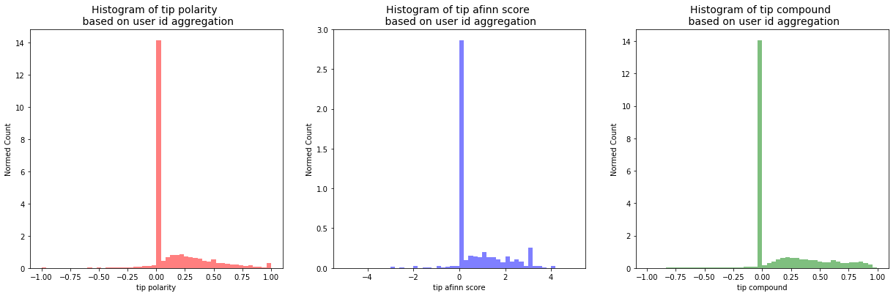
Tip Dataset
Figure 4: Distribution of Tips Sentiment Scores based on User id aggregation

Slide 11
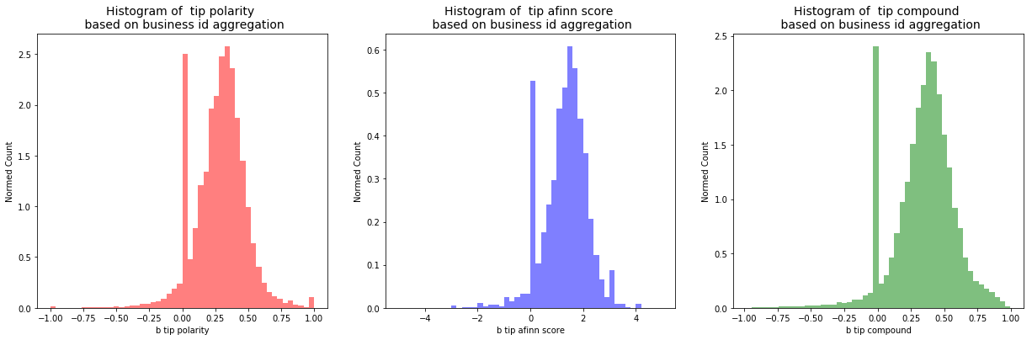
Tip Dataset
Figure 5: Distribution of Tips Sentiment Scores based on Business id aggregation

Slide 12
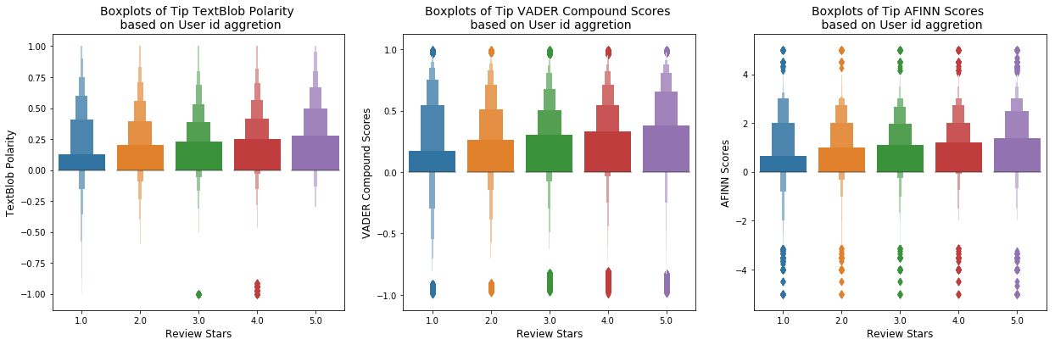
Tip Dataset
Figure 6: Boxplots of Tips Sentiment Scores over Review Stars based on User id aggregation

Slide 13
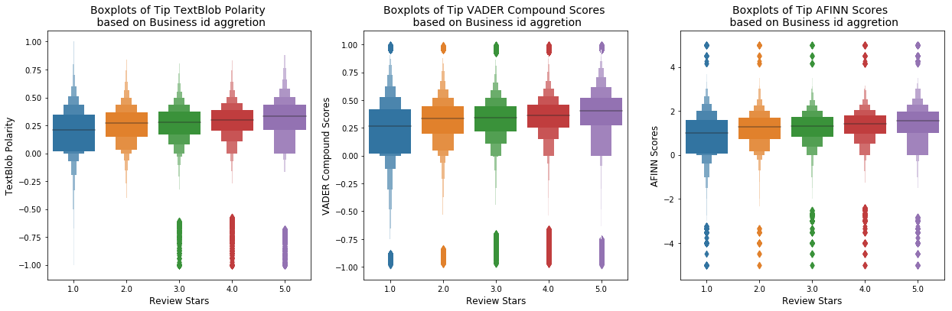
Tip Dataset
Figure 7: Boxplots of Tips Sentiment Scores over Review Stars based on Business id aggregation

Slide 14
User Dataset
User id | KMAI8qT7LUKFrZCqEMqFfA
User stars | 4.03
Elite | 2015, 2016, 2017, 2018
Compliments | Compliment cool | 0
User tags | Funny | 17
Fans | 5
Friends | c78V-rj8NQcQjOI8KP3UEA, aIRMgPcngYSCJ5raFRBz5g...
Review count | 95
Yelping since | 2013-10-06 23:11:33
The number of elite years
The number of friends
How many days with Yelp

Slide 15
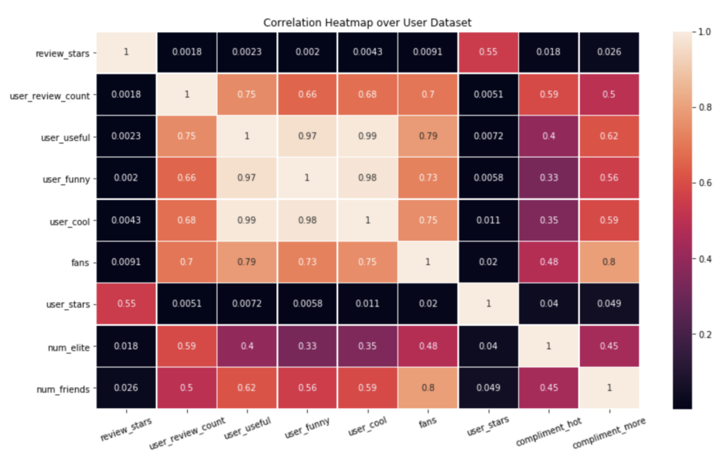

Slide 16
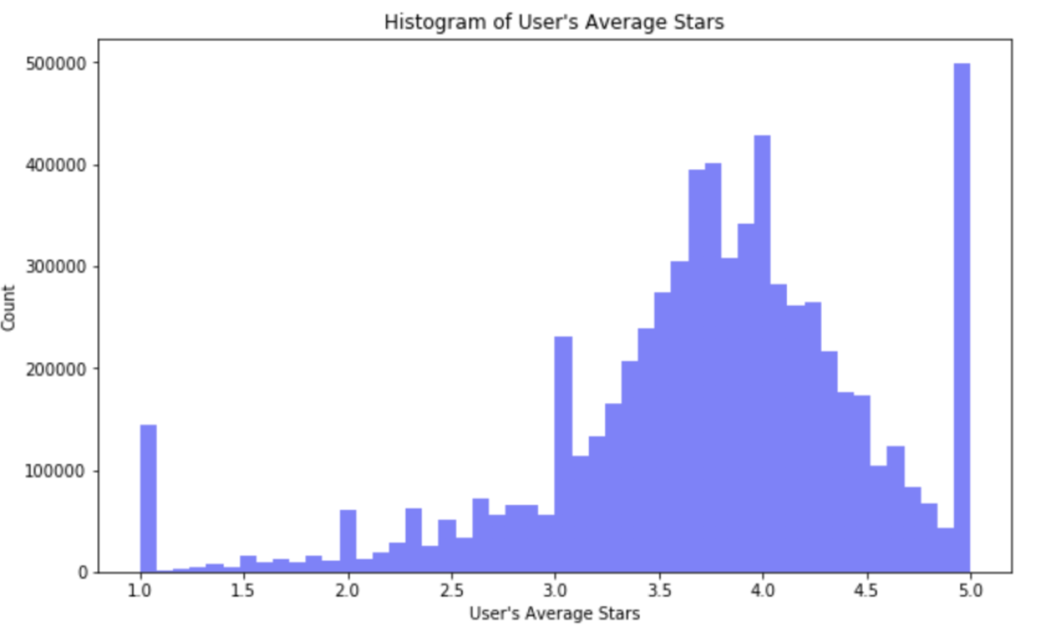
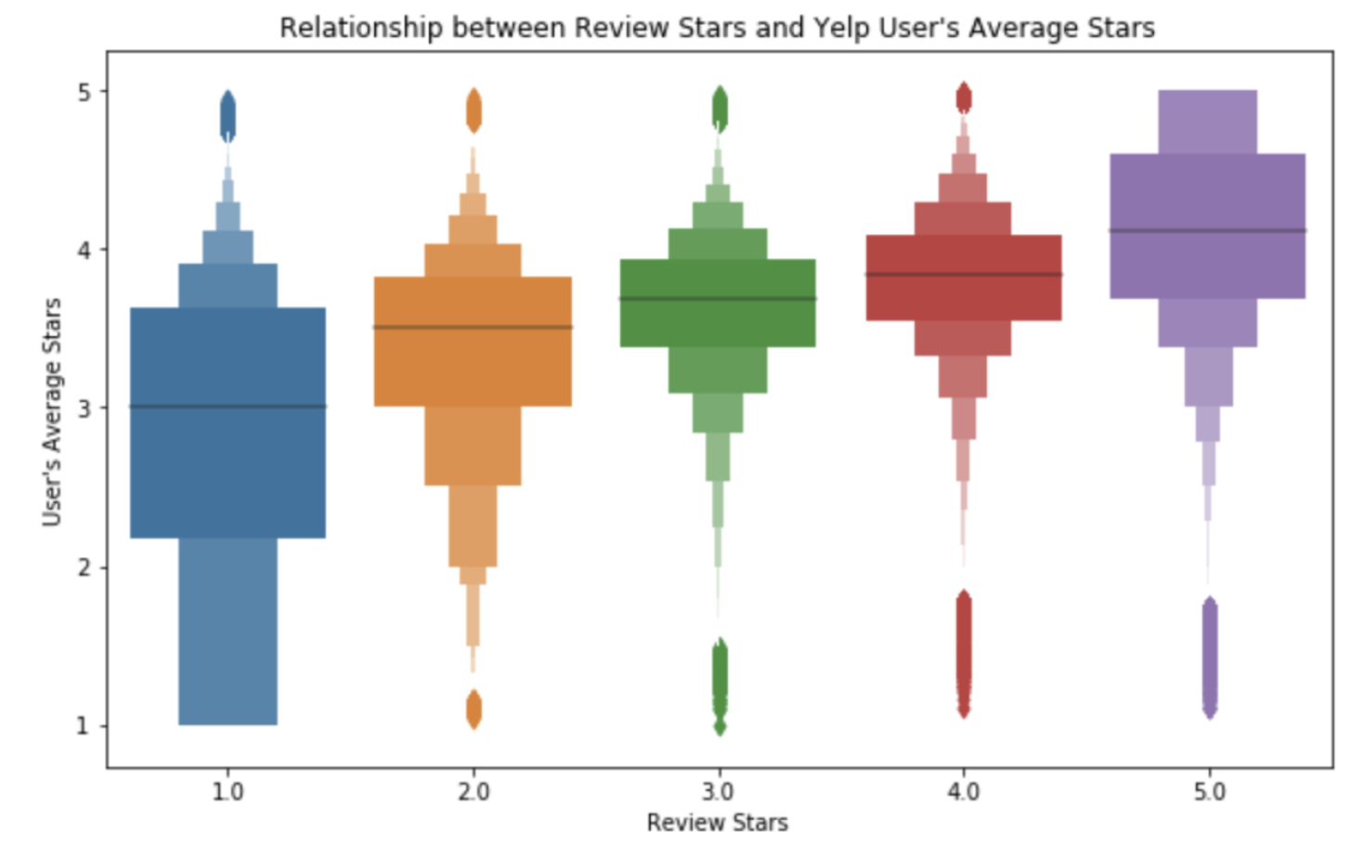
User Dataset
Figure 8: Histogram of User’s Average Stars
Figure 9: Boxplot of Review Stars and User Stars

Slide 17
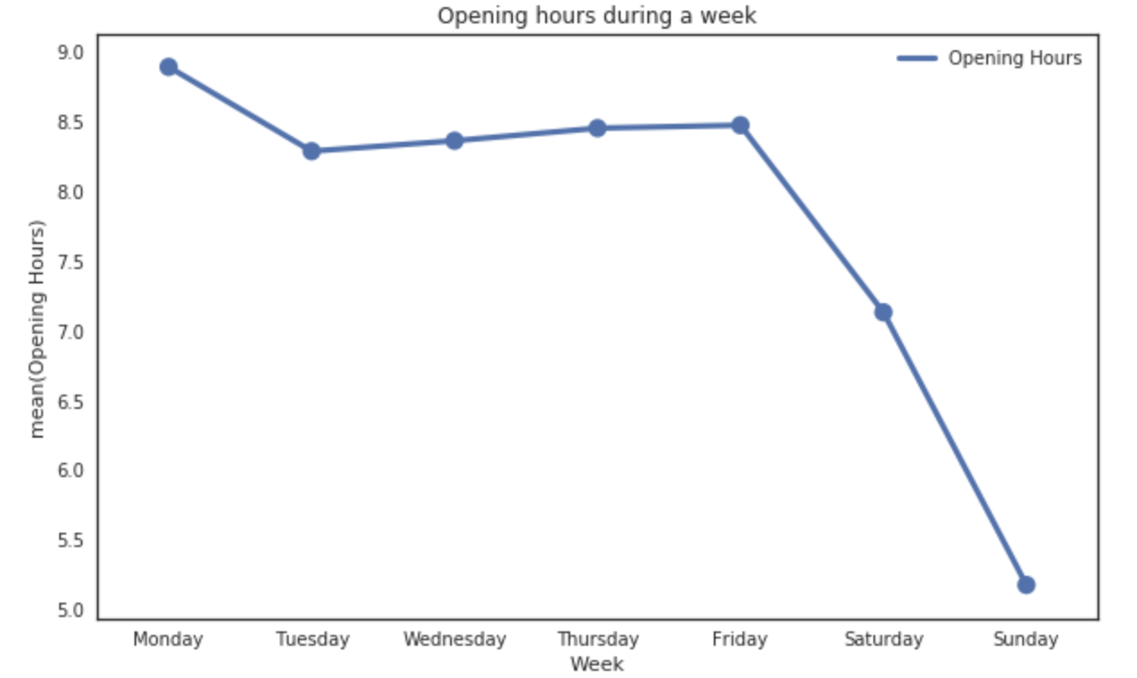
Business Dataset
 | Sample
Business id | ujmEBvifdJM6h6RLv4wQIg
Coordinates | [-115.248798, 36.215546]
Business ratings | 4.5
Number of reviews | 30
Categories | ["Mexican", "Gastropubs"]
Opening hours | {'Friday': '9:0-1:0', 'Sunday': '9:0-0:0', 'Tu…}
Figure 10: Opening hours during a typical week
Notes:
The business data including 6 most useful features. We transfer the category list into the number of categories, and map the opening hours into a seven-column feature matrix of opening duration within a typical week.

Slide 18
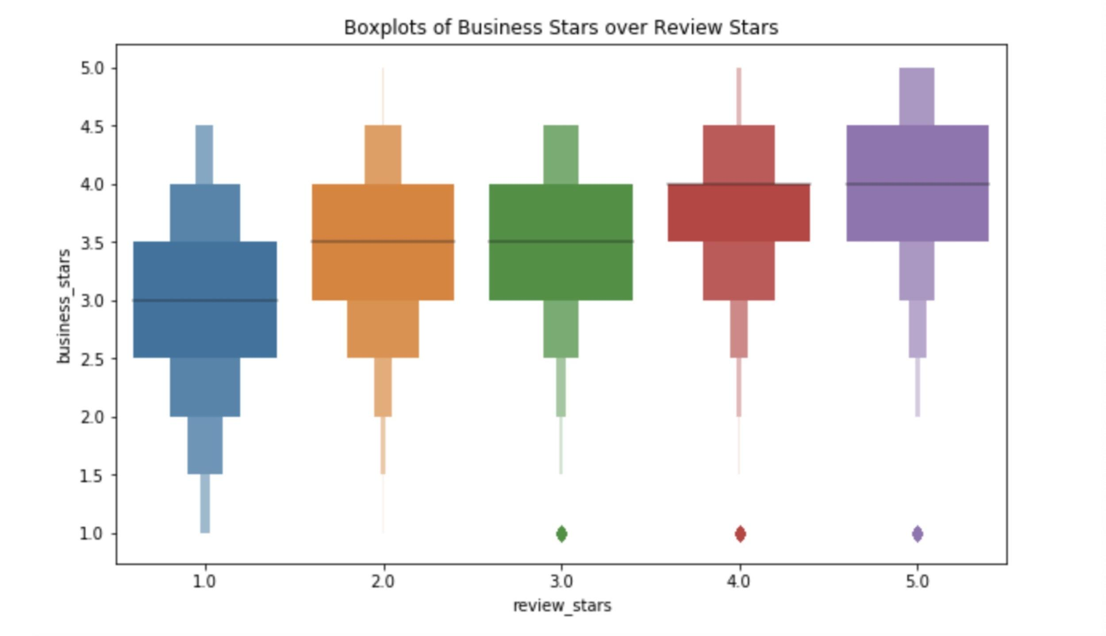
Business Dataset
 | Sample
Business id | ujmEBvifdJM6h6RLv4wQIg
Coordinates | [-115.248798, 36.215546]
Business ratings | 4.5
Number of reviews | 30
Categories | ["Mexican", "Gastropubs"]
Opening hours | {'Friday': '9:0-1:0', 'Sunday': '9:0-0:0', 'Tu…}
Figure 11: Business stars vs. review stars
Notes:
We check the correlation between business stars and review stars, which shows a positive trend.

Slide 19
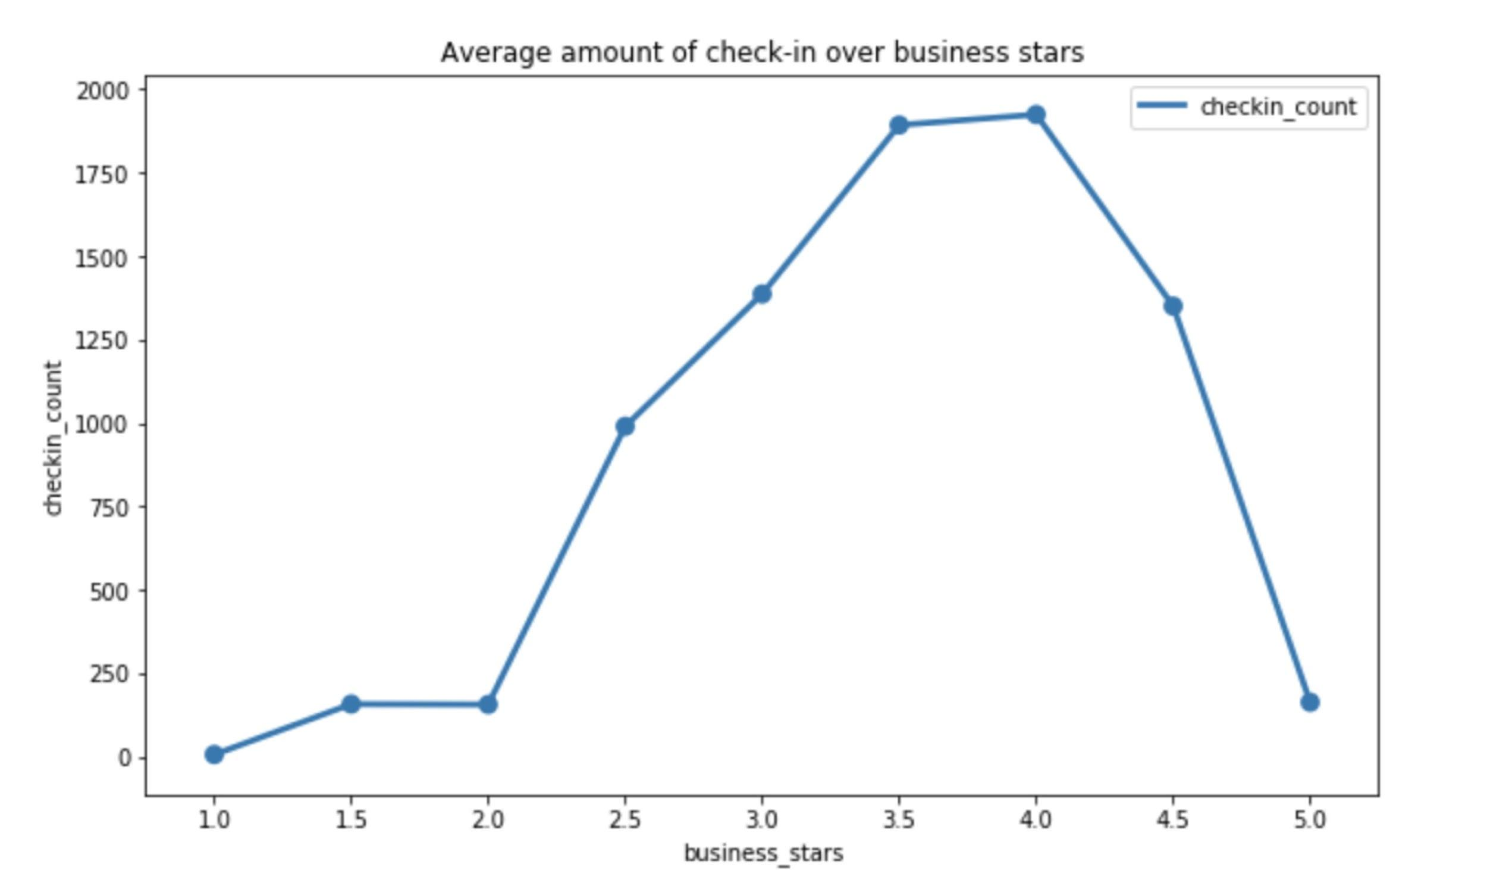
Checkin & Photo Dataset
 | Sample
Business id | ujmEBvifdJM6h6RLv4wQIg
Checkins | [2017-12-05, 2017-12-15]
Checkin Gaps | [10, 8, ...]
 | Sample
Business id | ujmEBvifdJM6h6RLv4wQIg
Labels | [food, food, inside...]
Figure 12: Amount of checkins vs. business stars
Notes:
For checkin and photo data, we calculate the gaps of every checkin dates, and based on that, give average and the variance of these gaps. For the photo data, there are five distinct labels, so we map them counts just as we map the opening hours before.

Slide 20
Modelling, Conclusion & Improvement

Slide 21
Features
 | Review Features |  | User Features | Business Features | User & Tip | Business & Tip | Checkin Features | Photo Features | Target Value
Sample Field | Review Score 1 | Review Score 2 | User Stars | Business Stars | Avg Tip Star | Avg Tip Star (B) | Checkin Counts | Labels Count | Review Stars
Sample | 0.80 | 0.78 | 3.6 | 4.5 | 4.2 | 3.8 | 29 | 20 | 4.0
66 numeric features in total
1 seemingly discrete but real-value target value
6,685,898 rows
8 GB

Slide 22
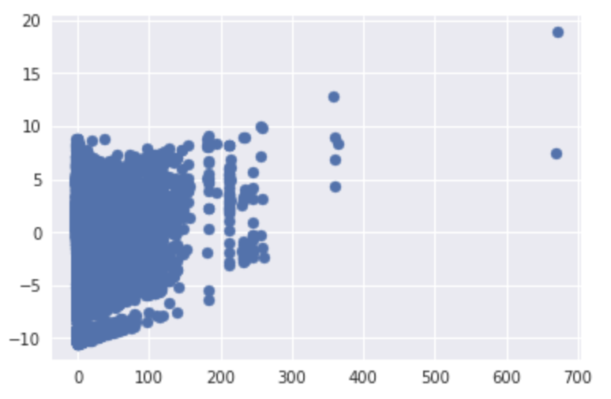
Noisy Data Detection
Using 2D PCA Components to show anomaly samples, only 7 outliers
Notes:
Using a simple PCA techs to show anomaly samples, only 7 outliers

Slide 23
Parameter Setting
Train/test ratio: 7:3
Metrics：
1. Precise Accuracy: sum(prediction.round(0) == test) / test
2. Benefit Accuracy: sum(prediction.round(0) >= test) / test
Models: Random Forest & Light Gradient Boosting Machine
Notes:
LGBM is an another tree-based gradient boosting framework. The difference between LGBM and other tree-based model is that LGBM grows tree vertically while other algorithm grows trees horizontally meaning that Light GBM grows tree leaf-wise while other algorithm grows level-wise. It will choose the leaf with max delta loss to grow. When growing the same leaf, Leaf-wise algorithm can reduce more loss than a level-wise algorithm.

Slide 24
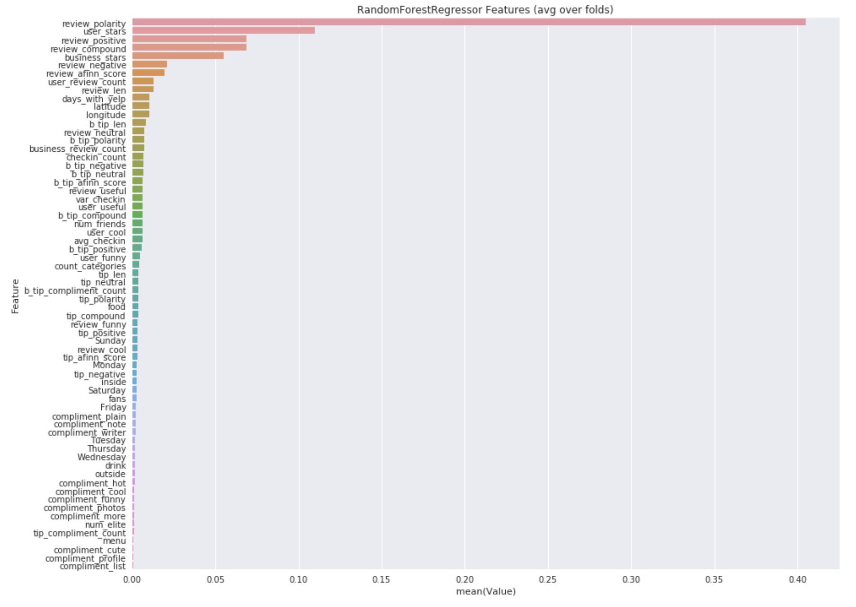
Regression
PA: 0.559
BA: 0.789

Slide 25
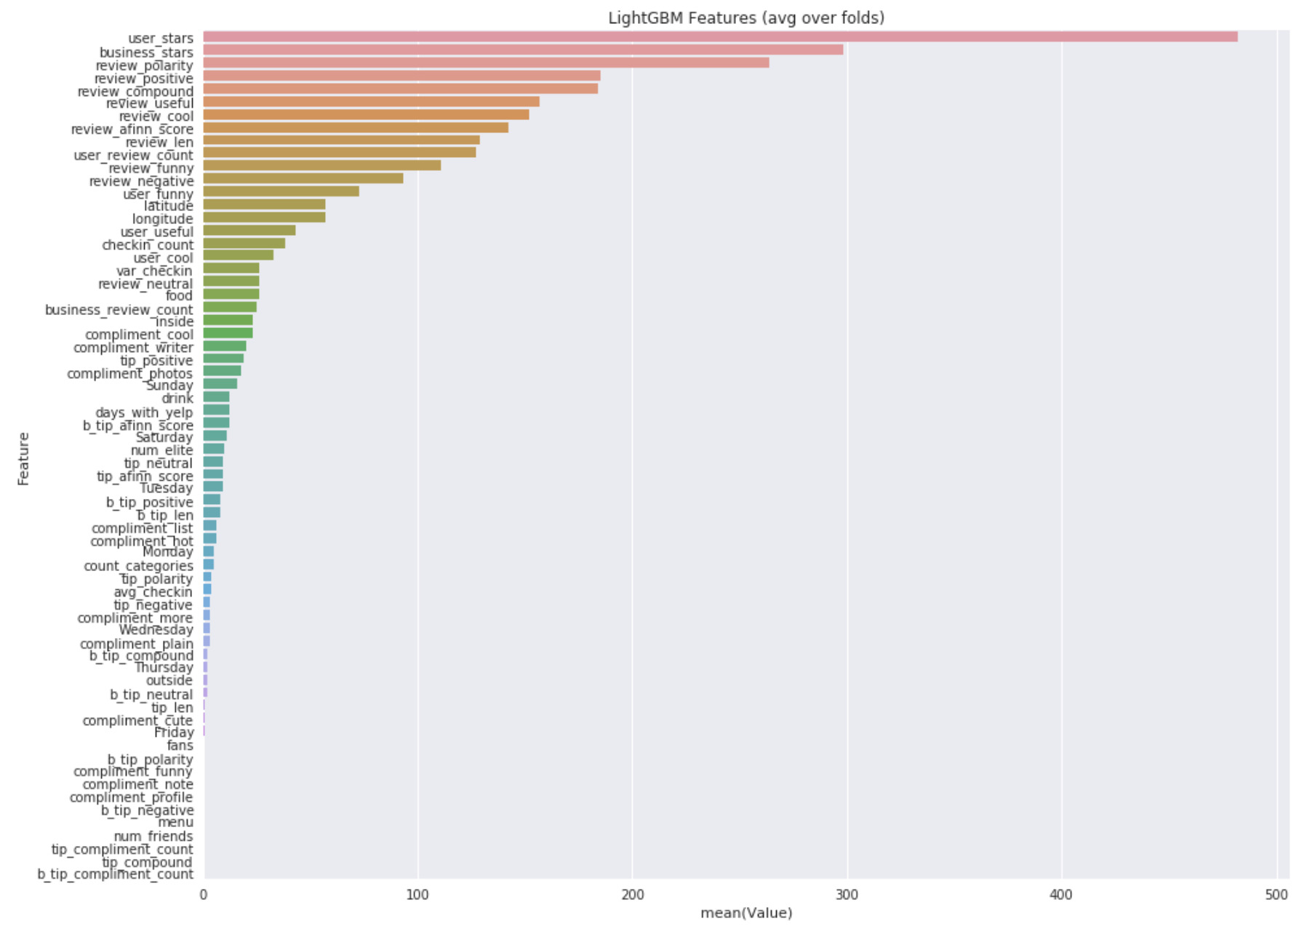
Regression
PA: 0.578
BA: 0.785
Notes:
The contribution of features are consistent with our intuition as well as the analysis we have done just before.

Slide 26
Improvement
Feature Engineering:
1. length of review
2. business categories
Parameter Optimum: grid search
Ensemble Learning: stacking while time complexity grows
Notes:
2. Using grid search to find the best combination of parameters. We currently only get some overfitting result

Slide 27
Can we improve Yelp's services by precise user-business match-up?
https://github.com/LuJunru/MLC2019_Final_Project
Notes:
Thank you for listening.

